Slide 1

BETTER ASSESSMENT BETTER PLANS BETTER OUTCOMES
Brian Gale
NatSIP Policy Group

Slide 2

Starting assumption
An education, health and care plan should be as good as, if not better than, a statement.

Slide 3
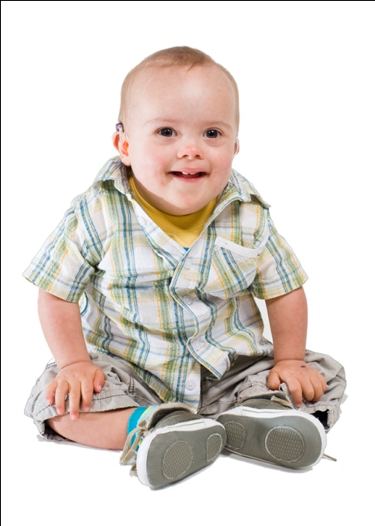
The importance of assessment
‘A focus on the quality of assessment will improve the quality of outcomes’.
Ofsted 2010: A statement is not enough

Slide 4
The importance of assessment
‘The quality of a statement will be significantly determined by the quality of advice submitted during the assessment process itself, including contributions made by parents and by children and young people themselves’.
DfE (2010) Guidance on Improving the quality of statements

Slide 5
NatSIP work on assessment
NatSIP has therefore tried to identify what information should be gathered and reviewed as part of a single assessment process so that the proposed EHC Plan is fully informed of the CYP’s strengths and needs and the actions to be taken to ensure good outcomes.

Slide 6

Better assessment, better plans, better outcomes framework
Purpose: To provide a multi-disciplinary framework for the assessment of the need of a child or young person with sensory impairment.

Slide 7
So that....
Their EHC Plan is based on a full understanding of that person’s needs and their implications.
Any barriers to their development and achievement are identified and measures are put in place to address them.

Slide 8
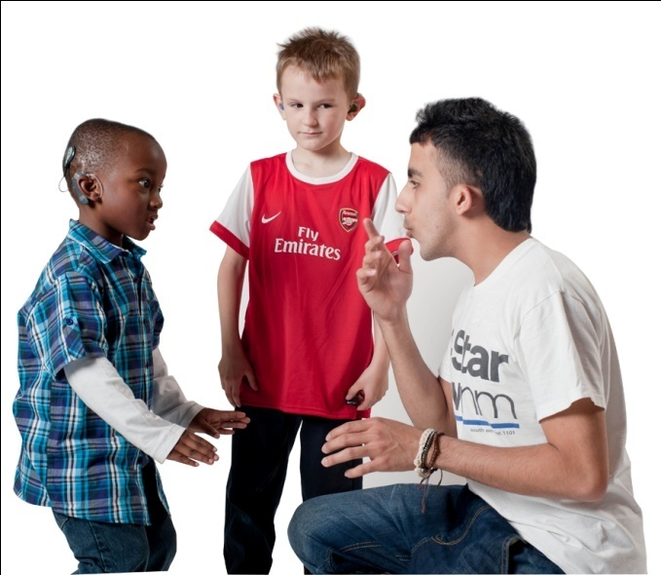
So that....
Outcomes
are
improved

Slide 9
The EHC Plan
Follows on from assessment.
Draft framework produced sets out the minimum content of an EHC Plan.

Slide 10
Draft Bill – EHC Plan sets out
the child’s or young person’s SEN
the outcomes sought for him or her
the special educational provision required by him or her
Any health and social care provision of a prescribed description required by him or her.

Slide 11
A key question:
What is an outcome and how are outcomes incorporated in the Plan?
What is the difference between an objective and an outcome. Does it matter?

Slide 12
Are these outcomes?
For Matthew to be able to eat independently.
To develop Adam’s handwriting skills to that others can read his work.
For James to be able to take part with his friends at play times.
For Daniel to form friendly links with other pupils in his class.

Slide 13
For Natisha to develop the skills needed to cope with the organisational demands of secondary school.
To enable Mary to use similar language to the rest of her class.
To enable Raj to communicate at an age-appropriate level using Braille.

Slide 14
Next steps....
Consult on the draft frameworks to get agreement on:
Minimum information and assessment requirements to inform the EHC Plan.
Minimum content of an EHC Plan.

Slide 15
Next step....
Produce exemplars to illustrate minimum requirements

Slide 16

Questions?
Brian.Gale@ndcs.org.uk

