Slide 1
Quality Improvement Support Pack
Tina Wakefield, Lynda Holland & Ros Kendrew
June 2014

Slide 2
The Quality Improvement Support Pack
• A resource to help Heads of Educational Support Services in England review the quality of their provision for CYP with sensory impairments.
Brings together a range of existing template documents and proformas in a way that guides the services in effective self review through a tool-kit for the self evaluation of support services.

Slide 3
The Quality Improvement Support Pack Cont…
Builds on existing NATSIP work around Quality Standards and service structures.
Helps ensure that services are focused on improving outcomes and have the tools to review their effectiveness.
Remember Services should be constantly reviewing their provision to ensure it meets the needs of children and families and leads to improved outcomes.

Slide 4
What is Quality Improvement?
The systematic measurement, comparison against a standard and monitoring of processes with feedback ensures error prevention.

Slide 5

So…
Is Quality Improvement basically about maintaining and assessing Quality Standards?

Slide 6
Quality Improvement?
“Suitable quality is determined by product users, clients or customers”

Slide 7
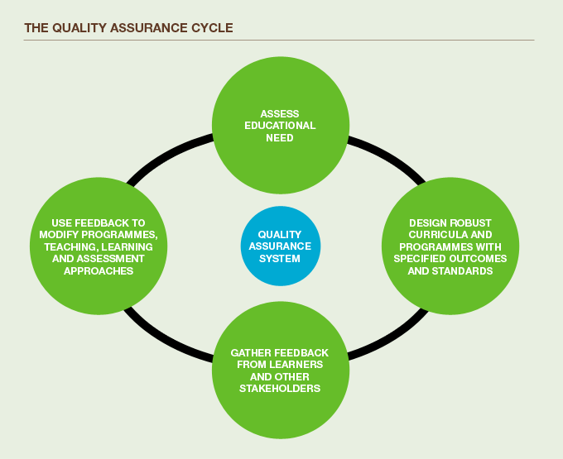
The Quality Assurance Cycle

Slide 8
Self or peer review?
'Robust Moderation' is the new buzz phrase from OFSTED
Self review is vital but how can we moderate these findings?
Peer review?
External consultant?
Internal LA review?

Slide 9
What does a good Service look like?
‘Where the support teacher has a good knowledge of the pupil, works with the pupil, school and parents on a regular basis depending on need. It works with the pupils, teachers and teaching assistants in enabling them to access the curriculum successfully so the pupil can reach their full potential.’ SENCo.

Slide 10
QTVI
‘The child should be our raison d’etre. A good service prioritises the interview and appointment of QTVIs who are passionate about inspiring each and every child.
An inclusive attitude and respect for equality underpins our ability to do the job.
Feedback should reflect the service given.
One to one time is vital within Services with colleagues
Multi agency working is also a crucial test of effective SI teams.’

Slide 11
TOD
'A good service is clear about the offer it provides for local needs…has a clear picture of its service users and future demands…has sufficient staffing levels to meet local demands whilst maintaining the capacity to respond to changes in caseload numbers… communication with other agencies is strong and parents are actively engaged with their children’s education.'

Slide 12
Parent
'A good service needs to involve service users both those children and the parents. User consultation helps to focus on what people want from a service. Staff need to be approachable and empathetic to the needs of the child and family. Cultural needs must be considered and met so it is important to have staff who can speak different languages to reach parents who don't speak English.'

Slide 13
Parent
'Support is crucial around the point of diagnosis when the parents may be upset and shocked and have no idea how to cope.'

Slide 14
Parent
'The service we received was excellent. Both my sons had issues with self confidence ...always feeling different in a class of hearing children. The service provided a range of ways to increase their self confidence thanks to a TOD who went out of her way to encourage the boys to experience new opportunities, gain awards and visit new places. I have no doubt that this impacted on shaping their ability to cope at Uni and in the workplace. I also feel that listening to the anxieties or worries of the parents and carers is important.'

Slide 15
Deaf Pupil
‘I get support that really helps me … it makes me feel like I can do anything even if I’m deaf.’
‘When I don’t understand the teacher, the support teacher helps me understand better.’

Slide 16
Visually Impaired Pupil
'The support I get in school is really good because they do it in the right way that I need it to be. We are all different and we have different needs so they get to know all of us and so they can help all of us in our own ways.'

Slide 17
Health – Paediatric Audiology Consultant
We need good communication between Health and Education. Both areas attending the CHSWG and discussing issues really helps.
More joint working with the Teachers of the Deaf, and their attendance at clinics would be good.

Slide 18
Ophthalmologist
"We have a multi disciplinary group in ---- which was formed to facilitate close collaboration between health, education and parents with the unifying aim of sharing information, knowledge and skills in order to provide an excellent service to the visually impaired children and young people in our locality."

Slide 19

“My Sensory Service is of high quality
and is highly effective.”
IM Sure
Service Manager

Slide 20
Evaluating Service Delivery
What is the evidence?
How do we know how effective the provision made is? What is the evidence base?
What do services do that should be evaluated?
What questions should we be asking ourselves about the services delivered?
Who should be evaluating the quality of provision for Sensory Impaired pupils?

Slide 21
Outcomes of your provision
How good are they?
How do you know?
Data analysis- what are you collecting?
Soft data- where you believe you make a difference?
How would you document this?

Slide 22
Delivering SSS within the changing context – The Challenges
Responding to the implications of the Children and Families Bill and the new Code of Practice
The Local Offer
Understanding the learning context for pupils
Understanding the changing educational landscape

Slide 23
Delivering SSS within the changing context – The Challenges
Support to parents re choice
Changes to service delivery and organisation
Multi-agency working
Research into effective practice
New populations
Diverse roles in educational settings
Quality assessment = quality intervention

Slide 24

Other available Quality Standards include…
Quality Standards for specialist teaching and support services for deaf children and young people - guidelines
http://www.batod.org.uk/index.php?id=/resources/guidelines/qs-specialist-supportservices.pdf

Slide 25
QS
Quality Standards in Education Support Services for Children and Young People with Visual Impairment
http://webarchive.nationalarchives.gov.uk/20081230134948/http:/www.teachernet.gov.uk/docbank/index.cfm?id=6576

Slide 26
QS
Multi Agency Planning and Improvement Tool (MAPIT)
http://www.ncb.org.uk/media/925077/mapit_document_april_2013.pdf

Slide 27
QS
Quality Standards in the Early Years NDCS
www.ndcs.org.uk/document.rm?id=112
Quality Standards for the use of personal FM
systems (NDCS)
www.ndcs.org.uk/applications/publications_shop/view.rm?id=11398

Slide 28
OFSTED Docs such as…
Communication is the key - A good practice
survey of services for deaf children.
Published: October 2012 Reference no: 120169
Handbook for the inspection of LA arrangements
for supporting school inclusion.
Published May 2013 Ref Number 130149
Useful Effective Descriptors List for supporting school improvement in appendix.

Slide 29
Collecting the Evidence
What do we already use?
What works well?
How do we evidence it?
How do we moderate this evidence and the conclusions we have come to??

Slide 30
The Support Pack

Slide 31
Developing the Support Pack
Based on the DCSF 2008 Quality Standards for Special Educational Needs(SEN) Support and Outreach Services

Slide 32
The Standards
Two Sections
Outcomes and Service management
Standards 1 to 6 Outcomes
Standards 7 to 16 Service management

Slide 33
Nov 4th
Group of Heads of VI and HI Services spent a day in London exploring issues around QA and then started the formidable task of completing the templates

Slide 34
Refining and redesign
Since that day there has been a lot of changes and refinements made. It is very important to stress that this is very much a live document.
We are developing an effective way of keeping it up to date by adding new templates and links.

Slide 35
Structure of Pack
PART 1
What is Quality Improvement
Importance of QA
Getting Started
Context for QA/Ofsted
Using the support pack

Slide 36
Support Pack
Part 2
16 Standards with cross reference to Ofsted judgements
Examples of sources of evidence
Links to documents used by services.

Slide 37
Group Work
Now over to you:
Please read the section of the document identified for your group and make comments, suggestions for improvement.
Please think about whether you understand how it is meant to work
Make suggestions about additional sources of evidence
and any documents that could be included. These could be documents developed by your service.

Slide 38
Please make changes, suggestions on the document.
Any further thoughts that you have after todays session
should be sent to:
ros.kendrew@natsip.org.uk
THANKYOU FOR YOUR HELP

Slide 39
Impact of the day
We hope that you:
Understand why it is important to quality assure and provide evidence on the Service you deliver
Have reflected on the quality of the Service that you provide
Have developed your thinking and gained some ideas to Support the Quality Assurance processes for your Service

Slide 40
Some quotes for you to think about….
The real problem is that perception is all there is.
There is no reality as such, there is only perceived reality.
Only the reflective practitioner, reflective service, proactive service will secure the quality and indeed the future.
The culture of professional reflection required for continuous self-improvement does not happen by chance- the onus is on service leaders to create it.

Slide 41
Before you go
What specifically are you going to do differently as a result of the day?
What are you going to do first?
(The first step is the most significant)
When are you going to do it?

Slide 42
The chances are further increased when you:
    Write the answers down
    Tell someone else
    Answer the question when with the word
    NOW!

