Slide 1


Support and aspiration:
Implementing the SEN and Disability Reforms

Slide 2

The current system of SEND support is complicated, expensive and delivers poor outcomes.
Parents struggle to find the services that should be helping them, have to battle to get the help their children need, and have to tell their stories time and again.
Moving from children’s to adults’ services can be very difficult.
English LAs spend over £5 billion a year on SEND provision, and yet those with special needs are far more likely to achieve poorly at GCSE, Not be in Education, Employment or Training, or be unemployed.
These issues affect a lot of people: 1 in 5 children are currently identified as having some form of SEND, with 2.8% having a more complex need.

Slide 3

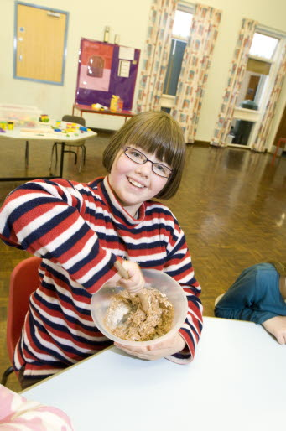



We want children and young people with special needs and disabilities to achieve well in their early years, at school and in college; find employment; lead happy and fulfilled lives; and have choice and control over their support.
The special needs reforms will implement a new approach which seeks to join up help across education, health and care, from birth to 25. Help will be offered at the earliest possible point, with children and young people with SEND and their parents or carers fully involved in decisions about their support and what they want to achieve. This will help lead to better outcomes and more efficient ways of working.

Slide 4

Update: the legal framework and implementation
Children and Families Act 2014 – Royal Assent 13 March 2014
Regulations laid – spring 2014
New Special Educational Needs and Disability Code of Practice – final stage of consultation until 6 May. See – https://www.education.gov.uk/consultations/
LAs, CCGs and education settings prepare for implementation – implementation pack published 8 April. See – https://www.gov.uk/government/publications/implementing-the-0-to-25-special-needs-system
SEND Reforms commence from 1 Sept 2014
Transitional arrangements – phase out LDAs by
Sept 2016, statements by April 2018

Slide 5
Children and young people at the centre
Where disagreements happen, they can be resolved early and amicably, with the option of a Tribunal for those that need it
Children, young people and parents understand a joined up system, designed around their needs
Enablers
Joint commissioning
Better disagreement resolution processes
Outcomes
Local offer
Having friends
Positive Wellbeing
Employment prospects
0-25
Children and young people with SEND
and families
Information, advice and support
Making their
views heard
Good qualifications
Option of a Personal Budget
Integrated assessment and planning
Education Health and Care Plan is holistic, co-produced, focused on outcomes, and is delivered
Extending choice and control over their support.

Slide 6
This approach works
31 Pathfinder authorities have been testing the reforms. They found:
Families feel more in control, better informed and more satisfied with the services they receive;
Professionals are finding genuine partnership working with families is highly rewarding and generates better results;
The reforms are bringing about a culture shift in assessment and planning, with a growing emphasis on personalisation, multi-agency working and outcomes-based approaches
“It was really rather lovely to feel... heard on an equal footing!...Sometimes it used to feel as if being a parent was itself a disability. Now I feel that I am part of the team…Now it feels as though there is someone on my side. Before I felt like the enemy.”
Parent from Surrey

Slide 7
Implementation challenges
Ensuring the full engagement of parents and especially children and young people
Strategic engagement of partners across education, health and care and the full 0-25 age range
Defining outcomes and provision clearly in EHC plans
Converting to the new system quickly, whilst ensuring the benefits of new approaches aren’t lost
Coordinating our messages out to parents, young people and professionals - so that they are tailored, consistent and well-timed
Achieving the culture change that the reforms will require if they are to have a genuine impact on the ground

Slide 8
Support offer 2014-15
£70 million SEND reform grant plus funding for new burdens
Up to £900,000 for pathfinder champions 2014-15; delivery partner contracts extended; VCS grants
Increased funding for parent carer forums
Support for parents and young people through 1,800 Independent Supporters
From May 2014, the Nasen gateway will provide a one-stop shop of resources for schools
For FE: funding bursaries of up to £9,000 for high calibre graduates to train as specialist SEND teachers (2013-14 and 2014-15)
Making £1m in grants available for the existing FE workforce to undertake specialist SEND CPD (2013-14)
Minimum of two champion one-to-one support days to each LA; plus support days from delivery partners
Champions and deliver partners are developing regional delivery plans during April, with support and co-ordination from Mott MacDonald and CDC/Early Support

Slide 9
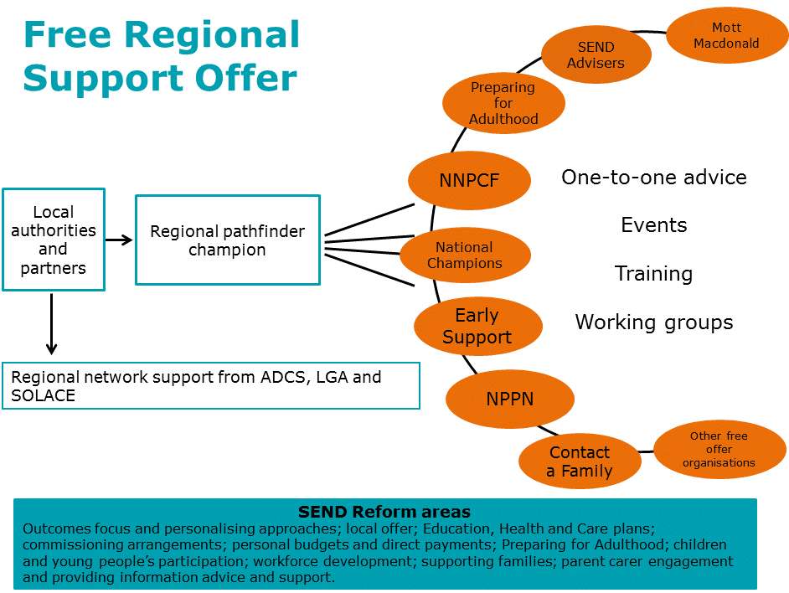

Slide 10
Making it happen: questions to help you deliver the reforms:
Have you got a plan?
Do you know what will be difficult to achieve?
Do you know what help is available to support you?
How you will work with children and young people?
What do you and your partners have in common?
How will you work with your partners?
Education
Improved outcomes for children, young people and families
NHS
Social
Care

Slide 11
A final thought…
“We have a brilliant keyworker. She has been of great emotional support to me and has made sure that all agencies working with us have met together regularly. When we wrote the "single EHC plan" everyone contributed to it - the school, (current and previous teacher), SALT, O.T., social care and us. We have now been living that plan for several months and the results have been incredible.
In the previous system his statement had not changed since it was issued at the age of 4 and it consequently looked as if little progress had been made. With his current plan, we have already achieved several short term goals and are working on longer term goals now. We all meet to review and update progress and people are working in partnership and really valuing our opinions and needs as a family.
It has been an emotional, but really positive experience and it has been great for us and professionals alike to celebrate his progress and achievements. To me it makes total sense to use this more holistic and personalised approach if we are to empower families and ensure that our children reach their potential and have the very best future that they deserve.” From a parent from East Sussex

