Slide 1
The National Curriculum Review
Phil Bannister
National Curriculum Review Division
Department for Education
20
Tuesday 4th June 2013

Slide 2
Aims of presentation
Tell you about:
why are we reviewing the national curriculum
main changes to the overall curriculum
GCSE & accountability announcements
what this all means for schools
wider implementation
timetable and next steps

Slide 3
The Importance of Teaching White Paper
benchmarking expectations for our children against the expectations of the most successful nations
ensure that our qualifications match the best in the world, providing a good basis for further study and employment
stronger leadership, more intelligent accountability and, above all, improvements in teaching quality are essential
extending school freedoms, reforming performance tables and reforming inspection
attracting even more outstanding people into an already great profession….
… and help raise attainment for all children and support poorest children most of all

Slide 4
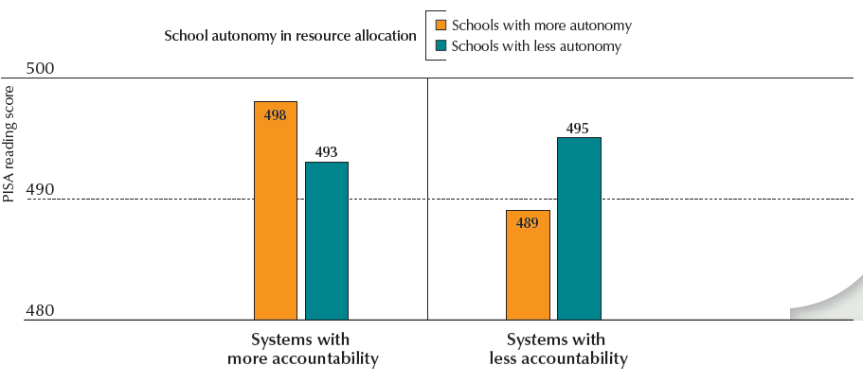
Autonomy and accountability
In countries where schools account for results, schools with greater autonomy, show better student performance than those with less. (OECD 2011)
In countries where there are no such accountability arrangements, schools with greater autonomy allocation tend to perform worse (OECD 2011)
4
Notes:
In countries where schools have greater autonomy over what is taught and how students are assessed, students tend to perform better.
In countries where schools account for their results by posting achievement data publicly, schools that enjoy greater autonomy in resource allocation tend to show better student performance than those with less autonomy. In countries where there are no such accountability arrangements, schools with greater autonomy in resource allocation tend to perform worse.
Autonomy in curricula and assessments
PISA 2009 asked school principals to report whether “principals”, “teachers”, a “school governing board”, a “regional or local education authority”, or a “national education authority” has considerable responsibility for: establishing student-assessment policies; choosing which textbooks are used; determining course content; and deciding which courses are offered. The ratio of the number of these four activities for which “principals” and/or “teachers” have responsibility to the number of these activities for which a “regional or local education authority” and/or a “national
education authority” has responsibility was computed.
Autonomy in resource allocation
PISA 2009 asked school principals to report whether “principals”, “teachers”, a “school governing board”, a “regional or local education
authority” or a “national education authority” has considerable responsibility for: selecting teachers for hire; dismissing teachers;
establishing teachers’ starting salaries; determining teachers’ salary increases; formulating the school budget; and deciding on budget allocations
within the school. The ratio of the number of these six activities for which “principals” and/or “teachers” have responsibility to the number of
these activities for which a “regional or local education authority” and/or a “national education authority” has authority was computed.
4

Slide 5
What was announced on 7 February 2013
National curriculum consultation
  Defining the school curriculum
  All subjects retained at all 4 key stages
  Foreign languages at Key Stage 2
  Removal of Attainment Target levels and descriptors
  Consultation ended Tuesday 16 April 2013
Reform of GCSEs
  Decisions regarding Key Stage 4 qualification consultation
Secondary accountability consultation
  Additional accountability measures for secondary schools
  Consultation ended Wednesday 1 May 2013
Notes:
By the end of each key stage, pupils are expected to know, apply and understand the matters, skills and processes specified in the relevant programme of study.

Slide 6
National curriculum consultation
Included questions on:
proposed aims for the new national curriculum
changes to the programmes of study for all subjects and key stages (except English, mathematics and science at Key Stage 4)
a proposal to replace the ICT programme of study with a new computing programme of study
the implementation of the new national curriculum
the disapplication of aspects of the current national curriculum for a limited period from September 2013
the likely equalities implications of our reforms

Slide 7
Primary programmes of study – key changes
Core subjects of English, mathematics, science
2-to-3 page introduction with purpose of study, aims and spoken language
Detailed programmes of study set out by academic year or 2 years, with notes and guidance
Clearer link between what children are taught and what is assessed
Only legal requirement is to teach children before end of key stage
Foundation subjects: art and design, computing, design & technology, geography, history, music, PE and foreign languages
Much shorter national curriculum set out by key stage
Focus on essentials, allowing schools maximum level of innovation
7

Slide 8
Secondary programmes of study – key changes
12 subjects at KS3 – English, mathematics, science, art and design, citizenship, computing, design & technology, geography, history, modern foreign languages, music & PE
6 subjects at KS4 - English, mathematics, science, citizenship, computing & PE
KS4 entitlement areas – the arts, the humanities, design & technology, modern foreign languages
English, maths and science programmes of study, specified by key stage only, from 6 to 18 pages long
Foundation subject programmes of study as brief as for KS1 & 2
8

Slide 9
Key changes - English
Emphasis on all pupils learning to decode using a systematic approach to learning phonics
Stronger emphasis on reading for pleasure and reading whole books
Increased emphasis on learning to spell (e.g. new list of words that all children should be able to spell by the end of primary school)
Higher demand in grammar
More emphasis on debate, presentation and use of spoken Standard English

Slide 10
Key changes - mathematics
Emphasis on mathematical fluency, reasoning and problem solving
Increased expectation in requirement to know multiplication tables (by end of Y4, pupils expected to know tables – including 11x and 12x tables)
Clear expectations around both written and mental methods for addition, subtraction, multiplication and division
More challenging content on fractions and decimals introduced earlier
Emphasis on pre-algebra and proportional reasoning (primary), and algebra, pre-calculus and probability (secondary)

Slide 11
Key changes - science
Content set out in much more detail than current curriculum
Focus on core essential knowledge in science – not specifying the range of social, health and environmental issues that schools could/should discuss
Additional content on evolution and inheritance (primary) and greater clarity on mathematical requirements for science

Slide 12
Inclusion
Setting suitable challenges
  “Teachers should set high expectations for every pupil. They should plan stretching work for pupils whose attainment is significantly above the expected standard. They have an even greater obligation to plan lessons for pupils who have low levels of prior attainment or come from disadvantaged backgrounds. Teachers should use appropriate assessment to set targets which are deliberately ambitious.”

Slide 13
Inclusion
Responding to pupils’ needs and overcoming potential barriers for individuals and groups of pupils
“A wide range of pupils have special educational needs, many of whom also have disabilities. Lessons should be planned to ensure that there are no barriers to every pupil achieving. In many cases, such planning will mean that these pupils will be able to study the full National Curriculum. The SEN Code of Practice will include advice on approaches to identification of need which can support this. A minority of pupils will need access to specialist equipment and different approaches. The SEN Code of Practice will outline what needs to be done for them.”
“Many disabled pupils have little need for additional resources beyond the aids which they use as part of their daily life. Teachers must plan lessons so that these pupils can study every National Curriculum subject. Potential areas of difficulty should be identified and addressed at the outset of work.”

Slide 14
School curriculum
Other subjects
  statutory subjects such as RE
  non-statutory subjects such as PSHE
  any other subject agreed by the school
  non-statutory guidance that must be followed
The school curriculum – by academic year
  more detailed than the national curriculum
  making clear what children are taught
  setting high expectations
  set out by academic year

Slide 15
Implementation – teacher development
Teacher training: We are working with the Teaching Agency to align training from September 2013 with curriculum changes and to explore provision of subject specialists
CPD: Existing government-funded CPD programmes in mathematics and science will be adapted to support the delivery of the new programmes of study in these subjects; plus funding for CPD to support delivery of the computer science element of new computing curriculum
School to school support: We are working with the Teaching Agency to identify ways for Teaching Schools, NLEs and LLEs effectively support the introduction of the new curriculum
Further guidance: Actively encouraging the subject associations and others to develop further guidance and plans to support schools to develop their school curriculum

Slide 16
Implementation – other factors
Inspection: Reforms will have implications for Ofsted in their inspection of schools’ “broad and balanced curriculum” and we will continue to work with them
Curriculum resources: We are working with the Educational Publishers Council (EPC) and British Educational Suppliers Association (BESA) to enable the publication and resources market to respond to schools’ needs - and discussing ways to ensure better quality of materials come to market
Assessment: Statutory assessment at the end of KS2 will influence interpretation of English and mathematics. We are working with the Standards and Testing Agency (STA) and Ofqual to ensure what we set out in the curriculum is genuinely assessed

Slide 17
GCSE reforms
  Main substantive change is that we are not implementing market reforms
  The GCSE title maintained
  New GCSEs remain accessible to the same proportion of pupils.
  Pass level to reflect that of high-performing jurisdictions
  Linear, no tiers, minimal controlled assessment, minimal exam aids and a new grading scale
  New GCSEs in English literature and language, mathematics, sciences, geography and history for first teaching from 2015

Slide 18
Secondary accountability reforms
publish extensive data on secondary schools
remove existing 5 A*-C measure and replace with:
  a threshold attainment measure showing the percentage of pupils in each school achieving a pass in English and mathematics; and
  a progress measure based on pupils’ average scores across a suite of 8 qualifications. The 8 qualifications counted in the measure will be English, mathematics, 3 further English Baccalaureate (EBacc) subjects, and 3 other high value qualifications – EBacc, other academic, arts or vocational
18

Slide 19
Looking ahead
Summer 2013 – Consultations on primary accountability and revised GCSEs
September 2013 – Final national curriculum published
September 2014 – First teaching of national curriculum
September 2015 – First teaching of new GCSEs in English, mathematics, sciences, geography and history
May 2016 – First Key Stage 1 and 2 assessment
September 2016 – First teaching of other new GCSEs

Slide 20
Links
2014 national curriculum:
www.education.gov.uk/nationalcurriculum
GCSE reform:
www.education.gov.uk/schools/teachingandlearning/qualifications/gcses
Consultations (new GCSEs and primary accountability):
www.education.gov.uk/aboutdfe/departmentalinformation/consultations

