Slide 1


Improving outcomes through joint commissioning
NatSIP Working Day
1st October 2013
Claire Lazarus & Martin Cunnington

Slide 2
Outputs
Share and review our top tips
Focus on SE7 and Making It Personal materials
Capture NatSIPexperience
Agree recommendations to be taken forward by NatSIP’s joint commissioning workstream

Slide 3
This session
  Interesting/information
  Interactive
  Useful
  Challenging
  Fun even!

Slide 4
Bringing initiatives together
We can view the needs of a child and family through different lenses or we can work on themes that unite us..
Education
Improved outcomes for children, young people and families
NHS
Social Care

Slide 5
Or we can work on the themes that unite us
Children and young people - maximising their potential
Co-production
Resilient families and local services
Safeguarding vulnerable children and adults
Joint commissioning & managing demand with finite resources

Slide 6
Challenges
Churn – transformation agenda - systemic
Knowing way around new structures and developing new relationships
Pace of change
Ensuring children and children with SEND are on the agenda for CCGs
Staying together at a time of great pressure

Slide 7
Top 10 tips to promote joint commissioning – Tip 1
Recognise and value the different lenses, build on what unites us…stay positive!

Slide 8
Tip 2 – New leglisation & policy creating a consistent message
Everyone Counts: Planning for Patients 2013/14
Govt response to CYP Health Outcomes Forum Report
Improved outcomes for children, young people and their families
Revised NHS Constitution
Revised NHS & Public Health Outcomes Frameworks
Draft Children & Families Bill
Draft Care & Support Bill
Notes:
Health & well being boards & strategies

Slide 9
Children and Families Bill
Clause 25 Promoting Integration
Clause 26 Joint Commissioning
Indicative Draft Code of Practice – section 3 education, health & care: integration, joint commissioning & co-operation
Edward Timpson & Dr Dan Poulter’s letter

Slide 10
Who are the commissioners?
Parents
Clinical Commissioning Groups
NHS Commissioning Board
Local Authority (Public Health)
Local Authority (Education)
Local Authority (Social Care)
Head Teachers
Local Authority (Housing)
Department of Work and Pensions

Slide 11
Commissioning levels
Individual level commissioning
  Parents and young people
  Co-production between parents and young people and lead professionals and/or social workers
Operational/community level commissioning
  Focus on localities and or care groups / care pathways
  CCG, District Council or County Council level
Strategic commissioning
  Set strategic direction with strategic plan, agree pace of change, allocate resources, manage whole system performance, well governed, cyclical, seasonal
Notes:
Research already available on the social and economic impact of co-production and parent carer participation in the commissioning process.

Slide 12
Engaging CCGs a Kent experience
KMCS – Kent and Medway Commissioning Support Unit
8 CCGs in Kent and Medway.
Works with CCG Clinical Leads for CYP.
Supported CCGs to identify a champion for SEND.
Facilitated multi-agency workshop to enable CCGs to have a clear understanding of issues and opportunities.
CCG Clinical Leads participate in multi-agency workshops and planning meetings.
CCG Clinical Leads playing a leading role in 2014/15 commissioning intentions.

Slide 13
Tip 3 – Co-production
“We must ensure patients’ and their families’ voices are heard and used to help us develop the insight to improve outcomes and guarantee no community is left behind or disadvantaged. We want to make the NHS the best customer service in the world and throughout the NHS, we must all strive to design and deliver care based on the needs and choices of each individual patient”.
Sir David Nicholson, Everyone Counts: Planning for Patients 2013/14

Slide 14
Tip 3 - Co-production
SE7 definition of co-production
“Co-production happens when all team members together agree outcomes, co-produce recommendations, plans, actions and materials as a collective. It is an approach which builds upon meaningful participation and assumes effective consultation and information sharing…Parent carers are not just there to illustrate the experience of service users, but rather to take responsibility to help shape future experiences and be an active part of delivering the solutions”.
Britton & Taylor (2013): Co-production with parent carers the SE7 experience. SE7 SEND Pathfinder.

Slide 15

Tip 4 – Jointly Commission & do it well!
Making It Personal initiative

Slide 16
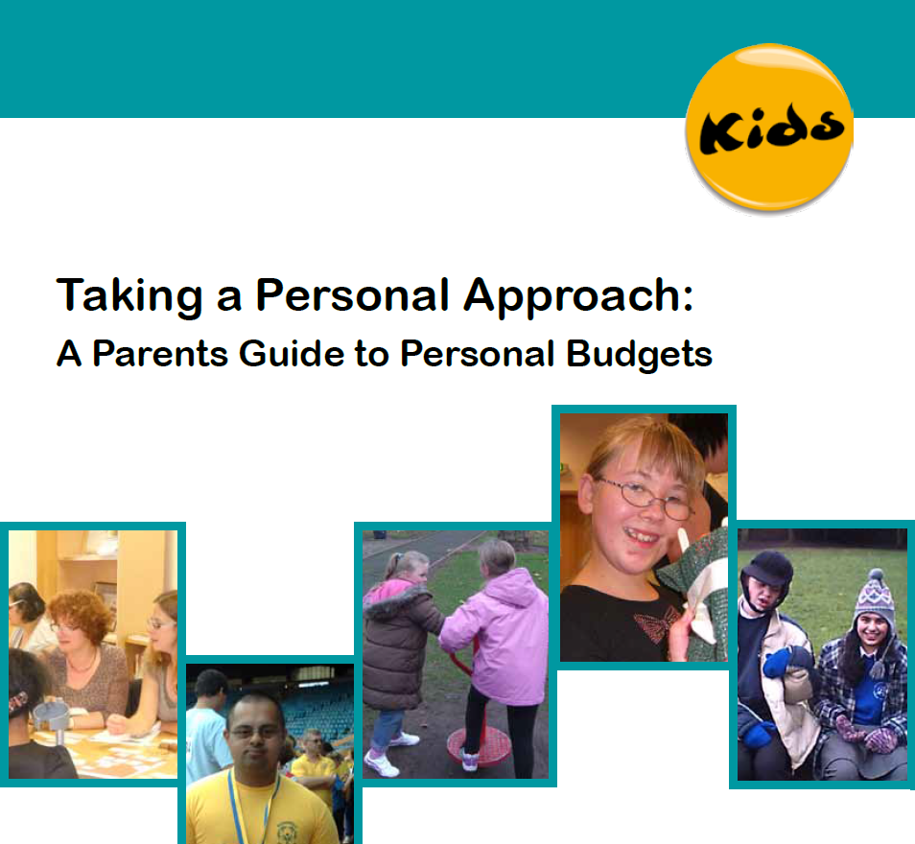
Making It Personal
Products:
Parents Guide to PBs
Case studies
E learning
Commissioners guidance
http://www.kids.org.uk

Slide 17


Making It Personal
Making it Personal
How to commission for personalisation – guidance for commissioners and others in children’s services

Slide 18
Making It Personal
The Guidance
Practical
Developed with commissioners and providers – over x 2 years
Resource for commissioners and others
Interesting, challenging, alive
Easy to use

Slide 19
Making It Personal
Content
Understanding personalisation – the changes needed to traditional systems, cultures, behaviours and processes
Policy drivers
The commissioning cycle and personalisation
Lots of exemplars

Slide 20
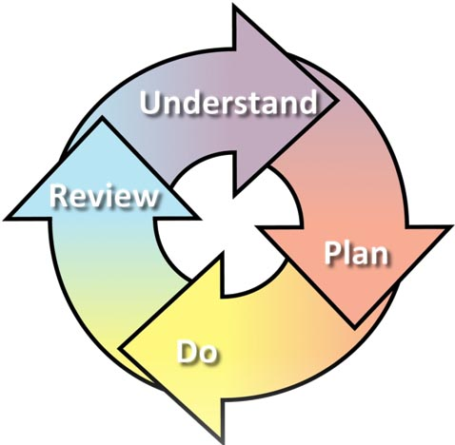
What is commissioning?

Slide 21
What is commissioning?
The activities and processes that lead to decisions about how best to use public money and all the other resources available
Good commissioning is needs led, outcome focussed and uses evidence of what works.

Slide 22
Tip 5– Develop a Common understanding of outcomes & indicators
Mark Friedman’s Results Based Accountability Model
Joint data sets
New Joint Strategic Needs Assessment’s for Children and Young People

Slide 23
Tip 5 Common understanding of outcomes & indicators
SE7 shared outcomes
To Participate
To Enjoy
To Achieve

Slide 24
Tip 5 - Whole system approaches to meeting current & future demand
Outcomes COMMISSIONED
For children & families
Delivered by an integrated WORKFORCE
Specialist
Specialist
Workforce
Targeted
Universal
Wider
Workforce
Training and Development
Leadership & Management

Slide 25
Tip 5 – Whole system approach to meeting current & future need
Shared aims, objectives and outcomes
New integrated pathways focusing on positive transitions at all key stages in life
Joint approaches to assessment, intervention and review
Joint approaches to early intervention and prevention
Promotion of family and community resilience
Key working functions
Joint approaches to workforce training and development
Co-location of staff
New multi-agency professional networks

Slide 26
Tip 6 ‘Do’
Personal Budgets
By 2014 all parents in receipt of new Health, Social care and education plans (or statements) will be able to request a personal budget

Slide 27
Tip 6 Personalisation & Promoting choice and control
Universal services & mainstream
Targeted services & support
Child & Family
Social capital & community wealth
Choice & Control Self-directed support
Notes:
Research already available on the social and economic impact of co-production and parent carer participation in the commissioning process.
Personal budgets

Slide 28
Personal Budgets – what do we know?
PBs are one element of a personalised approach
They should be seen as an integral part of the co-ordinated assessment and Education, Health & Care Plan process
They should have a clear focus on improving outcomes for children & young people with SEN

Slide 29
What does the draft legislation/indicative say?
A PB is “an amount available to secure particular provision in the plan with a view to the child’s parents or the young person being involved in securing the provision”.
COP – describes a PB as “An amount of money identified by the LA to deliver all or some of the provisions set out in an EHC Plan”.

Slide 30
Accelerated testing group
Response to the Select Committee challenge
Targeted work with small groups of children and young people
Working with schools or colleges, with an emphasis on mainstream, but not to exclusion of specialist provision.
Supported by external partners
Case studies, including key lessons along the way.

Slide 31
Emerging principles – personal budgets should:
be based on clear, agreed outcomes
be transparent and challengeable
allow families and young people to manage agreed elements of the additional and individual support they need
be part of the planning process in order to empower creative solutions
reflect the holistic nature of an EHCP, covering education, health and care as appropriate, where additional and individual support is needed
come with support for parents and young people to take up and manage them
support and inform market development
allow for local flexibility.

Slide 32
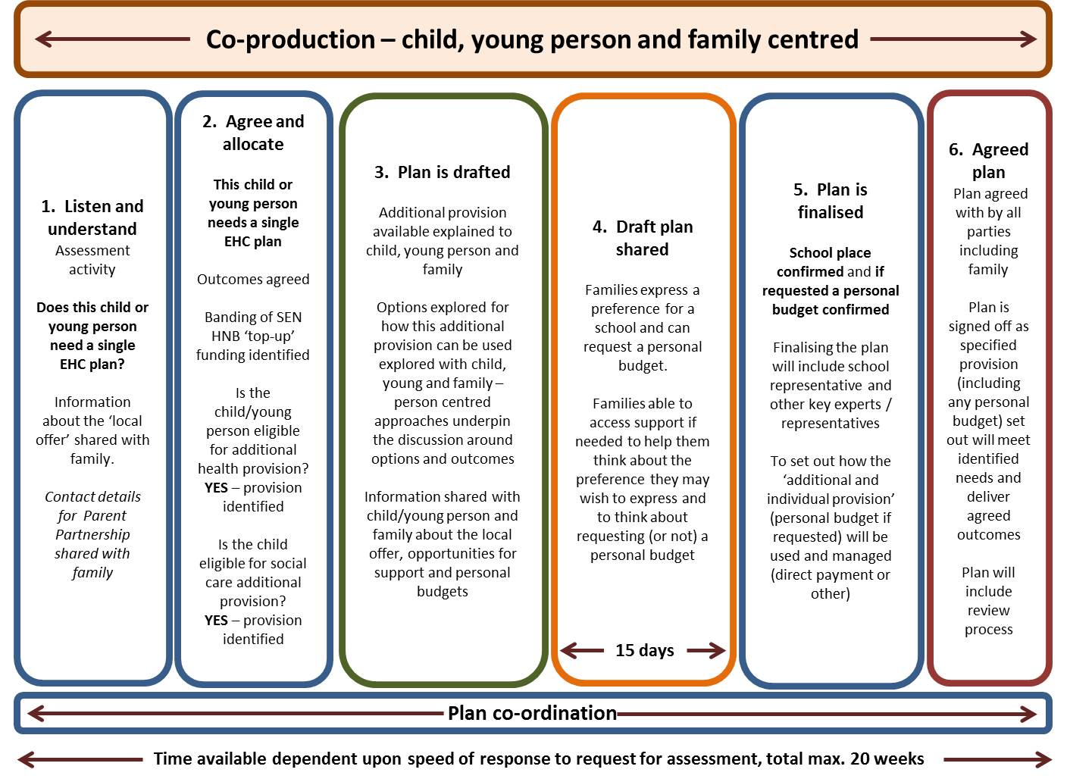

Slide 33
Funding EHC personal budgets
Health provision
Base funding
School/college budget
High-needs block
Personal budget
if agreed by school/college
Notional SEN budget
Social care provision

Slide 34
Funding EHC personal budgets
Health provision
Base funding
School/college budget
High-needs block
Personal budget
if agreed by school/college
Notional SEN budget
Social care provision

Slide 35
Learning to date – what’s worked well?
PBs have reinforced the importance of a person-centred approach, focused on outcomes.
Supportive Headteachers
New conversations between the family and the school/college , leading to a much greater understanding of the child’s/young person’s whole life and what is important for their wider family, as well as for them.
  “I thought I knew my families, but I had no idea!”
Innovative solutions identified by empowering individuals
Small amounts of money have made big difference
Positive family feedback.

Slide 36
Evidence
Adults Poet
Individual budgets pilots
In Control’s evidence
Development of a children’s POET

Slide 37
Tip 7 – Evidence based commissioning
Evidence of what works at a local, national and international level
Local evaluation and improved local data
ChiMAT
National websites e.g. NatSIP, Council for Disabled Children, DfE, Local Government Association

Slide 38
Kent multi-agency commissioning framework for CYP with SLCN
Universal
Children with significant primary SLCN requiring targeted and / or specialist support in addition to universal.
All children benefiting from good language environments as part of early development
Targeted
Specialist
Children with severe, complex & long term SLCN requiring specialist support in addition to targeted and universal provision

Slide 39
Tip 8 – Core principles for integrated working
“The provision of integrated services around the needs of patients occurs when the right values and behaviours are allowed to prevail and there is a will to do something different. We need to move beyond arguing for integration to making it happen.”
Professor Steve Field, NHS Future Forum

Slide 40
Tip 8 – Core principles for integrated working
No decision about me, without me.
Tell my story once.
Parent carers / young people and professionals both have active roles to play in the assessment of need, identification and implementation of the shared goals.
Shared goals that a team around a child / family can work on.
Shared understanding of key working functions.

Slide 41
Tip 8 – Core principles for integrated working
Clear and accessible information that is available to parent carers and young people early in the process.
Shared values.
Open and transparent process.
Joint workforce training and development, with parent carers empowered to deliver key aspects of the training programme jointly with professionals.
The training offered to professionals linked to a particular child / young person should also be delivered to the parent carers.

Slide 42
Tip 9 - The local offer
Local offer aligned to the new joint commissioning duty.
Web based tool that creates a snap shot in time.
Opportunity to innovate.
Organic process that changes over time.
Improved information, transparency and accountability

Slide 43
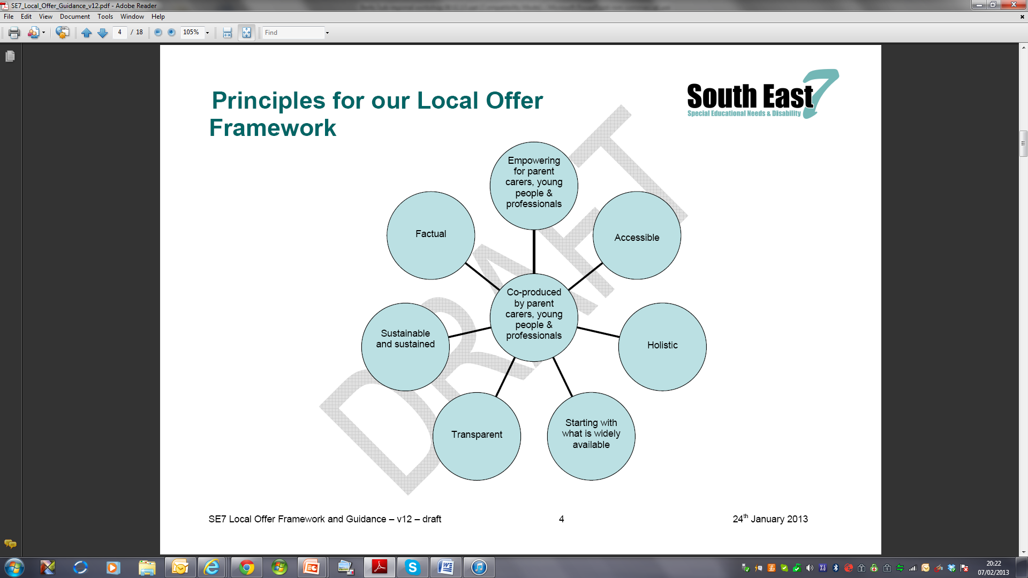
The SE7 Principles for their local offer framework
Personal Budgets

Slide 44
The time is right!
Colleagues across Whitehall are giving the same messages
Personalisation
Personal Budgets
Duty to cooperate at both the strategic and operational levels
Duty to include and work with users – users at the centre of developments – “no decision about me without me”
Transparency
Focus on outcomes - joint

Slide 45
Table discussions
Please share examples of joint commissioning happening now
What else could you do locally to extend joint commissioning?
What else could NatSIP do to support joint commissioning?

Slide 46
Our 10 top tips
Build on what unites us
New legislation & policy creating a consistent message
Co-production
Common understanding of outcomes and indicators
Whole system approaches
Personalisation and promoting choice and control
Evidence based commissioning
Core principles for integrated working
The local offer
Making It Personal guidance
Tip 2 - The Legislation

Slide 47
Contact details
Claire Lazarus, Associate, In Control
  clairelazarus@btinternet.com
  07880 787190
Martin Cunnington, Interim Associate Partner, Children & Maternity, KMCS
martin.cunnington@nhs.net
07545934676

