Slide 1


Support and Aspiration
Implementing the reforms to special educational needs and disability
Helen Nix
Notes:
1

Slide 2

Our vision
  Early identification and support
  Trained and equipped workforce
  Easily accessible information
  Clear focus on outcomes
  Assessment and EHC Plan from birth to 25
  Increased control for parents and young people

Slide 3


Where are we in the legislative process?
Lords Committee: Oct 2013
Regs/Code: Oct 2013
Report Stage: Nov 2013
Royal Assent : Feb 2014
Law: September 2014
Houses of Parliament
The Government
Houses of Parliament
London, England

Slide 4
Legislation - key highlights
  Local Offer
  0-25 Education, Health & Care Plan
  Joint Commissioning duty
  Health duty
  Personal Budgets
  Duties on Academies
  New rights & protections for 16-25 year olds
  Preparation for Adulthood
  Clear focus on outcomes
  Assessment and EHC Plan from birth to 25
  Increased control for parents and young people

Slide 5
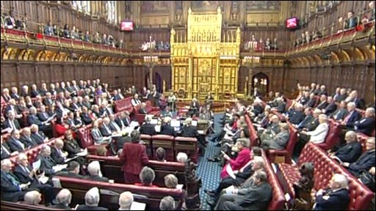
Legislation: Remaining debates
Young Offenders with SEN in custody
“Have regard to age”
Disabled children and young people
Single point of redress
Duty on social care
Notes:
5

Slide 6
Pathfinders
20 pathfinders, made up of 31 local authorities
September 2014 – scale up & support
Key role in informing new legislation
Informing regulations and SEN Code of Practice

Slide 7
June 2013 - SQW pathfinder evaluation findings
Pathfinders are increasingly family and outcome focussed with improved multi agency working and holistic single planning.
Parents have been involved fully as part of the assessment and planning process, through the use of person / family centred approaches and key working.
New approaches were reported to have increased choice and control for families.
Challenges for the next phase of pathfinding include: how to scale up approaches to a whole area in a sustainable way e.g. key working; fully engaging children and young people; developing approaches that work for new entrants to the system.
An impact evaluation will be published in September 2013, assessing the experiences and outcomes achieved by around 200 families with the first EHC plans.
Notes:
Evaluation is being carried out by SQW, based on monitoring data and parent and practitioner surveys, and enhanced by intensive case studies in selected areas.
There are been four published reports, including the latest report published in June 2013.
The evaluation findings are available on the DfE’s website at http://www.education.gov.uk/childrenandyoungpeople/send/b0075291/green-paper/pathfinders.
Summary of latest findings:
-Overall, the report shows that good progress is being made. Levels of engagement with the programme are generally high – especially with parents - and key working approaches have been well-received by families, with an increase in choice and control. After a relatively slow start, pathfinders are picking up pace in developing their local offers and we are seeing the beginnings of a culture shift in assessment and planning, with a growing emphasis on personalisation and multi-agency, outcomes-based approaches.
-The report identifies a number of significant challenges, most notably for pathfinders to scale up new approaches to whole areas without losing the benefits to families and within tight resources. It notes that most pathfinders have some way to go in their engagement with children and young people, and with health professionals. While parents value the personalised approach which they offer, take up of personal budgets and SEN direct payments remains relatively low.

Slide 8

Pathfinders: What have we learned?
Engaging families and young people critical
Good practice in engaging institutional settings
Local offer: engaging, accessible, transparent & comprehensive
Requires a culture shift in thinking & approach
Person-centred planning is important
Takes time, energy and determination

Slide 9
Supporting You: Pathfinder Champions
Each region has a pathfinder champion, to provide advice and support to non-pathfinder areas as they prepare for implementation of the reforms:
London | Bromley and Bexley
South East | SE7 (consortium of seven LAs) and Southampton
South West | Wiltshire
North East | Hartlepool
East Midlands | Leicester City
East of England | Hertfordshire
West Midlands | Solihull
Yorkshire & Humber | North Yorkshire and Calderdale
North West | Greater Manchester Group (Wigan, Trafford and Manchester)

Slide 10
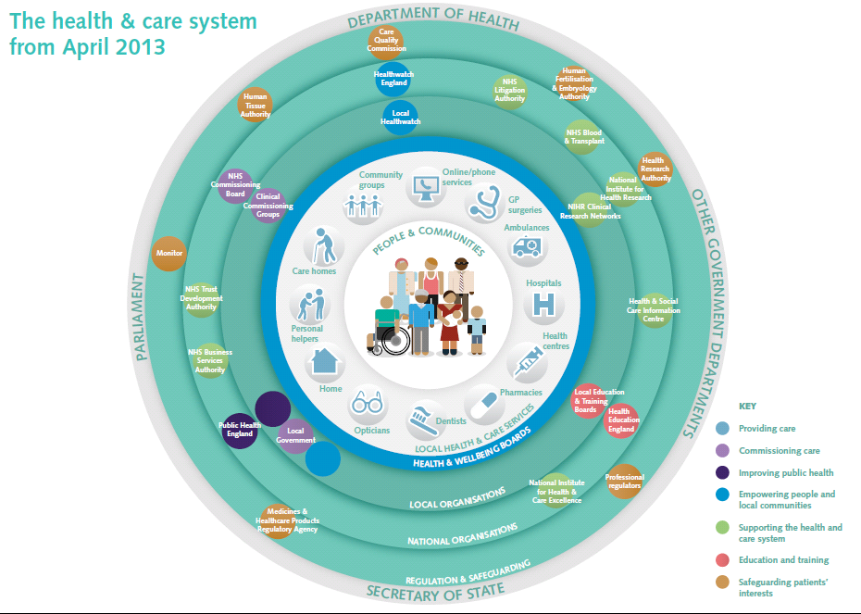

Slide 11
The Mandate : from the Government to the NHS Commissioning Board: April 2013 to March 2015
Sets priorities for the NHS for the coming two years.
The NHS Commissioning Board is legally required to pursue the objectives in the Mandate. CCGs have a statutory duty to act consistently with the Mandate (and meet any commissioning guidance the Board chooses to issue to deliver against the Mandate).
The Mandate states:
“…there is a particular need for improvement, working in partnership across different services… in supporting children and young people with special educational needs or disabilities. The Board’s objective is to ensure that they have access to the services identified in their agreed care plan, and that parents of children who could benefit have the option of a personal budget based on a single assessment across health, social care and education.”
11

Slide 12
NHS Outcomes
NHS Outcomes Framework
Domain
1
Preventing people from dying prematurely
Domain 2
Enhancing quality of life for people with long-term conditions
Effectiveness
Domain 3
Helping people to recover from episodes of ill health or following injury
Domain 4
Ensuring people have a positive experience of care
Patient experience
Domain 5
Treating and caring for people in a safe environment and protecting them from avoidable harm
Safety

Slide 13
Children and Families Bill: Summary of Key Reforms
Joint commissioning – LAs and CCGs required to work together to meet the education, health and care needs of children and young people with SEN
Local offer – LAs must make available information on services for the full range of children and young people who are disabled and those with SEN
Integrated Education, Health and Care Plan (EHC Plan) - built on streamlined assessment process which includes parents, children and young people, reflecting the child or young person’s needs.
Personal budget - parents of disabled children and those with SEN, and young people themselves, will have a legal entitlement to a personal budget where they have an EHC Plan.

Slide 14
Joint Commissioning

Slide 15
Supporting You: Information & Partners
SQW evaluation reports & impact evaluation
Pathfinder Information Packs (www.SENDpathfinder.co.uk)
Council for Disabled Children
Delivery Partners:
- Early Years
- National Parent Partnership Network
- NDTi

