Slide 1

Safeguarding at SI Schools – good practice and common pitfalls
Claire Dorer – CEO NASS

Slide 2
Framework of legislation and guidance
UN Convention on the Rights of the Child 1989
Ratified by UK in 1991
Education Act 2002
Children Act 1989
Children Act 2004
Sexual Offences
Act 2003
What to do if you’re worried a
child is being abused (2015)
The PREVENT duty
Safeguarding Vulnerable
Groups Act 2006
Childcare Act 2006
Information sharing guidance
for designated staff (2015)
Working Together to
Safeguard Children (2015)
Keeping children safe in
education (2015)
Notes:
This slide is included simply to demonstrate that child protection is underpinned by
several pieces of legislation and associated guidance. It is not necessary for participants to
be familiar with the diverse content. Reference to the appropriate legislation and guidance is made in the EL model CP policy.
The Children Act 1989 is the overarching legislation that covers the state’s responsibilities
towards children. It includes the framework for children in need (section 17) and children
in need of protection (section 47).
The Children Act 2004 is the legislative framework for the Every Child Matters agenda.
Show participants What to do if you’re worried a child is being abused, Safeguarding
Children and Safer Recruitment in Education and Leeds LSCB procedures.
Tell participants where they can find these documents, both in school and on websites.
Most child protection documents can be downloaded, or ordered free of charge from:
www.everychildmatters.gov.uk
www.teachernet.gov. Leeds LSCB website

Slide 3
Why has guidance recently changed?
The previous statutory guidance needed updating to reflect changes in legislation. HM Government also wanted to:-
Reduce guidance to enable schools to decide how best to protect their own pupils
Reduce the SoS’s accountability for Safer Recruitment
Re-balance the role of school leaders and the State
Clarify the changes to school recruitment as a result of Regulated activity and the merger of CRB and ISA to create DBS
Align school guidance with Working Together 2013/15

Slide 4
Key themes of WT 2013
Local arrangements / reducing statutory control
Early help
Shared assessments –
    Managing risk
    Timely
    Transparent
    Proportionate
Listening to children
Information sharing
Supervision & support

Slide 5
Changes in WT 2015
Changes to the LADO role:
  Now the DO (designated officer)
  Doesn’t have to be a specific person
  LAs can choose to route allegations through children’s social care
Clarification that WT applies to schools
All organisations must have whistleblowing arrangements which are covered in training / staff CoC
Changes to part 3:
  Clarification for LAs of notifiable incidents
  Definition of ‘serious harm’ clarified in relation to SCR threshold

Slide 6
Keeping children safe in education 2015
“Where a child is suffering significant harm, or is likely to do so, action should be taken to protect that child. Action should also be taken to promote the welfare of a child in need of additional support, even if they are not suffering harm or at immediate risk.”
“Anybody can make a referral. If the child’s situation does not appear to be improving the staff member with concerns should press for re-consideration.”

Slide 7
The 5 main aspects of safeguarding arrangements
Extent to which leaders create a safe culture
Application & effectiveness of safeguarding policies & safer recruitment
Quality of safeguarding practice
Timeliness of response to any concerns
Quality of multi-agency plans

Slide 8
What commonly goes wrong at inspection?
the failure to maintain a single central record of recruitment and vetting checks covering all adults who had regular contact with children insufficient child protection training
key risk assessments not completed
a failure by the governing body to monitor and review the policies to protect children.
From ofsted ‘Safeguarding in schools report ‘ 2011

Slide 9
But …
Very rare for schools to be judged inadequate solely on safeguarding issues
Both inadequate and outstanding practice have close links to the quality of leadership and management
Focus in schools since September and residential since April is IMPACT of provision on learners

Slide 10
Signs of successful safeguarding arrangements
Children are protected and feel safe
Leaders and managers have effective safeguarding and staff behaviour policies
Staff and other adults are clear about what to do if they are concerned about a child
Children can identify a trusted adult & report that adults listen to them
Written records are timely and held securely
Referrals are made immediately, with appropriate consent and a record kept

Slide 11
More signs of successful safeguarding arrangements
Written plans are in place to protect children
Risks to children who go missing are understood and responded to
Children are enabled to take age appropriate & reasonable risks – risk assessments are clear
Children presenting risky behaviours receive positive support
Physical environment is safe and secure
Staff & other adults have a copy of and understand the procedures for child protection, complaints and whistleblowing

Slide 12
It starts with the internet
Inspectors know they will be visiting long before you do:
School website
Ofsted portal
Parent view
Google
Local media
Social media
Notes:
Policy is available, includes review date and has been updated in the last 12 months

Slide 13
And then they look for Safer Recruitment
Single central record
Additional checks:
    Overseas checks
    Prohibition from teaching
    Prohibition from management
    Disqualification from childcare
Recruitment of volunteers
Vetting visiting speakers
Vetting of those living on the premises but not connected with the school

Slide 14
Induction
All staff should have an induction which includes:
The child protection arrangements
Signs & indicators of abuse, neglect and harm
Staff behaviour / code of conduct
Whistleblowing
KCSE part 1
“What to do if ….”
Temporary staff and volunteers should be made aware of the arrangements and their responsibilities

Slide 15
Training & awareness raising
All staff have regular training that equips them to meet their statutory responsibilities
All staff read and understand KCSE part 1
All staff are aware of WT 2015, what to do if … and local arrangements
  Staff are confident to challenge senior leaders over safeguarding concerns
Governors / trustees are knowledgeable about their responsibilities
DSL attends training at least every 2 years
At least one member of every recruitment panel has attended Safer Recruitment training

Slide 16
Specific issues
Staff understand the risks associated with:
Racist / disability abuse & homophobia/transphobia
Gender based violence / VAWG
Teenage relationship abuse
Radicalisation & extremism
Sexually harmful behaviour
Female Genital Mutilation (FGM)
Child Sexual Exploitation (CSE) & trafficking
Impact of new technologies e.g. sexting
Poor parenting

Slide 17
Policies & procedures
Child protection (updated annually)
Written procedures for management of allegations against staff or volunteers
Written procedures for managing allegations against pupils
Whistleblowing
Staff code of conduct / behaviour policy (updated annually)

Slide 18
Inter-agency working
Records of any concerns are timely and stored securely
Information is shared appropriately to protect a child and with the necessary consent
CP and safeguarding concerns are immediately shared with Social Care; this is recorded
Written plans are in place to protect a child for whom there are concerns
The role, actions and participation of the school in working in partnership with external agencies
Staff understand that they may be required to support social workers in keeping a child safe

Slide 19
A broader view of safeguarding
Learner health & safety and wellbeing
Use of reasonable force/restraint/deprivation of liberty
Meeting children’s medical needs
First aid
Educational visits
Intimate care
Online safety & associated issues
Arrangements to ensure children’s security

Slide 20
The learner’s voice
Children know how to complain and can identify a trusted adult*
They report that adults listen to them and take their concerns seriously
They are consulted on issues that affect them
They are enabled to make choices
Children who present risky behaviours experience positive support from professionals
In residential settings, children have access to an independent advocate
Children’s liberty is not restricted
Notes:
Where they have been at risk, the trusted adult has been instrumental in helping them to be safe in line with LA arrangements

Slide 21
Governing bodies / trustees
Governors / trustees can evidence that:
The school contributes to inter-agency working in line with Working Together – which includes coordinating an offer of early help
There is a DSL and cover for this role
Responsibilities of the DSL are included in their JD
The DSL is enabled to play an effective role in pursuing concerns and protecting learners
DSL has access to supervision
They undertake an annual review of policies and procedures relating to safeguarding and how the safeguarding duties have been discharged
Notes:
It undertakes an annual review

Slide 22
And:-
There are arrangements in place to identify any risk to children who go missing from education settings
Has written procedures for dealing with allegations of abuse against staff / volunteers and makes appropriate referrals to the LADO and to the DBS
There are procedures in place to handle allegations against pupils
There is a whistleblowing procedure which is covered in training and in the staff CoC / behaviour policy
A member of the governing body (usually the Chair) is nominated to be responsible for liaising with the LA/partner agencies in the event of allegations of abuse being made against the Head teacher
Notes:
It undertakes an annual review of its policies and procedures relating to safeguarding and how the above duties have been discharged

Slide 23
and that …
Personal development, behaviour & welfare of children: children’s welfare & safety is promoted
Learners in off-site provision are safeguarded
Any deficiencies or weaknesses brought to its attention are remedied without delay
They operate safe recruitment procedures and ensure appropriate checks are carried out on all new staff and volunteers
The PREVENT duty has been incorporated into all areas of the school’s arrangements
Unchecked volunteers / visitors are supervised appropriately
Notes:
It undertakes an annual review

Slide 24
Record-keeping
Documentation
Cause for concern forms
Wishes and feelings of the child recorded.
Follow up actions
Records of verbal / written conversations
Records of referrals / confirmations
Correspondence
Chronology of events
Subject to Data Protection legislation
Intervention & Support Plans
Individual to a child’s needs
Wishes and feelings recorded.
Review of intervention
Review
Clear evidence of regular case reviews.
Transition
Clear evidence of handovers to other staff.
Record of file transfer to another establishment.

Slide 25
Will we be rated as ‘inadequate just for getting something wrong on our SCR?
No – not necessarily!
Inspector guidance allows for ‘minor’ administrative errors:
  failure to record one or two dates
  individual entries that are illegible
  one or two omissions where it is clear that the information is already held by the school or college but the school or college has failed to transfer over the information in full to the single central record

Slide 26
But you will be vulnerable if …
You have failed to check staff with DBS
Multiple minor areas appear symptomatic of wider lack of leadership and embedding of safeguarding e.g. staff not clear of requirements
The information necessary is not held anywhere within the school

Slide 27
Teaching young people to be safe
“Schools and other children’s service providers play an important role in making children and young people aware of behaviour towards them that is not acceptable, and of how they can help keep themselves safe. For example, pupils should be taught to:-
recognise and manage risks in different situations and then decide how to behave responsibly
judge what kind of physical contact is acceptable and unacceptable
recognise when pressure from others (including people they know) threatens their personal safety and wellbeing and develop effective ways of resisting pressure.”

Slide 28
DfE guidance on CP training
“Employers are responsible for ensuring that their staff are competent to carry out their responsibilities for safeguarding and promoting the welfare of children and creating an environment where staff feel able to raise concerns and feel supported in their safeguarding role”
“Staff should be given a mandatory induction, which includes familiarisation with child protection responsibilities and procedures to be followed if anyone has any concerns about a child’s safety or welfare.”
Working together to safeguard children (DfE 2015)

Slide 29
Need a training quick fix?
Do training as often as you can
Be creative
Don’t assume you have to be the expert – staff often learn more from the discussion than the slides
If the wheel has already been invented, use it
And some rules …
Always keep a record of who was there
Remind staff about personal safety / emotional impact and where they can get support
Keep a copy of the hand-out / slideshow
Evaluate – what difference did it make?

Slide 30
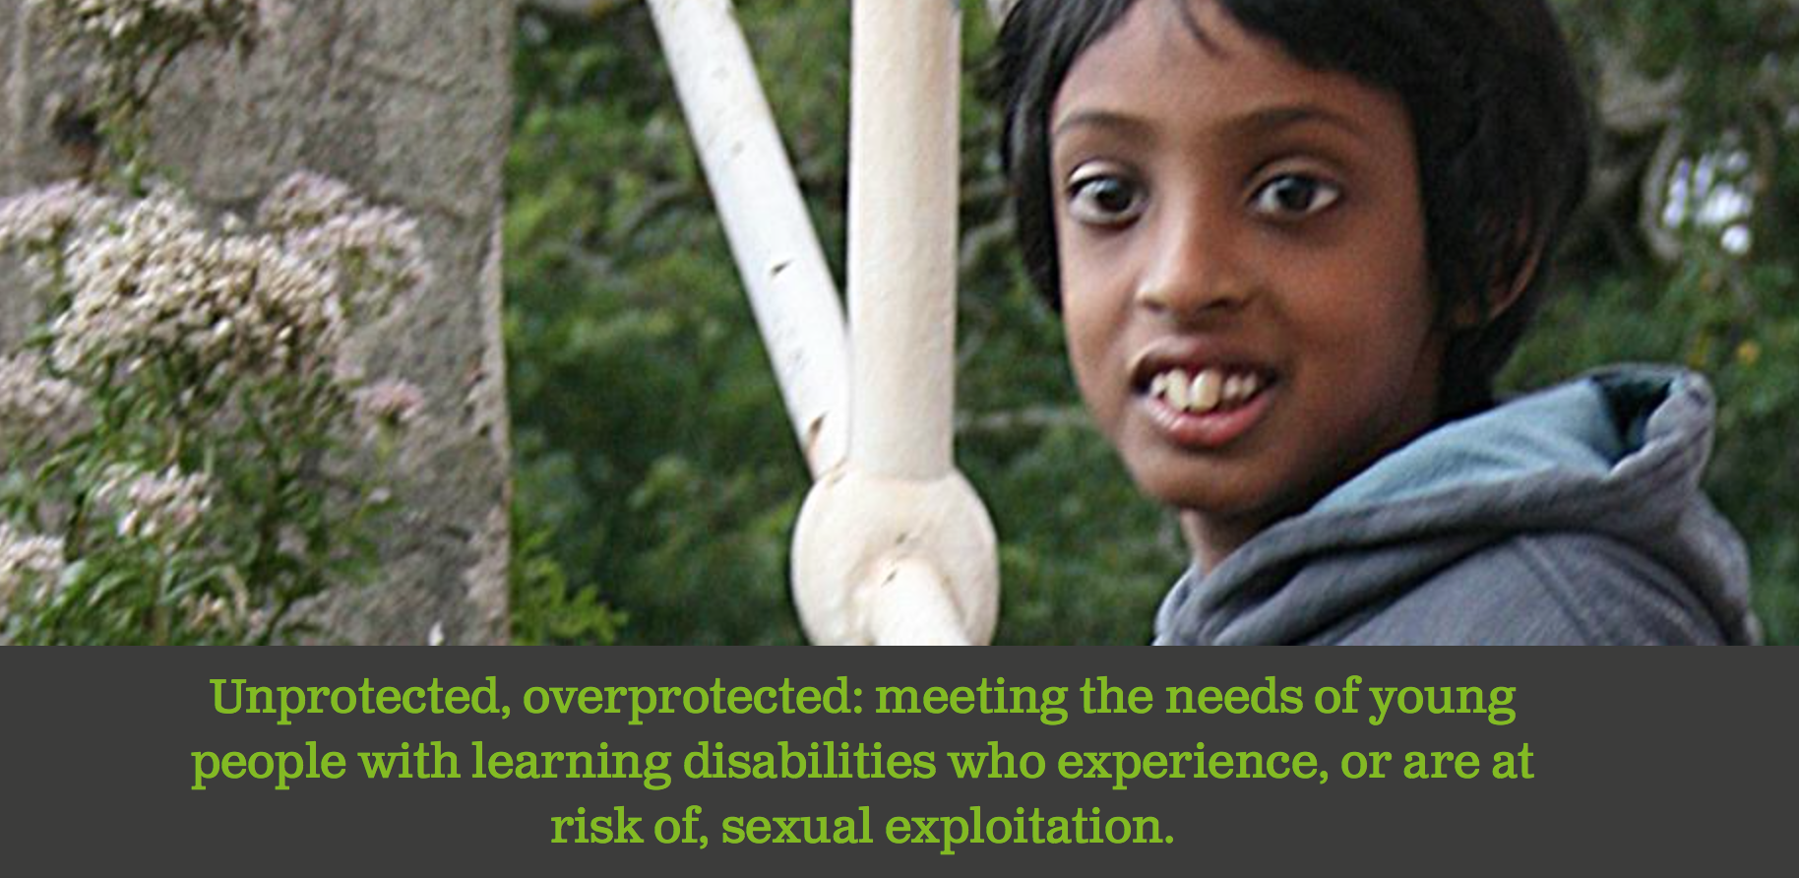

Slide 31
Safe working practice 2015
Based on the original GSWP 2006 / 2009
DfE asked the Safer Recruitment consortium to update / refresh
Small task group represented NASS schools
Focus is on schools rather than wider children’s workforce
There will also be a training resource for DSLs to use

