Slide 1
So what is ‘health’ doing to improve children’s outcomes?
Anna Gill OBE – CDC Associate

Slide 2
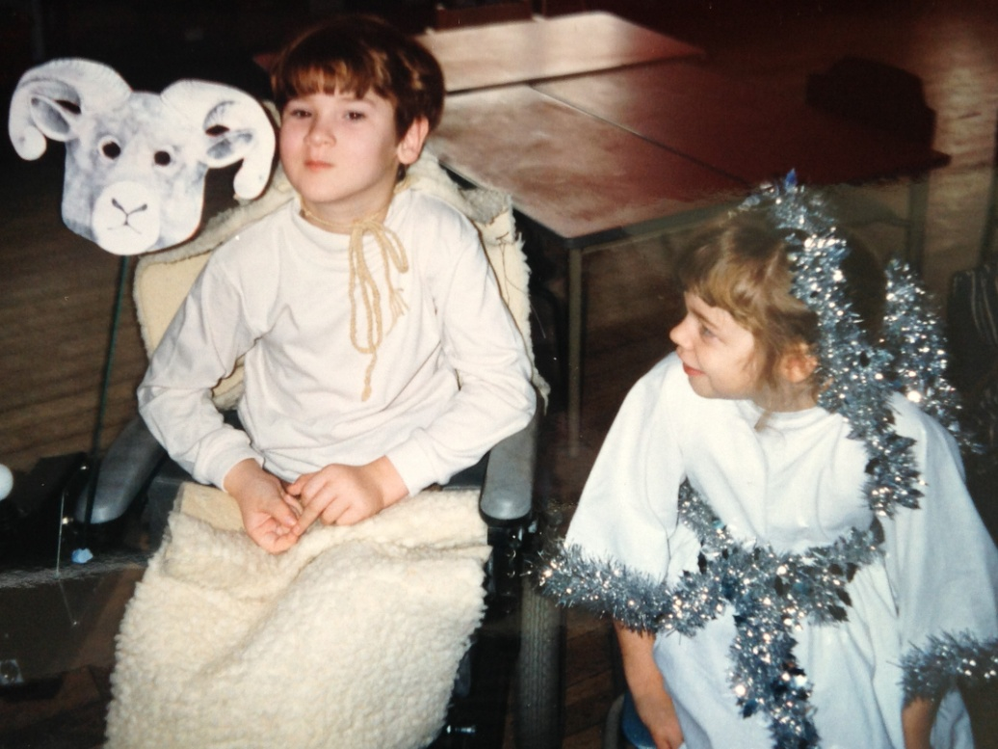
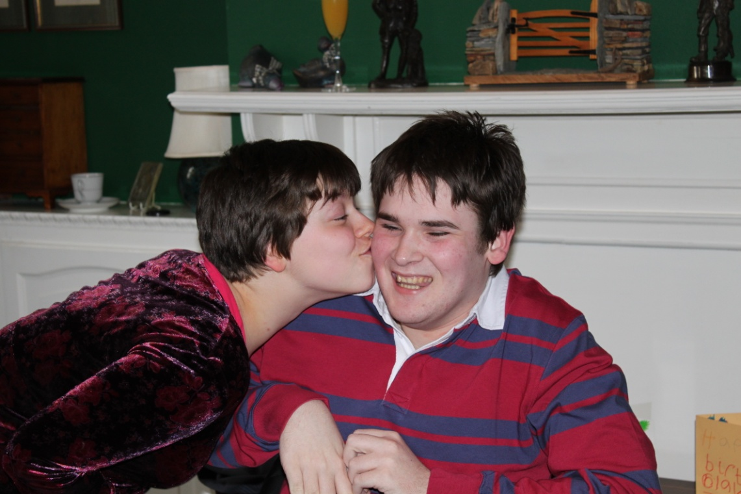
Best possible outcomes?
Notes:
Intro – why me? What does good look like? Who’s outcomes are we striving for?

Slide 3
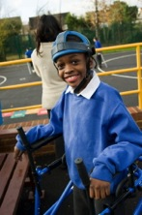
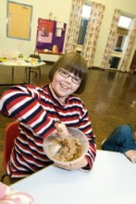





Our vision for children and young people with special needs is the same as for all children and young people – that they achieve well in their early years, at school and in college; lead happy and fulfilled lives; and have choice and control.
Notes:
Keep reiterating – how ever hard it is this is what we are collectively striving for – culture change is not going to be overnight

Slide 4
National: a shared challenge
Everyone Counts: Planning for Patients 2014/15
Govt response to CYP Health Outcomes Forum Report
Improved outcomes for children, young people and their families
Revised NHS Constitution
Revised NHS & Public Health Outcomes Frameworks
Children & Families Act
Care Act
Notes:
Everyone counts- focus on joint commissioning and patient voice ( section 19) Pledge- we know outcomes poor in this country/key messages to new government Constitution- focus on integration/voice/JSNAs Outcomes frameworks – too thin re children C & F Section 19/use your Local Offer/DMO/JC Care Act- transition duties

Slide 5
Strategic: Key asks from the CYPs Outcomes Forum
CYP’s Health Strategy
Financial incentives for a healthy population
Health outcomes & strengthening international comparisons
Information sharing & data linkage
Integration of children’s services
Mental health
CYP’s involvement & engagement
Workforce & sustainability
Develop and implement a children and young people’s health strategy: a coordinated, system wide approach to improving CYP’s health

Slide 6
Local levers: Children and Families Act 2014
  Children and Families Act applies new legal duties to CCGs, NHS Trusts and NHS England
  CCGs, NHS Trusts and NHS England must have regard to the SEN and Disability Code of Practice when carrying out these duties
  Using your Local Offer to improve outcomes
  Guidance on ‘Supporting pupils at school with medical conditions’
  Role of the DMO
Notes:
The Children and Families Act 2014, legislation which comes into force from September 2014, applies new legal duties to both CCGs and NHS England who must have regard to the SEN Code of Practice when carrying out these duties. The Code of Practice is statutory guidance to support the implementation of the act.

Slide 7

Support and learning tools
The Council for Disabled Children
Health Resources
www.councilfordisabledchildren.org.uk/makingithappen
General SEND Resources
www.councilfordisabledchildren.org.uk/resources
Notes:
Welcome, housekeeping, introduction

