Slide 1




Dual Sensory Lost
By Joe Scott

Slide 2
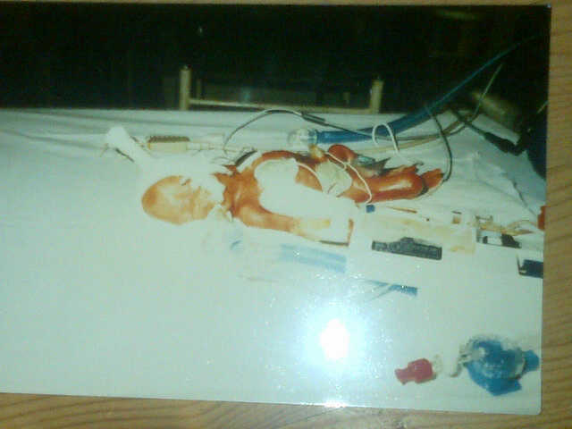
First born?

Slide 3
Visual Impairment
I have retinal detachment in my right eye. I only have -22% vision the right eye and -5% in my left.
I can only see shadows e.g. If I follow my finger, I cant see it until the shadow follows.
There is a possibility that I can go blind if I get hit in the head very hard.
I don’t mind what side people to sit on.

Slide 4

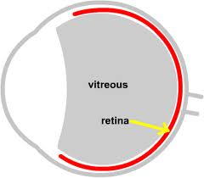
Image of my eye and a normal person
My eye
Normal person eye

Slide 5
Deafness
I Have difficulty understanding speech without a hearing aid.
I have moderate hearing loss this mean I hear better low pitches than high pitches
I may miss out on a significant number of speech sounds and need to use lipreading.

Slide 6
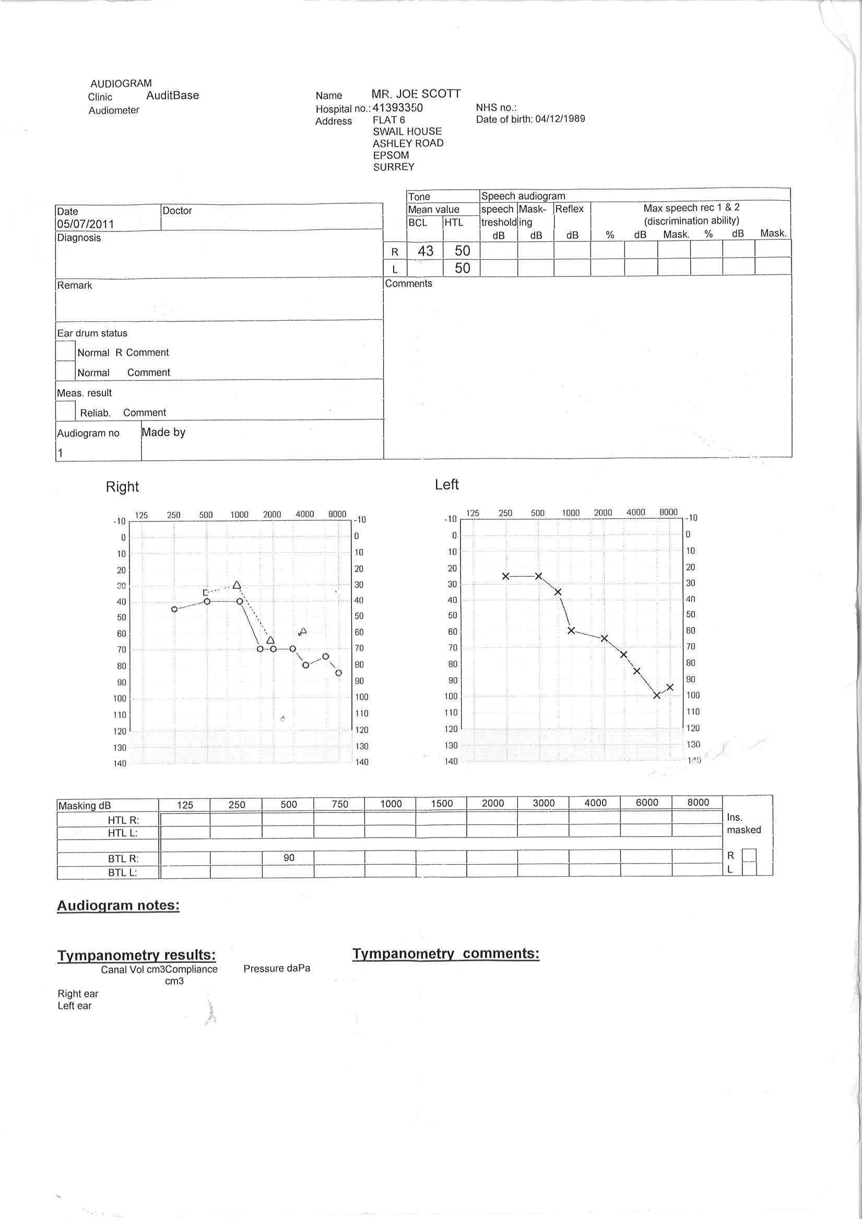
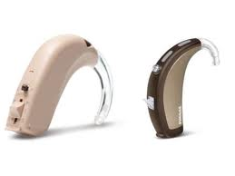
Diagram of my hearing

Slide 7
Every day problems?
I can watch TV and listen to music but I need it louder than what a normal person has it.
Because of my eye sight I have trouble reading bus stop print and I wont know what bus is coming till it got close to the stop.
If i am in a noisy palce i have trouble hearing people. (background noise)

Slide 8
Using a computer?
I need to enlarge the icons on the screen
I use large print. The font I use is 16 bold Arial.
I may have to bring the screen forward.
I maybe able to have a bigger screen
It would help for the teachers to give me hands out for the PowerPoint presentation

Slide 9
Who and what helped me growing up?
Being around good and positive people
My parents were the people who helped me the most

Slide 10
My five top tips for young people
Be proud of who you are
Don’t let adults run your life – make your own choices
Make sure you know what you want to do in life – have a plan
Ask for help
Do your best in life

Slide 11
My five top tips for professionals
Don’t be scared to ask questions
Just be prepared to adapt your company for a visually impaired or blind person
Make sure everything is accessible

Slide 12
What I want out of this – my message for today
Just don’t take your eye sight and hearing for granted because it can happen at any time.
I just wanted to be treated like anyone else would be treated.
You don’t have to shout because I am hard of hearing I can hear you but not very well!

Slide 13
Thank You for listening
Any Questions???
Would any one like to try and see what is like to be me for a couple of minutes?

