Slide 1
Young people’s participation and the SEND reforms
Pamela Shaw, Senior Participation Officer
NatSIP: The voice of young people in improving outcomes

Slide 2
Young people’s views on participation
“It means so much when people listen to me, but when they don’t I just tend to not bother. Kind of like as if I’m worthless.”
“We can make our own decisions. We have our own ideas about what we’d like to achieve.”
“I believe that disabled young people should be involved in decisions that could really affect them because they are the ones that are going to be affected and they know what helps them in life and what doesn’t.”
Notes:
Outline the importance of participation from young people’s point of view using quotes from young people who’ve benefited from authentic engagement opportunities. Important to highlight why non-participation is disempowering for young people.

Slide 3
Cultural change
Children and Families Act: PART 3
19 Local authority functions: supporting and involving children and young people
A local authority in England must have regard to…
(a) the views, wishes and feelings of the child… or the young person…
(b) the importance of the child… or the young person participating as fully as possible in decisions…
(c) the importance of the child… or the young person being provided with the information and support necessary to enable participation in those decisions
Notes:
This sets out what the Children and Families Act says about the participation of children and young people.
Important to highlight that it also extends the right to appeal to SENDIST to children and young people – which will obviously have implications for how these young people are supported to participate and have their views heard in these decision making processes.
Personalisation agenda will also have a huge impact on how to involve disabled children and young people in decision making
Note: Clause 19 relates to children and young people’s involvement in decision-making in decisions about their individual services and care, not collective or strategic decision-making.

Slide 4
Degrees/ levels of Participation
Degrees of Participation
Assigned but informed
Adult-initiated, shared decisions with young people
Youth-initiated and directed
Youth initiated, shared decisions with adults
Consulted and informed
Notes:
The Degrees of Participation is based on a theory proposed by Phil Treseder (1997) Empowering Children and Young People: Promoting Involvement in Decision Making, Children’s Rights Office & Save the Children.
This shows five degrees of participation as five different but equal forms of good practice. Each of these approaches result in young people being involved in influencing decisions about their lives which is in turn empowering.
Assigned but informed = YP assigned a specific role, views taken into account
Consulted and informed = YP give advice/ views, informed about how their views influence decisions made by adults
Adult initiated, shared decisions with young people = YP are involved in decision making together with adults
Youth initiated, shared decisions with adults = YP share power and responsibility for decision making with adults
Youth initiated and directed = YP make autonomous decisions
Discussion Point: Ask the group to choose which one will have the most benefit for a specific purpose relating to their role.

Slide 5

EPIC – SEND reforms young people’s advisory group

Slide 6
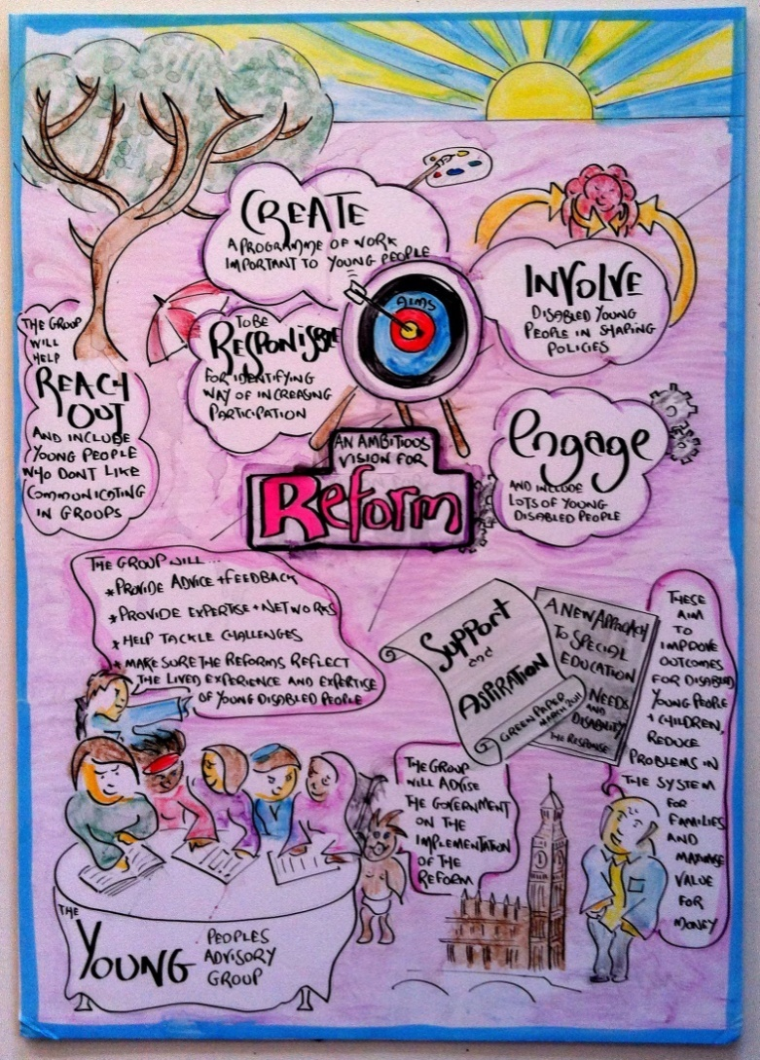
What EPIC does
Education, Health and Care Plans
The Code of Practice
The Local Offer
The national curriculum changes
Post-16 support
The single category
Joint commissioning
Implementation

Slide 7
EPIC’s impact
Young disabled people having the chance to highlight what effects them.
Creating a range of media outlets such as videos and leaflets so that young disabled people can view some of the changes to the reforms.
Challenging government and having a direct influence on the reforms.

Slide 8
SEND Information materials
SEND changes
EHC plans
Local Offer
Post-16
Decision Making
Videos, leaflets and posters
Face to face training

Slide 9
Your Rights, Your Future
“Thank you to all involved, we cannot stress enough how important the workshop was. It really allowed the young people to explore their future aspirations and learn about the laws around SEND.”
Birmingham Disabled Young People’s Group

Slide 10
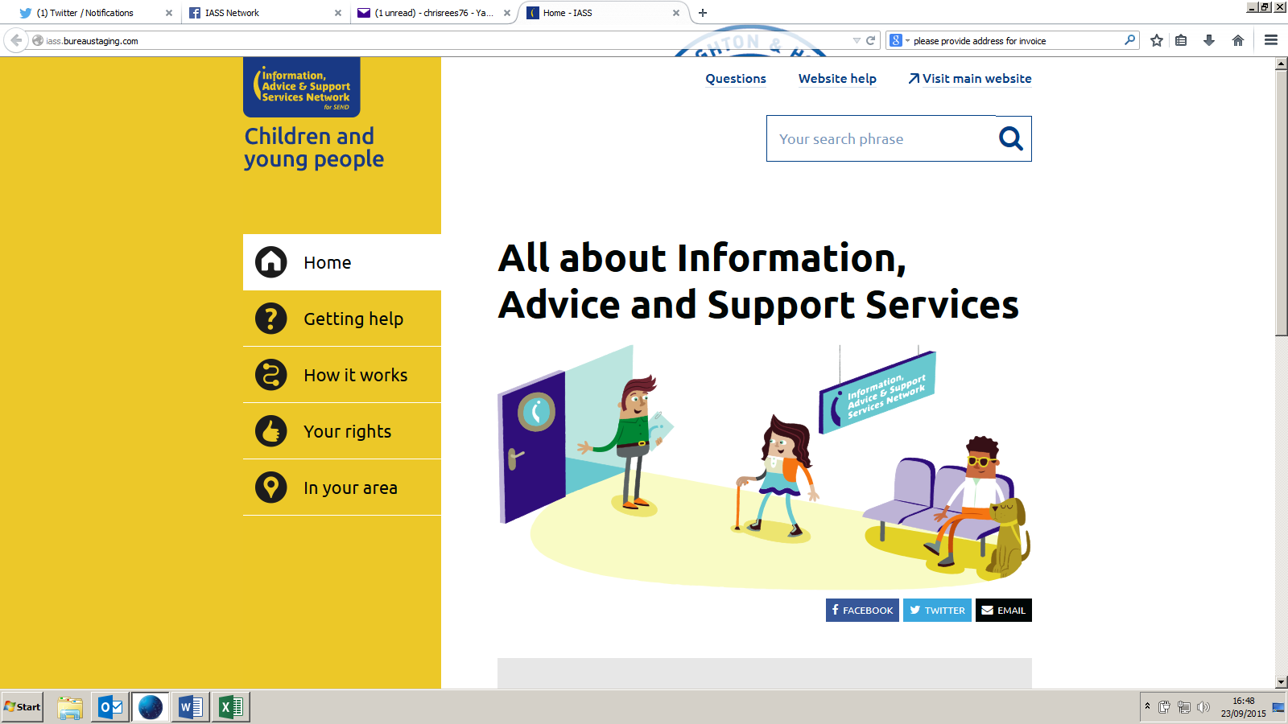
Information, Advice and Support Services

Slide 11
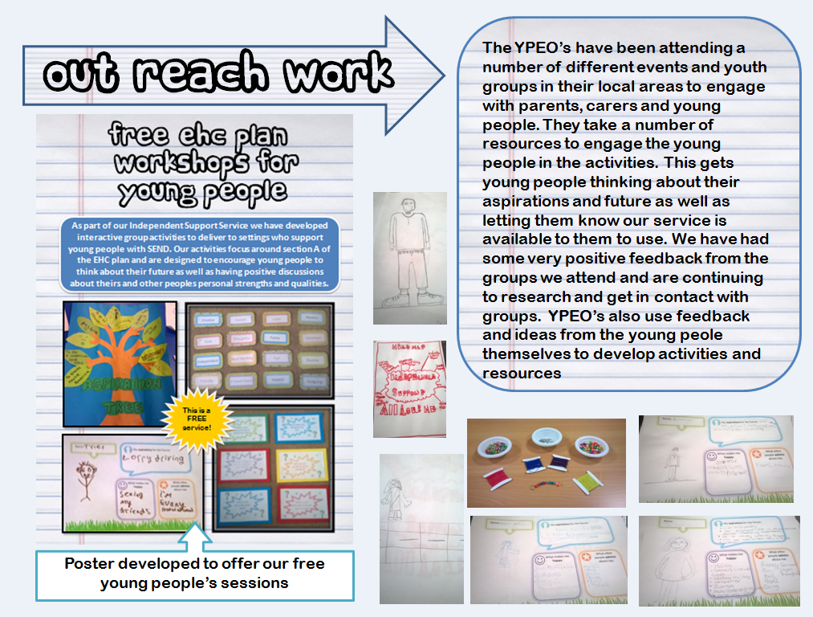

Slide 12
Difference between individual and strategic participation
Engagement of individual parent carers and families
Strategic participation of parent carers
Strategic participation of disabled children and young people
Engagement of individual disabled children and young people
It is important that local areas embrace all of these – and not one at the exclusion of others
Notes:
Highlight the difference between individual and strategic participation to ensure a complete participation journey.

Slide 13
Summary
Levers and duties exist to support young people’s participation in the SEND reforms
Good examples of young people’s participation in national programmes and local areas
Need to be better at promoting examples, practice and learning

