Slide 1
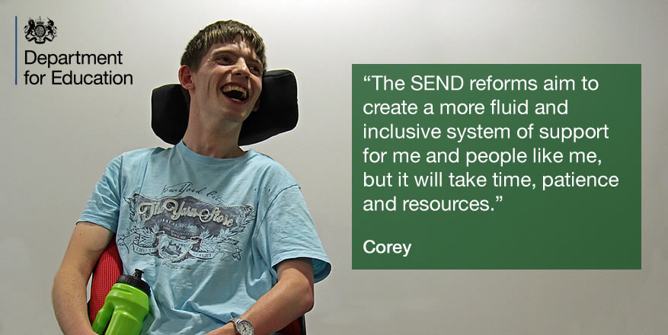
Implementation of the SEND reforms: Children and Young People Participation
NatSIP
London
1st October 2015
Jan Miller, DfE

Slide 2

SEND Code of Practice 0-25 – children and young people (CYP) participation
We want Independence
We have aspirations
We want to be consulted
Support and involve us in all decisions and matters that affect us from the start
A say in the Local Offer, EHC plans, personal budgets, FE and employment …
Prove you’re listening to us
Respect us
Now in law, the Code of Practice sets out a clearer focus on the participation of CYP and parents in decision-making at individual and strategic level

Slide 3

The new SEN system – Key features
2. All duties apply to all state-funded schools, inc. Academies
1. Involvement of children, young people and parents
3. Coordinated assessment; 0-25 Education, Health and Care Plan
7. Offer of a personal budget; more choice and control
4. LA, health and care services to commission services jointly
6. Statutory protections for 16-25s; focus on preparing for adulthood
5. A clear, transparent local offer of services for all CYP with SEND

Slide 4
CYP participation in the SEND reforms
INDIVIDUAL LEVEL
Impartial information, advice and support – support necessary to participate in decision making e.g. EHC plans and personal budgets.
At school and at college – so CYP are consulted and involved in their education/FE.
PfA - discussions about their aspirations, needs and support they think will suit them best.
STRATEGIC LEVEL
Impartial, information, advice and support - councils must provide this to CYP to enable them to fully participate in the support available locally.
Councils must consult CYP about what should be in their Local Offer and in joint commissioning discussions to inform the Offer.
CYP Forums - councils should consider establishing them where they don’t already exist.

Slide 5
LA implementation survey and Parent Carer Forum Survey – summer 2015: key findings
LAs response on how they are doing on engaging with CYP - out of 147 responses:
9 LAs – extremely well
47 LAs – very well
69 LAs - moderately well
22 LAs – not very well
0 LAs – not at all well
PCFs response on engaging with CYP in their LA – out of 97 responses:
2 of PCFs – extremely well
10 of PCFs - very well
31 of PCFs – moderately well
33 of PCFs – not very well
13 of PCFAs – not at all well
8 of PCFs - didn’t know

Slide 6
CYP participation: the challenges
Ensuring local councils are engaging CYP effectively
Ensuring CYP are involved in making decisions about their EHC plan, personal budgets
Engaging with those CYP without statements or EHC plans
Engaging the hard to reach CYP, so those with limited communication
Enabling schools and colleges to involve CYP in their education/personalised study programmes
Employer engagement in colleges
Understanding what works/what doesn’t, the barriers, plugging the gaps and spreading good practice
No national infrastructure as there is for parent participation

Slide 7
Support for implementation
Working with a team of SEN and Disability Advisers to identify challenges/barriers and areas of good practice
Support for Independent Supporters and Parent Carer Forums
CoP guidance materials and Easy Read Guide (GOV.UK and CDC websites)
Delivery support from 9 regional LA leads and a consortium of Mott MacDonald, the Council for Disabled Children and the National Development Team for Inclusion
Contracts and grants with the Voluntary and Community Sector to provide specialist advice, information and support to local areas
PfA workshops with colleges and LAs with a focus on writing outcomes, and using them to develop high-quality, personalised study programmes.
£5 million for supported internships
Notes:
-

Slide 8
Practice examples
Merton LA is looking at different media for young people to input into their EHC reviews, such as video, apps and blogs. For example, the LA used an iPad to obtain survey responses from a young person with a hearing impairment at her review which was extremely successful in finding out about her concerns about communication and learning.
Independent Support. A 16 year old with a statement has been diagnosed with ADHD for which she takes medication. She lives with her dad and younger sister; her dad suffers from multiple sclerosis and she has assumed some caring responsibilities. She and her dad were worried about moving to college. An independent Supporter helped her with her transfer review to an EHCP. To help to overcome some of the family’s anxieties, the Independent Supporter organised a visit to the college. The young person and her dad met the tutor whose course she would be attending and learnt about the help she could expect to receive. After the visit, the young person said she felt less anxious about moving on from school.

Slide 9
Questions to the group
What ‘top tips’ would you suggest to enable effective engagement with CYP with a sensory impairment?
Do you have examples of good practice you could share?
Please contact Glenn.foster@education.gsi.gov.uk

