Slide 1
Schools Offer for Sensory
Brian Lamb

Slide 2
Code of Practice-Local Offer/Schools Offer
In addition to the information in the local offer about the special educational provision the local authority expects to be available in early years providers, schools and post-16 institutions, schools are required to publish, under the Special Educational Needs (Information) Regulations, more detailed information about their arrangements for identifying, assessing and making provision for pupils/students with SEN. The school-specific information should reflect the local offer and elaborate on it.

Slide 3
Equality Act Duties
The specific duties that schools, early years providers, post-16 institutions and local authorities have towards disabled children and adults are included in the Equality Act 2010 the key elements are as follows:
• They must not discriminate against, harass or victimise disabled children and young people;
• They must make reasonable adjustments to ensure that disabled children and young people are not at a substantial disadvantage compared with their peers. This duty is anticipatory: adjustments must be planned and put in place in advance, to prevent that disadvantage.

Slide 4
Schools Report
•the kinds of special educational needs that are provided for
• policies for identifying children and young people with SEN and assessing their needs, including the name and contact details of the SENCO (mainstream schools)
• arrangements for consulting parents of children with SEN and involving them in their child’s education
• arrangements for consulting young people with SEN and involving them in their education
• arrangements for assessing and reviewing children and young people’s progress towards outcomes, including the opportunities available to work with parents and young people as part of this assessment and review
• arrangements for supporting children and young people in moving between phases of education and in preparing for adulthood. As young people prepare for adulthood outcomes should reflect their ambitions, which could include higher education, employment, independent living and participation in society
• the approach to teaching children and young people with SEN

Slide 5
Schools Report
•how adaptations are made to the curriculum and the learning environment of children and young people with SEN
• the expertise and training of staff to support children and young people with SEN, including how specialist expertise will be secured
• evaluating the effectiveness of the provision made for children and young people with SEN
• how children and young people with SEN are enabled to engage in activities available with children and young people in the school who do not have SEN
• support for improving emotional and social development. This should include extra pastoral support arrangements for listening to the views of children and young people with SEN and measures to prevent bullying
• how the school involves other bodies, including health and social care bodies, local authority support services and voluntary sector organisations, in meeting children and young people’s SEN and supporting their families

Slide 6
Draft Evaluation Tool for Developing a schools offer

Slide 7
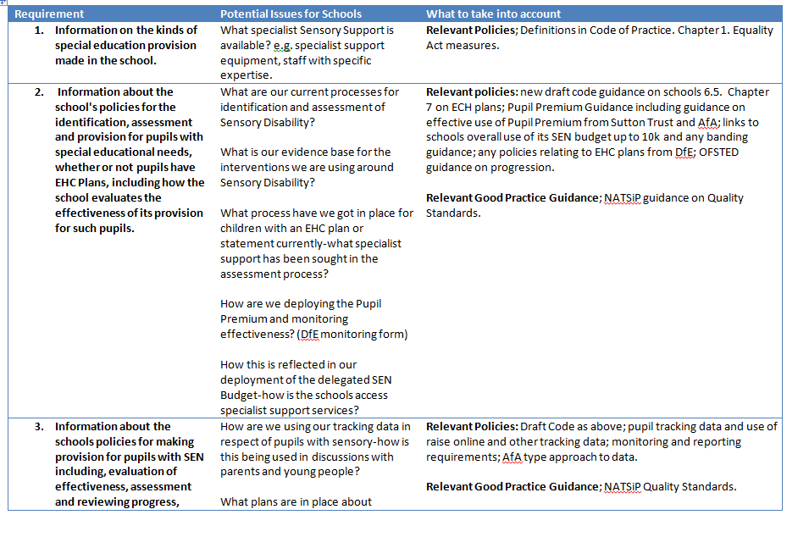

Slide 8
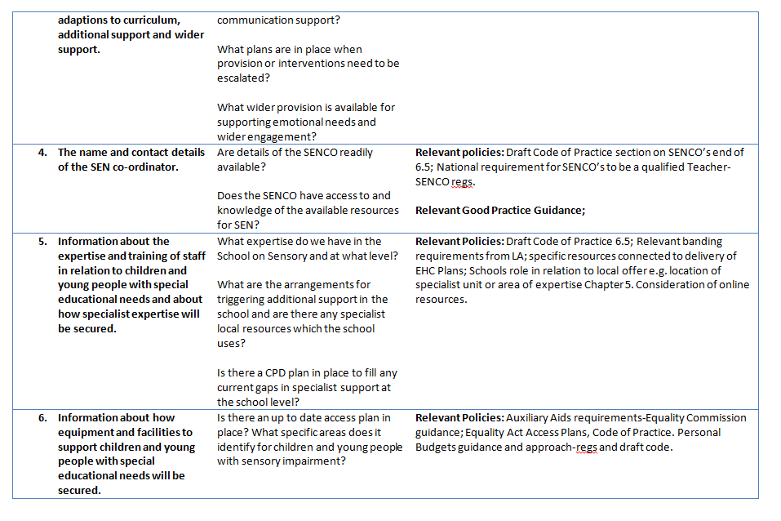

Slide 9
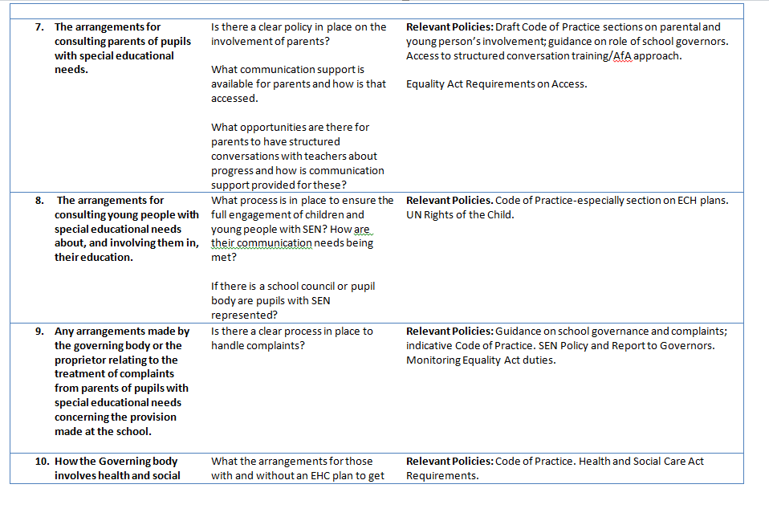

Slide 10


