Slide 1
The Children and Families Act; Making the Vision a Reality for
Children and Young People with Sensory Impairment
Brian Lamb

Slide 2
What is driving the Reforms?
Greater focus on Outcomes in SEN:
“We know that the educational achievement for children with SEN is too low and the gap with their peers too wide.” Lamb Inquiry.
Greater Parental Involvement and Choice:
“The empirical evidence shows that parental involvement is one of the key factors in securing higher student achievement and sustained school performance.” Harris 2006.

Slide 3
What is driving the Reforms?
Move to a more family based system;
Providers must take account of;
“the views, wishes and feelings of the child or young person, and the child’s parents
• the importance of the child or young person, and the child’s parents, participating as fully as possible in decisions; and being provided with the information and support necessary to enable participation in those decisions
• the need to support the child or young person, and the child’s parents, in order to facilitate the development of the child or young person and to help them achieve the best possible educational and other outcomes, preparing them effectively for adulthood” SEND Code of Practice April 2014. (Clause 19)

Slide 4

From this…..?
Statements
IEP’s
School Action Plus
School Action
Welcome to the Special Educational Needs and Disability Maze
Health and Social Care second exit on the right

Slide 5

Leaving parents and children and professionals feeling like this!

Slide 6
To this…..

Slide 7
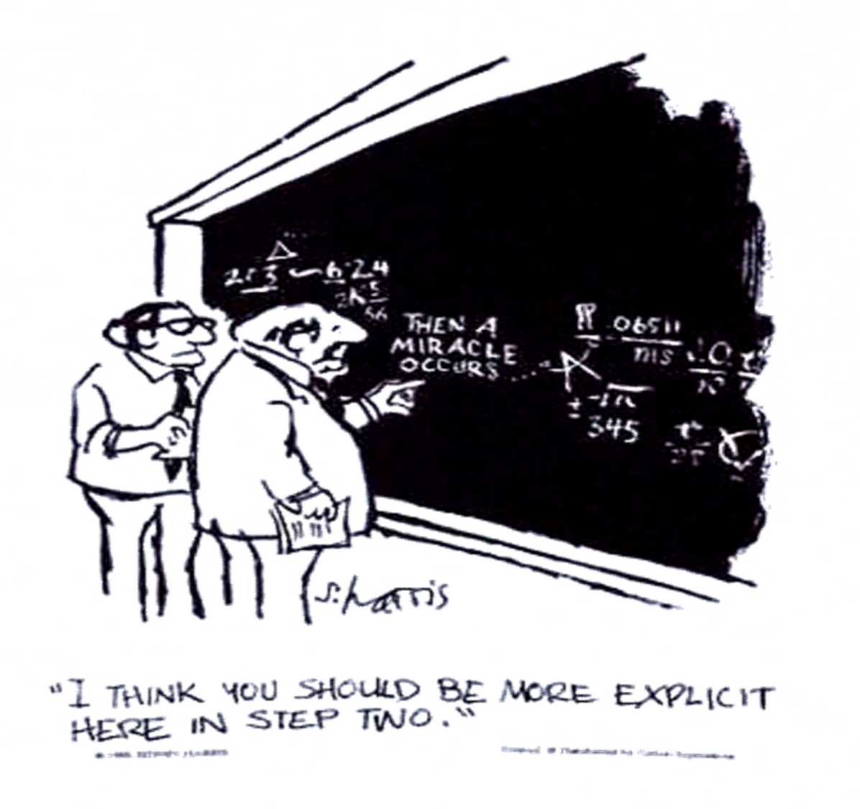
With a little of this…?

Slide 8
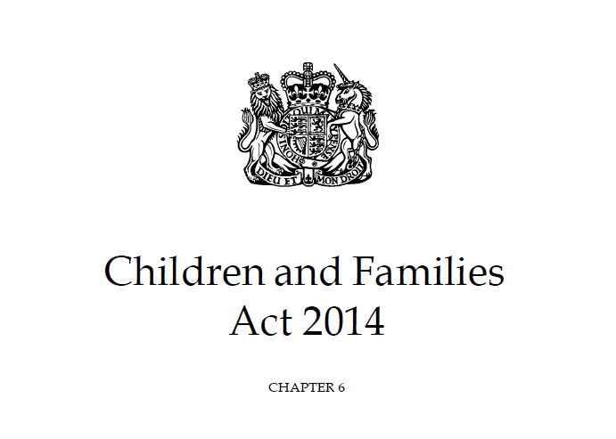

Slide 9
Definition of SEND

Slide 10
Definition
Overall definition of SEN has not changed but broader scope of definition and areas to which disability is included:
“A child or young person has SEN if they have a learning difficulty or disability which calls for special educational provision to be made for him or her.
xii. A child of compulsory school age or a young person has a learning difficulty or disability if he or she:
• has a significantly greater difficulty in learning than the majority of others of the same age, or
• has a disability which prevents or hinders him or her from making use of educational facilities of a kind generally provided for others of the same age in mainstream schools or mainstream post-16 institutions”
CoP April 2014.

Slide 11
Disability; definition and responsibilities
‘…a physical or mental impairment which has a long term and substantial adverse effect on their ability to carry out normal day-to-day activities’.
“This definition includes sensory impairments such as those affecting sight or hearing, and long term health conditions such as asthma, diabetes, epilepsy, and cancer.”
“Where a child or young person requires special educational provision over and above the adjustments, aids and services required by the Equality Act 2010 they will be additionally covered by the SEN definition.”
All aspects of the legislation apart from EHC Plans now include disabled children.

Slide 12
Sensory definition
“Some children and young people require special educational provision because they have a disability which prevents or hinders them from making use of the educational facilities generally provided. These difficulties can be age related and may fluctuate over time. Many children and young people with vision impairment (VI), hearing impairment (HI) or a multi-sensory impairment (MSI) will require specialist support and/or equipment to access their learning.”
CoP 2014

Slide 13
Progression and SEND
Where progress continues to be less than expected the class or subject teacher, working with the SENCO, should assess whether the child has SEN.
This can be characterised by progress which:
is significantly slower than that of their peers starting from the same baseline
fails to match or better the child’s previous rate of progress
fails to close the attainment gap between the child and their peers
widens the attainment gap

Slide 14
Specialist Support
“Where a pupil continues to make less than expected progress, despite evidence-based support and interventions that are matched to the pupil’s area of need, the school should consider involving specialists, including those secured by the school itself or from outside agencies.”
Such specialist services include….,
specialist teachers or support services, including specialist teachers with a mandatory qualification for children with hearing and vision impairment , including multi-sensory impairment, and for those with a physical disability. (Those teaching classes of children with sensory impairment must hold an appropriate qualification approved by the Secretary of State. Teachers working in an advisory role to support such pupils should also hold the appropriate qualification.)”

Slide 15
Structure of Legislation
Individual Duties;
Graduated response
EHC Plans
Personal Budgets
Rights to Tribunal or Health complaints mechanism
Presumption in favour of mainstream schools
Wider approach to Disability enables integration of reasonable adjustments?
Extension to 25
Young people have additional rights to appeal and hold budgets post 16

Slide 16
Strategic Duties
Local Offer
Joint Commissioning within and outside an EHC Plan
Co-operation over delivery of services
Promoting integration of SCP, HCP and SEP-danger of SEN focus being lost?
Review of adequacy of local provision
Not all of these co-operation duties are new but they are strengthened
LA’s identify children with SEND in their area
CCG’s, NHS Trusts and Foundation Trusts must bring to the attention of LA’s children with SEND

Slide 17
Additional SEN Support
What replaces School Action and School Action plus?

Slide 18
Schools Duties
Use their best endeavours to make sure that a child with SEN gets the support they need – this means doing everything they can to meet children and young people’s SEN
Ensure that children and young people with SEN engage in the activities of the school alongside pupils who do not have SEN
Designate a teacher to be responsible for co-ordinating SEN provision (the SEN co-ordinator, or SENCO)
Inform parents when they are making special educational provision for a child
Prepare a report on the implementation of their SEN policy and their arrangements for the admission of disabled children, the steps being taken to prevent disabled children from being treated less favourably than others, the facilities provided to enable access to the school for disabled children and their accessibility plan showing how they plan to improve access progressively over time

Slide 19
Schools Duties
Schools have additional duties under the Special Educational Needs and Disability Regulations 2014. Schools must publish more detailed information about their arrangements for identifying, assessing and making provision for pupils with SEN.
The information must also include information about the arrangements for the admission of disabled pupils, the steps taken to prevent disabled pupils from being treated less favourably than other pupils, the facilities provided to assist access for disabled pupils and the schools’ accessibility plans. The school-specific information should relate to the school’s arrangements for providing a graduated response to children’s SEN. It should elaborate on the information provided at a local authority wide level in the Local Offer.

Slide 20
Graduated Response -
Implementation issues
School Action and School Action Plus: Assess, Plan, Do, Review
Working with teacher and SENCO to establish if there is an SEN need-linked to progress and attainment measured against peers, views of parents and child taken into account
Reviewed against further progress following the interventions which have taken place
Involvement of specialist support if there is no progress, differentiated provision and provision mapping
Consideration of a Plan depending on need and continued lack of progress

Slide 21
The Four Elements
Leadership
Ensure schools maintain a sharp focus on the aspirations, access, and achievement of pupils identified with SEN or vulnerable and disadvantaged pupils
Teaching and Learning
High quality teaching and learning – leading to improved progress for all pupils (assessment and target setting)
Parent and carer Engagement
Structured conversations with parents and carers – to improve parents’ and carers’ engagement with school and their involvement with their child’s learning and achievement
Wider Outcomes
Wider outcomes – to support the participation, enjoyment and achievement of pupils in all elements of school life
Notes:
21

Slide 22
Implementation
Availability of specialist support services/ Specialist Teachers
Capacity of SENCO’s, Teachers and Support Staff
Accessibility of classrooms
Access to and maintenance of equipment
Is low incidence reflected in school planning or LA support?
Flexibility of high needs funding block and schools focus on delegated funds

Slide 23
Education, Health and Care Plan
How Statements are being replaced

Slide 24
EHC Plans and Personalisation
The Education, Health and Care Plan-triggered by an SEN Educational need and Education retain overall responsibility but duty to jointly commission services
20 weeks to complete a plan
Parents and young people must be consulted at each stage
Jointly commissioned-dispute resolution procedures between providers must be in place
Focus on Outcomes first then provision to meet these objectives-clearer format for plans in latest CoP
Mediation for Education, Health and Social Care
Tribunal for Education, Health Complaints procedure
Health and Social Care requirements are not the same as Education

Slide 25
Who is involved?
“The local authority must gather advice from relevant professionals about the child or young person’s education, health and care needs, desired outcomes and special educational, health and care provision that may be required to meet identified needs and achieve desired outcomes.”
“If the child or young person is either visually or hearing impaired, or both, the educational advice and information must be given after consultation with a person who is qualified to teach pupils or students with these impairments.”
CoP 2014

Slide 26
EHC personal budgets
Once an LA confirms a plan is necessary, a parent or young person can request an EHC personal budget. This is an amount of money identified to achieve outcomes agreed in an EHC plan.
It may be managed in three ways:
  The local authority manages the funds and commissions the support specified in the EHC plan (sometimes called “notional arrangements”).
  The funds are paid to a third party to manage on behalf of the parent or young person.
  The funds are paid to the parent or young person as a direct payment, and they buy the provision specified in the plan.
An EHC personal budget should cover only the special individualised provision made available through the EHC plan.
Notes:
An EHC personal budget should not, for example, cover a school place.

Slide 27
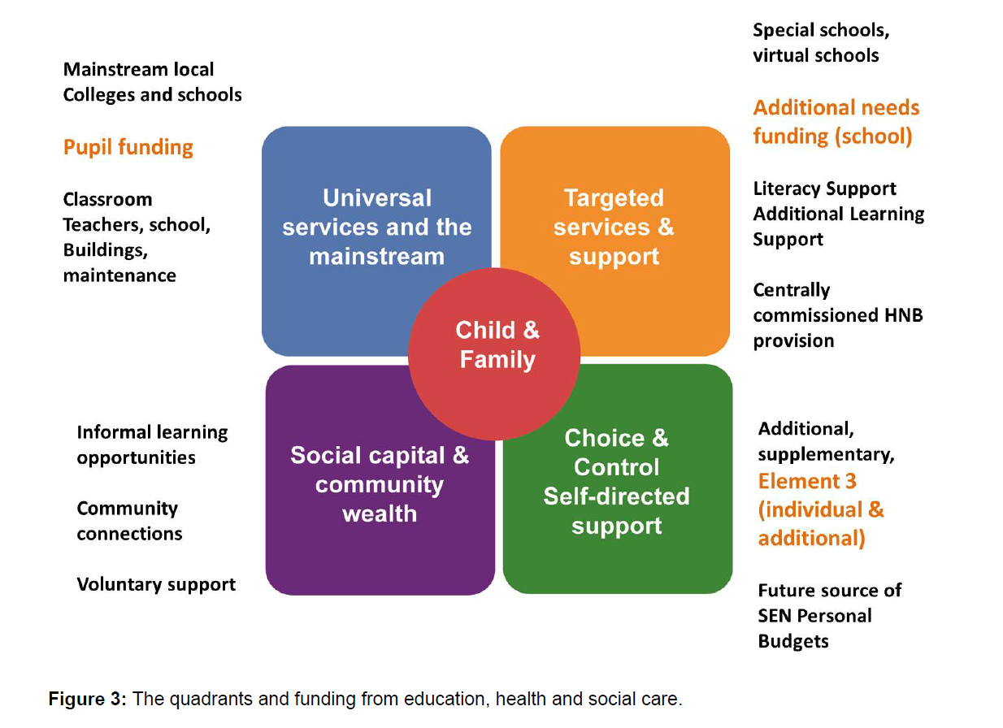
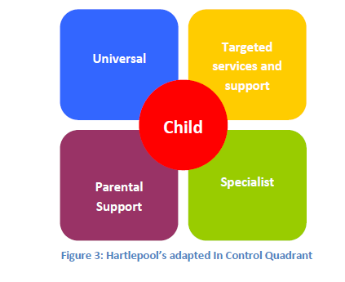
DfE-In Control Model

Slide 28
Implementation Issues
New process in place in time for September 2014
3 Years and two terms to implement
How to handle those children who already have a statement-up to three years to make the transition?
Address at review points-secondary transfer, post 16 transfer, or annual review?
Provision mapping and what comes out of high needs block-conversation with schools about delegated budgets
Ensuring specialist support and advice is available
Integration with health and social care-therapy and mental health services
Post 16 Commissioning-continuance of “LAG” funding issues
Joint Commissioning-how far are health and social care now involved in process-need to have dispute resolution procedure in place

Slide 29
the local offer
Addressing confidence in the SEN system/Changing the culture of provision?

Slide 30
Local Offer
Parents, children and young people must be involved developing the local offer: co-production of the offer with parents and young people,
It must set out what families can expect from local services and where they have eligibility criteria and/or thresholds for accessing services,
What services are available to support those without Education, Health and Care Plans, including what children, young people and parents can expect schools and colleges, to provide from their delegated funds
What specialist support is available and how to access it and to give details of where parents and young people can go for information, advice and support.
Each service will be accountable for delivering what is set out in the local offer and if families are unhappy with what they receive or what is available they will be able to take this up with those services
The local offer will give details of how to complain about provision and about rights of appeal.
It must be reviewed and action taken on comments made by parents or young people

Slide 31
Local Offer Schools must include
Information about the arrangements in place for:
identifying the particular SEN of children and young people
approaches to teaching, adaptations to curriculum, the learning environment and access to ancillary aids and assistive technology,
assessing and reviewing pupils’ and students’ progress towards outcomes, including how they work with parents and young people in doing so
securing the services, provision and equipment required by children and young people with SEN or disabilities
securing expertise among teachers, lecturers or other professionals to support children and young people with SEN or disabilities – this should include professional development to secure expertise at different levels

Slide 32
Local Offer Schools
awareness (to give a basic awareness of a particular type of SEN, appropriate for all staff who will come into contact with a child or young person with that type of SEN)
enhanced (how to adapt teaching and learning to meet a particular type of SEN, for early years practitioners, class and subject teachers/lecturers and teaching assistants working directly with the child or young person on a regular basis), and
specialist (in-depth training about a particular type of SEN, for staff who will be advising and supporting those with enhanced-level skills and knowledge)
assessing and evaluating the effectiveness of the education and training provision they make for children and young people with SEN or disabilities

Slide 33
Implementation Issues
Schools focus on their offer
Link with LA Local Offer
How specialist sensory services are represented in the Local and Schools based offer

Slide 34
Post 16 new challenges?

Slide 35
FE Duties
The duty to co-operate with the local authority on arrangements for children and young people with SEN. This is a reciprocal duty.
The duty to admit a young person if the institution is named in an Education Health and Care (EHC) plan. Young people have the right to request that an institution is named in their EHC plan, and local authorities have a duty to name that institution in the EHC plan
The duty to have regard to the Code of Practice
The duty to use their best endeavours to secure the special educational provision that the young person needs. This duty applies to further education colleges, sixth form colleges and 16-19 academies. It does not apply to independent specialist colleges or special schools, as their principal purpose is to provide for young people with SEN

Slide 36
The Elephant in the Room.. resources?

Slide 37
Not lose sight of the Aim
Children and young adults with Sensory Impairments achieve better outcomes and attainment
Parents have more confidence in the system
Resources get used in right places to deliver this

Slide 38
Important Links
http://www.education.gov.uk/childrenandyoungpeople/sen/a0075339/sengreenpaper
http://www.education.gov.uk/a00221161/children-families-bill
https://www.gov.uk/government/news/landmark-children-and-families-act-2014-gains-royal-assent
http://www.afa3as.org.uk/
http://webarchive.nationalarchives.gov.uk/20091207163458/dcsf.gov.uk/lambinquiry/
http://www.education.gov.uk/complexneeds/
http://www.sendpathfinder.co.uk/
http://www.official-documents.gov.uk/document/cm84/8438/8438.pdf
http://educationendowmentfoundation.org.uk/toolkit/

Slide 39
Contact Details
Brian.publicaffairs@gmail.com

