Slide 1


Lessons learned from the Special Educational Needs and Disability Pathfinder Programme
Meera Craston and Kathryn Lupton (nee Hill), SQW
1st October 2014 – NatSIP National Working Day

Slide 2
An introduction to the Evaluation
Evaluation led by SQW, in association with Ipsos MORI, OPM & BPSR
Commissioned by the Department for Education in September 2011
Original aims of the evaluation were to consider if the pathfinders…
  Increase real choice and control, and improve outcomes for families from a range of backgrounds with children and young people with SEN and disabilities
  Make the current support system for children and young people with SEN and disabilities, and their parents or carers more transparent, less adversarial and less bureaucratic
  Introduce greater independence into the assessment process by using the voluntary sector
  Demonstrate the value for money by looking at the cost of reform and benefits
…and, was a need to comprehensively understand the processes and approaches that were developed to deliver the new system

Slide 3
Evaluation undertaken in two phases…
Phase One (Sept 11 – July 13)
Evaluated activity undertaken over first 18 months of the programme
Focus
Understanding approaches adopted to deliver the new processes
Approaches used
Area case studies
Collection of monitoring data
Assessing experiences and outcomes of initial cohort of participating families
Parent carer survey
Qualitative in-depth work with participating families
Staff work and satisfaction survey
Phase two (Jun 13 – Mar 15)
Evaluating activity undertaken in second 18 months of the programme
Approaches being used
Thematic case studies
Second parent carer survey
Understand progress made as transition from initial trials to roll out
Focus
Assess experiences and outcomes of second cohort of participating families
Qualitative in-depth work with participating families
England wide survey to assess readiness to meet the reforms

Slide 4
Learning from the ongoing second phase…

Slide 5
Thematic case studies
Sept-Dec 13 - published
  The Education, Health and Care (EHC) Planning Pathway
  Key working Part I
Jan-Mar 14 - published
  Understanding the comparative costs of delivering the EHC planning and SEN Statementing processes
  Collaborative working with health
  Collaborative working with social care
  Engagement of schools
  Transition and the engagement of post-16 providers
Jun-Sept 14 – draft reports submitted to DfE
  Personal budgets and integrated resourcing
  Key working and workforce development Part II
  The Local Offer
  Provision for Older Young People aged 19-25

Slide 6
Comparative cost research – our approach
Data gathered from 5 areas over course of Jan-Mar 14
Two focus groups with operational staff held in each, looking at costs of delivering the Statement and EHC plan
Discussed two hypothetical cases
2. Who is involved at each stage?
4. How much time is spent delivering each task?
3. How is each individual involved?
Identify frontline and back office staff involved in delivery
1. How are the two processes delivered?
Key stages
Sequencing
Identify the set of tasks undertaken by each member of staff
Estimate no of hours spent by all involved on each task
5. What are the monetary costs associated with the estimated inputs?
Monetise inputs using salary data
6. Comparison of costs of delivery of the new and traditional processes
EHC Planning Pathway for Newcomers to the SEN System thematic work
Additional comparative cost research

Slide 7
Quick recap on the Statement and EHC planning pathways...
Referral
Consider whether an assessment is necessary
Statutory/Coordinated assessment
Consider whether to proceed with a Statement/EHC plan
Development of Statement/EHC action plan
Sign-off
Common pathway identified with similar stages and sequencing of these…

Slide 8
Comparative cost research – key findings
Costs of delivery
Varied considerably for both SEN Statement and EHC planning processes across the areas
Direction of change
Inconsistency in direction of change between costs of delivering the two processes
Reasons for change
Limit any comparison between delivery of two processes to within area and not across areas
However, more estimated an increase in cost from the SEN Statement to the EHC plan
Reduction in time appeared to be associated assessments being undertaken prior to referral – and therefore not costed
No consistent relationship between changing time contributions of specialist health or social care professionals
Change in overall delivery time directly related in all cases to the change in contribution from the SEN team/s
Common findings across the areas…
Assessment stage tended to take less time in the EHC planning process relative to the SEN Statementing process
Development of an EHC plan took longer than an SEN Statement
EHC planning process involved a more family-focused and multi-agency approach, which tended to require more time to facilitate

Slide 9
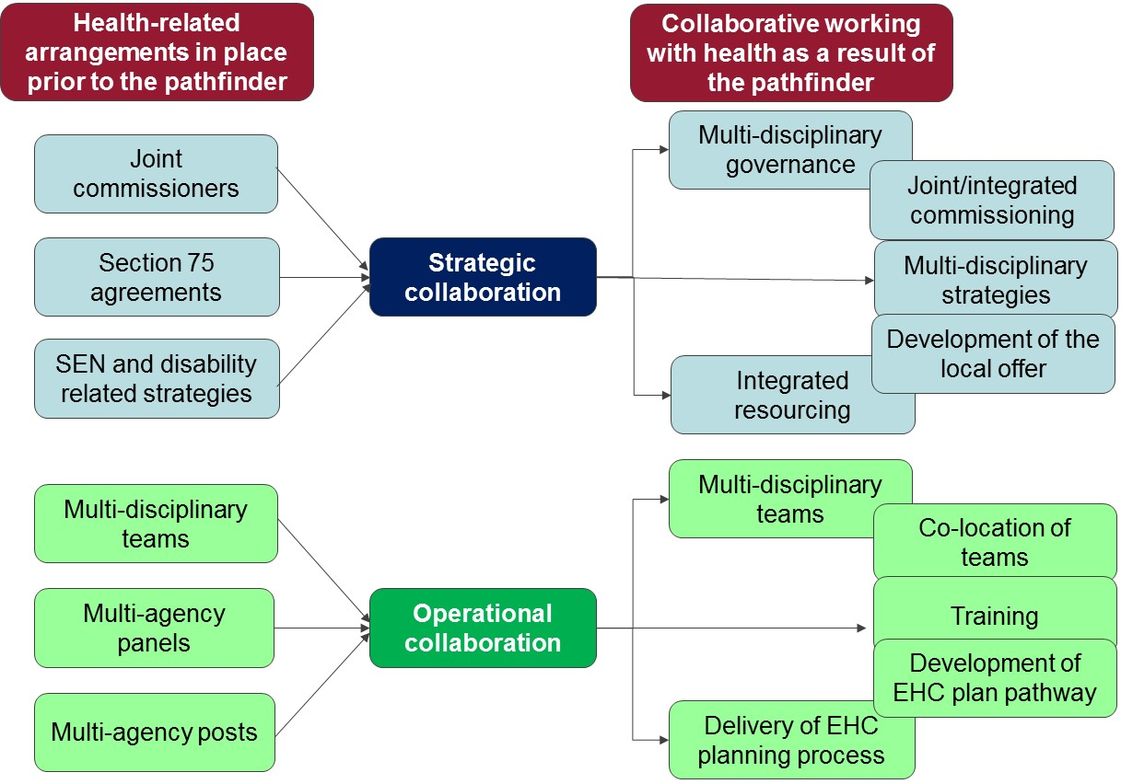
Collaborative working with health – key findings
Evidence gathered from strategic and operational staff from across health, social care and SEN in four pathfinder areas
Diverse range of approaches developed, majority of which were strategic and had not yet been fully operationalised

Slide 10
Collaborative working with health – challenges
Remaining challenges
Engagement of adult health commissioners and operational health professionals
Engagement of the wider health workforce and workforce development
Keeping CCGs engaged
Information sharing
Creation of pooled budgets and personal health budgets
Ensuring sufficient capacity build into the system

Slide 11



Collaborative working with social care
Evidence gathered from strategic and operational staff from across health, social care and SEN in five pathfinder areas
Many of the findings similar to the health thematic…so instead illustrate differences between inputs into old and new processes…
Stage | Involvement in EHC planning process | Involvement in statementing process | Implications of the introduction of the new process
Referral | Children’s or adult social worker may act as referrer or support referral Social care managers may be involved in the decision of whether to proceed to statutory assessment through position on multi-agency panel | Children’s social care professionals unlikely to refer families into process | Increased involvement of professionals at referrals expected to lead to: Earlier identification of new cases An additional cost associated with involvement of social care managers in decision making
Co-ordinated assessment | Across some areas a children’s or adult social worker may act in the ‘key worker’ role, which ranged from acting as the named contact to a process coordinator Social care also encouraged to develop suggested outcomes in relation to the child/young person’s special educational need while developing their existing assessments and may participate in a new Team Around the Child (TAC) meeting as appropriate | Children’s social worker would feed in assessment information relevant to the child/young person’s special educational need where available (i.e. where child known to children’s social care) | More consistent and comprehensive involvement of social care professionals expected to lead to: More comprehensive evidence base for planning Potential identification of previously unmet social care need May involve more social care time attending meetings, or may be incorporated into existing assessment time
Planning | Children’s or adult social worker may feed into planning process through attendance at a TAC meeting They may also facilitate the TAC and write the plan in some areas, if they are operating in the key working role | Neither children’s nor adult social care professionals are likely to be involved at this stage | Social care involvement in planning expected to lead to: More holistic and appropriate plans with increased focus on outcomes beyond the school day Increased social care time associated with delivery
Sign off/ resourcing | Adult and children’s social care managers likely to be involved in sign off through their positions on multi-agency panels Areas tended to be in the relatively early stages of signing off jointly resourced plans implying this stage in the process requires further testing | Neither children’s nor adult social care professionals are likely to be involved at this stage | Social care responsibility for agreeing and delivering the social care content of EHC plans expected to lead to: Increased social care involvement in decision making and sign off of plans linked Increased social care time associated with delivery

Slide 12
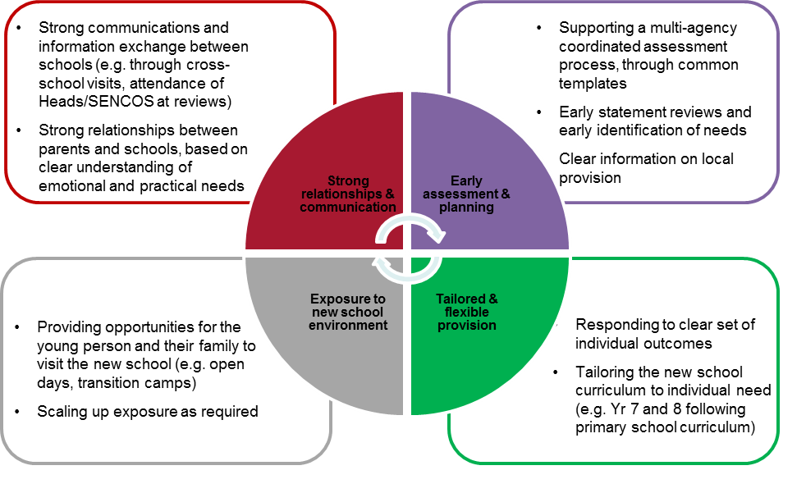
Engagement of schools in the reforms
Research focused on primary-secondary transition for children with an SEN statement – good practice highlighted, in terms of:
But also wide variation between schools - reforms provide a good opportunity to address:
  Evaluate (and revise) systems between schools
  Fresh dialogue with Local Authority staff
  Identify best practice – what works in terms of transition

Slide 13
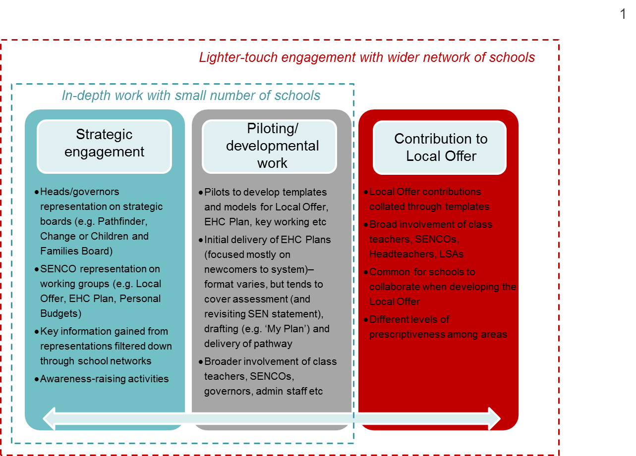
How have schools been engaged?
Schools to play a key role in implementing the reforms, particularly in terms of delivering EHC plans and translations
Schools need awareness, skills and capacity to do so:
  Important to use a blend of awareness-raising and developmental work
  Still some gaps in knowledge (e.g. personal budgets, teaching staff)
  Concerns about capacity and scalability – particularly given need to undertake translations

Slide 14
Engagement of post-16 providers in the reforms
Research again focused on transition (school to further provision) - greater engagement as fewer providers, though still mixed
Recognition that reforms will improve previous LDAs, through focus on longer term outcomes of employment and independent living… but number of issues to be ironed out to achieve these outcomes
GFECs
Significant workforce issues – increased capacity and upskilling to respond to increased enrollments
Young people and parents
Greater say in their transition – may lead to tensions with families where views differ
ISPs
Sensitive discussions required with ISPs to explain the changes and underlying rationale
Behavioural issues – staff need to be skilled in how to deal with such issues
Increased aspirations about future options (e.g. employment and independent living) – opens up discussion about suitable local provision
Need to develop wider provision – in collaboration with local authorities.
The Pathfinders had in some cases sought to encourage ISPs to change their day offer – e.g. offering part of the 5-day week
And longer term challenges…
  Need to get non-education providers on board (e.g. work providers)
  Market development – for example, where college provision is not close to where young people live
  Readiness to use personal budgets is still limited

Slide 15
Contact
Meera Craston
Director
SQW
t. 020 7391 4112
e. mcraston@sqw.co.uk
w. www.sqw.co.uk
Kathryn Lupton (nee Hill)
Senior Consultant
SQW
t. 020 7391 4116
e. klupton@sqw.co.uk
w. www.sqw.co.uk
Access the pathfinder evaluation reports here:
http://www.sqw.co.uk/expertise/personalisation-changing-public-services/
https://www.gov.uk/government/publications/send-pathways-programme-evaluation

