Slide 1


SEN and Disability Reforms – young people
October 2014

Slide 2

Recap: the current system of SEND support is complicated, expensive and delivers poor outcomes.
Parents struggle to find the services that should be helping them, have to battle to get the help their children need, and have to tell their stories time and again.
Moving from children’s to adults’ services can be very difficult.
English LAs spend over £5 billion a year on SEND provision, and yet those with special needs are far more likely to achieve poorly at GCSE, Not be in Education, Employment or Training, or be unemployed.
These issues affect a lot of people: 1 in 5 children are currently identified as having some form of SEND, with 2.8% having a more complex need.

Slide 3





Vision: children and young people with special needs and disabilities to achieve well in their early years, at school and in college; find employment; lead happy and fulfilled lives; and have choice and control over their support.
The reforms will implement a new approach which seeks to join up help across education, health and care, from birth to 25. Help will be offered at the earliest possible point, with children and young people with SEND and their parents or carers fully involved in decisions about their support and what they want to achieve. This will help lead to better outcomes and more efficient ways of working.

Slide 4
Children and young people at the centre
Where disagreements happen, they can be resolved early and amicably, with the option of a Tribunal for those that need it
Children, young people and parents understand a joined up system, designed around their needs
Enablers
Joint commissioning
Better disagreement resolution processes
Outcomes
Local offer
Having friends
Positive Wellbeing
Employment prospects
0-25
Children and young people with SEND
and families
Information, advice and support
Making their
views heard
Good qualifications
Option of a Personal Budget
Integrated assessment and planning
Education Health and Care Plan is holistic, co-produced, focused on outcomes, and is delivered
Extending choice and control over their support.

Slide 5

What the reforms mean for young people
A bigger say in decision making:
  in developing and reviewing the local offer so it is accessible and more responsive to local needs
  in requesting an EHC needs assessment
  In requesting a particular school or college and a personal budget for their support – for those with EHC plans
  In appealing to a Tribunal if they are unhappy with the decisions of their local authority – on EHC assessments and plans
Access to impartial information, advice and support
Responsive support from colleges who must use their best endeavours to ensure that young people get the support they need
Joined up support across education, health and care - with an EHC plan replacing statements and Learning Difficulty Assessments and running up to age 25 where needed

Slide 6
The legal framework and implementation
Children and Families Act 2014, Regulations and Special Educational Needs and Disability Code of Practice in force from 1 Sept 2014
Transitional arrangements in place to move from the old to the new system gradually - LDAs by Sept 2016 and statements by April 2018 – guidance issued August 2014
Implementation packs sent to LAs, CCGs in July and September and tailored materials provided for schools, and soon…colleges
Short guides to the Code of Practice published September 2014 for health professionals, social care practitioners, early years, schools, FE colleges
Materials published for parents and carers and young people
Easy read materials to be published in November 2014
April 2015 – Regulations and guidance on young people in custody and Care Act provisions come into force

Slide 7
Managing the transition to the new system (1)
All new requests for assessments from 1 September 2014 will be treated as Education Health and Care needs assessments
Local authorities should aim to make the new arrangements for all Children and young people as quickly as they can.
Local authorities must publish a transition plan in Sept 2014 setting out how they will do this and publish a report on progress annually.
Statements must be transferred to EHC plans by 1 April 2018.
All young people who receive support as a result of a Learning Difficulty Assessment who are continuing in Further Education or training beyond 1 Sept 2016 who need an EHC plan should have one by 1 Sept 2016.

Slide 8
Managing the transition to the new system (2)
Phasing of transfers
Requirements between Sept 2014 and Sept 2015:
Young People who receive support as a result of a LDA who request an EHC needs assessment;
Young People moving into Further Education or training from school in Sept 2015 (by 31 May 2015; by 31 March subsequently)
Other priorities:
Those issued with EHC plans prior to Sept 2014 who do not have statements
Those facing key transition points – such as entry to primary school, primary to secondary school, and secondary school to FE- and at year 9

Slide 9
Support offer 2014-15
£70 million SEND reform grant plus funding for new burdens (£45.2m in 2014-15)
Up to £900,000 for pathfinder champions 2014-15; delivery partner contracts extended; VCS grants
Increased funding for parent carer forums
Support for parents and young people through 1,800 Independent Supporters
Nasen SENDgateway providing a one-stop shop for resources
For FE: funding bursaries of up to £9,000 for high calibre graduates to train as specialist SEND teachers (2013-14 and 2014-15)
Minimum of two champion one-to-one support days to each LA; plus support days from delivery partners

Slide 10
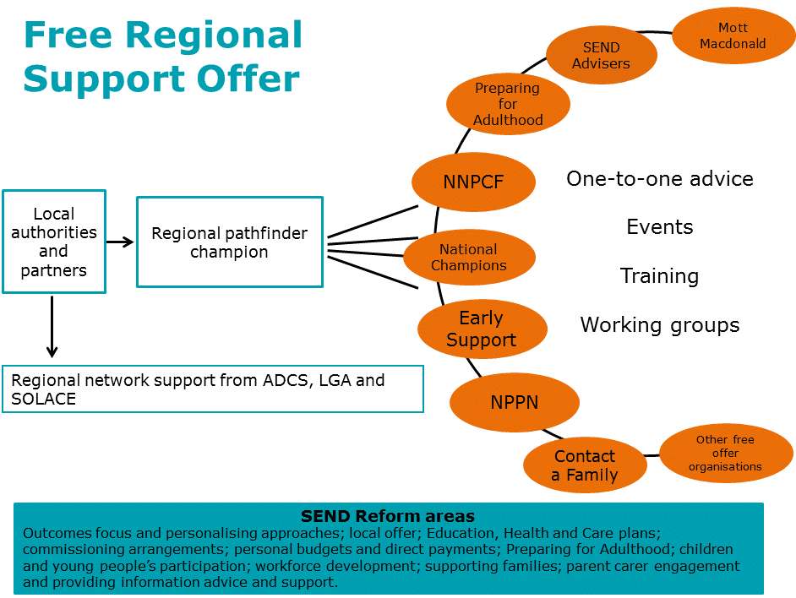

Slide 11
Implementation challenges
Ensuring the full engagement of parents and especially children and young people
Engaging partners at a strategic level across education, health and care and the full 0-25 age range
Defining outcomes and provision clearly in EHC plans
Managing the transition to the new system
Communicating well - coordinating messages to parents, young people and professionals - so that they are tailored, consistent, well-timed and not overwhelming
Achieving the culture change the reforms will require if they are to have a real impact on the ground

