Slide 1
INSET
Northumberland Sensory Support Service
Data Dashboard
Nicola Taylor
Service Manager

Slide 2
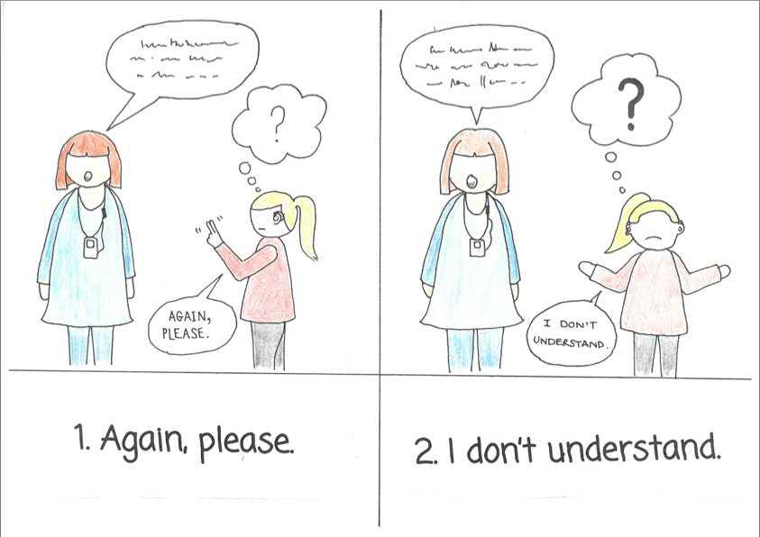
The world of data??

Slide 3
The context
A changing landscape:
Increased accountability
Are we measuring outcomes and how?
Are we providing ‘value for money’?
Are we a cost effective service?
Traded services - how should we prepare?

Slide 4
Sources of information
Sensory Support register
Sensory Support specialist assessment database
Local Authority data unit
NatSIP benchmarking exercise and reports
Schools
Annual Service Stakeholder Audit
LA SEND Team
Quality Standards Document
NatSIP Quality Improvement Pack (June 16)

Slide 5
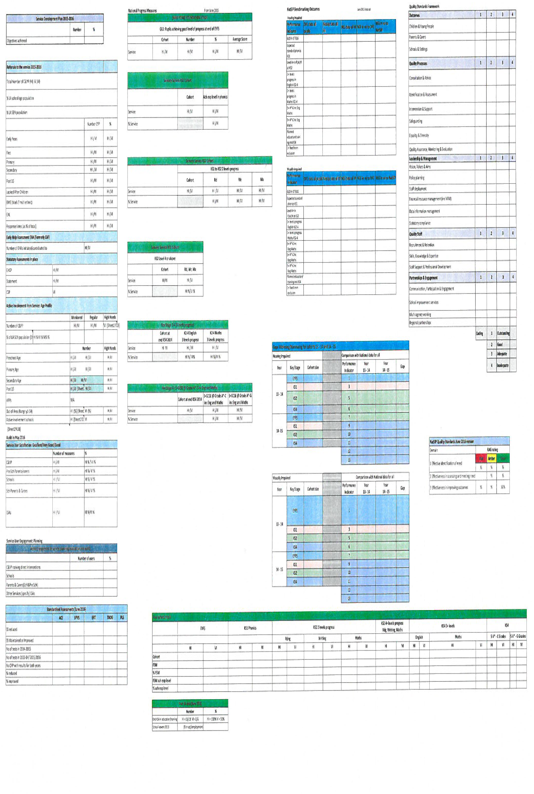

Slide 6
The dashboard
Data around service numbers and activity
2015-2016
(includes progress on standardised assessments)
Data around attainment and outcomes for cohort 2014-2015
Comparison over 2 years
Data around service self evaluation for academic year 2015-2016
Dashboard - Summary of service activity and impact

Slide 7
Service Activity
Hard data around:
Referrals
Early Help Assessment (EHA)
Statutory Assessments (includes any High Needs application ie top up funding, EHCP assessment, CSP)
Age profile of CYP with active involvement (regular and monitored CYP)
Out of County placements
Service User satisfaction
Standardised assessment results for HICYP, comparisons from 2014-15 to 2015-16

Slide 8
Attainment and Outcomes
Data on attainment of SICYP submitted for NatSIP benchmarking report for cohort June 2015
EYFS
KS1 Phonics
KS2
KS4
Comparative Northumberland outcomes data with NatSIP and National across 9 Performance Indicators
RAG rating for comparison
Green: Northumberland cohort matches or exceeds national figure
Amber: Northumberland cohort is within 10% of national figure
Red: Northumberland cohort is >10% poorer than national figure
Widening/Narrowing gaps over 2 year period

Slide 9
Service Self Evaluation
Data relevant to the process of self evaluation (management and whole staff) with regard to:
Quality Standards Framework
Outcomes
Quality Processes
Leadership and Management
Quality Staff
Partnerships and Engagement
NatSIP Quality Standards (June 2016)
Effective identification of need
Effectiveness in assessing and meeting the need
Effectiveness in improving outcomes

Slide 10

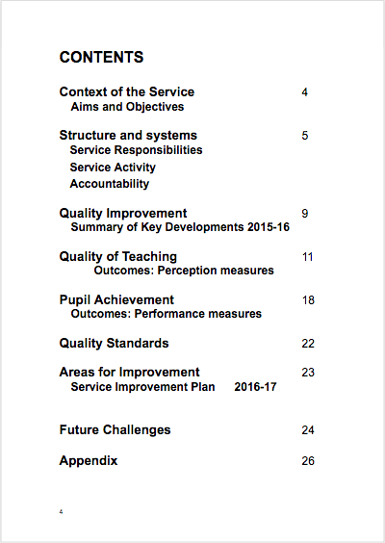
How do we use it?
To demonstrate impact - narrowing the gap??
To allow consideration of data within County context
To allow scrutiny of outcomes, identifying trends
To inform Service Development Plans
To inform the SEF

Slide 11
Contact:
For more information, please contact:
Nicola Taylor
Service Manager
Sensory Support Service
Riverside Centre
Armstrong way
Ashington
Northumberland
NE63 0YD
T: 01670 624854
E: nicola.taylor@northumberland.gov.uk

