Slide 1

NatSIP HoSS Conference October 2016
Funding Changes and SI Services
Brian Gale
Director of Policy and Campaigns

Slide 2
Currently
Dedicated Schools Grant with 3 blocks:
Early Years Block: £2,742 million
Schools Block - funding delegated to schools: £32,650 million
High Needs Block: £5,300 million
(Also the Education Support Grant outside the DSG)

Slide 3
HNB pays for
SEN support services, e.g. ToD
Special schools and resourced provision,
Alternative provision,
Top up payments for children 0-16
Post 16 HN students
HN = additional provision required cost more than £6,000

Slide 4

Pay attention
When the DfE established the HNB in 2012/13 all of the funding for support services was transferred into the HNB to support children with and without statutory plans.
LAs cannot claim schools are double funded

Slide 5
Currently
The allocation of the 3 blocks to LAs is based on historic spend rather than need.
DSG is ring fenced but LAs can move money between the 3 blocks
For example if more pupils attend special schools money could be moved from the schools block to fund it.

Slide 6

The changes
Spending review highlights
Early Years and SEN funding
Post 16 and Apprenticeships

Slide 7
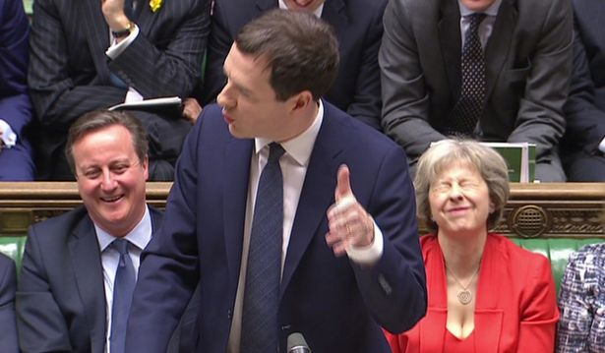
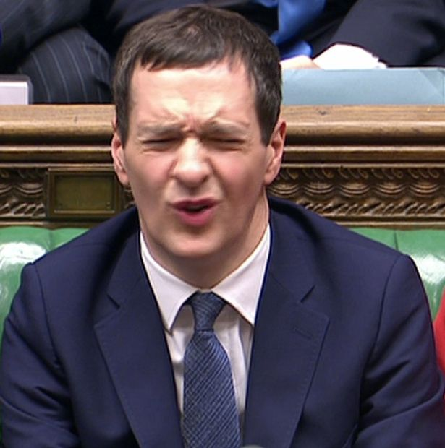
The spending review

Slide 8
Spending review
Total schools budget including pre-16 HNB is protected and increased in line with the GDP deflator (but does the GDP deflator reflect the real inflationary pressures?)
High Needs Allocation to LAs increases slightly in 2016/17 by £90m

Slide 9
HNB pressures 2012-2015
12% increase in under 5 in special schools (6051 in 2015)
5-10 years: in mainstream increased by 8% but 21% increase in special (27,905 to 33,684
11-15 years: in mainstream decreased by 3% but an increase in 1% in special to 50,923

Slide 10
Spending Review
Commitment to introduce national funding formulae for schools, high needs and early years from 2017/18 (now delayed until 2018/19)
£23 billion capital investment over 5 years – 500 free schools, 600,000 additional places and more places in special schools

Slide 11
Spending Review
For 16-19 years national base rate per student protected. Savings from post 16 demography
Big increases in childcare and apprenticeships big decrease in DSA
£600m cut to ESG
Schools commission AP

Slide 12
Spending Review Early Years
£1 billion extra by 2019-20 pays for:
  Doubling of entitlement for parents working more than 16 hours
  Uplift of general funding rates
EY pupil premium retained at 53p per hour
Pilots: Wigan, Staffs, Swindon, Portsmouth, Northumberland, York, Newham and Herts

Slide 13


Current EY funding allocation per hour
Darlington £3.92 | Sunderland £5.39

Slide 14
Allocation to LAs
Introduce a funding formula:
Universal base rate (89.5%)
Additional needs factor - FSM eligibility (8) EAL (1.5 %) and DLA (1%)
Area cost adjustment

Slide 15
Darlington’s new allocation
£3,900,000 universal
£431,000 for FSM
£19k for EAL
£51k for DLA
TOTAL 4.4million
Average hourly rate £4.44 (compared with £4.17)

Slide 16
Allocation to LAs
75% of LAs will gain
Temporary transitions relief for those losing – no more than a 10% reduction on the 2016/17 baseline

Slide 17
Gains and losses examples
Hounslow 46%, Richmond 43% Middlesbrough 38%, N Tyneside +19%, Solihull 36%
Losers around 10%: Inner London e.g. Islington, Hackney, Tower Hamlets, Camden
Also Suffolk, Sunderland, Bristol, Bradford

Slide 18
LA role
Limits imposed on how much money LAs can retain for central functions at 5% (a possible issue for LAs funding SEN from the EY block)
Universal base rate for all types of provider
Simpler local formula for distributing the money

Slide 19
EY SEN
Introduce disability access fund. Providers will automatically receive additional funding for every child in receipt of Disability Living Allowance
But only £12.5m just over 1% of the extra 1 billion promised

Slide 20
EY SEN
LAs are encouraged to build on existing good practice by creating SEN inclusion funds
Most have them already. It is the pressure on the HNB that is the main issue

Slide 21
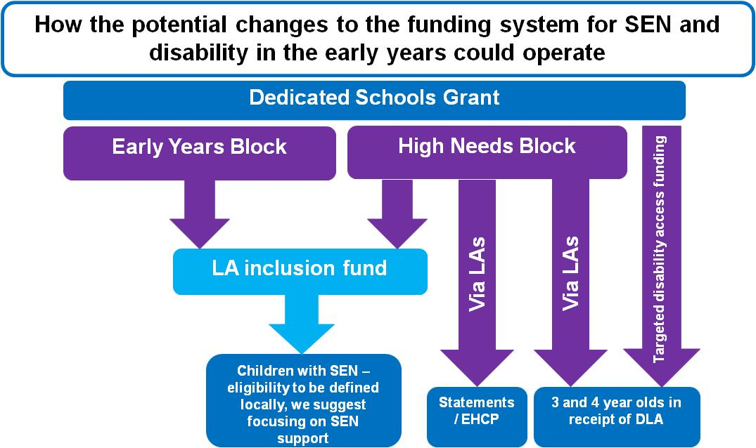
Clarify funding route
21

Slide 22
SEN support services
“Where LAs wish to use part of their inclusion fund to support local services, for example specialist services, we believe that they must be able to continue to do so. Some of these services may be delivered to LAs to providers free at the point of use.

Slide 23
Where this is the case we are minded that such services would not be considered as part of the 95% of funding, which must be passed through to providers, although we welcome view on this. LAs may wish to move to offering more of these specialist services with a charge to providers”.

Slide 24
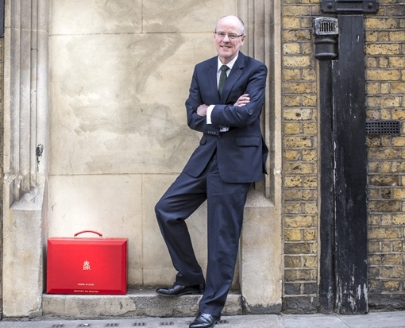
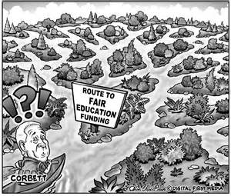
Changes to SEND funding

Slide 25

HNB distribution to LAs
“Negotiations over a shrinking pie are especially difficult because they require an allocation of losses. People tend to be much more easy going when they bargain over an expanding pie”.
Prof D Kahnman

Slide 26
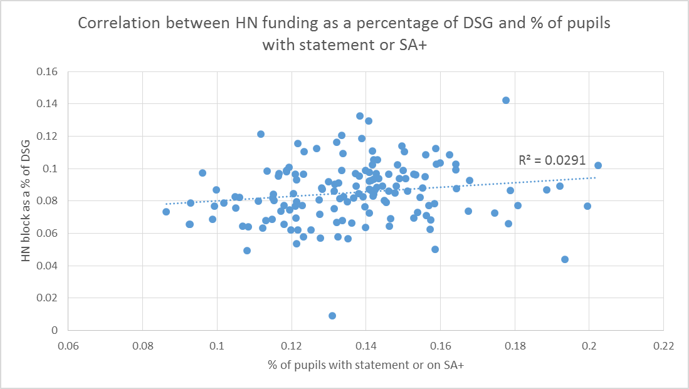
HNB vs statements/SA+

Slide 27


Slide 28


Funding per statement and SA+
Worcestershire £4,400 | Kensington and Chelsea £15,500

Slide 29
Proposed formula
Attainment: pupils not achieving level 2 in reading at end of KS2
Health and disability: children not in good health and DLA
Deprivation: FSM
Number aged 2-18 years
Plus area cost adjustment
No special factors /allowances

Slide 30


So LA winners and LA losers

Slide 31
The losers
Faced with an immense challenge
Difficult to reduce spending on those with EHC Plans
New cohort of children with high needs could be substantially disadvantaged
Possible threat to support services!
Therefore level up not down

Slide 32

What is fair funding

Slide 33
Transitions
DfE will include an element of current spend in the formula for at least 5 years
Limits on year on year reductions with a minimum funding guarantee

Slide 34
Interdependencies of the blocks
Fair funding just cannot take the schools block and HNB in isolation
Two LAs X and Y identical in every way apart from X having 100 pupils more in special schools
X needs £1m more (110 x £10k place funding) in HNB and £1m less in SB

Slide 35
SB ring fenced?
Major concern that this will put immense pressure on the HNB and create an incentive for schools as a whole to be less inclusive as the export funding pressures to LAs without it impacting on their budgets

Slide 36
Possibilities
HIGH NEEDS BLOCK GAIN SCHOOLS BLOCK LOSE | HIGH NEED BLOCK LOSE SCHOOLS BLOCK GAIN
HIGH NEEDS BLOCK GAIN SCHOOL BLOCK GAIN | HIGH NEEDS BLOCK LOSE SCHOOLS BLOCK LOSE

Slide 37
School / college level
Retain the notional SEN budget for schools
More national guidance on what should be included in the schools offer?
LAs have a role in supporting inclusion

Slide 38
SEN units
Current | Proposed
£10k place funding Plus top up | Per pupil amount based on a pupil count Plus £6,000 for each place Plus top up

Slide 39
Post 16 providers
Strong opposition from the AoC to the proposal that FE colleges like schools pay the first £6k toward the cost of a HN student
Now likely that in most cases the HNB will pay for the full additional cost for large providers with significant numbers

Slide 40
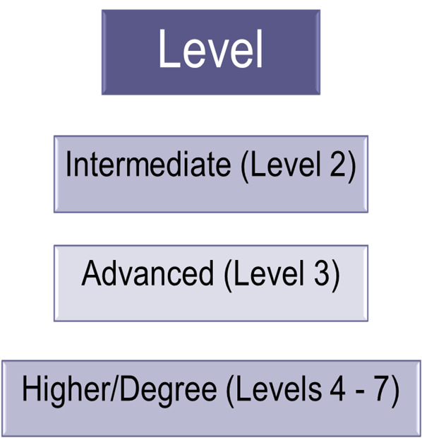

Apprenticeships – what is involved?

Slide 41
How is apprenticeship training funded?
Full funding from Skills Funding Agency for the training of those aged 16-18 and 19-24 with EHC plans
Partial funding for 19-24 year olds. Partial funding from employer.

Slide 42
Apprenticeship levy
New digital system from 2017
Employers will receive digital vouchers to spend on apprenticeship training
Employers will receive a payment for taking on apprentices aged 16-18 or with an EHC plan

Slide 43
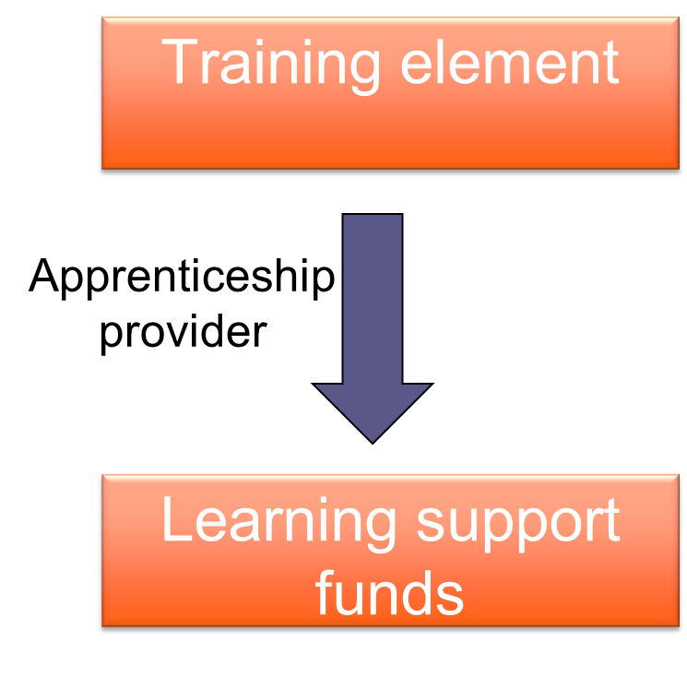
Funding for additional support
Workplace element
Individual
Access to Work

Slide 44
Learning support funding
£150 a month from the Skills Funding Agency for any apprentice requiring additional support
Plus additional funding up to £19K
Exceptional learning support funding for costs over 19K

Slide 45
Consultation on the levy August 2016
Proposals
Employers and apprenticeship providers receive £1,000 for 16-18 year olds
Employers and apprenticeship providers receive and additional £1,000 for those with EHC Plans (but unclear how this will work with AtW and additional support for learning funding)

Slide 46
Access to Work
Department for Work and Pensions scheme
Been available since 1995. Known as ‘best kept secret in government’
Funding has recently been increased as Government wishes to extend scheme
Funds practical support if you have a disability or mental heath condition

Slide 47
Access to Work
Can pay for:
  Equipment, software or adaptations
  Transport costs
  Support workers (e.g. communication support)
  Disability awareness training for work colleagues
  Job coaches to support transition to employment

Slide 48
Access to Work
Up to 1.5 times average income available annually (£40,800 in 2015)
Must be applied for by individual. Some young people may need support with application process.
Workplace assessment

Slide 49
Maynard taskforce
Terms of reference:
Identify barriers to disabled people completing apprenticeships
Identify solutions
Make recommendations to Ministers

Slide 50
14 recommendations
See http://bit.ly/29I1fma
Includes: relaxation of the requirement on English and Maths where occupational standards can be met.
Development and evaluation of funding models to promote participation
Join up funding streams e.g. Access to Work and Additional Learning Support

Slide 51
Supported internships
Type of study programme for young people aged 16-24 with EHC plans
Includes work placement of at least 6 months
Work towards relevant qualifications including English and Maths

Slide 52
Supported internships funding
Funded through EFA’s post-16 high needs funding methodology
Access to Work can pay for workplace support/equipment costs
16-19 bursary fund

Slide 53
High needs funding post-16
Element 1
Programme funding
EFA place funding
Element 2
Additional support costs
EFA place funding
Element 3
Top-up funding
Local authority

Slide 54
Traineeships
Aimed at young people aged 16-24
Can last between 6 weeks and 6 months
Includes:
  Work experience placement
  Work preparation training
  English and Maths (if required)

Slide 55
Traineeship funding
Can be funded by EFA or SFA
High needs funding for 16-18 (from EFA and local authorities)
Additional learning support (from SFA)
Access to Work

Slide 56


Questions?

