Slide 1
Using Data to Demonstrate Service Impact
Nicky Ereaut
SENSS Specialist Manager
(Sensory, Physical & Complex Needs)
HOSS 19.10.2016 Birmingham

Slide 2
Key Cohort Data
SENSS Dashboard
Input: service costs, staff profile, costs of service/pupil, income generated, commissioning costs
Output: referrals, active involvements, eligibility framework, contributions to LA processes e.g. Panels, Chairing transfer meetings, contributions to strategic developments locally and nationally
Outcomes - IMPACT

Slide 3
Service Progress Data - Impact
COHORT
Outcome Benchmarking / Wider VI Outcomes
Wider Outcomes – R2L and How’s it Going?
INDIVIDUAL TRACKING
Monitoring Protocol / Developmental Journal
Attainment – national curriculum
Specialist assessment
Wider outcomes – independence, social, self esteem
Attendance data
Participation data

Slide 4
How does SENSS use the outcomes data to demonstrate impact?

Slide 6
Issue: End of KS2 maths (HI)
2009-2010
2010-2011

Slide 7
Action
Focused on developing staff awareness and expertise in maths assessment, planning and interventions
Skilling up of HI team in maths – team SIP theme
Whole HI Team INSET day – maths Advisers
Linked to Performance Management pupil focused objectives
One of the Area HI managers took an across team lead
Resources added on SENSS shared drive

Slide 8
Performance Indicator: Percentage of C&YP with HI progressing by two or more levels in mathematics at KS2
Academic Year | DfE Data All Pupils | NatSIP Data | Oxfordshire Data All HI | NatSIP Gap | Oxfordshire Gap
2009-2010 |  | 63% (All) | 0% (S&P)
2010-2011 | 82% | 72.7% | 66.7% | 9.3% | 15.3%
2011-2012 | 87% | 73.1% | 80% | 13.9% | 7%
2012-2013 | 88% | 78% | 75% | 10% | 13%
2013-2014 | 90% | 78.1% | 80% | 11.9% | 10%
2014-2015 | 90% | 76.5% | 91% | 13.8% | -1% No Gap
Notes:
Oxfordshire sample size – averaging around 12 children each year.

Slide 9
NatSIP Outcomes Benchmarking 2014-15 academic year data
** Cohort 3 YP with mild VI

Slide 10
Key Stage 4 Contextual factors?
Oxfordshire pupils with School Support continue to perform poorly against similar pupils elsewhere with only 15.3% achieving 5+GCSEs at A*-C inc English and maths compared with 23.5% nationally.
Oxfordshire is the lowest performing out of its statistical neighbour group
Nationally Oxfordshire is the 14th lowest LA for this measure

Slide 11
Actions: CYP - low eligibility support level
Training
Webinar Conference Ear Foundation 04/02/16
(Mild Hearing Impairment)
Assertiveness training
Changed the SENSS report
Greater accountability for school
More challenge
Review of Impact

Slide 12
SENSS Report Headings
Details of visit
Strengths
Impact of strategies recommended at last visit
Current Issues / Concerns / Challenges
Suggested strategies and recommendations
Outcomes desired
Any other key information shared at the visit
Suggested ‘whole school’ strategies for supporting pupils with visual impairment

Slide 13
Details of Visit (02/07/2015):
‘……… unfortunately in science, only about half the sheets are enlarged. Currently the enlargements of sheets are mostly on A3. This is not ideal as it means that M will need to look more to the left and right as the paper is broader. Looking more to the left and right will make M’s eyes wobble more and this will make his vision less clear. Enlargement really needs to be on a standard page.’

Slide 14
Details of Visit (12/11/2015):
‘I observed M in a Science lesson I then met with M and Neelam and looked at some of M’s books. Observations are as follows:
A large number of the sheets in M’s science book are enlarged to the appropriate size. This is a significant improvement on my last visit to a science lesson. M was given an electronic copy of the teacher’s Powerpoint which was very helpful.’
Notes:
M – secondary aged child
Neelam - SENCo

Slide 15
(12/11/2015) cont.
Impact of strategies recommended at last visit:
‘There has been a significant improvement in provision of appropriate materials for M in Science. Other subject teachers are enlarging materials but not always on A4. When I return in term three I’ll want particularly to check provision in History.’
Outcome Desired
“M to access all print to be read using near vision. “

Slide 16
Other examples of link between issues and actions as evidenced through SIP and Performance Management
Wider outcome tracking – developing pupil autonomy
Provision of Braille workshops for parents
Development of Intervention Log pro-forma
Use of Case studies – pro-forma for individual and cohort

Slide 17


I can get on with work on my own
My teachers understand what I need and do things to help
I enjoy break and lunchtimes
Notes:
Wide Outcome tracking : whole cohort data
CYP completes

Slide 18
Readiness to Learn
Please use one of the following descriptors: Always (10) Most of the time (7) Sometimes (4) Never (0) | Date: (Term 1/2) | Date: (Term 5/6)
S/he is engaged in lessons (listens, co-operates, attempts set tasks, joins in group activities)
S/he is independent in school (self-care, ability to organise belongings etc)
S/he can work independently.
S/he is confident to participate in classroom activities
S/he is confident to participate in the wider social life of the school
Notes:
TA/ Classteacher or SENCo completes

Slide 19
Wider Outcomes
Readiness to Learn
How’s it Going?
SENSS collated data
Team | Readiness to Learn |  |  | How's it Going?
 | Average % score | Average % score | % Change | Date completed | % score
 | Term 1/2 | Term 5/6
HI | 74 | 80 | 6% | Term 1 | 84
VI | 62 | 69 | 7% | Term 1 | 84

Slide 20
Intervention Logs:
Evidence the ‘Assess, Plan, Do, Review’ Cycle
Set priorities for intervention linked to the EHCP or personalised plan
Meet requirements of the new assessment system
Log specialist assessment
Summarise progress and longitudinal data

Slide 21
VI assessment summary - Intervention Log

Slide 22
Example: HI individual pupil progress
Language | March 2012 | March 2015
Receptive vocabulary | 4yr 8m | 10yr 2m
Receptive grammar | 5yr | 11+yr (above test ceiling)
Expressive grammar | 4yr | 8+yr (above test ceiling)
Spelling | 7yr 3m | 11yr 5m
Reading | 7yr 5m | 10yr
Academic | KS2 | KS3 | Level gain
Maths | 4c | 6a | 2
English | 2a | 5c | 3
Science | 3b | 5a | 2
How’s it going? questionnaire - 97%

Slide 23
Case Studies
Intended Outcomes
To enable S to take part in extra-curricular activities to support social and emotional development; to understand how her deafness impacts on her life
Team involved
S, Parents, TOD, CSWs, subject teachers, SLT, CI team

Slide 24
Social emotional and mental health
S is now in Year 10 and has started her GCSE courses. She is having to adapt to the high demand of her GCSE subjects and achieve a balance with her extra-curricular activities. S has been taking part in an after-school drama club to prepare for the Shakespeare Schools Festival and has started preparing for Duke of Edinburgh Bronze Award…….. S needs time to discuss and explore her own deafness and how this impacts her life and identity. This is an intervention priority. (see Intervention log, Priority 4)

Slide 25
Strategy / Provision over time
Intervention relating to priority area 4 : PSHE/Personal Deaf/Hearing awareness. Fortnightly base session using Think Right, Feel Good, NDCS Buzz resources and Personal Understanding of Deafness (PUD) toolkit to consider the following topics: Personal Deaf identity; Audiology - trouble shooting, Equipment ………….. ; Blogs and websites; Moving on to adult services

Slide 26
Impact
Attendance: 98.7%
R2L: Improvement in all areas since term 2
Outcomes
Year | End KS1 |  |  | End KS2 |  |  | Y7 |  | Y8 |  | Y9 |  |  | Y10 |  | Y11
Attainment | R | W | M | R | W | M | E | M | E | M | E | M | E |  | M | E | M | W | M
 | 1a | 1b | 2a | 4b | 4a | 4c | 4b | 6c | 5b | 6a | 6c | 8b
Progress Summary – sub levels
S made 2 sub-levels progress over 1 year in English S made 5 sub-levels progress over 1 year in Maths

Slide 27
Impact
“Overcoming the difficulties of communication within a group, self-advocating, explaining to others about her deafness and how others can best communicate with her, developing relationships with peers, problem solving, leading to increased confidence and self-understanding.
S has decided she will undertake the final expedition for her Duke of Edinburgh Bronze award unsupported on 25th-26th June 2016. This shows a huge gain in confidence over the year, from the start of the Duke of Edinburgh training when she found it difficult to involve herself in the group activities.”

Slide 28
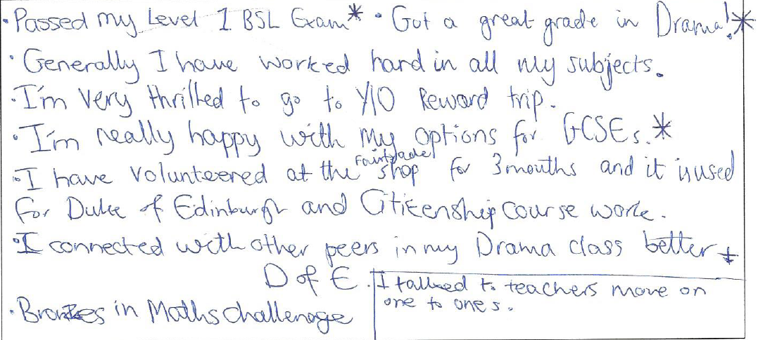
Pupil reflection

