Slide 1
Setting Good Outcomes
Andrea Scrivens
Education Policy Adviser, NDCS
30 June 2015

Slide 2

What is an outcome?
outcome
noun : something that happens as a result of an activity or process
(Merriam-Webster online dictionary)
n. a result; a visible effect
(Concise Oxford Dictionary)

Slide 3
Outcomes: a new emphasis
One of the principles underpinning the new framework.
Code of Practice (1.1) states that LAs must have regard to “the need to support the child or young person, and the child’s parents, in order to facilitate the development of the child or young person and to help them achieve the best possible educational and other outcomes, preparing them effectively for adulthood.”

Slide 4
Outcomes: a new emphasis
Improved outcomes are central to the joint commissioning cycle. The March 2015 guidance to local authorities,
Implementing a new 0 to 25 special needs system: LAs and partners
www.gov.uk/government/publications/implementing-the-0-to-25-special-needs-system
states:

Slide 5
Outcomes: a new emphasis
“The Code encourages the LA to start by building partnerships, and use those relationships to build a joint understanding of the needs of the area, before planning, delivering and reviewing that offer so it can improve the outcomes of 0-25 year olds with SEN or disability, whether or not they have Education Health and Care plans. “

Slide 6
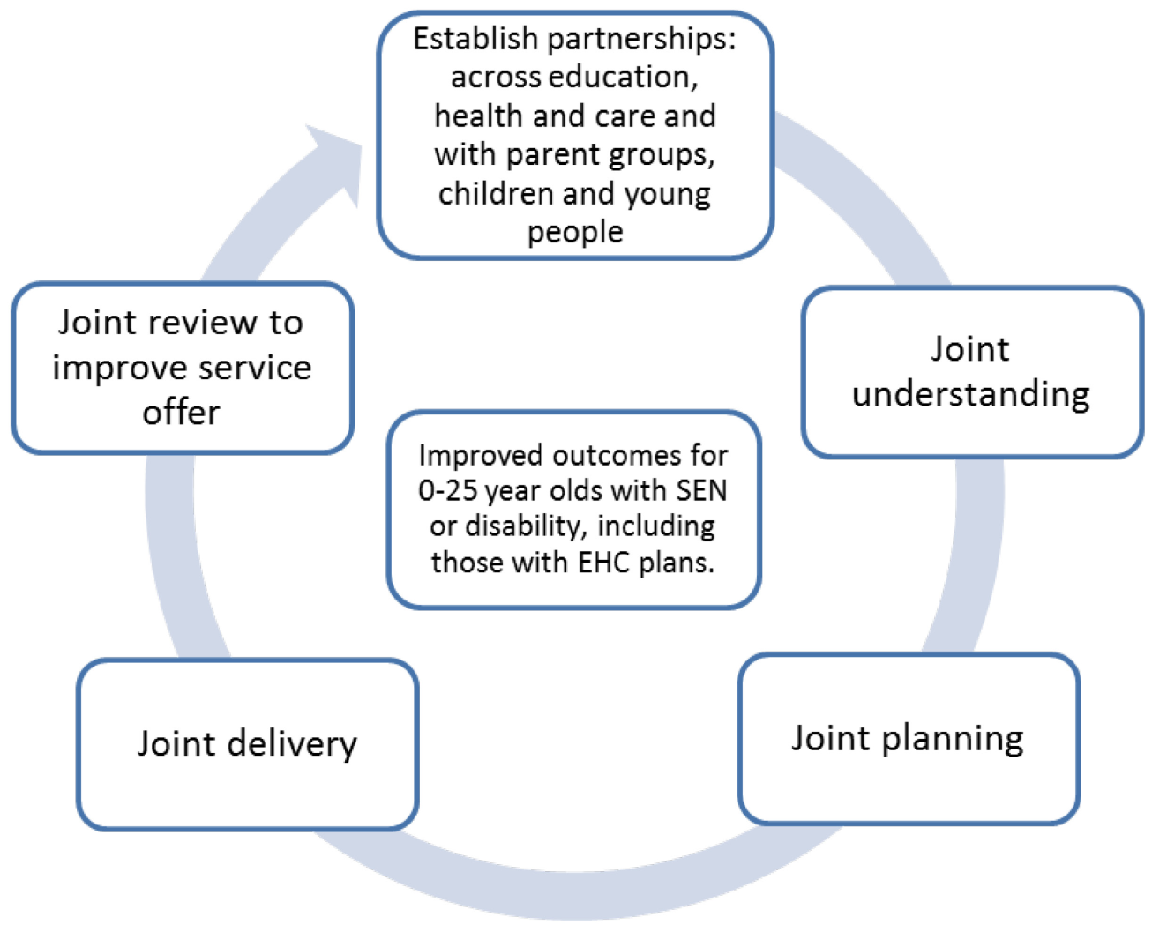
The joint commissioning cycle

Slide 7
Outcomes: a new emphasis
The proposed Ofsted/CQC inspection of local areas will look at effective identification of need; effectiveness in meeting needs; and local arrangements to achieve better identification and outcomes.
For more information see:
www.gov.uk/government/publications/send-supporting-local-and-national-accountability

Slide 8
And if you’re not yet convinced of the importance of outcomes...
the word “outcomes” appears 230 times in the 2015 SEND Code of Practice!

Slide 9
Aspirations, outcomes...What’s the difference? Where do they fit into a plan?
An aspiration is something which it is hoped will happen further into the future e.g. employment or further study plans, or the degree of independence hoped for in adulthood. Aspirations should appear in Section A of an EHC plan. LAs can’t be held accountable for aspirations. (9.65)

Slide 10
An outcome is something which can be measured and is expected to be achieved in the not too distant future, e.g. by the end of the key stage. Outcomes are in Section E.

Slide 11
A hierarchy of expectation
Aspiration (A): the ultimate goal
Outcomes (E): measurable “milestones” on the way to achieving an aspiration
Steps towards achieving the outcomes (E)
Shorter term targets, set by the school and recorded on internal planning documents, reviewed maybe once per term or half-term.

Slide 12
An illustration of the hierarchy of expectation
For a deaf boy in Year 7...
Aspirations (A) : to get a good job; to live independently; to have friends.
Outcome which will mark progress towards getting a good job (E):
By the end of Year 9, he will achieve academic outcomes which reflect his true ability (as assessed by the EP)

Slide 13
Step towards achieving the outcome above (E):
He will make measurable year on year “expected progress” (see CoP 6.17) in English and Maths.
Short-term target set by school:
He will be able to understand and give examples of the following terms: adjective; adverb; noun; pronoun.

Slide 14
What the CoP says about outcomes
Outcomes should always enable children and young people to move towards the long-term aspirations of employment or higher education, independent living and community participation.” (9.64)

Slide 15
What the CoP says about outcomes
“An outcome can be defined as the benefit or difference made to an individual as a result of an intervention. It should be personal and not expressed from a service perspective; it should be something that those involved have control and influence over.....it should be specific, measurable, achievable, realistic and time bound (SMART).” (9.66)

Slide 16
“When an outcome is focused on education or training, it will describe what the expected benefit will be to the individual as a result of the educational or training intervention.”
“Outcomes are not a description of the service being provided – for example the provision of three hours of speech and language therapy is not an outcome. In this case, the outcome is what it is intended that the speech and language therapy will help the individual to do that they cannot do now and by when this will be achieved.” (9.66)

Slide 17
“Outcomes underpin and inform the detail of EHC plans. Outcomes will usually set out what needs to be achieved by the end of a phase or stage of education in order to enable the child or young person to progress successfully to the next phase or stage.”
“From year 9 onwards, the nature of the outcomes will reflect the need to ensure young people are preparing for adulthood.” (9.68)

Slide 18

Developing good outcomes
Good outcomes start with good assessments.

Slide 19
Writing good outcomes
To develop outcomes, consider:
the aspirations of the pupil and those of their parents
the challenges for the pupil as identified by thorough assessment.
Together they will provide the areas of focus which can then be turned into SMART outcomes.

Slide 20
Setting good outcomes: example
Kirsty, aged 4
Aspiration: father wants her to make the most of her ability, particularly her communication skills.
Challenges identified by assessment:
Moderate bilateral hearing loss in low and mid frequencies, and profound loss in high frequencies.

Slide 21
Difficulties in the development of making the right speech sound; in language (both receptive and expressive) and in communication skills (using Sign Supported English).
Assessment of language skills at 4 years identified a delay of 2 years.

Slide 22
Outcome: By the end of Year 3, Kirsty’s speech, language and communication skills will be at a point where they are, as a minimum, at a level or close to that expected of a child of her chronological age and ability.

Slide 23
Steps towards achieving that outcome:
1)Kirsty’s vocabulary, spoken language and understanding of language will show year on year improvement
2)She will be able to make the sounds required in English.
SMART targets working towards these steps will be set by the school/nursery.

Slide 24
Questions to ask about an outcome
Does it enable the pupil to move towards one of their/their parents’ long-term aspirations?
Is it SMART?
Is it expressed from a personal (i.e. not service) perspective?
Is it something over which those who are involved have control and influence?
Is it clear what difference or benefit will be made to the pupil?

Slide 25
Further information
See sections 9.64-9.69 of the SEND Code of Practice 2015.
The following documents can be downloaded
from the NatSIP website:
Better Assessments, Better Outcomes, Better Plans
Model EHC plans

