Slide 1
Quality Improvement Support Pack

Slide 2
vipashyana and shamatha

Slide 3


Slide 4
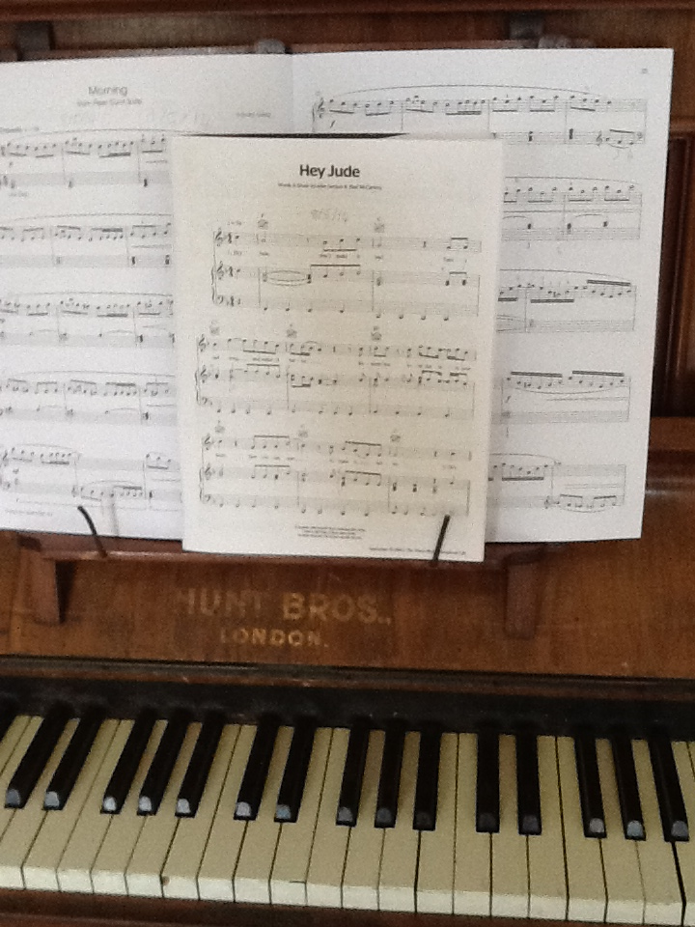

Slide 5
http://www.natsip.org.uk/index.php/doc-library-login/cat_view/54-natsip-documents/168-quality-improvement-for-services

Slide 6
HugeThanks

Slide 7
Top Ten
10.Sensory Strategy
9.Budget information/charges/costs
8. Information and support on tribunals
7.Record of Involvement/SLA/Information to schools
6. Evaluation reports/justifications/proving you make a difference
5. Equipment:policies/home use/repairs/insurance
4.Addressing new processes/policies (i pads)
3.Impact of interventions log
2.SEF for Services
1. Matrix of different types of support for children with outcomes

Slide 8
The whole is more than the sum of its parts. Aristotle

Slide 9
lynda@earfoundation.org.uk
tina@earfoundation.org.uk

Slide 10


