Slide 1

LA Pathfinder developments
Hartlepool Borough Council
SEND Pathfinder National Champion Programme
Emma Straker and Lesley Gallagher
June 2013

Slide 2
Background
March 2011: Green Paper published – ‘Support and Aspiration: A new approach to special educational needs and disability’
September 2011: 31 Local Authority ‘Pathfinders’ announced to test the proposals
September 2012: Draft ‘Children and Families Bill’ published, with timetable for parliamentary scrutiny
September 2014: Children and Families Bill due to be implemented
Hartlepool Borough Council
SEND Pathfinder National Champion Programme

Slide 3
A summary of the reforms
A new 0-25 co-ordinated assessment process and single Education, Health and Care Plan
The option of a personal budget for all families with children with an EHC Plan
Local authorities and other services setting out a local offer of all services available
A new approach to identifying SEN through a single Early Years setting-based category and school-based category of SEN
A new duty on health to provide services detailed in EHC plans
Hartlepool Borough Council
SEND Pathfinder National Champion Programme

Slide 4
Emerging principles from the Pathfinders
Co-ordinated assessment and single EHC plan
Children, young people and their families at the centre of the process
A “tell us once” approach to sharing information
Use of person centred and key working approaches
Plans focused on outcomes (short and long term) with detailed an specific provision requirements
More streamlined but time invested in joint agreement on key outcomes
Hartlepool Borough Council
SEND Pathfinder National Champion Programme

Slide 5
Emerging principles from the Pathfinders
Personal budgets
Development of an indicative budget for all EHC plans
Exploration of funding streams where choice and control can be offered
Use of notional budgets and direct payments
Local offer
Informative and helpful, not just a directory of services
Collaborative development with families and young people
Easily accessible
Hartlepool Borough Council
SEND Pathfinder National Champion programme

Slide 6
Pathfinder national champion programme
Hartlepool Borough Council
SEND Pathfinder National Champion programme
13 Pathfinder LA’s, one in each region;
Sharing learning and practice with non-pathfinder LA partnerships including CCG’s, health providers, schools, colleges, parent carers, young people and the voluntary/community sector;
Support offered across 6 thematic areas:
- Preparing for adulthood and post 16;
- Co-ordinated assessment and Education, Health and Care plans;
- Personal budgets
- Local offer
- Joint commissioning
- Engagement with children and young people and parents/carers

Slide 7
Pathfinder national champion programme
Delivery of the programme
Regular sharing of information across the region;
One regional conference;
Four workshops/seminars per thematic area;
Contribute to developing self-evaluation tools
A minimum of one 1:1 support day with each individual non-pathfinder local authority area
Quarterly case studies
Hartlepool Borough Council
SEND Pathfinder National Champion programme

Slide 8
Middlesbrough Hearing and Visually Impaired Services
Joint arrangement across the Tees Valley (Middlesbrough, Hartlepool, Stockton & Billingham, Redcar & Cleveland) to provide educational support to sensory impaired children
Middlesbrough is the lead LA
Delegated Primary and Secondary resource bases
455 CYP on the peripatetic caseload – 99 Hartlepool
74 statemented CYP – 10 Hartlepool
31 CYP in the Primary resource base – 2 Hartlepool
28 CYP in the Secondary resource base – 4 Hartlepool
Hartlepool Borough Council
SEND Pathfinder National Champion programme

Slide 9
The Hartlepool context
Population c. 90,000
High levels of deprivation
37 schools (including 2 special)
c. 350 children with a Statement of SEN
60 statutory assessments completed per year
Above average prevalence of sensory impairment
Hartlepool Borough Council
SEND Pathfinder National Champion programme

Slide 10
The assessment process – an example
Referral
Assessment
Planning
Hartlepool Borough Council
SEND Pathfinder National Champion Programme

Slide 11
The assessment process – an example
Stage One: Referral
Referral received by LA
SEND panel considers referral
Accepted or recommended for non-statutory support
6 weeks
Hartlepool Borough Council
SEND Pathfinder National Champion Programme

Slide 12
The assessment process – an example
Stage Two: Assessment
SEN team meet with family – consent and explanation of the process
Assessment planning meeting held; family and all professionals
New/further assessment work completed
8 weeks
Hartlepool Borough Council
SEND Pathfinder National Champion Programme

Slide 13
The assessment process – an example
Stage Three: Planning
Support planning meeting held; identification of outcomes
Proposed EHC plan written
Proposed plan delivered to parents
Plan finalised, shared and implemented
6 weeks
Hartlepool Borough Council
SEND Pathfinder National Champion Programme

Slide 14

SPOTLIGHT ON [NAME]
First test cohort
Mainstream school reception class
Profoundly deaf, cochlear implants fitted
Identified for assessment through care co-ordination
Support team included Mum, social care, school, ToD, SaLT
Hartlepool Borough Council
SEND Pathfinder National Champion programme

Slide 15
AN ASSESSMENT TOOL – FOR SENSORY CYP
The NatSIP tool BETTER ASSESSMENT, BETTER PLANS, BETTER
OUTCOME identifies the information needed to ensure:
that plans for education, health and care support are based on a full and thorough understanding of that person’s needs and their implications.
any barriers to their development and achievement are identified and measures are put in place to address them.
The document provides:
A template to illustrate how those working in education, health and social care could record relevant assessment information and the implications.
A table setting out the information and assessment required to produce an EHC Plan that focuses on improving outcomes.
Hartlepool Borough Council
SEND Pathfinder National Champion programme

Slide 16
The single EHC Plan – an example
Part One: Personal details
Part Two:
- a personalised profile of the child
- the child’s current needs
Part Three:
- the support the child needs to succeed and achieve
- the child’s support plan
- education placement
- who’s involved
Part Four: Agreeing the plan
Hartlepool Borough Council
SEND Pathfinder National Champion Programme

Slide 17
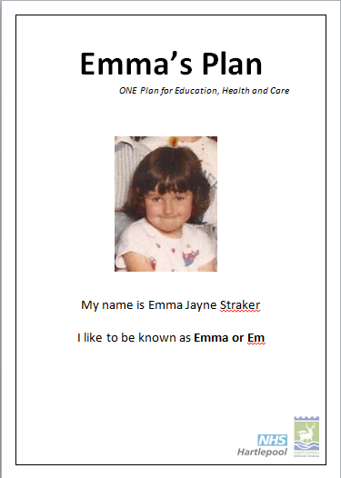
The single EHC Plan – an example
Belongs to the child and family, not professionals
Optional picture
Legalistic aspects moved
Hartlepool Borough Council
SEND Pathfinder National Champion Programme

Slide 18

The single EHC Plan – an example
Part Two: All About Me
Optional use of first person
What do people like and admire about the child?
What’s important TO and FOR them?
What’s working and what’s not working?
Hartlepool Borough Council
SEND Pathfinder National Champion Programme

Slide 19
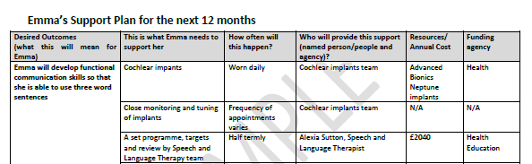
The single EHC Plan – an example
Hartlepool Borough Council
SEND Pathfinder National Champion Programme
Part Three: The Support Plan
Focuses on outcomes
Detailed provision to support progress
Frequency and provider of support
Annual cost
Funding agency

Slide 20
SPOTLIGHT ON [NAME]
Hartlepool Borough Council
SEND Pathfinder National Champion programme
Personalised profile
Current needs
Support plan - outcomes
Review cycle

Slide 21
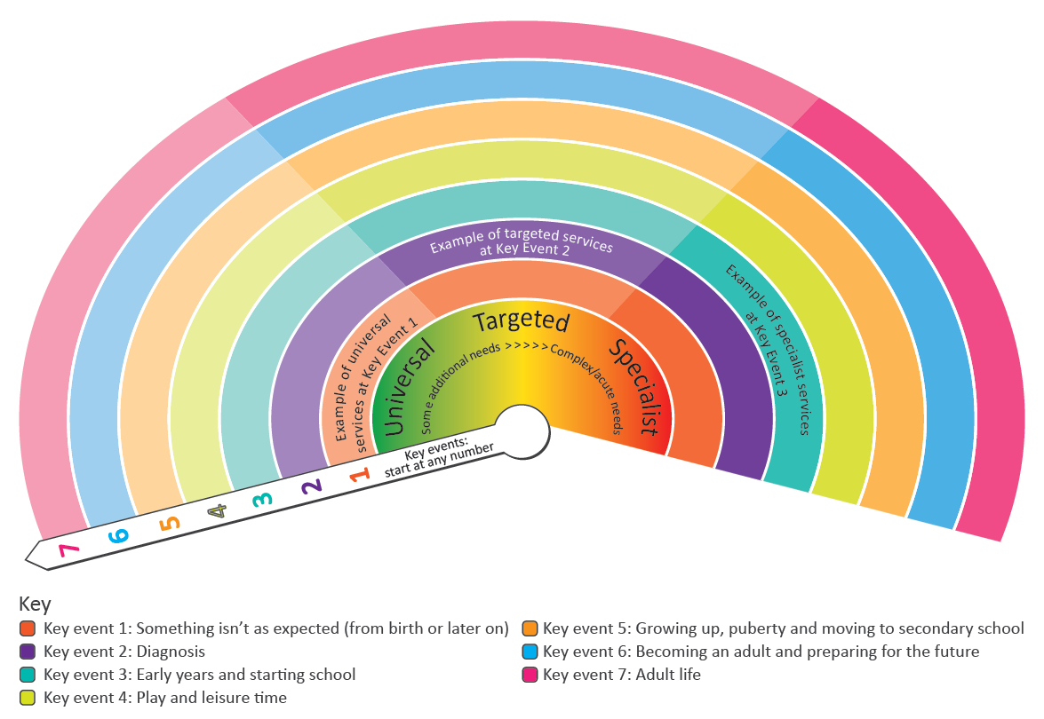
The local offer – an example
Details of all services available to children, young people and their families at different stages in their lives
Clear, concise and relevant information
Provide a mechanism for feedback – complaints and redress
Hartlepool Borough Council
SEND Pathfinder National Champion Programme

Slide 22
Hartlepool Borough Council
SEND Pathfinder National Champion Programme

Slide 23
SENSORY SUPPORT SERVICES LOCAL OFFER
General information
Name of the Service – Middlesbrough Hearing Impaired Service
Base- Sensory Support Centre, Whinney Banks Primary School Site, Fakenham Avenue, Middlesbrough, TS5 4QQ
Contact details – Tel: 01642 354354, Fax 01642 354356, Minicom: 01642 354357, SMS 07825 358104, e-mail: lesley-ann_gallagher@middlesbrough.gov.uk
Hartlepool Borough Council
SEND Pathfinder National Champion programme

Slide 24
SENSORY SUPPORT SERVICES LOCAL OFFER
Hartlepool Borough Council
SEND Pathfinder National Champion programme
Universal Offer
NHSP
Information on HI Service website
Advice and information available to parents, schools and professionals by contacting the Service
Deaf awareness training provided to settings and professionals

Slide 25
SENSORY SUPPORT SERVICES LOCAL OFFER
Hartlepool Borough Council
SEND Pathfinder National Champion programme
Targeted offer – the occasional caseload
Specialist Intervention – the regular caseload
Route in – referral of a CYP with a permanent educationally significant hearing loss by a Paediatric Audiologist or ENT Consultant with the consent of parents
Eligibility – support levels determined by use of the NatSIP Eligibility Criteria for Scoring Support Levels

Slide 26
SENSORY SUPPORT SERVICES LOCAL OFFER
Hartlepool Borough Council
SEND Pathfinder National Champion programme
Targeted offer – the occasional caseload
Advice on teaching style, language modification, NC implications, acoustic considerations, exam concessions
Appropriate overview negotiated with HT/CT/SENCO/parents
Attendance at audiological hearing aid review appointments
Radio hearing aid system for use in school and other appropriate technology
Assessments of functional hearing
INSET to staff/pupils/parents/governors
Advice on teaching strategies
Key Stage advice

Slide 27
SENSORY SUPPORT SERVICES LOCAL OFFER
Specialist Intervention – the regular caseload
Advice on teaching style, language modification, NC implications, exam considerations
Appropriate pupil support negotiated with HT/CT/SENCO (maximum of one session between 45 minutes and 75 minutes per week)
Attendance at audiological hearing aid review appointments
Radio hearing aid system for use in school and other appropriate technology
Functional hearing and linguistic assessments
Key Stage advice and support where appropriate
Twice yearly individual targets from Service to inform parents and pupil's school
Copies of targets & annual report sent to parents, school and professionals
Input to review/transition planning meetings & liaison prior to all transfers
INSET to staff/pupils/parents/governors

Slide 28
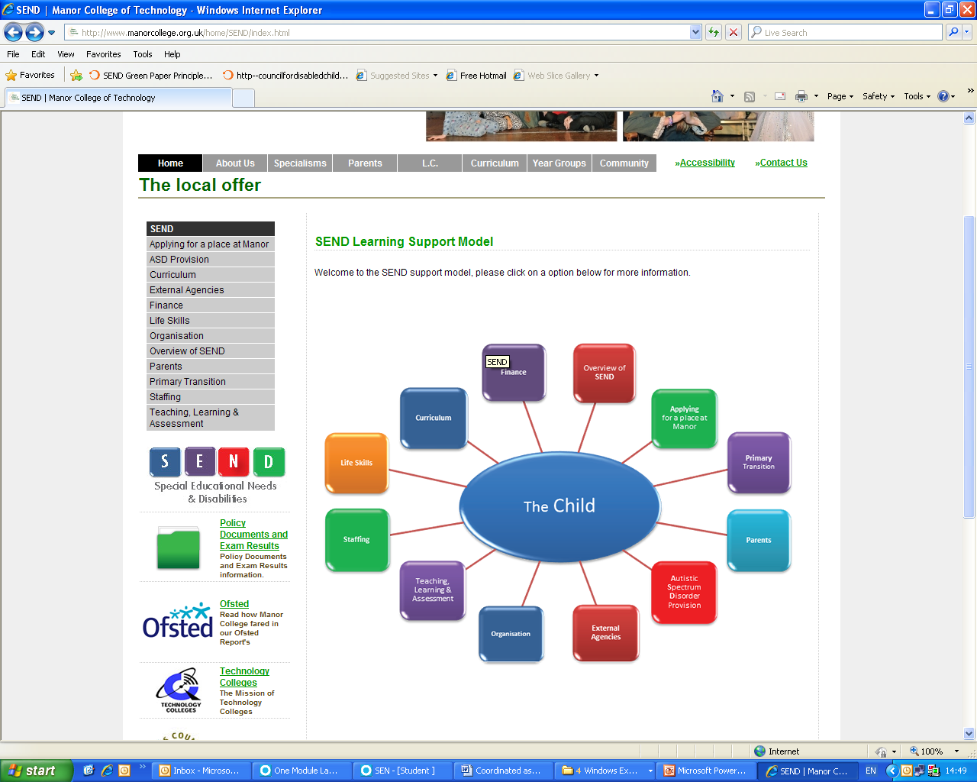
Manor College of Technology
Hartlepool Borough Council
SEND Pathfinder National Champion Programme

Slide 29
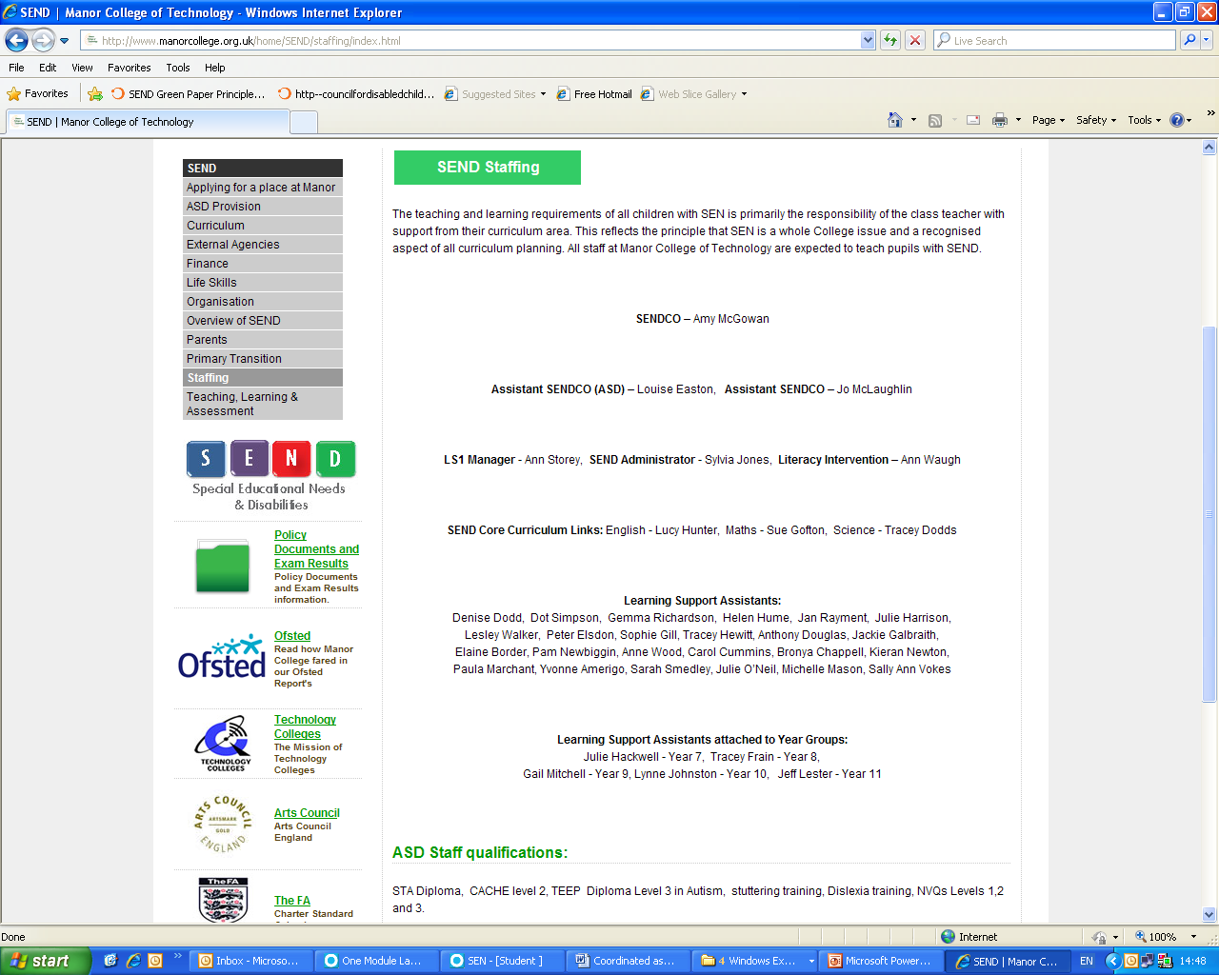

Slide 30
Transition arrangements
Pathfinders to offer new assessment process for all referrals from September 2013;
Conversion of existing statements – likely to be through Annual Review process;
Support to non Pathfinder LAs underway from National Champions;
Publication of ‘How to’ and case studies.
Hartlepool Borough Council
SEND Pathfinder National Champion programme

Slide 31
Next steps?
Hartlepool Borough Council
SEND Pathfinder National Champion programme
Are you in a Pathfinder area?
Who is your regional Pathfinder champion? Make contact?
Who is your SEND contact in the LA?
Raise EHCP as an agenda item at regional sensory groups
Indicative Code of Practice – how will this impact?
Look at “food for thought” items on the SEND Pathfinder website
NATSIP assessment tool – how can you use this?

Slide 32
NEXT STEPS?
Look out for the November 2013 BATOD magazine article on preparation for EHCP
Consider your caseload – who has a Statement, who needs assessment?
Consider the implications for your Service
Refer CYP early
Potential for TOD/TOVI to be key workers
Attendance at training
Process needs an up-front time investment
Hartlepool Borough Council
SEND Pathfinder National Champion programme

Slide 33
Questions?
Hartlepool Borough Council
SEND Pathfinder National Champion programme

