Slide 1


The HoSS E‐mail Forum is supported by:
Physical & Sensory Support
“specialist support for living and learning”
Nicki Harris
Lead Professional - Post 16
18th June 2013

Slide 2
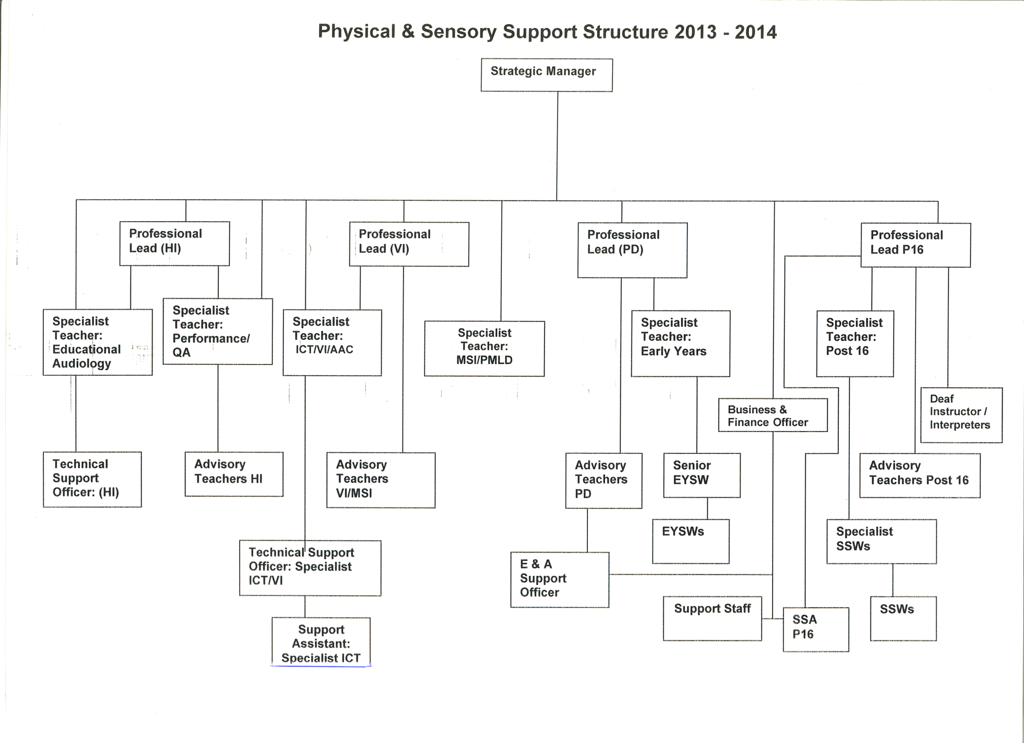

Slide 3
Appropriate Support
Student
Skills match
SSW

Slide 4
T - 24
Year 9 Transition planning
Post 16 participation in AR
Post 16 liaison with school colleagues

Slide 5
T - 12
Year 10 AR
Advice on open days – support
Taster days
Interviews – ‘talk the talk’

Slide 6
T
Year 11 AR
Course choice / college choice
Applications
Course interview / screening tests
Support for interview – LSM interview
Liaison

Slide 7
The whole picture
Course taster day, staff training trips, exams, in class support, tutorials
Assessments - NATED, VIEW
College / trainer provider
Post 16 AT
Student

Slide 8
Preparation for university students
Contacted by Disability Advisor
Support Needs Meeting
Course content – what support is needed?
Any extras – trips?
Exam – modified papers, exam support
Support package – notes, communication support, interpreting, equipment, tutorials and e coaching

Slide 9
Chargeable bespoke support package
Notes
Tutorials
Equipment
Staff training
Support for trips
Transcripts

Slide 10
Chargeable
DSA
College
Access to Work
Training – various courses
Consultancy
Interpreting
Transcripts

Slide 11
Additional costs
On-costs
Sickness – own, dependents
Holiday pay
Travel
Travel time
Appraisals
CPD
Compassionate leave
Study leave

Slide 12
Current Activity
Funding
Local Offer
Collaborative Working

Slide 13
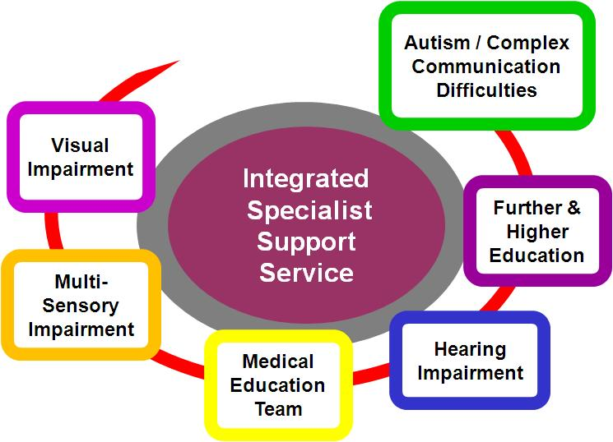
F/HE Provision
Speaker:
Brian Perry
Principal Teacher of the Deaf
www.worcestershire.gov.uk

Slide 14
F/HE Provision
Service Structure
  Principal Teacher
  Senior Specialist Teacher
  Administrator
  Qualified teachers for each area of specialism provided: Teacher of the Deaf, Qualified Teacher of the Visually Impaired, Specialist Teacher for Autism/CCD
  Deaf Field Worker
  Area Support Coordinators
  Communication Support Workers
  Support Workers
  Mobility Training Officer
  Transcription Coordinator
  Braille proof reader

Slide 15
F/HE Provision
Remit of Service
  All costs to be reclaimed via each individual student
  No financial support provided by Worcestershire County Council
  At present support is provided to nine Colleges and two Universities across three Counties
  Costs reclaimed from Colleges for FE Learners and HI via Disabled Student Allowance
  Assessment of support and individual learner costs identified
  NATED and VIEW assessments used
  Liaison with ISSS colleagues incorporating their reports
  Attendance at Annual Reviews
  Individual Support package provided – including Specialist Teacher and / or Support Worker and /or Equipment

Slide 16
F/HE Provision
Profile of Learners Supported during 2012/13:
  HI – 58 learners
  VI – 46 learners
  ASD – 164 learners
  Total – 268 learners
Age profile 16 – 65+

Slide 17
F/HE Provision
CURRENT ACTIVITY
Provision in Worcestershire:
  Post 16 Assessment and Placement Manager
  Two ‘assessment officers’ formally from connexions team who used to work with LLDD
  They will be carrying out 139a assessments with all learners with a statement.

Slide 18
Opportunities?
  LA to provide LDA assessments and adequate support for LLDD - rural areas?
  School v College level of support
  Will local authorities who have not ‘statemented’ many learners with high level needs be disadvantage under the new arrangements?
  Flexibility of staff
  Time taken to appoint/train new staff in appropriate numbers
  Number of students?

Slide 19
Opportunities?
  Potential pay discrepancies College v Local Authority
  Contracts
  Core Costs of service
  Service Level Agreements
  Constant timetable changes
  Protecting staff salaries / working hours
  Skills mix v Redeployment
  Cautious estimates to colleges

Slide 20
Opportunities?
  Collaborative working relationships with Colleges / Universities
  Realistic and inclusive LA charges
  Quality Standards
  Different term dates for colleges and Universities and schools – contacts dependent on academic year?

Slide 21
Educate colleges and LAs
High impact low incidence
Cheaper staff – non-specialist?
Provision equality

