Slide 1
Improving Classroom Acoustics
For the benefit of children with HI and VI
David Canning
d.canning@ucl.ac.uk
david.canning@newham.gov.uk

Slide 2
Overview
Why consider classroom/educational acoustics?
    SEN Law
Recent acoustic studies relevant to education
    Essex study
Concluding remarks

Slide 3
Learning points:
Noise in classrooms is usually generated within the classroom by the children and adults present.
Without clear strategies for managing ‘noise’ (including work noise), sound levels can become high.
Careful management can control noise even the most challenging room – the ‘Miss Bradley’ effect.
Simple changes to the physical acoustic environment can have a marked impact on the behavioural acoustic environment.

Slide 4
Education of Children with Special Educational Needs (SEN)
WHY
The Education Act 1996 says that 'a child has special educational needs if he or she has a learning difficulty which calls for special educational provision to be made for him or her.
‘Where a child has a special educational need then LEAs must make decisions about which actions and provision are appropriate for which pupils on an individual basis…
This can only be done by a careful assessment of the pupils’ difficulties and consideration of the educational setting in which they will be educated’. DfE formerly DCSF formerly the DfES…

Slide 5
SEN continued
“The real question ... is whether [the statement] is so specific and clear as to leave no room for doubt as to what has been decided and what is needed in the individual case.“ L v Clarke & Somerset County Council
It would be helpful for the professional specifying classroom acoustics for a particular child to have available measures of the aided hearing, including acceptable levels of noise, desirable reverberation times and required signal to noise levels. (BB93 p77)
Notes:
Because there is sometimes not the expertise to carry out appropriate assessments of individual needs BB93 allows for consideration of alternative standards and in section 6 it presents standards identified by professional bodies:

Slide 6
Reverberation time
Neuman et al (2010) Ear and Hearing Vol 31, 3, 336-344
Normally hearing signal to noise threshold (50% score and standard errors). BKB -SIN
Notes:
Vertical axis: threshold in noise signal to noise level required for a person being tested achieves 50% score. 2 issues apparent from this recent study: The greater the rt the greater the signal to noise level needs to be in order to achieve 50% level…..with anaechoic providing the least challenging environment – tolerate most competing noise.

Slide 7
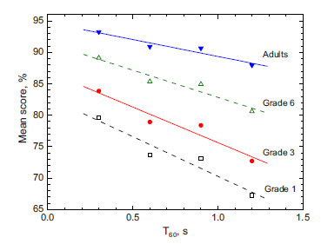
Reverberation time
Binaural Headphone test, 217 children 17 adults, constant Signal to Noise levels
Yang and Bradley 2009
Notes:
Again … ‘normally hearing’ but this time if signal to noise ratio is kept the same rt reduces the mean discrimination score….and there is clearly an age effect too.

Slide 8
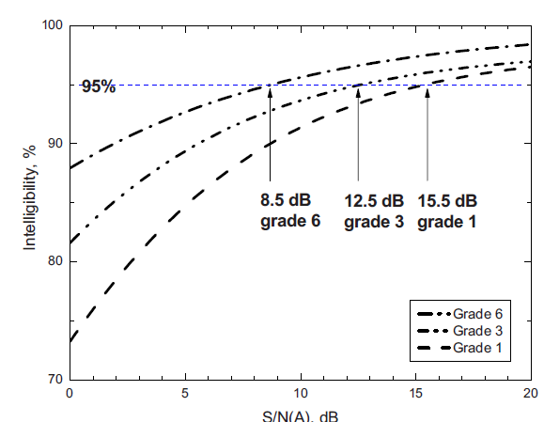
Signal to Noise Level
Bradley and Sato (2008)
41 classrooms and 2285 individual speech recognition tests
Notes:
A large number of speech recognition tests (sentence tests)… lends some support for the American standard of 15dB for school children.

Slide 9
Age and Signal to Noise Level
Bradley and Sato (2008)
41 classrooms and 2285 individual speech recognition tests
Notes:
Important to look at the individual data rather than the regression lines….marked by considerable variability…important to know individual performance….

Slide 10
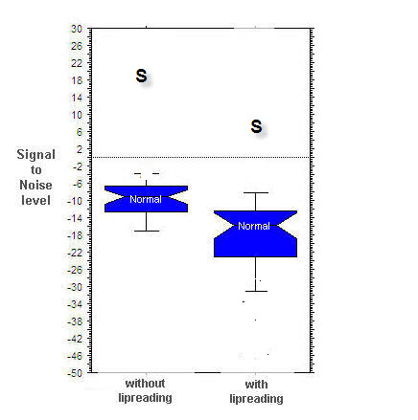
PAVT (Paediatric Audiovisual Test)
Individual differences
Low noise
S represents a child whose performance is adversely affected by noise
High noise
Work in progress: 48 children in 4 classrooms
Notes:
Details of this test can be found on the advanced bionics website. Not yet released but is a test designed to be used in clinics or classrooms and takes about 5 minutes to complete. It is a computerised adaptive test that provides threshold for hearing in noise both with and without vision. It provides a clear goal which can then be related directly to the environment. It can be used to explore potential of FM as well as some of the more interesting potential in hearing aid design we expect to have this incorporated in to regular clinical audiology which should then provide educational services with valuable information about a child's needs – not available from an audiogram.

Slide 11
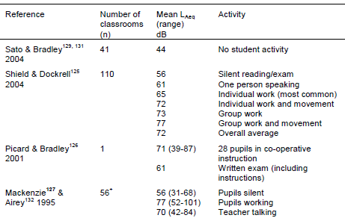
Noise Levels in Classrooms
Greenland (2009)
Notes:
2 things to notice here: first that as the classroom becomes louder – noisier – so the personal fm system becomes less effective offering less signal to noise advantage.
The second thing is that when there are multiple simultaneous talkers of similar loudness it is very difficult to tell them apart without access to that fine spectral information that identifies one speaker from another. What you end up with is a ‘noise soup’

Slide 12
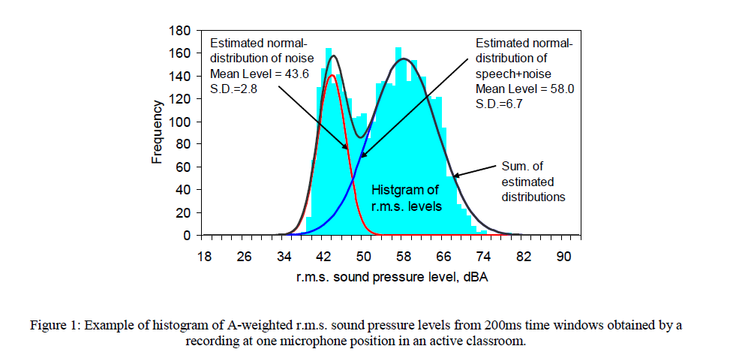
Signal to Noise
Sato and Bradley 2008
Notes:
Those who have access to B&K products will be able to collect this data with relative ease. It is a histogram of sound levels in 1 second bins. In the example taken from Bradley we can see two peaks, the one on the right , the louder one if you like, represents the voice of the lecturer and the other peak is that of the air-conditioning.

Slide 13
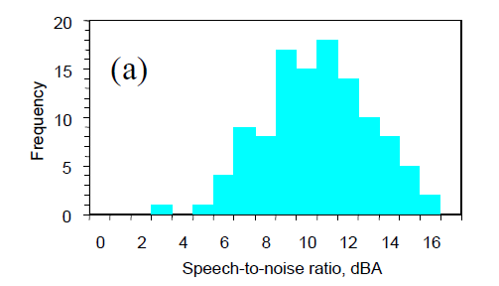
Signal to Noise
Signal to noise distributions in 28 classrooms
Sato and Bradley 2008

Slide 14
What can a designer/architect control?
Noise
Control noise entering the room (or created within it by plant e.g. air-conditioning units but not computers)
Reverberation
Control what happens to sound created in the room

Slide 15
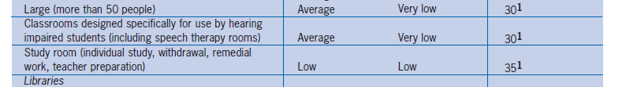
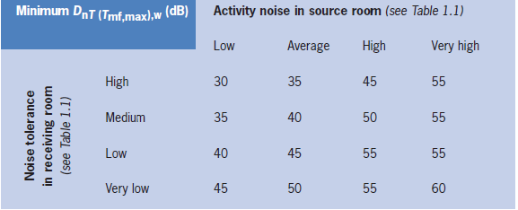
Noise
Anticipated Revisions
Teaching spaces used by children with hearing impairment or are deaf or have special hearing requirements
BB93 section 1

Slide 16
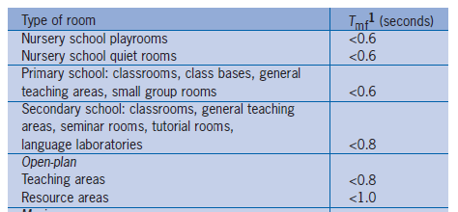
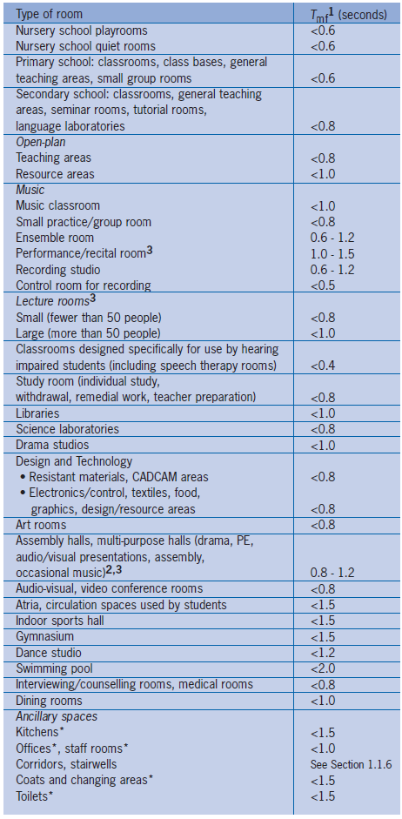

Reverberation
Anticipated Revisions
Teaching spaces used by children with hearing impairment or are deaf or have special hearing requirements
0.4s
125Hz – 4kHz

Slide 17
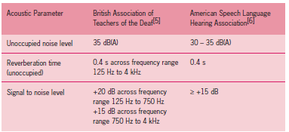
Alternative acoustic standards in the absence of child specific information
BB93 Section 6

Slide 18
Classroom acoustics and the Enhancement of the Speech Signal
Essex Study:
  Experimental study involving 14 teachers and 400 children using 4 ‘identical classrooms’
  3 classrooms modified acoustically whilst remaining visually the same, such that each classroom experienced each of the 3 acoustic conditions

Slide 19
Classroom acoustics and the Enhancement of the Speech Signal
Room A
Condition A
Condition B
Condition C
Room B
Condition B
Condition C
Condition A
Room C
Condition C
Condition A
Condition B
Room D
Control
4 months
Condition A: Reverberation time to BB93
Condition B Reverberation time to BB93 Hearing Impaired
Condition C Reverberation time to BATOD
Notes:
BATOD has low frequency rt control

Slide 20
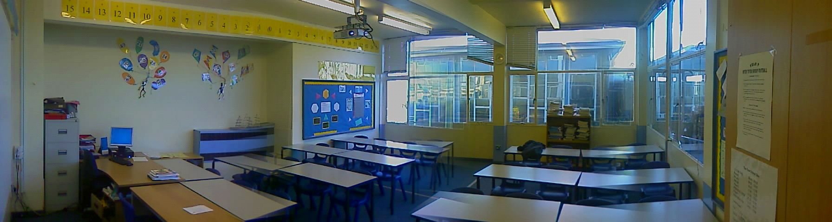
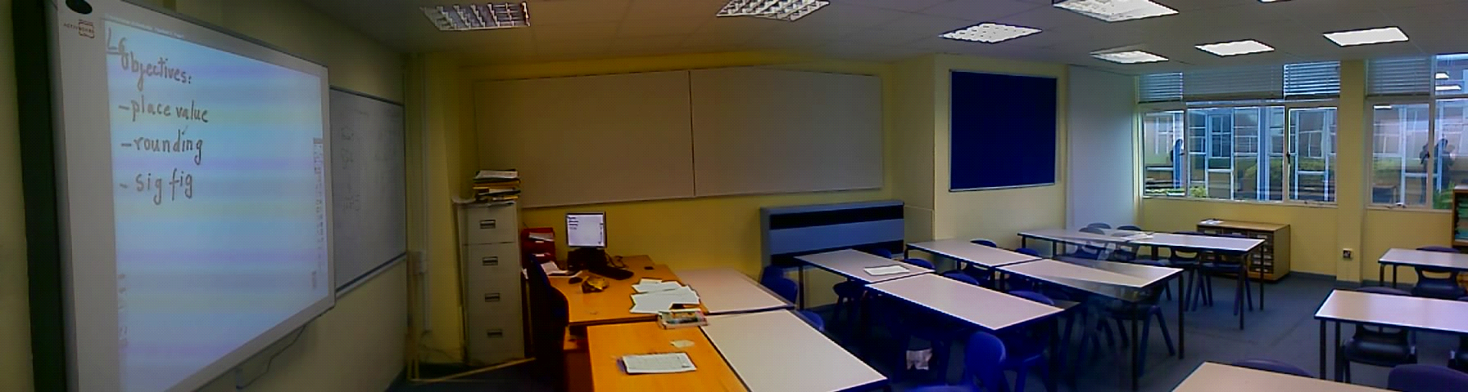
Classroom noise and Sound Treatment
Original
Treated

Slide 21
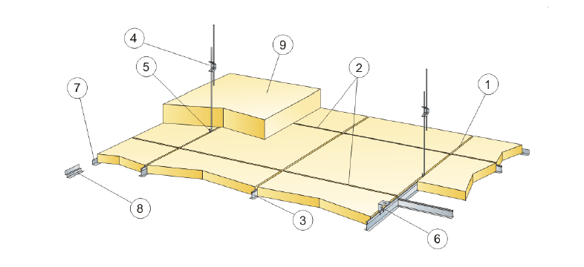
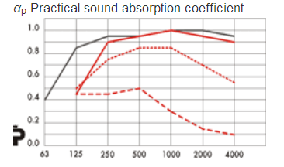
Selection of Acoustic Materials
Acoustic panels absorb sound energy.
The nature of the material used, and the manner in which is used all have an impact on the absorption characteristics
Particular attention to this area. The bit that designers (acousticians/architects) will not be concerned about

Slide 22
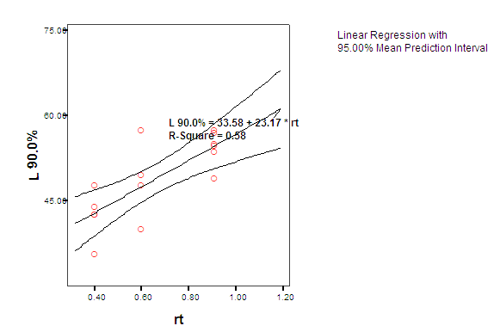
Acoustic treatment and classroom noise
Very significant changes in occupied sound levels:
17dB from untreated to highest level of treatment
(1.2 s to 0.4s)
c
9dB Reduction in Background Noise from current BB93 standard to proposed standard for children with ‘special hearing requirements’
Predicted differences in sound level range from 1.6dB to 2.7 dB. Actual >9dB

Slide 23
Acoustic treatment and classroom noise
Herriot Watt Study 1996-1999 (70 Primary Schools) David McKenzie
Considerable reductions in occupied noise levels reported following acoustic treatment to reduce reverberation times.
Average Background Noise Levels
 | Untreated | Treated
Room Unoccupied | 44.77 | 40.1
Pupils Silent | 55.5 | 46.5
Pupils Working | 77.3 | 70.1

Slide 24
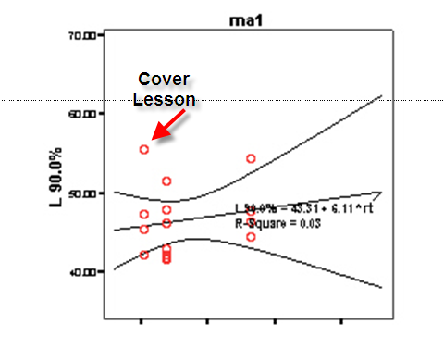
Miss Bradley Approach?
Not all classes changed:
Note the low noise levels in all conditions
Another teacher using this room said
    ‘Before – it was all about isolating and controlling the class, now I can teach’.

Slide 25
The significance of low occupied sound levels
The lower the sound level the greater the likelihood of achieving adequate signal to noise levels
  Teacher talking to the whole class (60dB at 1 m)
  Children talking to the whole class (<60dB 1 m)
  Children talking to each other during group work

Slide 26
The significance of low occupied sound levels
  Why are low occupied (working ) sound levels important?
  Greater likelihood of being able to hear adequately:
  Greater ability to segregate voices
  Pitch and harmonic structure of the voice
  Onset time of sounds
  Localise sound sources in space: timing cues and level differences.
  Glimpsing – listening to the speech during dips in noise levels

Slide 27
Summary
Room acoustics are within the control of the designer, whether new build or refurbishment.
There are tangible and real benefits to having high levels of absorption in a classroom.
Cost at time of construction is very small
Cost at refurbishment from £40.00 sqm
In financially tough times it is important to demonstrate the need through appropriate assessment and benefit through appropriate outcome measures.

Slide 28
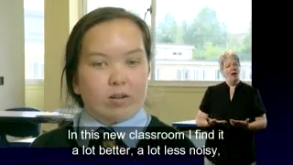
Last word
BBC SeeHear http://www.youtube.com/watch?v=DIJJkxuWk3E

Slide 29
References and links
BBC. (2009). "See Hear Education Acoustics." from http://www.youtube.com/watch?v=DIJJkxuWk3E.
Bradley, J. S. and H. Sato (2008). "The intelligibility of speech in elementary school classrooms." J Acoust Soc Am 123(4): 2078-86.
DfES (2003). Building Bulletin 93: Acoustic Design of Schools. DCSF, TSO London.
Greenland, E. E. (2009). Acoustics of open plan classrooms in primary schools. London, London South Bank University. PhD.
‘Miss Bradley’ Video: McDaniel, P. H. B. (1953). "How quiet helps at school." from http://www.youtube.com/watch?v=qOtkQWpKABo.
Neuman, A. C., M. Wroblewski, et al. "Combined Effects of Noise and Reverberation on Speech Recognition Performance of Normal-Hearing Children and Adults." Ear and Hearing 31(3): 336-344 10.1097/AUD.0b013e3181d3d514.
Sato, H. and J. S. Bradley (2008). "Evaluation of acoustical conditions for speech communication in working elementary school classrooms." J Acoust Soc Am 123(4): 2064-77.
Yang, W. and J. S. Bradley (2009). "Effects of room acoustics on the intelligibility of speech in classrooms for young children." J Acoust Soc Am 125(2): 922-33.
Yang, W. and M. Hodgson (2007). "Optimum Reverberation for Speech Intelligibility for Normal and Hearing-Impaired Listeners in Realistic Classrooms Using Auralization." Building Acoustics 14: 163-177.
LINK TO Classroom Simulation
http://www.hear2learn.com/HOSS/ndcssim.exe
Powerpoint version of this talk
http://www.hear2learn.com/HOSS/HOSSDC.zip

