Slide 1

NATSIP Implications of the Equalities Act 2010 for Schools, Disabled pupils and those with SEN
Richard Rieser
World of Inclusion Ltd
www.worldofinclusion.com
E-mail rlrieser@gmail.com

Slide 2
Aims of the Day
Aim to examine the provisions of the Equalities Act and how its provisions enable the equality of disabled pupils and students and help schools promote equality and eradicate discrimination.
Examine the Equality Act with Case Studies
Examine the Public Duty to promote equality and what it means

Slide 3

Equality Strands
When referring to equality and diversity this covers all the equality strands used by the Equality and Human Rights Commission (EHRC) and includes social aspects such as poverty and deprivation. The 8 strands or protected characteristics are:
age, (not in provision of education)
disability,
gender, maternity and breastfeeding
faith and religious belief including no belief,
race, ethnicity or nationality
sexual orientation,
transgender
Civil partnership and marriage
(http://www.equalityhumanrights.com).
Applies to those associated with or perceived to be e.g. parents

Slide 4

Different areas of activity are covered under different parts of the Act.
Part 2 Key Concepts
Part 3 of the Act deals with discrimination in the provision of services and the exercise of public functions.
Part 4 deals with discrimination in the sale, letting, management and occupation of premises, including housing.
Part 5 covers employment and other work-related situations.
Part 6 covers education including schools, further education, higher education and general qualifications bodies.
Part 7 deals with discrimination by membership associations.
Part 9 Enforcement
Part 10 Contracts
Part 11 Equalities and Public Duty
Part 12 Disabled People &Transport

Slide 5
Disability Duties to Children/Staff
There are different forms of discrimination:
Direct discrimination,
Indirect discrimination,
Discrimination arising from a disability and
A duty to make reasonable adjustments (for disabled people).
A youth /children’s project, school/nursery also must not harass or victimise a child or prospective pupil/member or staff member.
There is a Duty on all state funded schools and nurseries to have an equality policy including academies and free schools
eliminate discrimination, harassment, victimisation
advance equality of opportunity between persons
the need to tackle prejudice and promote understanding.
Positive action and more favourably action for groups shown to be discriminated against
www.equalityhumanrights.com/en/publications andresources/disability/pages/education.aspx

Slide 6
Scope for Schools of the Equality Act 2010
The Equality Act 2010 makes it unlawful for a school to discriminate against, harass or victimise a learner or potential learner in relation to:
Admissions
Exclusions
Educational provision re extra-curricular activities
Educational provision re curriculum and environmental access
( Save for environmental access which is covered by the School Access Plan)
Educational provision re access to any benefit, facility or Educational service
Provision of Auxiliary Aids and Services( awaiting a Government decision) Schools will be expected to provide an auxiliary aid or service for a learner with a disability when it would be reasonable to do so and if such an aid would alleviate any substantial disadvantage that the learner faces in comparison to learners without a disability.
Schools are advised to regularly review all their policies using Impact Assessment to ensure that they are not inadvertently discriminating.
Applies to all maintained schools and PRUs, academies, free schools and independent schools
Notes:
And s

Slide 7
Definition of Disabled Person
The Act says that a person has a disability if they have a physical or mental impairment which has a long term and substantial adverse effect on their ability to carry out normal day-to-day activities.
Disregard aids, medication and treatment
Physical or mental impairment includes sensory impairments such as those affecting sight or hearing and severe disfigurement.
A long term means that the impairment has lasted or is likely to last for at least 12 months or for the rest of the affected person’s life.
Substantial means more than minor or trivial.

Slide 8
PLASC Data England 2011 by type of school & impairment
 | Primary | Sec. | Special M&NM | Total
SpLD | 32,655 | 44,370 | 1,110 | 78,135
MLD | 77,625 | 64,920 | 18,250 | 160,750
SLD | 4,690 | 2,415 | 22,165 | 29,270
PMLD | 1,510 | 300 | 7,790 | 9,900
BESD | 61,905 | 82,985 | 13,125 | 158,015
Sp.LCom. | 93,005 | 23,075 | 4,530 | 120,605
VI/HI/MS | 12,095 | 11,200 | 2,495 | 25,685
PD | 13,410 | 9,690 | 3,750 | 26,970
ASD | 22,800 | 20,615 | 18,150 | 61,570
other | 13,105 | 16,730 | 640 | 30,480
Total | 332.8k | 276.2 | 92.3k | 701.38
Total SEN
Secondary 21.4%
Primary 19.3%
School Action
418,935
secondary pupils
467,615
primary pupils
+
Those with Medical
Needs- e.g. Diabetes,
Asthma, Allergy
+
Mental Health Issues e.g.
Depression
Eating Disorders
Self- Harmers
Source DFE Table 11. SFR14/2011
Notes:
Emphasis the large groups in mainstream Moderate Learning Difficulty, Behaviour Emotional and Social Difficulty, Specific Learning Difficulty, Speech Language and Communication. The traditional groups Sensory Impaired and Physically impaired are in a minority.
These are all pupils on School Action Plus and Statements.
There are only 15.2% in state special schools.

Slide 9
Which of the following would you think is a disabled person?
1.A person with cerebral palsy | 2. A Deaf person | 3.Someone who uses a hearing aid
4 A person with influenza | 5. A person who has had polio | 6. Someone with HIV
7.Someone with chicken pox | 8. Someone with a heart condition | 9. Someone who needs glasses to read
10.Someone who has Down’s Syndrome | 11.An amputee | 12.Someone with cancer
13. Someone with Oppositional Defiance Disorder | 14. Someone with Asthma | 15.Someone who is Bi-polar(Manic Depression)
16. Someone with Type II Diabetes | 17. Someone with a bad cold | 18.Someone with measles
19. Someone who is Dyslexic | 20. Someone with Depression | 21. A spinally injured person
22. A blind person | 23. A visually impaired person e.g. tunnel vision | 24. Someone who stutters
25. Someone with a fractured bone | 26.Someone with toothache | 27.Someone with kidney failure
28. Developmental Coordination Disorder | 29. A wheelchair user | 30. Sensory Processing Disorder
31. Someone with Learning Difficulty | 32. Someone with a burnt face. | 33. Someone with Cystic Fibrosis

Slide 10
Who count as Disabled pupils or students?
11 per cent of children aged 11 to 15 had one or more impairment
Life Opportunities Survey 2009/11. Self completed 16-24yrs was also 11%. As per their parents completing a questionnaire to fit Disability Definition
Children with impairment 11-15 were more likely to experience participation restriction than children without impairment:
• 28 per cent of children with impairment experienced a participation restriction to education compared with three per cent of children without impairment.
• 28 per cent of children with impairment experienced a participation restriction to leisure or play compared with nine per cent of children without impairment.
• 20 per cent of children with impairment experienced a participation restriction to transport compared with six per cent of children without impairment.
568,809 16-24 year olds are disabled people
3.5x more likely to be disabled in lowest socio economic class as highest
11-15 Statements nearly 3 times higher boys to girls.
Statements 3.1% HI 1.7% VI 0.2% MS
http://statistics.dwp.gov.uk/asd/asd1/los/children.pdf

Slide 11
Positive Action
Pupils with protected characteristics may be disadvantaged for social or economic reasons or for reasons to do with past or present discrimination. The Act contains provisions which enable schools to take action to tackle the particular disadvantage, different needs or disproportionately low participation of a particular pupil group, provided certain conditions are met.
These are known as the positive action provisions and allow (but do not require) schools to take proportionate action to address the disadvantage faced by particular groups of pupils. Such action could include targeted provision, resources or putting in place additional or bespoke provision to benefit a particular disadvantaged pupil group.
Positive action is intended to be a measure that will allow schools to provide additional benefits to some pupils to address disadvantage and is not the same as positive discrimination. Positive discrimination would be providing preferential treatment for a particular disadvantaged pupil group that exceeded the positive action conditions.
It is never unlawful to treat disabled pupils (or applicants) more favourably than non-disabled pupils (or applicants). That is, a school is permitted to positively discriminate in favour of disabled pupils (applicants).

Slide 12
Direct Discrimination
Direct discrimination occurs when a person treats another less favourably than they treat or would treat others because of a protected characteristic. S13.1
Direct discrimination is generally unlawful. However, it may be lawful in the following circumstances:
• in relation to the protected characteristic of disability, where a disabled person is treated more favourably than a non-disabled person;
• where the Act provides an express exception which permits directly discriminatory treatment that would otherwise be unlawful
To decide whether a service provider has treated a service user ‘less favourably’, a comparison must be made with how they have treated other service users or would have treated them in similar circumstances.

Slide 13
Direct Discrimination Case Study 1
An after school musical theatre drama group that organises theatre trips and productions for its members turns down an application for membership from a girl with a hearing impairment as they believe she would not get the same benefits as other members. Although the association may be well- intentioned in rejecting her membership application. Is this Direct Discrimination?
What reasonable adjustments could be made?

Slide 14
Direct Discrimination –Case Study2
An boy with albinism and low vision wishes to join his after school football club, but he is rejected because they consider his condition and that his parents are a lesbian couple.
Is this is direct discrimination by association?
because of sexual orientation due to the boy’s association with his parents?
Or is it a claim on 2 grounds?
Or both?

Slide 15
Indirect Discrimination
Applies to all protected characteristics apart from maternity and pregnancy
Indirect discrimination may occur when a school, college or service provider applies an apparently neutral provision, criterion or practice which puts persons sharing a protected characteristic at a particular disadvantage. s.19(1), 19(2)

Slide 16
Indirect Discrimination 2
For indirect discrimination to take place, four requirements must be met:
• the service provider applies (or would apply) the provision, criterion
or practice equally to everyone within the relevant group including a
particular service user;
• the provision, criterion or practice puts, (or would put), people who share the service user’s protected characteristic at a particular disadvantage when compared with people who do not have that characteristic;
• the provision, criterion or practice puts, (or would put), the service user at that disadvantage;
• the service provider cannot show that the provision, criterion or practice is justified as a proportionate means of achieving a legitimate aim.
For example, a school policy where learners are not allowed to write in pen until Key Stage 2 would disadvantage a learner with a vision impairment who struggles to see work in pencil.

Slide 17
Indirect Disability Dis.Case Study 3
A school internet newspaper which contains news, children’s cartoons and stories establishes a website to enable children to access its services more easily. However, the website has all of its text embedded within graphics. Although it did not intend to discriminate indirectly against those with a visual impairment, this practice by the school places those with a visual impairment and others at a particular disadvantage because they cannot change the font size or apply text-to-speech recognition software. They therefore cannot access the website. Is this Indirect discrimination?

Slide 18
Indirect Discrimination Case Study 4
A school is implementing a capital refurbishment project and has decided to carry out the work while the school is open.
The school is resourced for hearing impaired children and the acoustic standards for background noise are usually met.
However, to save money the governors have decided that the building work must go ahead in school time. This has increased the level of background noise to over 40-50 decibels across the school. This is seriously effecting some of the deaf children’s learning.
Is it indirect discrimination?
What reasonable adjustments should be made?

Slide 19
Discrimination arising from disability
The Act says that treatment of a disabled person amounts to discrimination
where:
• a service provider treats the disabled person unfavourably;
• this treatment is because of something arising in consequence of the disabled person’s disability; and
• the service provider cannot show that this treatment is a proportionate means of achieving a legitimate aim, unless the service provider does not know, and could not reasonably be expected to know, that the person has the disability.
Example:
A Scout Group – rejects an applicant for membership because she cannot, as a result of her disability, attend its weekly meetings. Even though the troop would reject others who cannot attend their weekly meetings, the girl has been treated unfavourably because of something arising in consequence of her disability. This will be unlawful unless the troop can show that the treatment is a proportionate means of achieving a legitimate aim.
The question is whether the disabled person has been treated unfavourably because of something arising in consequence of their disability(impairment).

Slide 20
Discrimination arising from disability-2
Indirect discrimination occurs when a disabled person is (or would be) disadvantaged by an unjustifiable provision, criterion or practice applied to everyone, which puts (or would put) people sharing the disabled person’s disability at a particular disadvantage compared to others, and puts (or would put) the disabled person at that disadvantage.
In contrast, discrimination arising from disability only requires the disabled person to show they have experienced unfavourable treatment because of something connected with their disability. If the service provider can show that they did not know and could not reasonably have been expected to know that the disabled person had the disability, it will not be discrimination arising from disability
What About disclosure and confidentiality?
Anticipatory duty?

Slide 21
Discrimination Arising from Disability Case Study 5
A deaf pupil with a cochlear implant is in the school swimming team. The coach refuses to learn some basic sign language, which the deaf pupil requires when in the water as the implant does not work. Although the pupil is a good swimmer he misunderstands what is required and is dropped from the team.
Is this discrimination arising from disability?

Slide 22

Duty to make Reasonable Adjustments
The duty to make reasonable adjustments only applies to disabled people. It applies to the learning environment which covers everything that schools provide for learners, not just curriculum access, and includes all school activities such as extra-curricular and leisure activities, work experience, after school and homework clubs, sports activities and school trips.
It is an anticipatory duty
It has been with us since 2002
It is the most pervasive and powerful right for disabled pupils, staff and parents.

Slide 23
Factors
Taking reasonable steps to avoid detriment to a disabled pupil such as:-
Time and effort expended
Inconvenience, indignity or discomfort
Loss of opportunity or diminished progress.

Slide 24
Reasonable adjustments,
factors that may be taken into account:
- standards
- resources
- costs
- practicability
- SEN provision
- health and safety
- interests of other pupils
Notes:
Reasonable adjustments and ‘factors’
The factors that may be taken into account, DRC Code p65, para 6.28, may limit what a school might be required to do under the duties, but they do not relieve the responsible body of the need to identify a reasonable adjustment to make sure that a disabled pupil is not placed at a substantial disadvantage.
Some of these factors may appear to limit the duties, but, for example a consideration of standards may dictate that a disabled pupil should participate in a particular activity, not that the pupil might be excluded from it. Examples:
standards, DRC Code p67, example 6.34A (include);
interests of other pupils, DRC Code p68, example 6.34B (exclude);
health and safety, DRC Code p69, example 6.34C (balancing).

Slide 25
Duty to Promote Disability Equality

Slide 26
Examples of Reasonable Adjustments for Learning
Provide opportunities for lip-reading
Provide suitable acoustic environment
Use subtitles for DVDs or internet/TV clips
Modify language of written material
Use a live speaker for material presented via CD/tape
Provide written materials in accessible format: large print or Braille
Print out interactive whiteboard presentations in large print
Ensure appropriate seating position of student
Use modified teaching strategies
Provide signing support or use of Soundfield system

Slide 27
RA’s in Assessment and Exams
Reasonable adjustments must be made for learners with disabilities for both internal assessments and public exams and assessments, such as SATs, Year 1 Phonic Check, GCSEs
Ensure appropriate JCQ Access arrangements are applied for and in place in line with learner requirements. These could include:
Modified language papers
Accessible formats such as enlarged, modified or Braille papers
Live speakers
Amanuensis/scribe
Oral language modifiers; BSL interpreters
Appropriate positioning in the exam hall
Use of specialist equipment
Ensuring a glare free environment with good lighting
Facilitation of extra time and/or rest breaks

Slide 28
RA’s in the wider life of the school
These may include parents with sensory or other impairments
Use a buddy system to ensure safety & avoid isolation
Use an agreed visual prompt when starting a race or a match e.g. a coloured flag
Arrange theatre visits when there is a signed and/or captioned performance
Arrange theatre visits when there is an audio described performance and/or a touch tour
Include learners with sensory impairment on the school council and/or ask their views on issues that are discussed at school council
Run a lunchtime/after school signing club or Braille club. Make sure after school clubs are accessible to all
Arrange transport to pick up learners after the end of a school club rather than at the end of the normal school day to enable participation in after school clubs

Slide 29
RA Case Study 6.
A pupil X is on the Autistic Continuum with hearing loss and attends a mainstream primary school. Teaching staff have been made aware of the needs of Autistic pupils and had training. X is in the dinner queue and some boys around him start jostling and pushing. The mid day supervisor(MDS) comes up and tells
them all to ‘stop messing about’ without lip speaking. X does not know what this means and has not understood and continues shoving. He is told ‘to pull his socks
up’ and ‘get in line’ again the MDS was not facing him. Then when he continues he is pulled out of line by the MDS. X hits the MDS and is sent by them to the Head. X is given a three day suspension.
Is this Disability Discrimination?
If so why and what should have been done?

Slide 30
RA Case Study 7.
A primary school is running a
residential trip. Pupils are told if they behave
themselves they will be able to go on the trip. For 1
Visually impaired pupils the risk assessment shows it will be too dangerous to take them as there is a cliff for abseiling and a lake for canoeing at the centre. A letter is sent home giving the reasons. The trip goesahead and the pupil come into school and
attend a different class.
Is this Disability Discrimination?
If yes, why and what should have happened?

Slide 31
RA Case Study 8.
A pupil Y attends his local primary school he has learning difficulty and low vision and is in Year 4.
He is making good progress in his class in academic subjects P5 to Level 1 and good at drama and singing. However, at break he has several times got out of school onto the playing field and run away. His parents are very worried and complained to the school about this and he is being bullied by his peers. The school have exclude him and are saying they cannot be responsible for him.
Is this Disability Discrimination?
If yes why and what should the school have done?

Slide 32
Making Reasonable Adjustments for disabled pupils
Sent out 9000 schools. Received nearly 400 nominations
54 LEA’s nominated schools
Chose a mix of schools
Visited 41 schools for filming-3DVDs & CD Rom
Gained many examples of reasonable adjustments
Now available 1 free copy per school. You have to send & for it. Implementing the Disability Discrimination Act in Schools and Early Years
Ref 0160-2006DOC-EN Tel. 084560 222 60
Online www.teachernet.gov.uk/publications
Notes:
Schools asked to self nominate good practice through distribution of questionnaire through NASEN database and DfES teachernet website
Received nearly 400 nominations
Selected schools by several criteria
Responses
the time they thought they had made Ras
Geographical location [part logistics, part to get a spread]
Contacted schools with lengthy phone call and then undertook further selection process
Filmed in two stages in 41 schools across England – even at last school in were gaining many egs
Schools fantastic in the help they gave us and their willingness to the work they had done
Currently writing training manual – at end of session – are there any particular areas you would like addressed?

Slide 33
Reasonable Adjustments in school: Key Factors
vision and values based on an inclusive ethos
a ‘can do’ attitude from all staff
a pro-active approach to identifying barriers and finding practical solutions
strong collaborative relationships with pupils and parents
a meaningful voice for pupils
a positive approach to managing behaviour
strong leadership by senior management and governors
effective staff training and development
the use of expertise from outside the school
building disability into resourcing arrangements
a sensitive approach to meeting the impairment specific needs of pupils
regular critical review and evaluation
the availability of role models and positive images of disability
Notes:
Get to indentify key factors in groups. In course book p 54. run through main ones
The schools in which the Reasonable Adjustments Project (RAP) filmed were all at different stages in developing their approach to making reasonable adjustments: some had long experience, others had embarked on the process more recently. Whatever stage the school was at, RAP found a number of key factors that enabled schools to make reasonable adjustments more readily and more effectively. The factors all relate to aspects of school ethos, policy and management that create the climate in which schools make reasonable adjustments.

Slide 34
Victimisation
It is unlawful for a school to victimise learners (present, future and past) and their parents who make complaints. For example, if a former learner with a vision impairment asks for a reference from the school to be sent via email rather than hard copy and the school refuses to send an email version, this is likely to be viewed as an unlawful failure to make a reasonable adjustment.

Slide 35
Harassment
“[Disability] harassment is unwanted behaviour related to [disability] that has the purpose or effect of violating the person’s dignity or creating an intimidating, hostile, degrading, humiliating or offensive environment for them.”

Slide 36
Hate Crime on the increase
12 million disabled people in the UK, 20% of our population.
69 disabled people were murdered in the UK between August 2007 and July 2010..
A further 519 serious attacks on disabled people were reported in the press over the same period.
Over 90% of pupils with learning difficult report bullying (Mencap)
Over 80% all disabled pupils report harassment or bullying (EHRC)
Most arise from social conditioning through myths, fears and stereotypes. See ‘Scapegoat’ Katharine Quarmby
http://www.ukdpc.net/library/The%20Bigger%20Picture1doc
Hidden in Plain Sight EHRC Report on disability Hate Crime http://www.equalityhumanrights.com/uploaded_files/disabilityfi/ehrc_hidden_in_plain_sight_3.pdf

Slide 37
Hidden in Plain Sight
‘You’re right to identify [a] pivotal role for education in shaping attitudes and values.’ David Bell, Permanent Secretary, Department for Education, inquiry hearing, 27/01/11
EHRC Inquiry says :-Schools have a significant role to play in changing attitudes to disabled people through:
increasing integration and inclusion of disabled pupils into society on an equal basis with non-disabled pupils
reducing fear of difference and encouraging understanding of diversity
dealing effectively with bullying of disabled pupils, both at school and outside it
dealing effectively with pupils harassing disabled people in public places and on public transport.

Slide 38

Scapegoating: Where does it come from?
81% of 16 year olds with a statement report bullying
75% of LGBT 16 year olds
65% of all 16 yr olds
What should be done to stop bullying of disabled people in school?
Educate for Zero Bullying
Involve young people
Understand where the oppression comes from
Always challenge it!
Othering- process –Adorno, Social Psychologist
Unwanted comments and name calling
Jokes at disabled persons expense
Exclude from social group
Discriminate
Violence
Death
All is run by projecting onto others your own worries and insecurities
Increases at times of economic and social dislocation.
Support UK Disability History Month

Slide 39
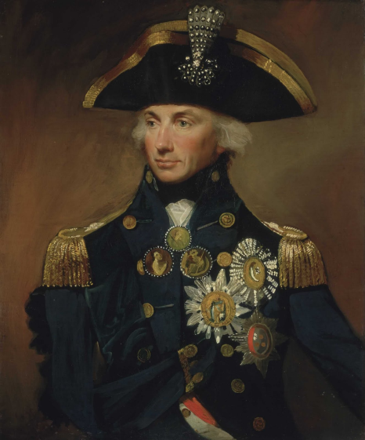
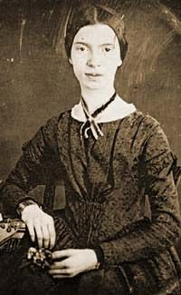





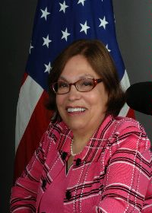
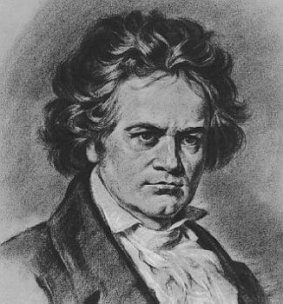
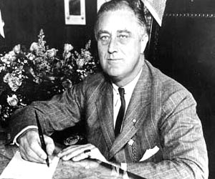


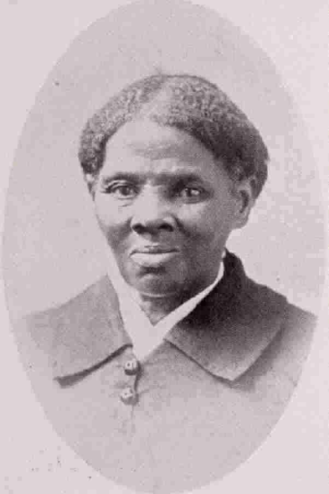

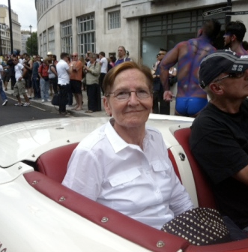

Slide 40
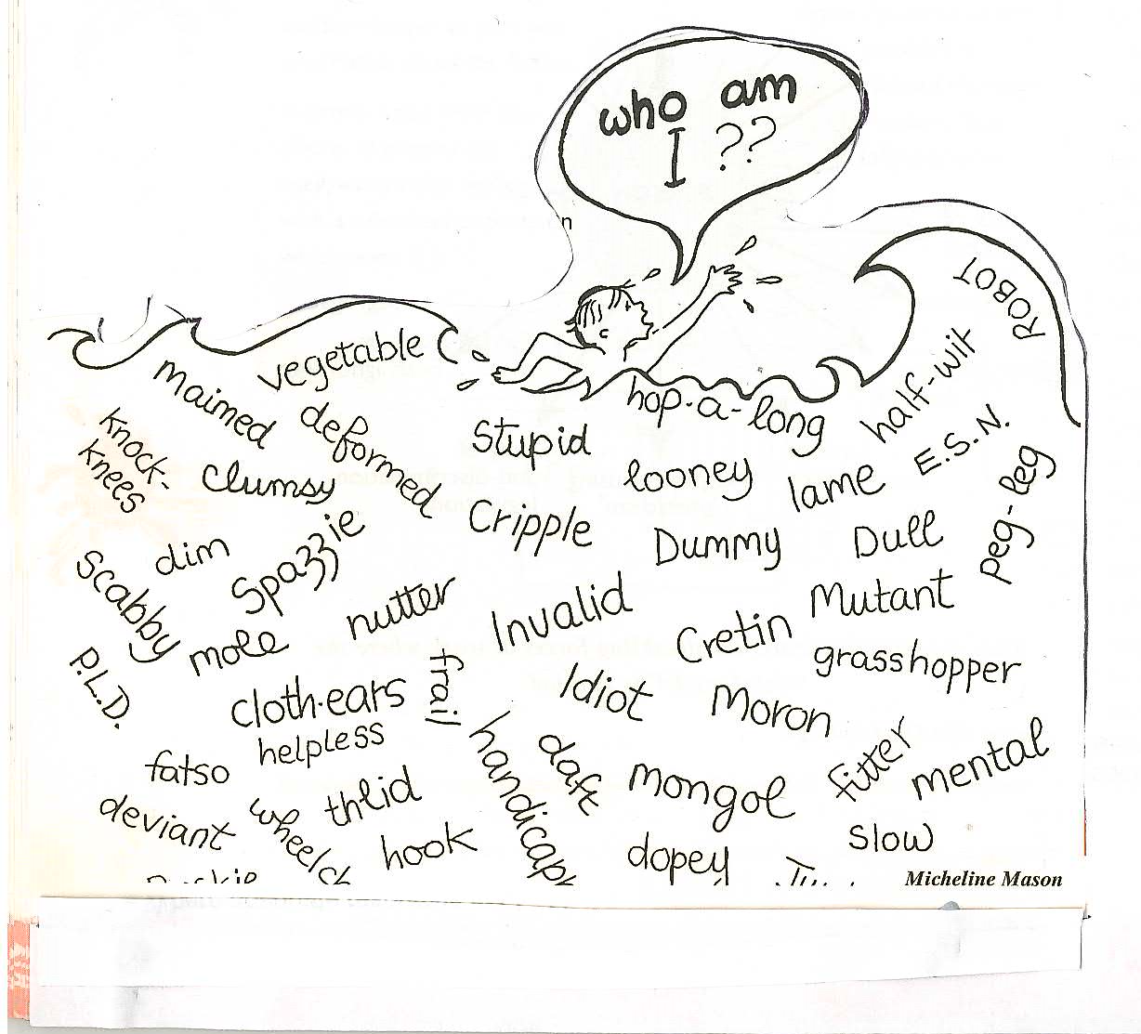

The language we use is like the social geology of attitudes to disabled people
over time

Slide 41
OFSTED 2012 Behaviour and safety of pupils at the school
pupils’ attitudes to learning and conduct in lessons and around the school
pupils’ behaviour towards, and respect for, other young people and adults, including freedom from bullying and harassment that may include cyber-bullying and prejudice-based bullying related to special educational need, sexual orientation, sex, race, religion and belief, gender reassignment or disability (para. 44)
how well teachers manage the behaviour and expectations of pupils to ensure that all pupils have an equal and fair chance to thrive and learn in an atmosphere of respect and dignity

Slide 42
Accessibility Plan
Schools and local authorities are obliged, under the Equality Act 2010, to carry out accessibility planning for learners with a disability (as was the case under the DDA).
Schools must implement accessibility plans, which are aimed at:
increasing the extent to which learners with a disability can participate in the curriculum
improving the physical environment of schools to enable learners with a disability to take better advantage of education, benefits, facilities and services provided
improving the availability of accessible information to learners with a disability
An accessibility plan may be a stand-alone document but may also be published as part of the school development plan. OFSTED inspections may include a school’s accessibility plan as part of their review.

Slide 43
Exclusions and 2011 Education Act
The Independent Exclusion Panel has been removed and Governors are the final arbiter on permanent exclusions
Disabled pupils with a statement are 8 times more likely to be excluded
Disabled pupils on School Action Plus are 22 x more likely to be exclude.
As a result from September 2012 Parents can bring a case to SENDIST to appeal the exclusion of disabled pupils/students. SENDIST will have the power to reinstate. SENDIST could already hear cases on suspensions
Parents of pupils with SEN threatened with permanent exclusion can ask for a report by an independent SEN expert to be made to governors prior to the decision to permanently exclude

Slide 44
Enforcement
It is always best to point out to teachers and the school management their duties and responsibilities under the Equalities Act
If the breach persists parents should complain to the head and, if not resolved, the Governors.
If a maintained school they could us LA complaints procedure
If issue continues Parents should then be advised and supported to take a case for disability discrimination to SENDIST
If the problem is more general and school has not paid due regard to the Equalities Act in making a decision or implementing it the any interested party can seek Judicial Review or complain to EHRC.

Slide 45
The Specific Duty from 2005 Act
The 2005 Disability Amendment Act had previously introduced the requirement on all publicly funded schools and colleges to have a Disability Equality Scheme and that this should be developed from a ‘social model’ perspective i.e. identifying the barriers of attitude, organisation, policy and practice to disabled people’s achievement, progress and employment.
The measure drew on the Macpherson’s Reports identification of ‘institutional racism’ and following the response to this which was the Race Equality Duty, a similar measure for public bodies on disability, including schools and colleges.
This required the involvement of disabled pupils, staff, parents and local community; gathering performance data, an equality impact assessment and the drawing up of series of implementable targets, in a school Action Plan, to improve disability equality over a three year period of which the Governors had oversight.

Slide 46
The dominant view is the
Medical Model.
CHILD DEVELOPMENT TEAM
SPECIALISTS
SOCIAL WORKERS
DOCTORS
SURGEONS
GPs
THE IMPAIRMENT
IS THE PROBLEM
SPECIAL TRANSPORT
SPEECH THERAPISTS
EDUCATIONAL PSYCHOLOGISTS
OCCUPATIONAL THERAPISTS
SPECIAL SCHOOLS
SHELTERED WORKSHOPS
BENEFITS AGENCY
TRAINING CENTRES
DISABLED PEOPLE AS PASSIVE RECEIVERS OF SERVICES AIMED AT CURE OR MANAGEMENT

Slide 47
The Social Model of disablement focuses on the barriers
LACK OF USEFUL EDUCATION
DISCRIMINATION IN EMPLOYMENT
INACCESSIBLE ENVIRONMENT
SEGREGATED SERVICES
THE STRUCTURES WITHIN
SOCIETY ARE THE PROBLEM
DE-VALUING
POVERTY
‘BELIEF’ IN THE MEDICAL MODEL
PREJUDICE
INACCESIBLE TRANSPORT
INACCESSIBLE INFORMATION
DISABLED PEOPLE AS ACTIVE FIGHTERS FOR EQUALITY
WORKING IN PARTNERSHIP WITH ALLIES.

Slide 48




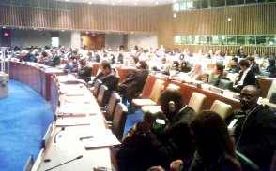
UNITED NATIONS CONVENTION ON THE RIGHTS OF PEOPLE WITH DISABILITIES DEC. 2006:A NEW PARADIGM CENTERED ON THE PERSON WITH DISABILITY
From Medical Model of Disability → Problem in the Person.
Cure, Fix or Separate
To Social Model of Disability based on Human Rights approach- Problem with Society that needs to be changed.
Attitudes
Organisation
Environment
To
153 signatories to the Convention
108 ratifications of the Convention

Slide 49
Shifting the Focus at UN
“Recognizing that disability is an evolving concept and that disability results from the interaction of persons with impairments and attitudinal and environmental barriers that hinders their full and effective participation in society on an equal basis with others.” http://www.un.org/disabilities/
Ratified UK Government July 2009
Move from a dominant medical model to a social model approach-Duty to Promote Disability Equality-2005

Slide 50
Article 24 Education
Requires all signatories to ensure all disabled children and young people can fully participate in the state education system and that this should be an ‘inclusive education system at all levels’
The development by persons with disabilities of their personality, talents and creativity, as well as their mental and physical abilities, to their fullest potential.
This right is to be delivered within an inclusive primary and secondary education system, from which disabled people should not be excluded.
Support provided
Reasonable accommodations should be provided for individual requirements and support provided in individualised programmes to facilitate their effective social and academic education.

Slide 51
UK Government Reservations
"The United Kingdom Government is committed to continuing to develop an inclusive system where parents of disabled children have increasing access to mainstream schools and staff, which have the capacity to meet the needs of disabled children.
The General Education System in the United Kingdom includes mainstream and special schools, which the UK Government understands is allowed under the Convention.
The United Kingdom reserves the right for disabled children to be educated outside their local community where more appropriate education provision is available elsewhere. Nevertheless, parents of disabled children have the same opportunity as other parents to state a preference for the school at which they wish their child to be educated."

Slide 52
Duty to Promote Disability Equality
What do we know?
I carried out an analysis of 50 primary and 25 secondary schemes published on the internet or the Secretary of State in 2008
Two-Thirds of the schemes analysed covered the required six areas:- Promoting Equality, Eliminating Unlawful Discrimination, Eliminating Disability related Harassment, Promoting Positive Attitudes, Encouraging Participation in Public Life and Treating disabled people more Favourably to varying extents.
Only 20% mentioned the social model.
70%+ had engaged with parents, students and staff, but only 6% had talked to ex-pupils and 20% engaged with members of the local community.
Very few schools had gathered any data.
This improved in 2009 and 2010 as OFSTED introduced and Equality Limiting Grade and judged this very largely on attainment data. The 2011 Act has removed this element of the OFSTED framework

Slide 53
Low level promoting positive attitudes in curriculum
Only 17% of this sample outlined how they would raise disability in the curriculum. This low figure led to the Secretary of State instructing QCDA to carry out some research, working with schools on how to raise disability in the curriculum from a social model perspective.
I was commissioned to carry out this work with 26 schools. We also made 9 films, which can be viewed on-line, together with more than 60 lesson ideas and 20 pages of resources for schools to use
QCDA ‘Disability and curriculum, project’ World of Inclusion 2010 http://www.worldofinclusion.com/qcda.htm

Slide 54
Other studies : What do they tell us
A further study I carried out in 2009 with all the schools in a London Borough confirmed these findings, with a wider range of scores. To score 50 a school had to be implementing all the statutory requirements.
None did in either study and many were scoring very lowly.
So they could tick the box that they had a scheme but for many there was little evidence of a serious attempt by the school to address the issues. This second study also reinforced the point that very few schools were using the Procurement of goods and services (6%) to get private providers to conform to the 2005 Disability Equality Act requirements, as was h0ped by the drafters.
A study of 40 secondary schools by Mencap in 2008 carried out by telephone interview found only 7 schools had a DES and only 1 met the statutory requirements
Leeds University Primary Study 2008 found primary focus groups the pupils thought disabled pupils could not achieve anything.
http://www.worldofinclusion.com/res/impact/DES_Anonomised_Report.doc
Mencap(2008) ‘Just Not a Priority: Schools and disability equality’ London, Mencap.

Slide 55
EHRC Study by Ipsos Mori
In 2010 the Equality and Human Rights Commission (EHRC) awarded Ipsos MORI a contract to investigate the impact of Race, Gender and Disability Equality schemes in schools.
This was based on 10% random stratified sample of telephone questionnaires to English and Welsh schools, with 503 interviews completed out of 3329 targeted schools.
This was followed up by 12 in-depth telephone interviews and one field visit.
The researchers found that 88% had a single equality policy and that 79% of schools had a Disability Action Plan, 52% a Race Equality Action Plan and 40% a Gender Equality Plan.
54% of schools that improved facilities to make them suitable for disabled pupils is taken out, as this rightly comes under the Access Planning Arrangements, then the next most commonly identified objective was 14% of schools had a target of making clubs, trips etc accessible to all.
It can be seen that this high figure does not represent the large majority of schools engaging with the key issues under the Public duty of the 2010 Equalities Act for disabled pupils.
‘The Equality Duty and Schools ‘ (2011) Bukowski, G., Roberts, H., Fraser, J and Johnson F EHRC Research Report 70 EHRC , London http://www.equalityhumanrights.com/uploaded_files/research/rr70_equality_duties_and_schools.pdf

Slide 56
The New Public duty came into force on 5 April 2011.
The Duty has three aims. When developing or implementing policy, it requires public bodies to have due regard to the need to:
Eliminate discrimination, harassment and victimisation and other conduct prohibited by the Equality Act 2010
Advance equality of opportunity between people from different groups
Foster good relations between people from different groups.

Slide 57
Equality analysis and engagement
In order to meet the duty, a public authority or school would need to analyse the impact of its policies and practices in respect of equality.
It should be able to demonstrate what has been considered, what information has been used, and what decisions have been reached

Slide 58
2008/9 Exclusions Type School and Level SEN
71 % of permanent Exclusions in 2008/09 Children with SEN
64% of Fixed Term Exclusions in 2008/09 Children with SEN
Fixed Term by | Primary | % Sch. Pop. | Secondary | % Sch. Pop. | Special | % Sch. Pop.
SEN Statement | 5,690 | 9.8% | 19,700 | 29.6% | 15,300 | 17.5%
SEN No St. | 27,250 | 3.7% | 167,080 | 26.8% | 500 | 26.3%
No SEN | 6,560 | 0.2% | 121,500 | 4.7% | 130 | 27%
Total | 39,510 | 1.0 | 307,840 | 9.4% | 15930 | 17.7%
Permanent Exclusion | 720 | 0.018% | 5,700 | 0.17% | 120 | 0.13%
%SEN Excluded | 83% |  | 60.8% |  | 99.2%

Slide 59
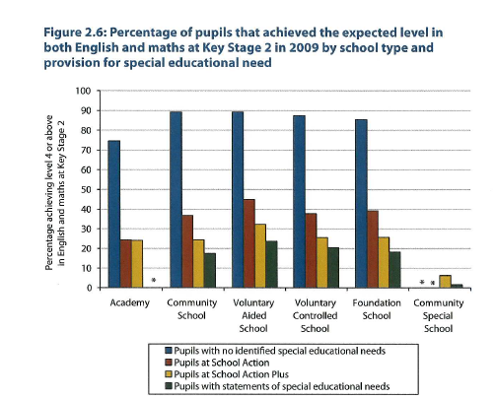

Slide 60
Achievement by type of special educational need comparing community schools and special schools in England at key stage 2 and key stage 4, 2009/2010-School Action Plus and Statement
 | Com. Special Ks2 Level 4 | Com. Prim. KS2 Level 4 | Com. Second 5 GCSE inc E&M | Com Special 5GCSE Inc E&M | Com Sec 5 A-G in E&M | Com Special 5A-G incl E&M
All SEN | 2% | 36% | 17% | 0% | 70% | 7%
MLD | 0% | 20% | 4% | - | 70% | 2%
Autism | 2% | 46% | 25% | 1% | 84% | 7%
BESD | 11% | 50% | 14% | 0% | 64% | 17%
HI | 0% | 49% | 36% | - | 89% | 20%
VI | 5% | 58% | 42% | - | 90% | 33%
PD | 2% | 53% | 33% | - | 86% | 9%
Nos. 1–5 suppressed
Source: Safeguarding and Vulnerable Children Analysis Team, Analysis and Research Division, Children, Young People and
Families Directorate, UK Department for Education, 2010.

Slide 61
OFSTED-2012
Achievement how well disabled pupils and those who have special educational needs have achieved since joining the school
how well gaps are narrowing between the performance of different groups of pupils in the school and compared to all pupils nationally
Quality-the extent to which well judged teaching strategies, including setting challenging tasks matched to pupils’ learning needs, successfully engage all pupils in their learning
the extent to which teachers secure high quality learning by setting challenging tasks that are matched to pupils’ specific learning needs

Slide 62
OFSTED 2012 Judging Attainment
while many pupils with special educational needs are not precluded from attaining as well as or better than their peers, for those groups of pupils whose cognitive ability is such that their attainment is unlikely ever to rise above ‘low’, the judgement on achievement should be based on an evaluation of the pupils’ learning and progress relative to their starting points at particular ages and any assessment measures held by the school, but should not take account of their attainment compared to national benchmarks

Slide 63
Due Regard
‘Due regard’ means to consciously consider these three aims when making decisions about policy or practice which would affect people. For example, the duty covers how:
they act as employers;
how they develop, evaluate and review policy;
how they design, deliver and evaluate services, and
how they commission and procure from others.

Slide 64
Due regard to need to advance equality of opportunity
Having due regard to the need to advance
equality of opportunity involves considering the
need to:
• remove or minimise disadvantages suffered by
people due to their protected characteristics;
• meet the needs of people with protected
characteristics; and
• encourage people with protected characteristics
to participate in public life or in other activities
where their participation is low.

Slide 65

Fostering good relations involves
Tackling prejudice and promoting understanding between people who share a protected characteristic and others.
Complying with the Equality Duty may involve treating some people better than others, as far as this is allowed by discrimination law.
For example, it may involve making use of an exception or the positive action provisions in order to provide a service in a way which is appropriate for people who share a protected characteristic – such as providing computer training to older people or people with learning difficulties to help them access information and services.

Slide 66

Taking account of disabled people’s disabilities
The Equality Duty also explicitly recognises that disabled people’s needs may be different from those of non-disabled people.
Public bodies should therefore take account of disabled people’s impairments when making decisions about policies or services.
This might mean making reasonable adjustments or treating disabled people better than non-disabled people in order to meet their needs.

Slide 67
Principles drawn from case law that it is essential to fulfil to meet the Equality Duty-1
Compliance with the Equality Duty involves a conscious approach and state of mind.
Timeliness – the Equality Duty must be complied with before and at the time that a particular policy is under consideration or decision is taken – that is, in the development of policy options, and in making a final decision. A public body cannot satisfy the Equality Duty by justifying a decision after it has been taken.
Real consideration – consideration of the three aims of the Equality Duty must form an integral part of the decision-making process. The Equality Duty is not a matter of box-ticking; it must be exercised in substance, with rigour and with an open mind in such a way that it influences the final decision.
Suffcient information – the decision maker must consider what information he or she has and what further information may be needed in order to give proper consideration to the Equality Duty.

Slide 68
Principles drawn from case law that it is essential to fulfil to meet the Equality Duty-2
No delegation – public bodies are responsible for ensuring that any third parties which exercise functions on their behalf are capable of complying with the Equality Duty, are required to comply with it, and that they do so in practice. It is a duty that cannot be delegated.
Review – public bodies must have regard to the aims of the Equality Duty not only when a policy is developed and decided upon, but also when it is implemented and reviewed. The Equality Duty is a
continuing duty.

Slide 69
Demonstrating compliance with the
Equality Duty
There is no explicit requirement to refer to the Equality Duty in recording the process of consideration but it is good practice to do so.
Keeping a record of how decisions were reached will help public bodies demonstrate that they considered the aims of the Equality Duty

Slide 70
What happens if the Public Sector Equality Duty is not considered?
If a public authority fails to give due regard to the duty, it could be challenged through a judicial review made by an individual, a union or NGO or by the Equality and Human Rights Commission (EHRC).

Slide 71
Specific Duty has been gutted
Coalition Government are of the view the specific duty places and undue bureaucratic burden on schools
From April 2012 Governing Bodies need to identify 1 Equality Objective over four years
They need to consult but this no longer says they must consult with disabled people and their organisations. There are no longer penalties for non-compliance.
Nothing to stop schools that have a good Disability Equality Scheme keeping it And adding to it. Without it how will they be sure they have paid due regard to the General Equality Duty.

Slide 72
Identify Three Key Equality Objectives for Schools you works with to meet to promote the equality of sensory impaired pupils
1.
2.
3.
How will you ensure disability equality remains on the agenda of schools you work with?

