Slide 1

Funding Update
NatSIP Working Day and
HoSS Event
4 October 2017
Brian Gale
Director Policy and Campaigns

Slide 2

Announcements

Slide 3
  In July 2017 the DfE confirmed :
  It would introduce national funding formulae in 2018-19 for schools and high needs funding.
  The formula would be supported by an additional investment of £1.3 billion across 2018-19 and 2019-20.
  The additional funding would be distributed in a way that will enable all schools and local areas to benefit.
  In Sept 17 the DfE set out its response to the consultation and the details of the final national funding formulae.

Slide 4
Structure
Dedicated schools grant now in 4 blocks:
Schools - must be distributed through a local formula
High needs
Early Years (see presentation from previous working day)
Central School Services (a new block )
  99.5% of the schools block will be ring-fenced. With agreement from their schools forum, LAs can move 0.5% into other blocks.
In the long-term schools’ budgets set by a single, national formula (a ‘hard’ formula). But use of local LA formula in 2018/19 and 2019/20 to ensure some transitional stability.

Slide 5

Schools Block

Slide 6
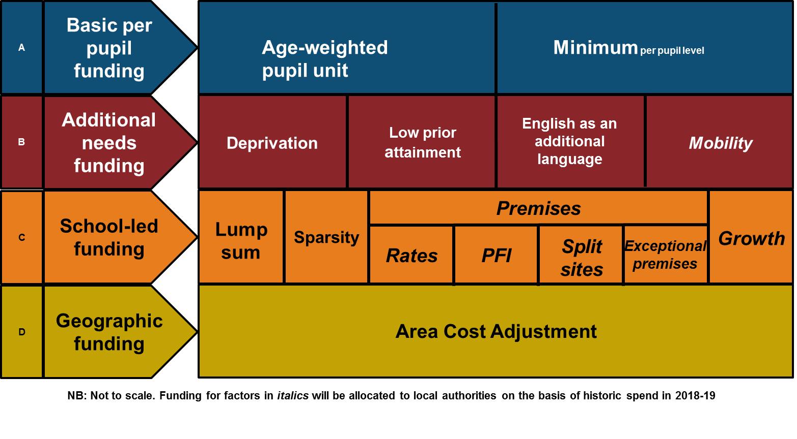
The schools NFF
14 factors – the minimum per pupil level is an addition to the 13 in the original proposals

Slide 7
School NNF
3 improvements to the formula proposed in December 2016:
  Increase in the basic per-pupil amount. Primary schools, key stage 3 and key stage 4 pupils attract £2,747, £3,863 and £4,386 respectively;
  An additional formula factor to provide a minimum per-pupil funding level over the next two years. For secondary it is £4,800 in 2019-20 (£4,600 in 2018-19).For primary it is £3,500 in 2019-20 (£3,300 in 2018-19).
  An increased the funding floor to provide for an increase of at least 0.5% per pupil in 2018-19 and at least 1% per pupil by 2019-20 in respect of all schools compared to their baselines.

Slide 8
Schools NFF – the 14 factors
  Basic per-pupil funding (£24.2bn, 72.9%)
    Age Weighted Pupil Units - the basic funding that all pupils attract (£2,747 for primary; £3,863 for KS3; £4,386 for KS4).
    Minimum per-pupil funding levels
    £4,880 for secondary in 2019-20 with transitional amount of £4,600 in 2018-19.
    £3,500 for primary 3,500 in 2019-20 with a transitional amount of £3,300 in 2018-19.

Slide 9
Schools NFF – the 14 factors
  Additional needs funding (£5.9bn, 17.8%)
    Deprivation funding– eligibility for free school meals (both current and historic), and postcode-based deprivation (IDACI).
    Low Prior Attainment– pupils not achieving the expected level on entry to primary school/at key stage 2 attract additional funding.
    English as an additional language– a pupil who speaks English as an additional language will attract funding if they have entered the state education system during the last three years.
    Mobility funding- allocated to LAs on a historic spend basis.

Slide 10
Schools NFF
  School-led funding (£3.1bn, 9.3%)
    Lump sum- £110,000 for every school.
    Sparsity- eligibility depends on the distance the pupils in the school would have to travel to their next nearest school and the average number of pupils per year group.
    Premises- Four factors: rates, split-sites, private finance initiative (PFI) and exceptional circumstances. Allocated on the basis of historic spend.
    Growth- allocated on the basis of what LAs plan to spend on growth in 2017-18.
  Area cost adjustment- takes into account the general labour market trends and the particular salary variations in the teaching workforce. Applies to basic per-pupil, additional needs and school led funding.

Slide 11
Schools NFF – Floors and Caps
  The funding floor
    Formula provides for an increase of at least 0.5% per pupil in 2018-19 and at least 1% per pupil by 2019-20 in respect of all schools compared to their baselines.
  The gains cap
    The gains cap will be 3% per pupil in 2018-19 and a further 3% per pupil in 2019-20, over 2017-18 baselines.
    A small adjustment to the gains cap to limit gains to the greater of 3% of a school’s baseline or 20% of their remaining formula cash gains. This is to ensure that schools with very low pupil-led baselines are not disadvantaged by the gains cap.

Slide 12
Central School Services Block
  Created from the DSG funding that is held centrally by the LA for central services, and the retained duties element of the Education Support Grant.
  90% of funding distributed according to a per-pupil factor and 10% of funding according to a deprivation factor. Both elements are adjusted for area costs.
  CSSB also provides funding for historic commitments.
  A protection will be in place in 2018-19 and 2019-20 that limits reductions to 2.5% per-pupil a year. The level of gains allowed in 2018-19 are up to 2.5%per pupil.

Slide 13

High Needs Funding

Slide 14
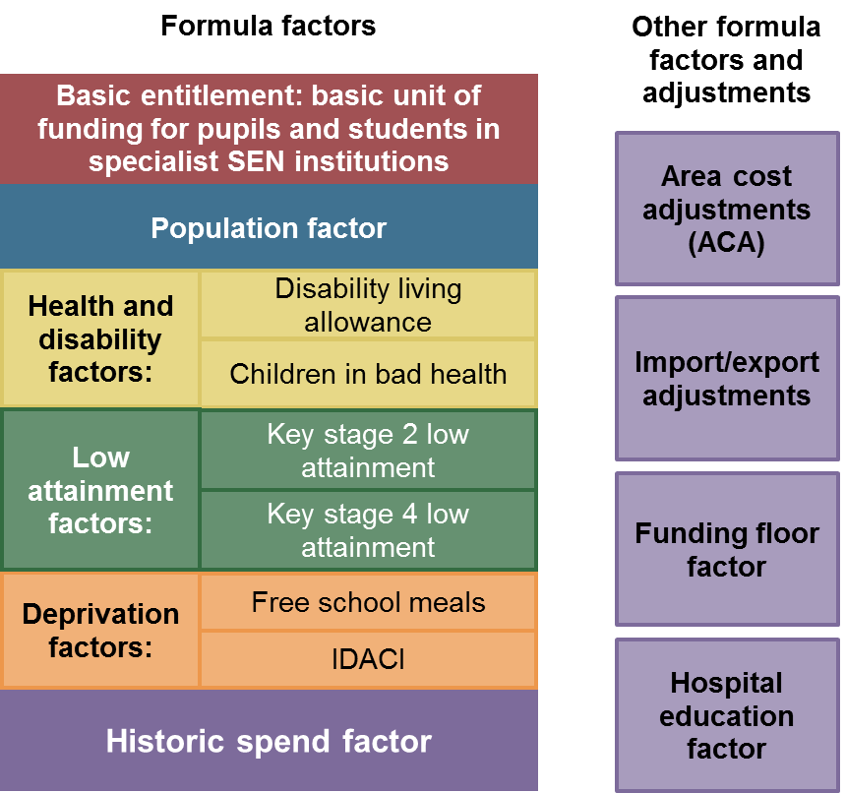
Adopt a NNF for allocating HNB

Slide 15
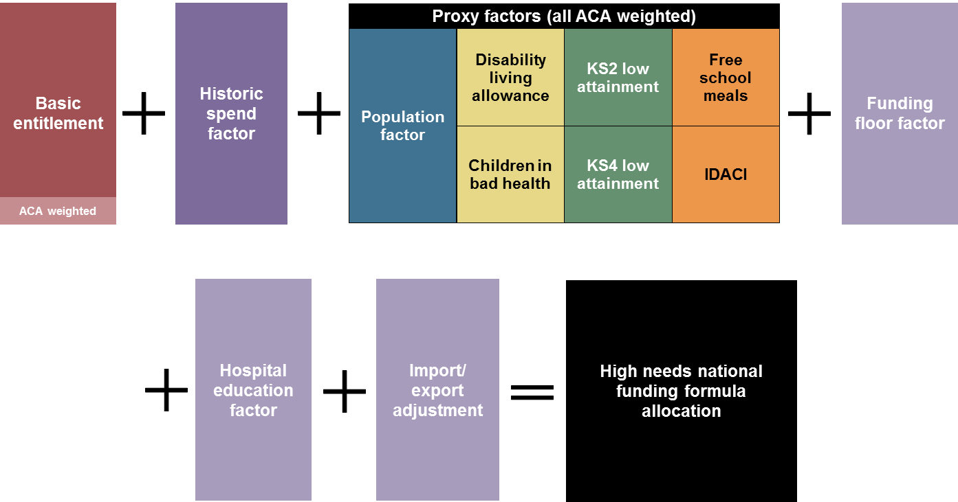
Calculation of a LA’s HN Block

Slide 16
Basic Entitlement factor = £4,000 per special school and special post 16 institution
Import / export adjustment = £6,000 per high needs pupil student
Historic spend factor = cash sum equivalent to 50% of the 2017-18 spend baseline

Slide 17
Formula weightings
Proxy factor | Proposed weighting
 | SEN (90%) | AP (10%) | Combined
Population | 50% | 50% | 50%
Deprivation
FSM eligibility | 8.3% | 25% | 10%
IDACI | 8.3% | 25% | 10%
Low attainment
KS2 results | 8.3% | 0% | 7.5%
KS4 results | 8.3% | 0% | 7.5%
Health and Disability
Children in bad health | 8.3% | 0% | 7.5%
Disability Living Allowance | 8.3% | 0% | 7.5%

Slide 18
December 2016 announcement
DfE will allocate HNB based on a NFF.
LAs who are underfunded will see gains of up to 3% a year in 2018/19 and 2019/20.
LAs who lose out will be protected by a funding floor of 0%.

Slide 19
Improvements to the Dec 2016 proposals
  Increase in the funding floor from 0% to 0.5% in 2018-19 and 1% in 2019-20. (Calculation based on adjusted 2017-18 spending baselines derived from the information provided by LAs.)
  The funding floor and the gains on a per head of (2-18) population basis to reflect demographic increases. The funding floor also has a cash floor to protect LAs with falling populations.
  For those elements of the formula which are intended to reflect more precisely the movement of pupils and students (the basic entitlement factor and import/export adjustments), there are later updates to the provisional allocations.

Slide 20
Impact of NFF by Region (Dec 2016) if NFF implemented in full
 | No. of LAs | No.& % of LAs gaining | Largest gain | Total Gain
Inner London | 13 | 5 (38%) | 4.7% | £3m
Outer London | 19 | 5 (26%) | 19.7% | £10m
East Midlands | 9 | 3 (33%) | 22..9% | £17m
South East | 19 | 5 (26%) | 19.3% | £16m
Y&H | 15 | 13 (87%) | 20.0% | £49m
North West | 23 | 13 (57%) | 17.6% | £26m
South West | 15 | 4 (27%) | 11.3% | £5m
East of England | 11 | 6 (55%) | 12.7% | £20m
West Midlands | 14 | 11 (79%) | 12.4% | £38m
North East | 12 | 7 (58%) | 19.0% | £8m

Slide 21
Impact of floors and ceilings
 | Gains with floor and ceiling 2017/18-2019/20 | Gain if implemented in full 20/17-2019/20
Nottingham | 6.4% | 23.1%
Liverpool | 5.8% | 17.1%
Tameside | 6.0% | 17.7%
Barking and Dagenham | 8.3% | 19.8%
Kirklees | 6.0% | 20.9%

Slide 22
Illustrative allocations
https://www.gov.uk/government/uploads/system/uploads/attachment_data/file/644810/Impact_of_the_high_needs_NFF.xlsx
https://www.gov.uk/government/uploads/system/uploads/attachment_data/file/644723/NFF_Summary_Table.xlsx

Slide 23
Demographic pressures
Number of C&YP with statements or EHC plans: |  | 2015 | 2016 | 2017 | Change 2016 to 2017
 | Under 5 years of age | 11,250 | 10,513 | 11,629 | 10.6%
 | Aged 5-10 | 91,045 | 92,213 | 97,379 | 5.6%
 | Aged 11-15 | 112,340 | 111,225 | 112,540 | 1.2%
 | Aged 16-19 | 25,538 | 41,300 | 58,034 | 40.5%
 | Aged 20-25 | 10 | 1,064 | 7,708 | 624.4%
 | Total | 240,183 | 256,315 | 287,290 | 12.1%

Slide 24
Demographic pressures
Children and young people with statements/EHC plans in
 | 2015 | 2016 | 2017 | Change 2016 to 2017
Special Schools | 109,519 | 113,962 | 118,588 | 4.1%
Alternative Provision | 1,549 | 1,489 | 2,209 | 48.4%
Excluded not placed | 17 | 39 | 102 | 161.5%
Other LA arrangement | 909 | 1,931 | 2,041 | 5.7%
Other parent arrangement | 1,439 | 1,734 | 2,111 | 136.8%
Awaiting provision | 1,073 | 1,710 | 4,050 | 53%

Slide 25

DSG Block Movements

Slide 26
DSG block movements
Original proposal was to ring fence the schools block because of the political imperative to have a “hard” national formula for school budgets.
In previous years LAs transferred over £100m pa to the HNB to help pay for SEND and AP pressures.
DfE will now allow for local budget flexibility arrangements associated with the schools block ring fence.

Slide 27
DSG block movements
  Schools forums can agree that up to 0.5% of their schools block can be transferred out (e.g. to LAs’ high needs budget).
  This is more than the amount LAs as transferred in previous years and would on average represent a 3% increase to the average LA’s HNB.
  The operational guide sets out what information schools forums should take into account, including the outcome of consulting all schools.
  The department will consider applications from any LA that finds it absolutely essential to seek an exception to the 0.5% and schools forum agreement rules.

Slide 28

Biggest worry
No repeat of the baseline exercise for 2019-20 so any transfers LAs make between their DSG blocks are for one year only

Slide 29
A reminder about resource provision
Place funding reduced from 10k pa to £6k pa
A cost neutral baseline adjustment to the DSG to reflect a change in funding of schools with units from April 2018
Involves transfer of £90m from the HNB to the Schools Block
The detail:

Slide 30
Units - Existing
£10k per place with the place number deducted from the pupil number used to calculate the mainstream school budget to prevent double funding. Pupils not counted on school’s roll for purposes of calculating mainstream school budget
Top up funding from LA

Slide 31
Units – proposed 2018/19
Pupils attending unit won’t be deducted from the mainstream funding allocation.
But level of place funding for places occupied by pupils will be reduced to £6k.
i.e. the £10k place funding is replaced by mainstream formula funding from the schools block +
Places not filled at the time of the school census will be funded at £10k.

Slide 32
Current example
20 places – 15 on roll at census time, 3 pupils join later, 2 empty places:
20 places at £10k = £200k
Plus any top up

Slide 33
Proposed example
20 places – 15 on roll at census time, 3 pupils join later, 2 empty places:
4k basic mainstream entitlement = 15x£4k = £60k
£6k per high needs place occupied = 15x£6k = £90k
£10k per unoccupied place = 5x£10k = £50k
Plus any top up

Slide 34
Managing the pressures
DfE support to LAs:
  £23m high needs strategic planning fund paid in January 2017
  Benchmarking tools published in March, due to be updated in October 2017
https://www.gov.uk/government/uploads/system/uploads/attachment_data/file/600374/High_Needs_LA_Benchmarking_Tool_v1.1.xlsm

Slide 35

What’s next

Slide 36

Response to all the concerns over post 16
“We recognise the need to proceed with care, address the underlying issues in the context of the wider changes to FE and in due course decide on what changes to propose and what the timetable for change should be” DfE Sept 17.

Slide 37

Alternative provision
Original proposal was that schools commission AP. No noticeable progress.
So if school block is ring fenced it is an open invitation to exclude without experiencing the financial consequences.

Slide 38
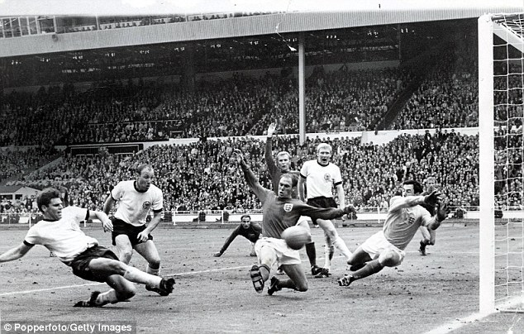
Just as you think it’s all over
Research into the factors that are driving cost and whether new indicators could improve the formula.
A review planned within 4 years.
But a tweak to the formula wont address underlying issues and pressures.

Slide 39


