Slide 1
‘Strengthening services through the voice of the child’:
Nicky Ereaut, Specialist Manager
(Sensory, Physical & Complex Needs)
Special Educational Needs Support Services, Oxfordshire
HOSS 2017 / NatSIP 04.10.2017

Slide 2
Participation of CYP in Service Development – ‘Nothing About Me Without Me’
What are we doing to engage CYP in developing services?
Activity | Team |  |  |  |  |  |  | Comments | TL
 | D&CN | HI/MSI | PD | Post-16 (SI) | SENICT AAC | VI | C&I |  | G | A | R
Annual review/transfer review meetings – In person, video, ‘All About Me’, Wiki |  |  |  |  |  |  |  | Feedback from CYP is key to establishing outcomes for EHCP. Reports from professionals are not written for CYP as primary audience. SENSS staff respond to specific requests from CYP raised at meetings
Writing personalised learning plans |  |  |  |  |  |  |  | VI/HI: Some CYP contribute to intervention programmes (logs) MSI communication passports C & I Bases involve students in target setting and writing communication passports
Exit Interviews/questionnaires |  |  |  |  |  |  |  | Post-16: Part of the ADEPT (NATED) process VI/PD: introduced in year 11 and year 13. C & I transition programme for some pupils in year 6 supported by C & I support workers/ learning mentors
How’s it Going? Readiness2Learn |  |  |  |  |  |  |  | How’s It Going and R2L with guidance to support collation of data established across SENSS from Sept 2015
Co-delivering training in schools - producing the power point, shared delivery, video … |  |  |  |  |  |  |  | Staff INSET Peer INSET where required HI – CYP included on film clips to support training nationally and locally SEN ICT: use film clips of CYP

Slide 3
Co-delivering training for parents / carers - pre-school support groups, parent eve’s … |  |  |  |  |  |  |  | HI: ODCS VI: Event for families with input from YP SEN ICT: use videos of CYP No involvement of CYP in Early Bird
Co-delivering training externally: mandatory teacher training courses, VCA’s |  |  |  |  |  |  |  | HI: ToD training / conferences For NDCS
School councils, form / tutor representatives |  |  |  |  |  |  |  | All teams encourage participation of CYP
Engagement Team Locally – OYE, Oxfordshire Youth Parliament, Sounding Boards |  |  |  |  |  |  |  | HI: OYE and Sounding Board
Engagement Nationally: VCA’s – YP sounding boards, National Youth Parliament |  |  |  |  |  |  |  | HI: NDCS DELTA CHARGE
Interview process for new staff – on the panel, feeding back after a teaching session |  |  |  |  |  |  |  | HI/VI – feedback from teaching task PD – Enabler Interview C & I candidates are observed working with CYP but feedback not requested
Trialling new equipment – feedback collated and used formatively |  |  |  |  |  |  |  | New equipment trialled but information not formally collated. PD / SENICTAAC – equipment often bespoke
Representation on Interagency Groups |  |  |  |  |  |  |  | Restricted due to timetable constraints
Facebook / Blogs / Twitter etc. |  |  |  |  |  |  |  | The Post-16 SI team has a Facebook page linked to CoOC.
Base students taking the lead showing transitioning students, parents and visitors round the base

Slide 4
Takeover Day: students take some of the adults' responsibilities such as taking the register, as well as teaching staff lessons about their chosen topic.
Priorities for the future | Reason for choosing this as a priority
Co-delivery – training CYP involvement | Impact on target audience
Exit interviews Y11, extending to Y6 | Extend across SENSS – quality of feedback generally very constructive in terms of service development
Person centred planning – quality of input from CYP to target and outcome setting | Impact on outcomes / ownership of targets

Slide 5
‘Pupil Voice’ Examples
‘All About Me’
Wiki’s
Personalised Learning Programmes / Plans
Passports
Pupil contributions to review meetings
Assessment (How’s it going?, Readiness to Learn)
Equipment trials

Slide 6
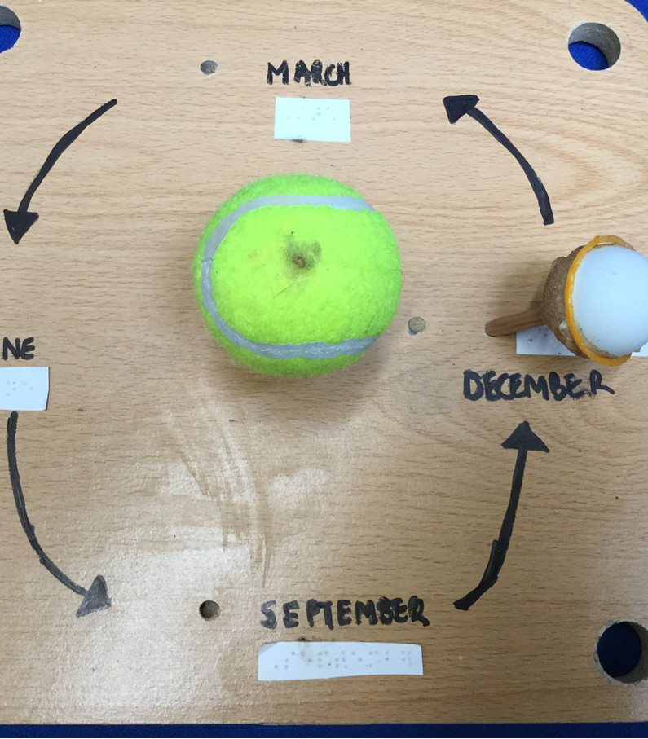
Appointing new staff
Involvement in teaching session
Pupil feedback about learning experience:
Accessibility of resources used?
Use of equipment?
Understanding?
What was good?
What was more difficult?

Slide 7
Training
Training for mainstream staff and peers (CYP writing / contributing / delivering training packages / use of video.

Slide 8
Listening with friends
This can be really hard because it’s really noisy with loads of people talking. Outside when it’s windy is even worse.
Sometimes they talk really loudly and with their mouth, like, really open.
Quite often I pretend I understand when I don’t, and I feel a bit stupid.
Sometimes they talk with their head moving and they cover their mouth while they’re talking.
Sometimes I can’t get what they’re talking about and I go “What are you talking about?” And they go “Oh, I’ll tell you later”
It makes me feel angry because I don’t know what they’re talking about!
Sometimes when they say a joke I don’t hear it, and they all start laughing, but they don’t say the joke again.
https://www.youtube.com/watch?v=al8dLLbzX_E&feature=player_detailpage&list=PL8D1ABCAD37FF582F
Notes:
R didn’t want to be ‘the guy who sat in the corner and nods and pretends I know what was going on.’ He had been coping academically well but was quite down about his social life at. He shared with all of Yr 9 pupils and the staff who observed then asked for this to be shared at a Staff training for all staff around well-being.

Slide 9
Things teachers do …
Keep the class quiet
Listen when I have a question
Repeat the question again till I understand
Speak clearly so I can understand
Use my radio well
Put a friend to sit next to me
Too much talking
Talk too fast
Don’t explain things enough
When they repeat it, they change the words around
Take the radio off
Turn their back and keep on talking

Slide 10
Positives & Negatives of being deaf
More rewards:
Going to deaf camps, to meet new people.
Having a day off school to go to the hospital for hearing tests.
Taking out my hearing aids to hear nothing, especially when my brother sniffs, urgh. HOW LUCKY!
One of the perks of being deaf is having free stuff and discounts, like having a free cinema ticket for some subtitled movies. Also when we go to a theme park we get a discount and a pass to skip the LONG queues.
There are some disadvantages of being deaf such as having to remember to charge your transmitter every day or changing your batteries and puffing out my moulds. Also in conversation I miss out important bits and it’s tricky to sometimes hear what people are saying.
Notes:
R Year 7 training which he made with me and staff said it was really useful and because it was in his words they really took note of it. They shared it with all staff including canteen and grounds staff.

Slide 11
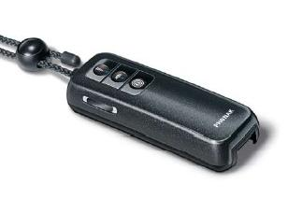
Zoomlink plus (FM system - transmitter)
This transmitter will go round your neck. Put the screen towards your chest so it doesn’t swing about. Pull up the neck cord and please don’t leave it swinging from side to side and fiddling with it as it makes a really annoying noise.
This is the button I use (white circle) It is also the on and off button
The microphone is quite sensitive to clothes rubbing against it – rubbing against wool is an especially irritating sound and necklaces and ID badges are a horrible sound like constant clapping in your ear.
It is helpful to pass it round when I am in a group and when pupils are speaking to the class. It needs to be held the right way, not touching the mic and I get a bit embarrassed having to tell people all the time.

Slide 12
Transitions
I’m not really worried about going up as much as just thinking about it a lot. It doesn’t help that my mum and brother don’t think I’ll ever get myself organised. BUT I think I’ll be more organised than my brother!
I need to know someone quite well to share worries. I tend to keep things to myself.
I don’t really care about bullying because I think what they are saying is rubbish and I don’t believe it, but I don’t want to get in fights. I know lots of Year 7 and 8’s already from Scouts and Roller Hockey.
I like to stay at the front of the class and I don’t think I will want to ask to move if I am not here. It might be embarrassing if other people have to move for me and leave their friends. So please can I be at the front on seating plans. I will need to be at the front in the hall for assemblies.
If the teacher talks really fast I don’t get it but I’m not sure if I can ask them to slow down. If you talk quickly could you check if I am following what you’re saying but not in front of the whole class – its better if you ask when everyone is starting their work.

Slide 13
VI Activity Day Feedback
I would improve the ‘Thomley Activity Day’ by:
Making time in the music room
Helping my friends more
I would go inside and go in the music room
Making more free time
Not sure
Nothing; it is perfect!

Slide 14
Peer support – HI secondary day
Whilst I missed some of the role models I did hear L speak and he was fantastic. It was great to hear him saying how he didn’t take ToD advice at the time but now realised it was important and that since he had changed his attitude and accepted his deafness he had found life a lot easier: that really resonated with a number of the students I heard talking about it afterwards

Slide 15
Young people talking to families
Input at family events such as pre-school support group
Meeting Oxfordshire’s children “Such an important, inspiring and useful session at every stage/level /age of huge benefit, particularly new families and those about to start school”

Slide 16
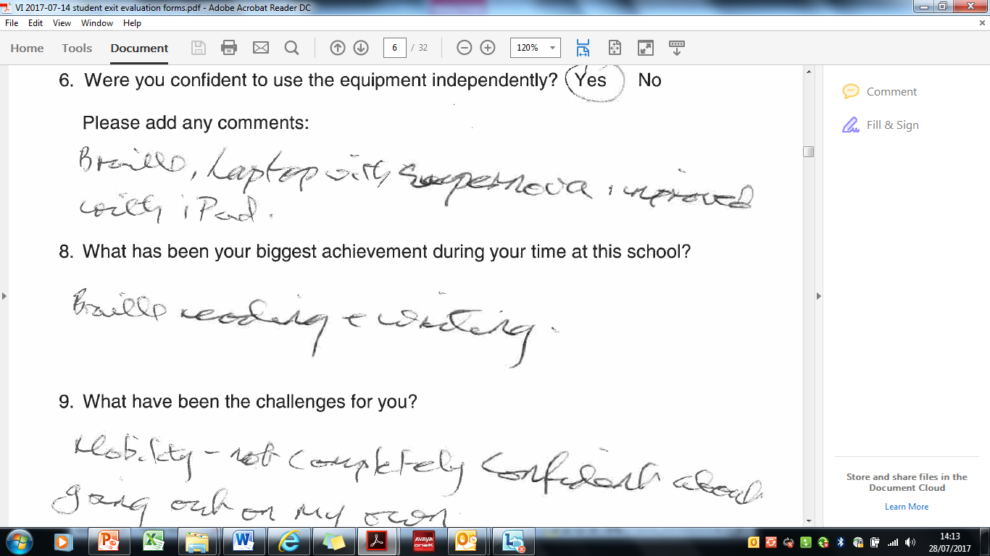
Exit Interview

Slide 17
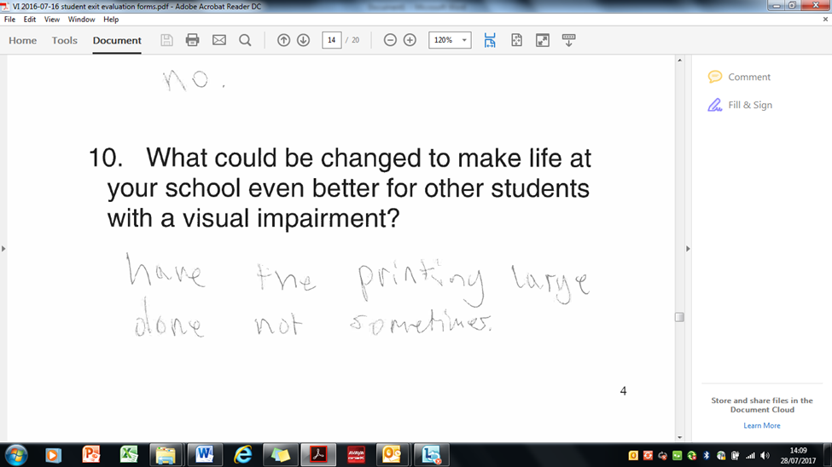
Exit Interview

Slide 18
School Information Report
Pupil contributions to the Aims of the Resource Base for the School Information Report for the secondary school hosting a resource base for children with hearing impairment
The first one about transition is absolutely accurate as Mr M gave me a few tours before moving up and it helped a lot! This tour made me feel much more grown up and I generally knew where things were
I think being an independent young person is the most important aim that you have. The HI helps me to be independent in school. For example I will be on my own without support for my Duke of Edinburgh expedition because I had support leading up to it. I’m really excited and proud that I’m going to do it on my own just like the other hearing people.

Slide 19

Schools Accessibility Strategy
5. Your chance to influence our Schools Accessibility Strategy
Headteachers, SENCos, Inclusion Managers
We’re reviewing our Schools Accessibility Strategy and want you, and pupils in your school, to get involved.

Slide 20
Schools Accessibility Strategy
Listening Post (session to listen to views)
Invitation to pupils:
Getting the right help at school
Findings out your views on what helps you to take part fully in every bit of school life will help shape a strategy

Slide 21
Wider involvement - county council initiatives and with VCS / NatSIP
SENSS Children’s Rights Group – development of on-line questionnaire in schools as part of the Anti-Bullying Strategy
NatSIP / NDCS – e.g. ‘Think Right Feel Good’, Supporting Deaf Young People Through Transition

