Slide 1

Update on SEND and SI Provision
NatSIP National Working Day and HoSS Event
Strengthening the sector in preparation for change
Wednesday 4 October 2017, London
André Imich,
SEN and Disability Professional Adviser, DfE

Slide 2
SEND Reforms – DfE Headlines
‘Business as usual’
A focus on transition
  Quality plans, transition complete by 31 March 2018
  Monitoring, and support and challenge to local areas
Looking to the future
  Working with a new Minister
  Support for reforms post March 2018

Slide 3

What does successful implementation of the SEND reforms look like?
2. All parties meet their statutory duties
1. Co-production with children, young people and parents
3. Increased satisfaction with access to local services
8. Improved parental confidence
4. Accurate and timely identification of SEN and disability
7. More YP go on to post-16 education, training & employment
5. Improved attainment and narrowing of gap for CYP with SEND
6. Strong focus on those at SEN Support

Slide 4
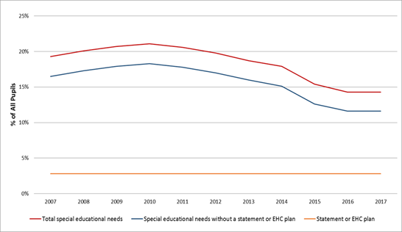
SEN Profile 2007-2017

Slide 5
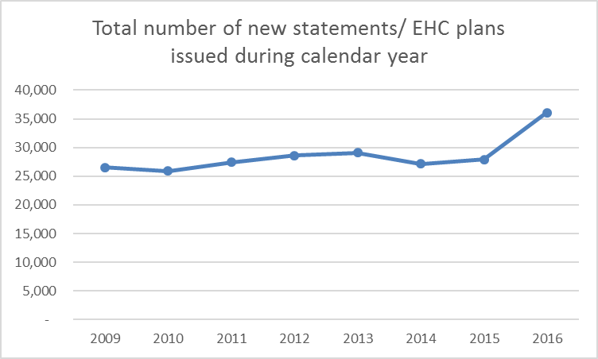
The position as at January 2017
  Increased demand for EHC Plans - over 8,000 more plans issued in 2016 compared to 2015
  There are now more than 30,000 statements/ EHCPs in the system than last year

Slide 6
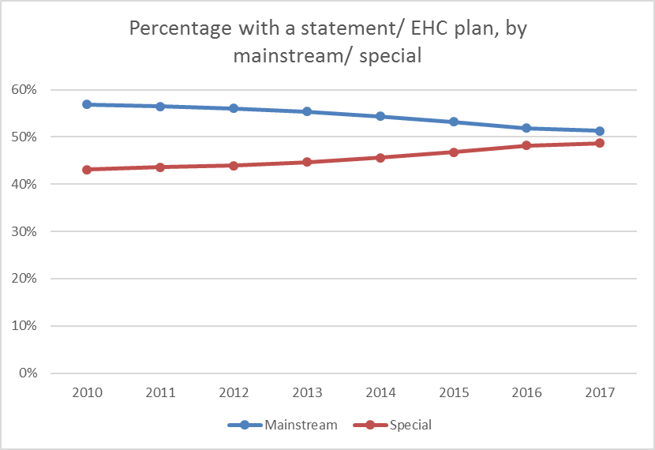
Mainstream/ Special Placements (May 2017)
  A small drop in numbers of EHC Plans or statements in mainstream education; an increase in special school places – now roughly 50:50

Slide 7
Further key data, May 2017
  Number of EHC plans issued within 20 weeks remains broadly stable at around 60% (compared to 2015)
  The transfer from statements to EHC plans is on track – at Jan 2017, EHC Plans made up 61% of the stock of all statutory plans
  1,886 mediation cases held during 2016. Of these, 477 (25.3%) were followed by appeals to the tribunal.

Slide 8
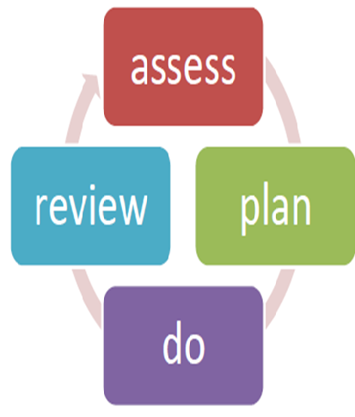
Making SEN Support work - Local authority
LAs must set out the responsibilities for special educational provision made from school, early years and post-16
Clear arrangements for accessing support services, e.g. EPs; CAMHS; specialist teachers/ support services; therapists
SENCO and class teacher, with specialists, involving the pupil’s parents - focus on evidence-based effective teaching approaches, equipment, strategies and interventions.
Support systems for SENCOs

Slide 9

A Good Education Health and Care (EHC) plan
Meets the requirements of the Act, regs and the Code.
Is produced in 20 weeks
Is co-produced
Sets good, relevant outcomes
Describes positively what children and YP can do
Can only be as good as the advice received during the assessment

Slide 10
Person-centred reporting in assessments - S19 Implications
All involved in assessment must:
seek and take account of the views of parent, child and young person;
enable/ facilitate access to the assessment process – locations, timings;
consider the long-term future for the child/ young person;
write assessments in ways that are understandable.

Slide 11
Specialist teacher advice should:
Be clear, accessible and specific;
Provide advice about outcomes relevant for the child or YP’s age and phase of education, and strategies for their achievement.
LAs can provide guidance about the structure and format of advice and information to be provided.
Professionals should limit their advice to areas in which they have expertise.
Can comment on the amount of provision a child or YP requires – must be specific and quantified

Slide 12

What are families saying about their experience of EHCPs?
Survey of 13,500 parents/YP who received EHC plan
in 2015.
66% were satisfied with the overall process of getting an EHC plan
62% agreed the help and support set out in the EHC plan will achieve the outcomes agreed
67% agreed their plan improved the child or young person’s experience of education
62% of those whose EHC plan addressed health needs
62% agreed it has improved the child/young person’s health or wellbeing.
https://www.gov.uk/government/publications/education-health-and-care-plans-parents-and-young-people-survey

Slide 13

The process of getting a plan
Two thirds of parents and YP were satisfied with the overall process of getting an EHC plan.
Half found that starting the EHC plan process was easy;
One quarter found this to be difficult.

Slide 14
Parents and young people who received an EHC plan in 20 weeks were more likely to report that:
involvement was very easy/easy
reaching agreement on the needs and support described in the EHC plan was much easier
the time and work that they had to invest was reasonable.
communication about the EHC plan was always or mostly clear throughout the process
that different professionals and services worked together
assessment staff were knowledgeable
their views were included in the EHC plan
the plan will achieve the agreed outcomes

Slide 15
% of EHC plan completed in 20 weeks during 2016
England | 58.6% (10 LAs – 100%; 35 LAs > 90%; 58 LAs > 85%)

Slide 16
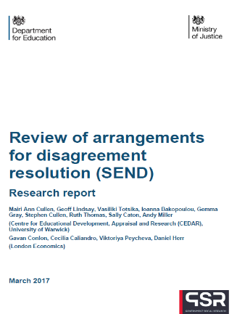
What parents want to experience during EHC plan processes
To see their child’s needs being recognised and met so the child/ young person had as good a chance as possible of a fulfilling life
To be in good communication with professionals/workers dealing with their child/young person’s case
To be listened to and have their views taken on board – or at least be respectfully included in discussion around ‘next best’ options
To interact with staff who know and apply SEND law and principles and who understand good practice
To interact with staff who show understanding and empathy of the lived reality of caring for a child/young person with complex SEND

Slide 17
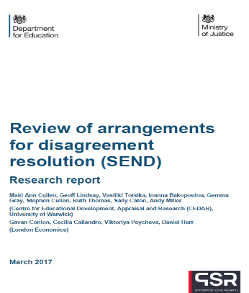
Decision-making – National data
72% of requests for EHC needs assessments
were agreed
7% of refused requests for assessment resulted in appeal
96% of assessments led to an EHC plan being written
94% of EHC plans were accepted without appeal
6% of EHC plans were appealed (Section B, F or I)
12% of assessments that resulted in a refusal to issue an EHC plan were appealed
Majority of appeals were conceded or withdrawn before being heard by the Tribunal.

Slide 18
From local area inspections (since May 2017)
High proportion of new EHC plans completed within 20 weeks AND the local area is well on track to complete all transfers by April 2018.
Cambridgeshire Gateshead
Halton Northamptonshire
Telford and Wrekin Brent
Bury Wakefield
Cornwall Rutland

Slide 19
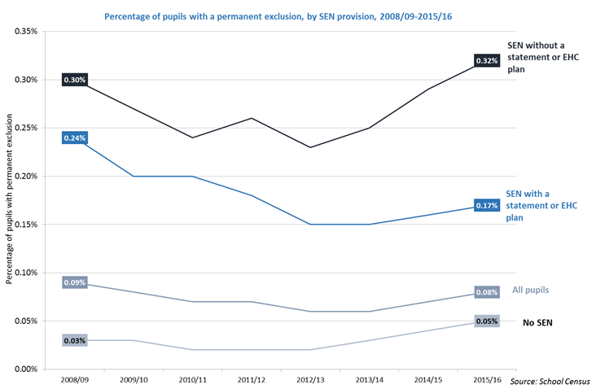
Permanent exclusions 2008-16
0.32% of pupils on SEN support received a permanent exclusion in 2015/16 compared to 0.17% of pupils with statements or EHCPs and 0.05% of pupils with no SEN.

Slide 20
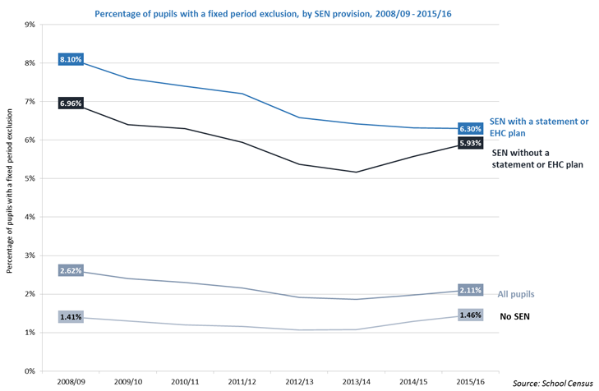
Fixed- term exclusions 2008-16
5.93% of pupils on SEN support received a fixed period exclusion in 2015/16 compared to 6.30% of pupils with statements or EHCPs and 1.46% of pupils with no SEN.

Slide 21
Exclusions – Inspection reports
Hartlepool (2016) - Levels of absence, persistent absence and fixed-term exclusion for CYP who have SEND are too high, especially in the secondary phase…..Leaders are not doing enough…...
Surrey (2016) - Rate of permanent exclusion…,,a continuing increase, above the national figures……. “This troubling picture has not been thoroughly evaluated by officers or identified as an area for improvement.
Cambridgeshire (2017) – Improvements in support for CYP who display challenging behaviour…..local area leaders and school leaders working together…permanent exclusions of CYP with SEND reduced by ¾ in a year
Trafford (2017) - Effective systems in place to avoid the permanent exclusion of CYP with SEN. As a result, the number of such pupils who are permanently excluded is low.
Greenwich (2017) - No permanent exclusions for pupils who have SEND in primary schools. Rates of fixed-term exclusions reducing overall, particularly for pupils without EHC plans.

Slide 22
Children and young people’s mental health green paper
DoH and DfE working jointly on a green paper; published by end of year.
To include proposals to promote effective activity in areas from increasing the focus on prevention through improved access to specialist services, and the role of social media.
Looks to learn from existing joint working and schools/CAMHS link pilots and capture ways to bring together different professionals with different expertise to deliver support.
We know EPs were involved with a number of the pilots (Evaluation: https://www.gov.uk/government/publications/mental-health-services-and-schools-link-pilot-evaluation)
Prime Minister 9 Jan 2017
“I want us to employ the power of government as a force for good to transform the way we deal with mental health problems right across society, and at every stage of life.
…
“I want us to forge a new approach recognising our responsibility to each other, and make mental illness an everyday concern for all of us and in every one of our institutions.”

Slide 23
Local Area Inspections: Specialist Teachers
SEN leaders work closely with advisory specialist teachers to ensure that mainstream staff deliver effective support to pupils with HI, VI and communication and interaction needs (Glos)
VI services, audiology and ToD provide effective support for CYP. Services are timely and of good quality. Making a positive difference to the lives and development of these CYP. (Halton)
Specialist teachers of CYP who are deaf and/or visually impaired provide valued support to pupils with sensory needs placed in mainstream schools (Bexley)
High-quality support from Greenwich services specialising in HI, VI and autistic spectrum disorders is consistently described as being of high quality by education settings and parents.
Provision for CYP who have a HI or VI is strong…….vast majority (of parents) reported positively about ….how this helps to secure strong outcomes.” (Windsor and Maidenhead)

Slide 24
Areas of opportunity for specialist teachers
Working more closely/ co-producing with parents, children and young people
High quality assessment, with clear recommendations for provision that works
Y9 transfer review
Supporting those at most risk – e.g. exclusions, LAC, at risk of ATU placements, in out-of-area provision
Post-16/ post-19 work

Slide 25


