Slide 1
COMMISSIONING FOR CHILDREN & YOUNG PEOPLE WITH SENSORY IMPAIRMENTS
Working with commissioners within the context of a changing landscape
Equipping the SI Sector for the Future
Brian Lamb OBE, NatSIP Associate/Visiting Prof SEND Derby
Michelle Allison, Director of SEND Services & Commissioning, Seashell Trust

Slide 2
The Future Role of the Sector
NATSIP was commissioned to look at the future role of the sector
This started as a concern about workforce and the future of the professional mandatory qualifications
But this assumed that needs in the future would be the same as the past - is this true?

Slide 3
Changing Environment
But we know the context is changing;
Children's and Families Act expects classroom teacher to be the leader and co-ordinator of support-where does this leave current models of specialist support?
EHC Planning is changing - still a continuing role for specialist support but will numbers decrease over time, and if so what is required from your service?
Changing Role of the LA and Schools - Excellence for All proposals/MATs and Schools as commissioners will change commissioning arrangements
Changing role of funding - clearer separation between the high needs block and DSG - What are the implications for your service?
Different role for Parents - taking a greater role in commissioning - individual budgets, personalised services

Slide 4
What the White Paper says
The Schools White Paper Educational Excellence Everywhere set out a clear vision for the local authority in relation to special educational needs (4.77, pp.69-70):
“Ensuring every child has a school place: including that there are sufficient school, special school and alternative provision places to meet demand. Local authorities will retain responsibility for this in a fully academised system. The government will support them by continuing to provide substantial funding to allow them to deliver sufficient places, as well as by creating places through the free schools programme…”
“Ensuring the needs of vulnerable pupils are met: including identifying, assessing and making provision for children with special educational needs and disability and looked after children; promoting school attendance and tackling persistent absence; ensuring that alternative provision is available for headteachers to commission for children and young people excluded from school or otherwise unable to attend a mainstream school…”
“Acting as champions for all parents and families: including listening to and promoting the needs of parents, children and the local community – working alongside elected mayors; supporting parents in navigating the system through a continuing role in admissions; supporting children, young people and parents to navigate local SEND arrangements (such as providing information, advice and support) and engaging them in designing and co-producing local SEND policies, service commissioning and delivery; and championing high standards locally for all pupils, for example, by encouraging high performing providers to establish new school places and where necessary calling for action from the Regional Schools Commissioner to tackle underperformance.”

Slide 5
Challenges for local authorities
Financial pressures:
  Existing pressure on high needs budgets.
  Requests for high needs spend in early years and 19-25.
  Potential impact of national funding formulae for schools and high needs.
  Pressure on wider LA budgets (e.g. social care, transport).
  Challenge of joint commissioning with health and social care.
Pressures on places:
  Demand for limited number of special school places.
  Potential impact of post-16 area reviews on availability of FE provision.
  Challenge for LAs developing provision in an increasingly autonomous school system.
Challenges in making placements:
  Importance of parental preference in individual placements.
  Statutory right to Tribunal appeal over placements.
Importance of early investment:
  Good preparation for adulthood for children and young people with SEN aged 0-25 will save on whole-life health and care costs.

Slide 6
Implications of Academisation
The move towards all schools becoming Academies will mean a significant change in the way local authorities operate:
LAs will become commissioners of provision rather than responsible for maintaining schools.
LAs will need to co-ordinate services and provision across a diverse range of autonomous providers (early years settings, Academies and free schools, FE colleges, independent / non-maintained providers).
LAs will need to develop new relationships with the schools (i.e. Academies and free schools) in their area.
  This will be particularly important for special schools, since places are principally filled by LAs naming the school on an EHC plan, and agreeing ‘top-up’ funding from the high needs budget.
We might expect LAs’ future relationships with Academies to mirror existing relationships with independent and non-maintained provision.
  Potentially greater use of commissioning and procurement approaches.
  Blurring the concept of “out of area” provision.

Slide 7
High needs placements - current
Social Care
“Out of county” provision
Academies / free schools (mainstream & special) – in a different LA
Health
LA “in county” provision
Mainstream LA schools, able to meet needs (with top-up funding)
Mainstream academies, able to meet needs (with top-up funding)
LA special schools – in a different LA
Local authority responsible for EHC assessment, placement & funding
General FE colleges
Independent special schools
LA Special schools – generic or specific needs
Special academies & free schools – generic or specific needs
Special post-16 institutions
LA mainstream schools with special units / resourced provision
Mainstream academies, with special units / resourced provision
Non maintained special schools
AP

Slide 8
High needs placements – future?
Social Care
Provision
Mainstream academies, able to meet needs (with top-up funding)
Health
strategic commissioner
General FE colleges
managing the ‘market’
Local authority responsible for EHC assessment, placement & funding
Special academies & free schools – generic or specific needs
Independent special schools
co-ordinating and brokering
Special post-16 institutions
championing parents and young people
Mainstream academies, with special units / resourced provision
Non maintained special schools
AP

Slide 9
Future of the Sector – Summary Challenges facing Sensory Impairment Services
Changing legislative requirements
Organisational changes in services
Changes to the school system
Changes to the profile and complexity of the C&YP Sensory Impairment Services are working with
Difficulties in recruiting/training an adequate number of specialist teachers and support staff – ageing composition of current workforce
Overall reduction in training places
Pressures of additional demands on a shrinking workforce
Funding pressures / squeeze on resources
More focus on numerically larger groups of C&YP with SEND and insufficient focus on HN-LI

Slide 10
Future Role of the SI Sector
We need to take a broader view of what services might need to be offered in the light of these changes
We also we need to understand what is changing?

Slide 11


There is a way of navigating through these challenges if Sensory Impairment Services…
Are flexible in adapting to the changes
Explore different models of SI Services to ensure focus on outcomes and demonstrate best use of resources
Work collaboratively/effectively with commissioners
A PERFECT STORM?

Slide 12
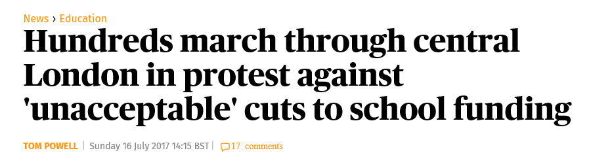

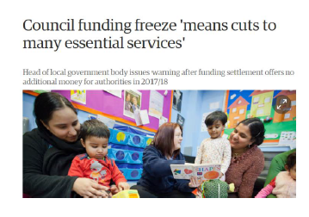
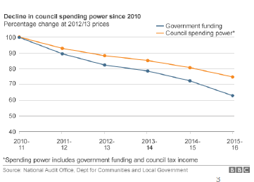
A Tightening Funding Envelope

Slide 13
In light of this SI Services need to…
Secure a future in the sector
Have a clear Strategy – what needs to change and/or improve?
Explore new models so Services are flexible/agile able to adapt to changing landscape
Make intelligent use of data and needs analysis
Enhance profile
Take an outcome focused perspective and plan accordingly whilst also achieving VfM
Enhance partnership working and collaboration

Slide 14

Future of the Sector – Working with commissioners – what the survey told us
I need support with:
Understanding how to market my service to commissioners (36)
Defining and presenting the outcomes my service achieves to commissioners (47)
Negotiating with commissioners (27)
Contracting (20)
Other (8)

Slide 15
The Report also showed….
Different models of how LA’s want to commission services;
‘All Age Sensory Service’ – bringing together adults’ and children’s sensory services into one grouping
going out to tender for a SI Service or merging with another commercial provision
combining with the SI Service provided by another LA
converting into a traded service (where not already the case) with schools taking a much greater role in commissioning
merging with other specialist support services either at the management level or as a whole service
combining resourced based provision with the SI Service if they were separate
establishing an SI Academy Trust where local SI provision might be lacking
creating new ‘hubs’ containing different professional groupings across SEND and other professionals into one support service.

Slide 16
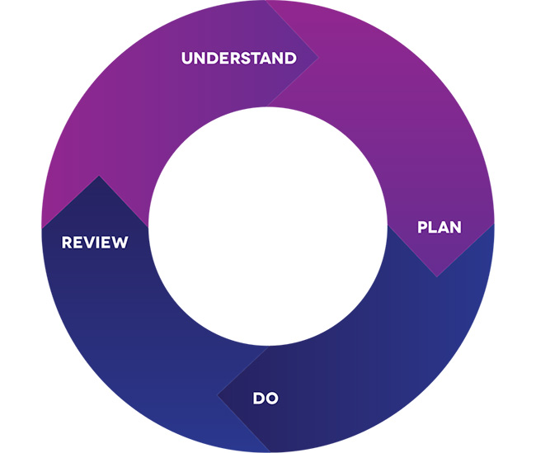
Working with the
Commissioner

Slide 17
Key functions of the commissioner
Understand local demand, needs and available resources
Work with Services to ensure available resources are used to maximum effect
Work with Services to identify where needs are not being met through the existing local offer
Work with Services to plan creative, forward looking solutions to address gaps in service provision and meet future needs (underpinned by a robust evidence base as to the key areas for change and/or improvement)
Ensure commissioned services provide value for money
Ensure commissioned activity achieves good outcomes for children, young people and families and is measurable in terms of impact
Support Services to engage (where necessary) in market engagement, market development and market management
Support Services to manage the performance of commissioned providers
Support Services to consider an integrated and strategic view of needs – joining the dots across children and young people’s services so that services do not work in silo’s and LAs generate maximum value from procurement activity
Use business intelligence and performance monitoring to support continuous improvement

Slide 18
Commissioning on 3 levels :
Individual level – ensuring we provide personalised support for children & young people with Sensory Impairment (needs normally identified via an EHCP or other statutory plan)
Service level – Specific services within the local offer addressing gaps in SI provision and improving outcomes
Strategic level – Ensuring combined resources meet the needs of the SI population, aligning resources, capability, capacity to achieve greater efficiencies and improved outcomes

Slide 19
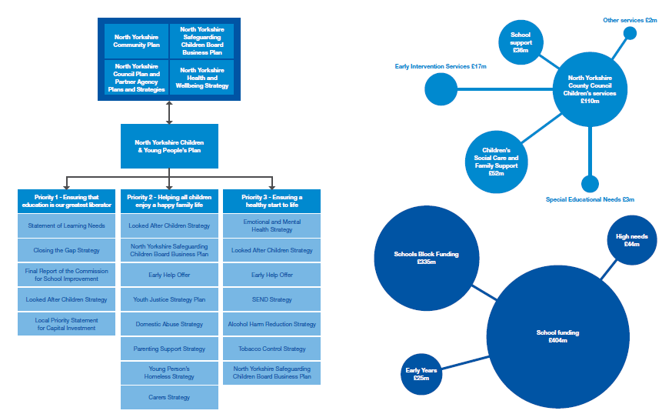
Commissioners need to balance a range of priorities with available funding. Sensory Impairment Services form one part of a complex ecology of services

Slide 20
Working with the commissioner in a structured way
1. Context
2. Analysis
4.
Case for Change
3. Outcomes and Impact

Slide 21
How might you work with the commissioner in a structured way?
Step 1 - Context
Explain the CONTEXT for your work including relevant legislation and key national policy and guidance (NatSIP have produced helpful guidance on this). Do not assume that the commissioner will understand the world of sensory impairment nor the machinery of your Service.
Step 2 - Analysis
Identify and explain the cohort of children and young people currently supported by the Service and needs analysis – including projections around future trends. Use data and needs ANALYSIS intelligently to support your case for change and/or improvement and to inform future commissioning requirements.
(CoP references data collection duties 3.27, 3.28)

Slide 22
How might you work with the commissioner in a structured way?
Step 3 – Outcomes and Impact
Identify and explain the OUTCOMES achieved by the children and young people currently supported by the Service and the IMPACT the service is making. Explain how the work of your service is contributing to broader key strategic priorities and plans and how the commissioned activity will lead to improved outcomes for children and young people. Identify what needs to change and/or improve?
Step 4 – Case for Change
Explain how your service achieves VfM and use cost/benefit analysis to support the CASE FOR CHANGE AND/OR IMPROVEMENT including the use of a robust evidence base and an EIA if relevant.
Have a clear strategic PLAN that underpins the case for change and/or improvement.

Slide 23

STEP 1 : CONTEXT
1. Context

Slide 24
Explaining Context to Commissioners
It is important that the commissioner understands the context for the work of the Service if they are to support you effectively, including the changing landscape in which you are operating. Do not assume that they know!
Clearly outline to the Commissioner your current Service Offer and make-up of the Service. Include here key information related to number of service users, number and type of settings supported, overall budget, key inter-dependencies with other aspects of the Children & Young People’s Service, key information in relation to multi-agency/partnership working, key performance indicators for the Service, overall staffing levels and the key opportunities and constraints facing the Service. It is also useful to map for the commissioner current provision against best practice from research and other local authorities.
The Commissioner also needs to understand the legislative context for the work and the changing landscape. NatSIP have produced a useful guide on aligning services for children and young people with sensory impairment with the specific requirements of legislation and guidance. https://www.natsip.org.uk/doc-library-login/natsip-guidance-on/checklist-for-service-alignment-with-legislation/1281-checklist-for-service-alignment-with-legislation-word-version

Slide 25

STEP 2 : ANALYSIS
2. Analysis
1. Context

Slide 26
Step 2: Using data and intelligence to inform your case
Commissioners use data and intelligence to understand needs and future demand and make evidence based decisions
Presenting clear and accurate data on the needs of the children and young people currently supported by your service and future projections/analysis of need (including gaps in service provision) will help to support the strategic planning and commissioning process and any case for change and/or improvement

Slide 27
Why is needs and gap analysis important within the strategic planning and commissioning process and what does it involve?
Needs analysis will help the SI Service identify the current and projected future needs of the SI population. It involves gathering and analysing a range of information from Service level data to regional and national demographic data.
Gap analysis involves undertaking a detailed review of what SI provision is currently available within the local offer and what will be required in the future (based on the needs analysis and what has been identified as key strategic priorities within the Children & Young People’s Plan and other key strategic Plans.)

Slide 28
Using needs and gap analysis to inform Service planning and design
What is the analysis telling you? Are you seeing increasing referrals over time? Are there any patterns emerging in terms of complexity of need? What other key trends and patterns can you see?
Looking forward - what are the SI population and needs projections telling you? How does this compare with existing service provision? Are you anticipating any gaps in service provision? If so, in what areas?
IMPORTANTLY - What impact will this have on (a) future workforce development needs? (b) future budgets and resourcing? and (c) future commissioning requirements?
WHAT MIGHT THIS MEAN IN TERMS OF FUTURE SERVICE DESIGN?

Slide 29
SEN Code of Practice identifies a range of data sets
Local data on disabled children from the Register of Disabled Children (including those with impaired hearing and vision). Local authorities should ensure that registers of disabled children and young people, and particularly details of those with a vision or hearing impairment, are kept accurate and up to date, as such low-incidence needs are particularly difficult to plan for from national data sets
Population and demographic data
Prevalence data for different kinds of SEN and disability among children and young people at national level – for example through the Child and Maternal Health Intelligence Network (CHiMat)
Numbers of local children and young people with EHC plans and their main needs
Use of out-of-area placements for those with low-incidence needs
Analysis of key performance indicators that are shared across health, education and social care as part of the new joint commissioning arrangements
The outcomes of developmental assessments (including the two-year-old check)
Information from the Early Years Foundation Stage (EYFS) profile
Where children or young people with SEN or disabilities are educated
An analysis of local challenges and sources of health inequalities
employment rates for young people leaving education

Slide 30
Other sources of data and intelligence
Statistical First Release (SFR)
Local Authority Interactive Tool (LAIT)
LG Inform
S251 Budget Statistics
Children & Young People’s Health Service Statistics
CCG Improvement & Assessment Framework
Public Health England Outcomes Framework
ONS Population Estimates
Internal Dashboards
Information from Health Related Behaviour Questionnaires
Ofsted and Care Quality Commission (CQC) inspection reports of local areas’ effectiveness in identifying and meeting the needs of children and young people who have special educational needs and/or disabilities
Self Assessment Reports
Data from JSNA
School Census data
Publications and surveys by NDCS, Blind Children UK, RNIB, NatSIP, CRIDE, Sense, LGA, ADCS etc,
Ofsted Thematic Reports
Pansi - Projecting Adult Needs and Service Information (18-64)
Poppi – Projecting Older People Population Information (65 and over)

Slide 31
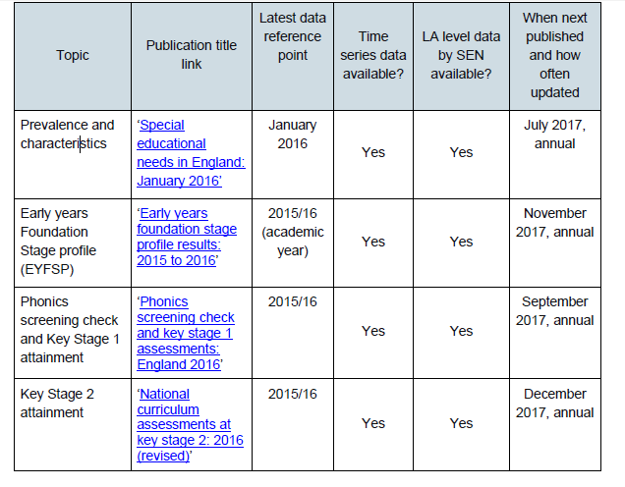
Benchmarking and Other Tools

Slide 32
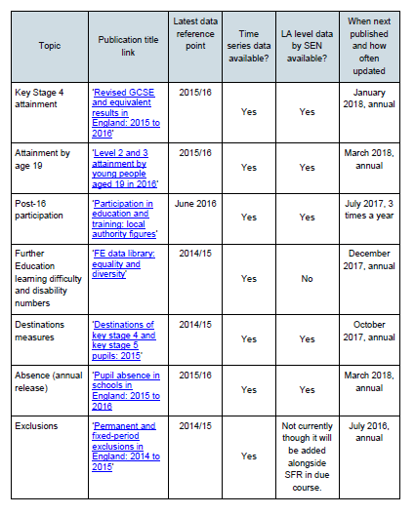
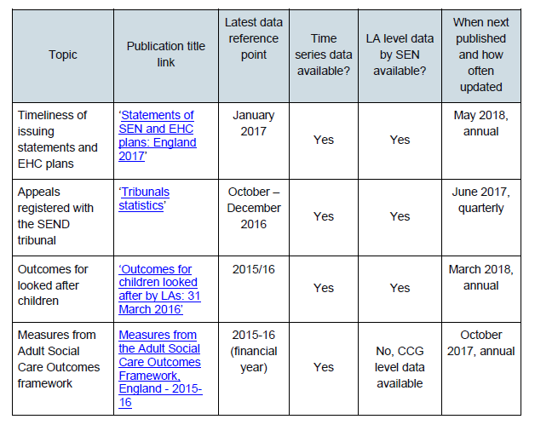
Benchmarking and Other tools

Slide 33
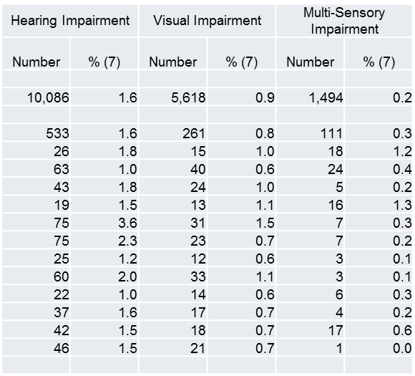
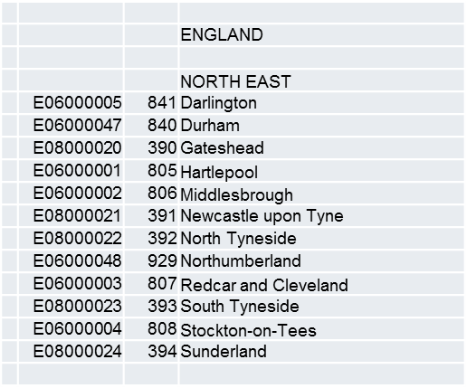
Let’s Look at a few examples of how we can use national data sets to support our case for change and/or improvement
What might we say to the commissioner if we were talking about prevalence rates and pressures on services?
(Source : SFR : SEN prevalence and characteristics)

Slide 34
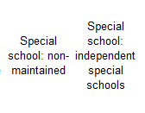
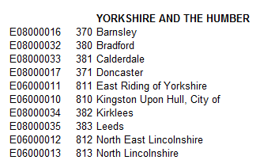
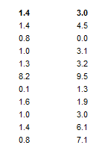
What might we say to the commissioner if we were talking about improving the ability of LA maintained schools to meet needs?
(Source SFR : Statements and EHCP Plans: England)

Slide 35
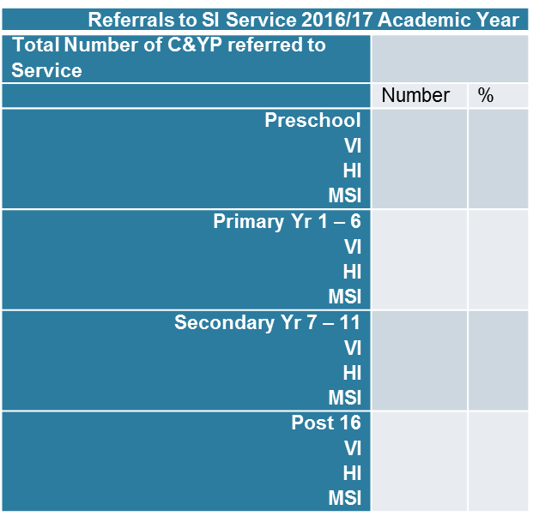
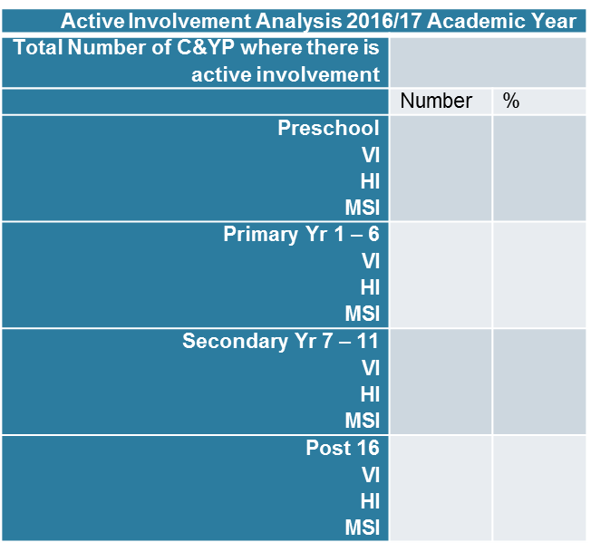
Local data is equally as important : Using information from your Service Dashboard

Slide 36
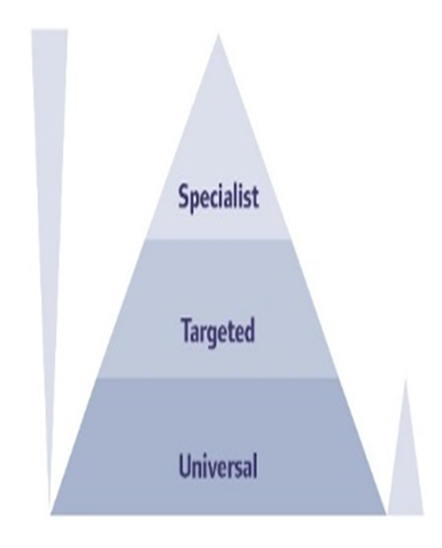
Using other information from your Service Dashboard
Timeliness - referral to active engagement
Referral - conversion rates and signposting
Source of referrals
Breakdown by gender and other characteristics e.g, LAC, CAF, BME, EAL etc
Number of schools supported in area (as a percentage of all schools)
Number of post 16 settings supported in area (as a percentage of all settings)
NEET / Transitions data
Complaints and commendations
Number of C&Y with SI by setting including OLA
How useful is your dashboard?
Is it capturing all relevant data?
How often are you reporting on
your dashboard? Who to?
For what purpose? What impact is
this having?

Slide 37
Funding analysis : Working with the School Forum and other funding sub-groups
As a Service, do you know what proportion of high needs funding (or other funding flowing into the LA) is currently being allocated and spent on children and young people with SI?
How does this compare with other children and young people with SEND?
How does this compare with existing and future demands on the SI Service?
How visible is the SI Service at School Forum and other forums who make decisions regarding funding?
What can be done to influence and inform decisions made at School Forum and other funding sub-groups in relation to how available funding is currently being allocated to support children and young people with Sensory Impairment?

Slide 38
GROUP DISCUSSION 1
How confident are you, at a local level, that your data and intelligence enables you, and your partners, to have an accurate picture of the cohort of children and young people with SI? (who, where, needs, typical journey, outcomes etc.)
WHAT MORE COULD BE DONE TO ENSURE DATA
AND INTELLIGENCE IS MORE EFFECTIVELY USED ?
WHAT DON’T YOU KNOW? WHAT SUPPORT
MIGHT YOU NEED?

Slide 39


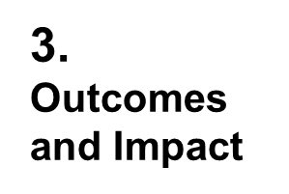

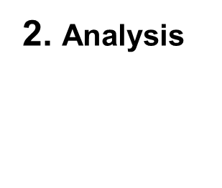
STEP 3 – OUTCOMES and IMPACT
1. Context

Slide 40
Step 3 – Demonstrating Outcomes and Impact
Evidencing outcomes and impact forms an important element of the strategic planning process
Identifying areas for improvement and/or change can help to inform service planning and future commissioning requirements. What needs to change and/or improve?
Lets look at some examples of quantitative and qualitative methods of demonstrating outcomes and impact

Slide 41
NatSIP Outcomes Benchmarking
NatSIP Outcomes Benchmarking - annual exercise, first completed in 2011
Involves services collecting and submitting data on CYP with SI on a range of performance indicators, mainly, but not exclusively, related to educational achievement/progression
It’s main purpose is to provide reliable data for use by LA sensory support services to evidence their impact and inform development needs
Provides opportunity for extensive benchmarking of data against 16 Performance Indicators and against which services can compare their results
Provides a comparison of HI, VI and MSI results
Provides trend data through a comparison of year on year results
Opportunity for services to compare NatSIP outcomes data with that for all CYP published by the DfE

Slide 42
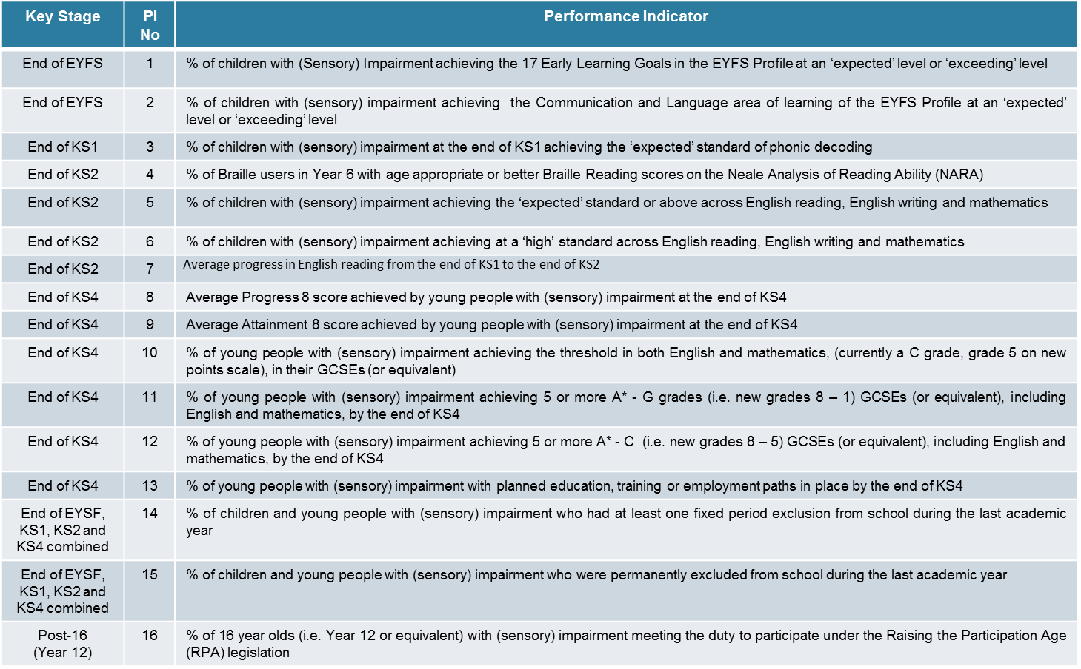

Slide 43
How else might the Service demonstrate outcomes and impact?
Outcomes from any self-evaluation exercise and/or service or peer review(s)
Direct feedback from children, young people and families
Feedback from schools/settings with whom the service works
Interviews with Headteachers, SENCO’s within individual settings
Outcomes from observations/visits
Feedback from partners (e.g, CCG, local health and other professionals with whom the service has contact)
Feedback from parent carer forum and other local networks
Case studies, publications, contributions service may have made to local, regional and national initiatives etc
Comments made within inspections (particularly Ofsted/CQC Local Area Inspections)
Feedback from any questionnaires (e.g, Health Related Behaviour Questionnaire)
Feedback from staff employed within the SI Service and others across the CYPS
Feedback from Members

Slide 44
What questions might you ask in gathering feedback on the Service?
Speed of response from initial enquiry/referral to active engagement
How well the Service explains the core offer
Feedback on the information provided as part of the local offer
Availability of staff
The overall quality of assessments and reports
Ability to explain assessments and reports provided by the Service (appropriate to the audience)
Overall contribution to the monitoring, review and planning for a child/young person with SI
Overall contribution towards child or young person’s progress
The overall quality of support / training offered by the Service
How well the work of the Service complements/supports the work of the school, college or other educational setting
Quality of relationships with internal stakeholders
Quality of relationships with individual settings and external stakeholders
Ability to work across organisational boundaries / feedback on multi-agency working
Management of complaints or concerns

Slide 45
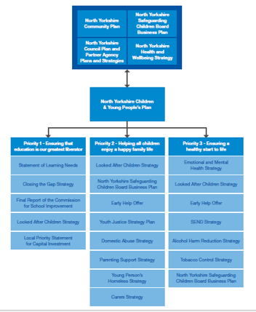
Planning Bookcase…
In demonstrating outcomes and impact you may also want to demonstrate/evidence how the work of the SI Service contributes to broader key strategic priorities and plans.
How are the needs of children and young people with SI currently reflected in key strategic priorities and plans? If not – what more can the SI Service do to influence this?
Remember : key strategic priorities and plans often drive and influence commissioning decisions and commissioning priorities
Resources follow key strategic priorities and plans – locally, regionally, nationally

Slide 46
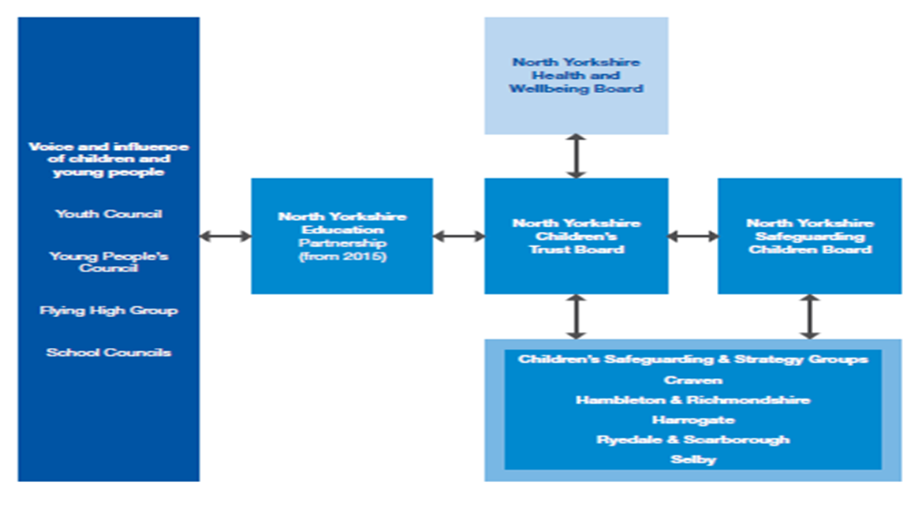
Engaging other stakeholders

Slide 47
GROUP DISCUSSION 2
How confident are you that locally key strategic priorities and plans effectively reflect the outcomes for children and young people with SI and key priorities moving forward?
WHAT MORE CAN BE DONE TO ENSURE WHAT
YOU KNOW ABOUT THE SI
POPUL.ATION LOCALLY IS BEING
USED TO INFORM STRATEGIC DIALOGUE AND PLANNING AND
HELPING TO INFORM FUTURE COMMISSIONING DECISIONS?
WHO MIGHT BE ABLE TO SUPPORT YOU WITH THIS? WHICH KEY STAKEHOLDERS (INTERNAL/EXTERNAL) DO YOU NEED TO INFLUENCE?

Slide 48


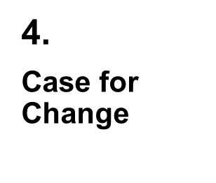
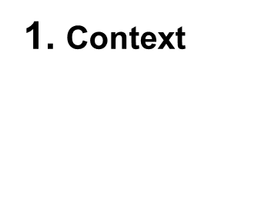
STEP 4 – CASE FOR CHANGE
3. Outcomes and Impact
2. Analysis

Slide 49
Working with the commissioner to build a case for change and/or improvement
The commissioner will need to be satisfied that any commissioned activity is:
Driven by best possible outcomes for children, young people and families and the impact of the commissioned activity is measurable
Underpinned by a clear business case which sets out why the commissioned activity is required
Meets identified current and future needs and gaps in SI provision. This must be underpinned and informed by robust needs analysis including evidence of what works best for children, young people and families
Is affordable, provides value for money and maximises the use of available resources
Takes account of national and local guidance and good practice exemplars in the field of SI
Achieve high performance and quality standards
Meets the requirements of a changing landscape – is future proof (as far as is possible)

Slide 50
Developing a Business Case
Developing a detailed Business Case outlining what you will achieve through any commissioned activity will support your negotiations with the commissioner. The Business Case might include the following:
Why the commissioned activity is required (underpinned by robust needs and gap analysis) i.e, the case for change and/or improvement. This may include identifying what may need to be reconfigured and/or de-commissioned in order to meet future needs.
An analysis of risks (Risk Assessment)
An analysis of the resources required (Resource Analysis)
An analysis of what other options have been considered by the SI Service (Options Appraisal)
An Equality Impact Assessment (particularly important if services are to be decommissioned)
How the commissioned activity contributes to key strategic priorities and improved outcomes for children, young people and families

Slide 51
Resource Analysis
This element of the business case involves the Service identifying with the commissioner the resources currently available and the costs/benefits of adopting different approaches to future SI provision.
Remember : The commissioner will want to ensure that any commissioned activity provides value for money, maximises available resources and is affordable within the context of a tightening funding envelope.
Talk to the Commissioner about how you
might maximise available resources
Resources can include staffing,
budgets, buildings or other assets.

Slide 52
Demonstrating Value for Money and undertaking cost/benefit analysis
Demonstrating value for money and undertaking cost/benefit analysis will become increasingly important as the funding envelope tightens
Let’s look at a couple of simple examples

Slide 53
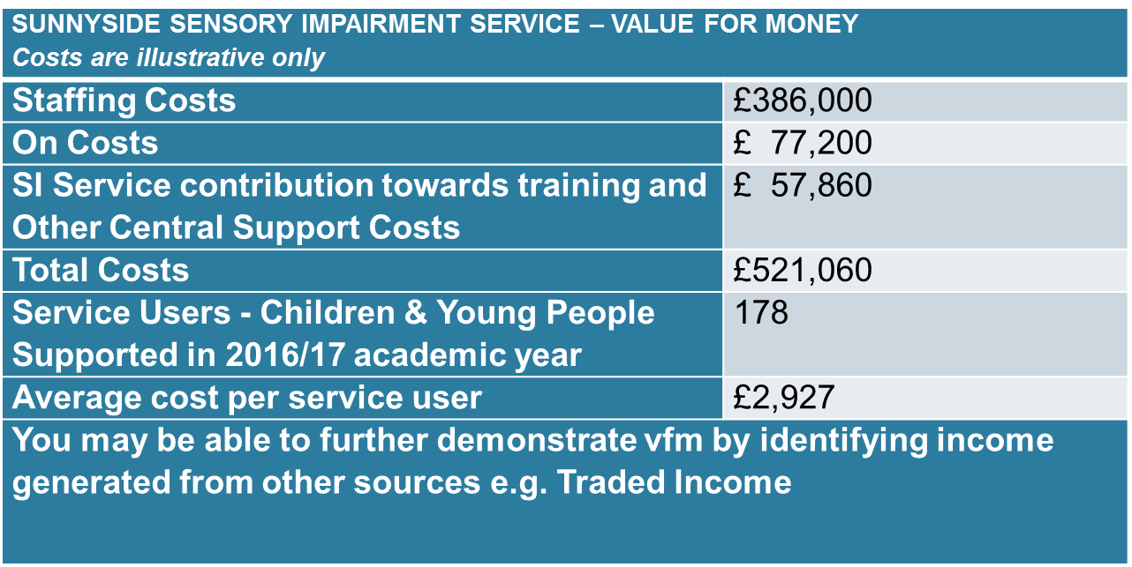
Simple Value for Money – Cost per Service User Tool

Slide 54
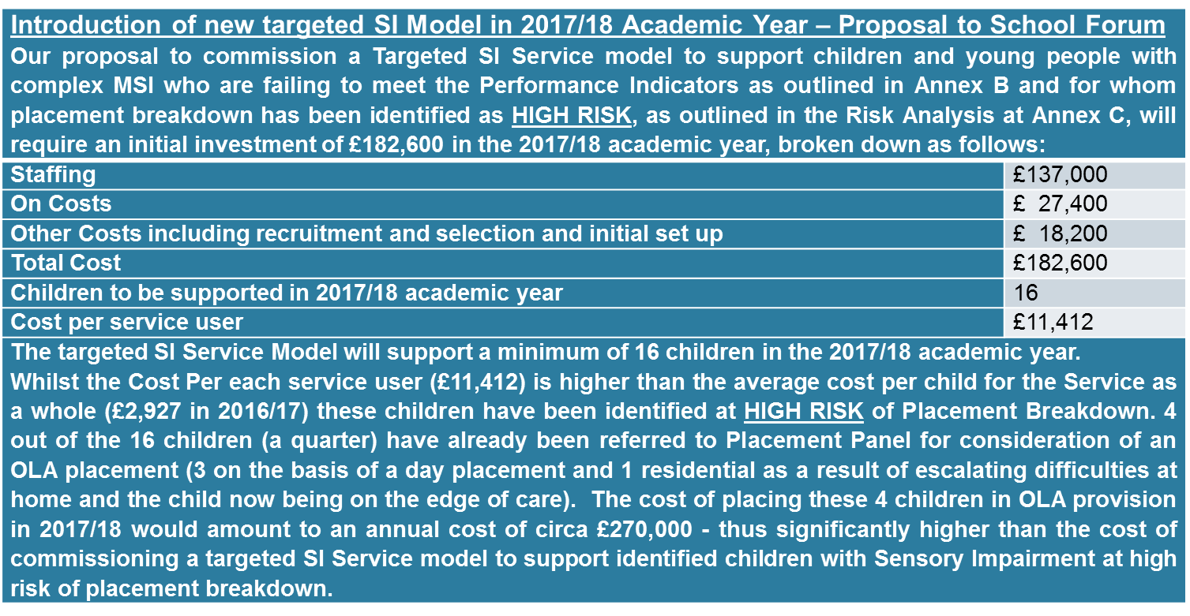
Commissioning a Targeted SI Service Model - Reducing the Requirement for OLA Placements - Cost/Benefit Analysis

Slide 55
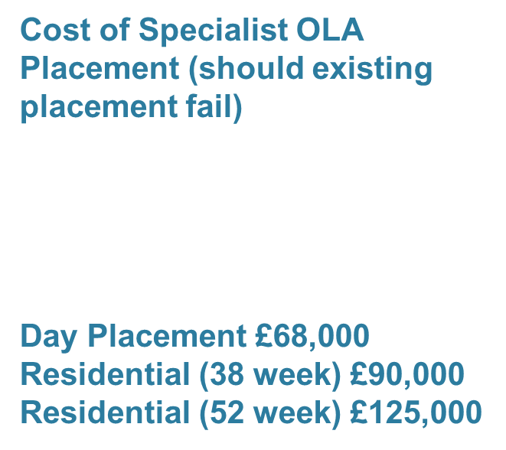
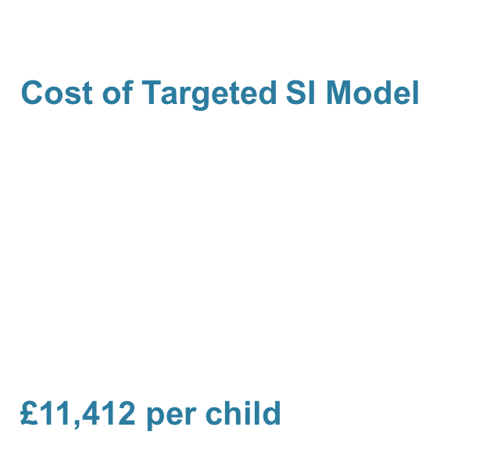

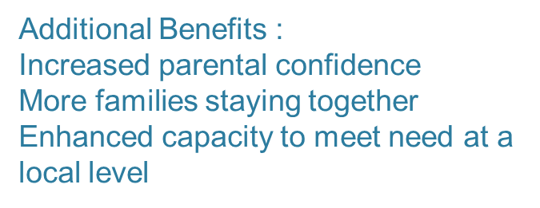
Targeted SI Service Model
Cost/Benefit Analysis

Slide 56
Evaluation and Review
Effective evaluation and review helps to showcase practice innovation and learning, share good practice and learn from what might have gone wrong.
Remember : good evaluation, evidencing improved outcomes and impact can be useful for drawing down further funding (Invest to Save and other funding and resources)

Slide 57
GROUP DISCUSSION 3
How confident are you that the service is effective at evaluating and reviewing activity?
WHAT MORE CAN YOU DO TO
ENHANCE EFFECTIVE EVALUATION OF
ACTIVITY IN ORDER TO INFORM FUTURE SERVICE
DELIVERY AND PRACTICE INNOVATION?

Slide 58

SHOUT ABOUT YOUR SUCCESS!

Slide 59
Reputation is all…..Area Reviews
SEN leaders work closely with advisory specialist teachers to ensure that mainstream staff deliver effective support to pupils with HI, VI and communication and interaction needs (Glos)
VI services, audiology and ToD provide effective support for CYP. Services are timely and of good quality. Making a positive difference to the lives and development of these CYP. (Halton)
Specialist teachers of CYP who are deaf and/or visually impaired provide valued support to pupils with sensory needs placed in mainstream schools (Bexley)
High-quality support from Greenwich services specialising in HI, VI and autistic spectrum disorders is consistently described as being of high quality by education settings and parents. (Greenwich)
Provision for CYP who have a HI or VI is strong…….vast majority (of parents) reported positively about ….how this helps to secure strong outcomes.” (Windsor and Maidenhead)

Slide 60
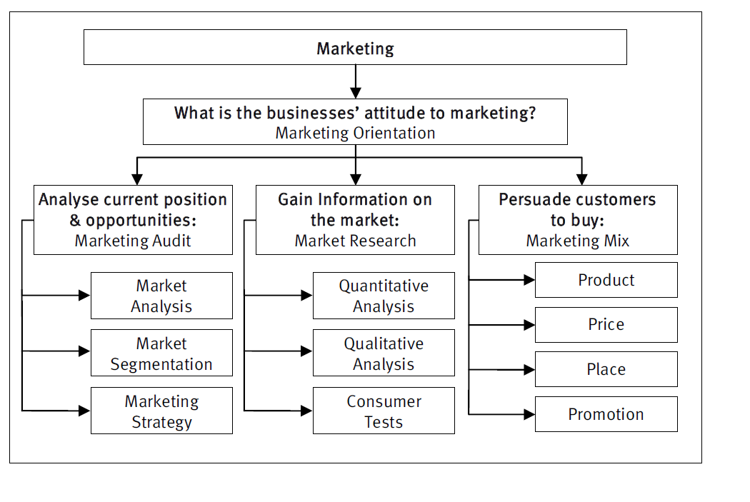
Overview of Marketing Process

Slide 61
Opportunities: Schools
Overall strategic driver: Children and Families Act/Schools Reforms
Identifying good practice and developing the evidence-base for what works - links to schools OFSTED performance
Making specialist expertise available to schools, EY settings and colleges, including signposting to existing resources
Building on current connections with SENCOs and support staff in schools
Supporting Code of Practice and especially SEND support by offering training and other workforce development opportunities
Helping mainstream schools set up or develop special units or resourced provision - or should services be offering to take these on to ensure more co-ordinated service?
Role in supporting Initial Teacher Training especially in Teaching Alliance settings
Cross over between work in special schools and mainstream settings - can this be extended?

Slide 62
Opportunities: System
How do you stay relevant as a statutory service-provision planning, statutory advice on EHCP, working with Special Schools?
Innovation-what do future models of specialist support look like?
Balance between 1-1 and whole school provision and advice-what should it be, what is needed?
Working with special schools to share expertise on SI and ensure access to specialist teachers / workforce development.
Working with special Academies or free schools in a Multi-Academy Trust.

Slide 63
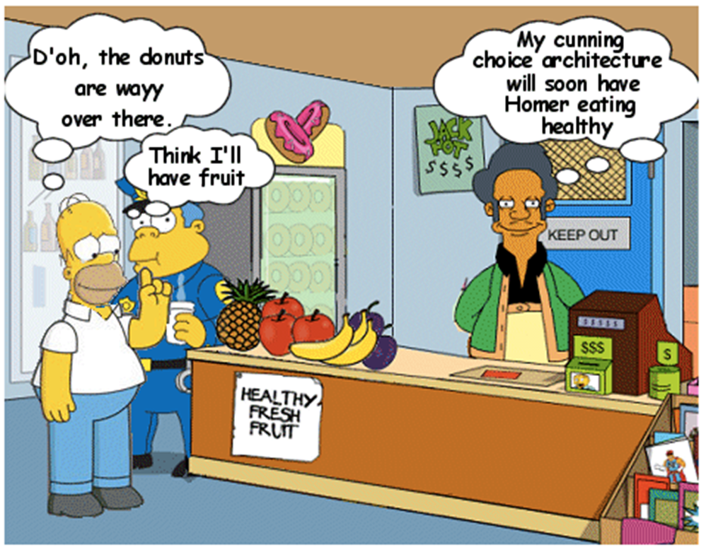
Leading the horse to water ?

Slide 64
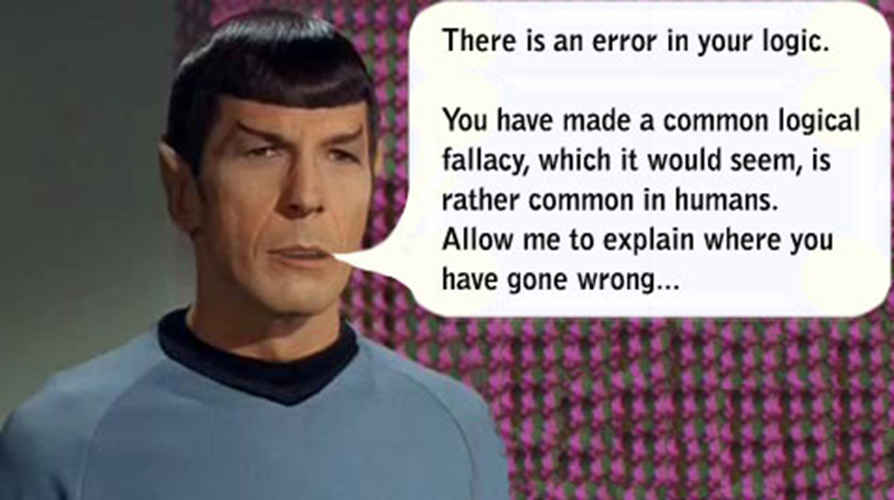
Using Logic…..

Slide 65

Being inspired!

Slide 66
TOP TIPS
Let’s Re-Cap

Slide 67

Understanding the legislative framework and context
Tip:
Make sure that you understand how your local commissioner is responding to the legislation
Remind your local commissioner of their legislative duties

Slide 68

Marketing and promoting your Service to the Commissioner
TIP : In order to market your service effectively to the commissioner you need to help them to UNDERSTAND your service, the context for your work, the changing landscape and the case for change and/or improvement.
Underpinning this needs to be clear and accurate data and intelligence and needs analysis.

Slide 69
Understanding needs and future demand and making evidence based decisions
TIP : TALK TO THE COMMISSIONER ABOUT:
How you are capturing, recording and reporting on SI data/intelligence locally and what that data is telling you about outcomes. What’s working well? Not so well? What needs to change and/or improve?
How you are benchmarking local data/intelligence with national / regional data sets / statistical neighbours (using some of the previously identified data sources). What is the benchmarking data is telling you?
What the population and needs projections are telling you and what impact will this have on future workforce developments, budgets and resourcing and future commissioning requirements

Slide 70
Working across the wider partnership and using it intelligently to inform strategic dialogue and planning
TIP : TALK TO THE COMMISSIONER ABOUT:
How you are sharing data/intelligence on the SI population with key stakeholders locally
How understood the data/intelligence is at a local level?
Which key forums have a handle on the data/intelligence and how this is being used to inform strategic dialogue and planning
Who else you may need to more effectively engage in the strategic dialogue. For example - what is the level of engagement at School Forum? SEND Board? Children’s Trust Board? Health and Well Being Board? Education Partnership? Safeguarding Board? Members?

Slide 71
Demonstrating Outcomes
Evidencing outcomes and impact forms an important element of the strategic planning process. Remember NatSIP have produced a very useful Benchmarking Tool.
Analysing outcomes can help to identify areas for improvement and/or change and can help to inform service planning and future commissioning requirements.
TIP : TALK TO THE COMMISSIONER ABOUT:
The evidence drawn from any outcomes benchmarking, evidence drawn from service reviews etc.
What needs to change and/or improve?

Slide 72
Making a Case for Change and/or Improvement
TIP: MAKING A GOOD CASE FOR CHANGE OR IMPROVEMENT NEEDS TO BE SUPPORTED BY:
A sound Business Case – what needs to change and/or improve and why
Risk Assessment
Resource Analysis (staffing, buildings, budgets, other assets)
Options Appraisal
Equality Impact Assessment
An overview of how the commissioned activity contributes to key strategic priorities and improved outcomes for children and young people

Slide 73
Planning - The musts
TIP: COMMISSIONERS AND STAKEHOLDERS WILL WANT TO SEE A PLAN THAT SETS OUT:
WHAT you are going to do
WHY you are doing it (position now/outcomes expected/what will change and or improve)
WHO you are going to do it for
HOW you will do it
WHEN you will do it
WHAT resources you will need to do it
Evidence of co-production should be demonstrated wherever possible

Slide 74
Evaluation & Review
TIP : TALK TO THE COMMISSIONER ABOUT HOW YOU INTEND TO:
Measure change over time – what is improving, what do we need to do better?
Share practice innovation and learning and lessons learnt to inform future working practice
Keep key stakeholders including children, young people and families and the commissioner informed of your progress
Other things that commissioners will be interested in – VFM, Spread and Scale, potential for Invest to Save ….

Slide 75
Where are the opportunities to promote your service?
Tip:
Schools could soon be your main commissioner
Do not assume they understand the benefit of your service or why they need it
Who else are your customers in the future?
This may feel very challenging but there are also opportunities

