Slide 1
COMMISSIONING FOR CHILDREN & YOUNG PEOPLE WITH COMPLEX SEND
Working with commissioners to secure good service outcomes
.
Michelle Allison
Director of SEND Services & Commissioning
Seashell Trust
Michelle.Allison@seashelltrust.org.uk

Slide 2
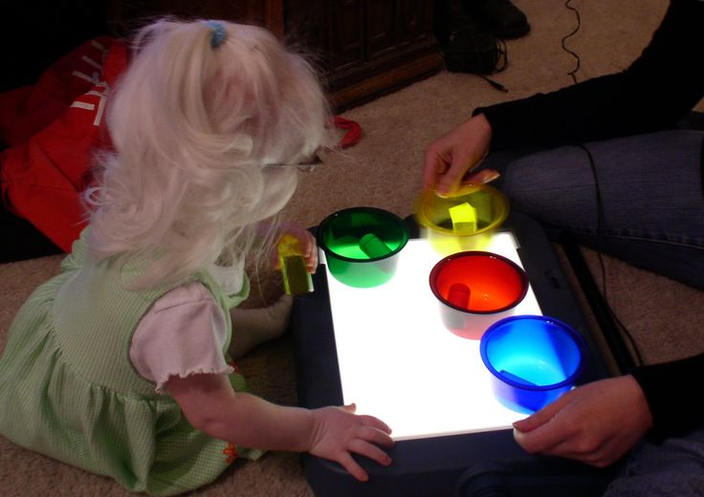
THINK OF A CHILD….

Slide 3

Education – you might have said…
A school that is appropriate to meet their complex needs
Continued progress in post 18
education
An EHCP that is person centred,
outcome focused and measurable
in terms of progress made and
that attaches the correct level of
resources in order to achieve positive outcomes

Slide 4

Health – you might have said…
Timely assessment of health care needs
Access to appropriate health professionals, health services and support
Specialist equipment that meets their complex health needs

Slide 5

Care – you might have said…
Access to appropriate short break/respite services
A family that is effectively supported to care for their child
For LAC - a loving/appropriate foster carer
Friendships and access to appropriate local support networks

Slide 6
The reality is because the vast majority of the children we work with have multi-dimensional needs, their long term life chances will be significantly influenced by the effectiveness of professionals across education, health and care services working together to secure good outcomes.
That includes planning and commissioning the most appropriate services and support to meet existing needs and future demand for specialist services/support at a local, regional and national level.
EDUCATION
HEALTH
CARE
IMPROVED OUTCOMES

Slide 7
Improving outcomes - commissioning on 3 levels
Individual level – ensuring we provide personalised support for children & young people (needs normally identified via an EHCP or other statutory plan)
Service level – Specific services within our local offer addressing gaps in provision and improving outcomes
Strategic level – Ensuring our combined resources meet the needs of the population, aligning resources, capability, capacity to achieve greater efficiencies and improved outcomes

Slide 8
But is it really that simple?
Growing demand for specialist services/support
Tightening budgets
Restructuring across public services
Changing legislative landscape
Given changing landscape/pressures in system – how do we effectively work with commissioners to improve outcomes for children and young people with complex needs?
LET’S GET INSIDE THE HEAD OF A COMMISSIONER!

Slide 9
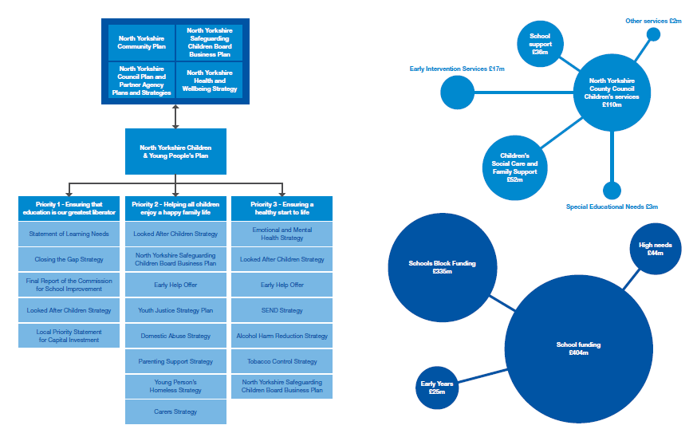
Big Picture
Balancing Priorities and Funding…

Slide 10
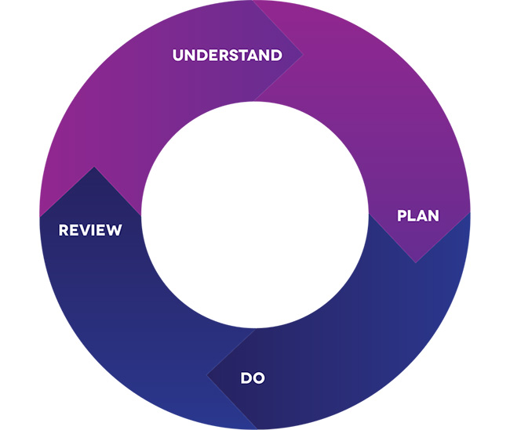
Effectively working with the
Commissioner

Slide 11

First thing a commissioner needs to understand is the data and intelligence on children/young people to be supported by any commissioned activity and context
Accurate data and intelligence underpins/informs strategic planning and commissioning and helps commissioners to better understand needs and future demand and make evidence based decisions.
Seems logical doesn’t it? Yet this important first stage of the strategic planning and commissioning process is often not quite as informed as it should be....

Slide 12

True Colours Trust for the Council for Disabled Children 2017
Simone Vibert for the
Children’s Services Development Group 2016
“Much more time should be spent understanding need and demand. All too often this is ignored or simplified because of the level of difficulty involved in analysing human trends and need patterns. Without it, however, commissioning is misguided at best”
“The national data set on disabled children is inadequate. It has gaps, anomalies and inconsistencies. It is unfit for purpose.”
“There is an urgent need to sharpen the focus on disabled children and young people, in particular, the rising number of children with complex needs. We need to know more about the numbers and the needs of this cohort, how this is changing over time and what this may mean in terms of future demand for specialist services.”

Slide 13

Is this the picture locally?
TIP 1 : WORK WITH THE COMMISSIONER TO UNDERSTAND THE DATA/INTELLIGENCE/LOCAL CONTEXT
How are you capturing, recording and reporting on SI data/intelligence locally?
How confident are you that the data is accurate?
What is the data telling you about outcomes? What’s working well? Not so well? What needs to improve?
How are you benchmarking local data with national / regional data sets / statistical neighbours?
How are you engaging children, young people and families and key stakeholders to inform your local intelligence?

Slide 14
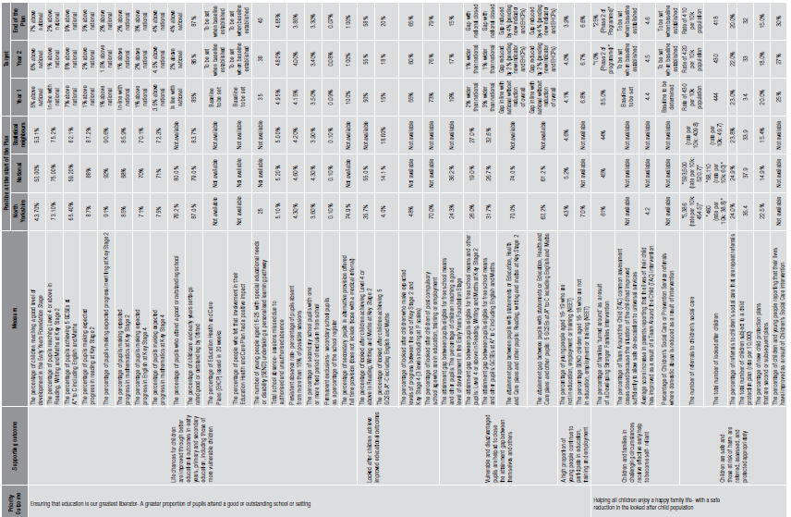
LET’S HAVE A
LOOK AT A GOOD
CHILDREN &
YOUNG PEOPLE’S
PLAN

Slide 15
Where children with HN-LI are educated locally
Balance & Mix
Use of out of area placements and overall expenditure
Health Inequalities data
Population and demographic data
Health Inequalities data
Prevalence data for different kinds of SEND
Number of EHC plans and their primary needs
Data in Disabled Children’s Register
Typical Types of Data

Slide 16
State of the Nation Q1
How confident are you, at a local level, that your data and intelligence enables you, and your partners, to have an accurate picture of the cohort of children and young people with SI (who, where, needs, typical journey, outcomes etc.)
We have an excellent picture locally and our data is very accurate
We have a very poor picture locally and our data
is very inaccurate
If you work in a setting you might want to think about this in terms of what information on SI you include in your data sets (including key performance data, SEN Information Reports, Reports to Governing bodies, what’s included in your Local Offer etc.) and how this helps to build an accurate picture

Slide 17

But even if you hold accurate data and intelligence – data is just data – unless you are using it to inform strategic dialogue and planning and influence commissioning behaviour

Slide 18
TIP 2 : TALK TO THE COMMISSIONER ABOUT HOW YOU ARE SHARING THE DATA AND HOW YOU CAN USE IT INTELLIGENTLY TO INFORM STRATEGIC DIALOGUE AND PLANNING
How are you sharing the data/intelligence with key stakeholders including children, young people and families?
How understood is the data/intelligence at a local level?
Which key forums have a handle on the data/intelligence and how is this being used to inform strategic dialogue and planning?
How can you make your data sit up and bark?

Slide 19
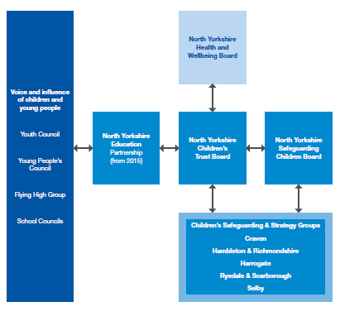

Slide 20

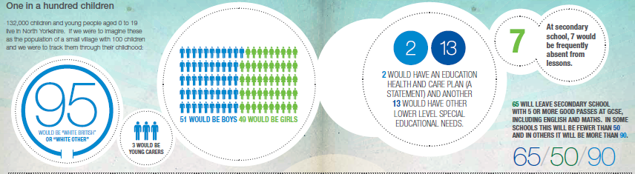

Slide 21
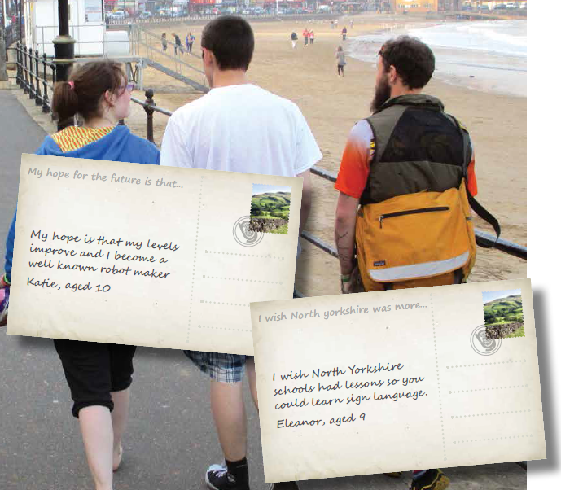

Slide 22
State of the Nation Q2
How confident are you that your data and intelligence on the SI population locally is being used to inform strategic dialogue and planning?
Data and intelligence very effectively helps to inform strategic dialogue and planning
Data and intelligence never helps to inform strategic dialogue and planning
If you work in a setting you might want to think about this in terms of how data and intelligence on SI is shared with your Governing Body, Senior Leadership Team, C&YP, parents/carers and how this informs strategic dialogue/planning

Slide 23
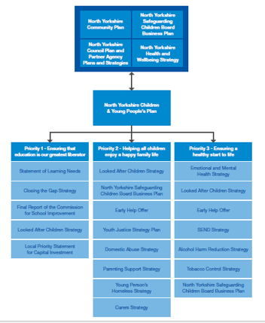
Planning Bookcase…
A key aim is to ensure that our work is reflected in key strategic priorities and plans.

Slide 24

Remember : key strategic priorities and plans often drive and influence commissioning decisions and commissioning priorities
Resources follow key strategic priorities and plans – locally, regionally, nationally

Slide 25
State of the Nation Q3
Locally key strategic plans very effectively reflect priorities for children and young people with SI
Locally key strategic plans never reflect priorities for children and young people with SI
State of the Nation Q4
Locally key strategic plans very effectively help to draw down funding for children and young people with SI
Locally key strategic plans never draw down funding for children and young people with SI

Slide 26


Slide 27
TIP 3 : TALK TO THE COMMISSIONER AND KEY STAKEHOLDERS ABOUT HOW YOUR WORK WILL CONTRIBUTE TO KEY STRATEGIC PRIORITIES AND PLANS
Commissioners and stakeholders will want to see a Plan that sets out:
WHAT we are going to do
WHY we are doing it (position now / outcomes expected / what will change)
WHO we are going to do it for
HOW we will do it
WHEN we will do it
WHAT resources we will need to do it
Evidence of Co-Production needs to be demonstrated throughout

Slide 28

Effective evaluation and review helps to showcase practice innovation and learning, share good practice and learn from what might have gone wrong.
Remember : good evaluation, evidencing improved outcomes and impact can be useful for drawing down further funding (Invest to Save and other funding and resources)

Slide 29
TIP 4 TALK TO THE COMMISSIONER ABOUT HOW YOU INTEND TO EVALUATE AND REVIEW THE WORK
How will you measure change over time – what is improving, what do we need to do better?
How will you share practice innovation and learning and lessons learnt to inform future working practice?
How will you keep key stakeholders including children, young people and families and the commissioner informed of your progress?
Other things that commissioners will be very interested in – VFM, Spread and Scale, potential for Invest to Save ….

Slide 30
State of the Nation Q5
Locally we are very effective at evaluating and reviewing commissioned activity related to SI
Locally we are very poor at evaluating and reviewing commissioned activity related to SI
State of the Nation Q6
Locally we are very effective at sharing what we learn from commissioned activity and lessons learnt help to inform future practice
Locally we are very poor at sharing what we learn from commissioned activity and future practice is never informed by lessons learnt

Slide 31

SHOUT ABOUT YOUR SUCCESS! !

Slide 32

FINALISTS - NATIONAL INNOVATION IN COMMISSIONING AWARD

