Slide 1
Identifying and meeting the needs of deaf children
Brian Gale OBE
Director, Policy and Campaigns
National Deaf Children’s Society

Slide 2

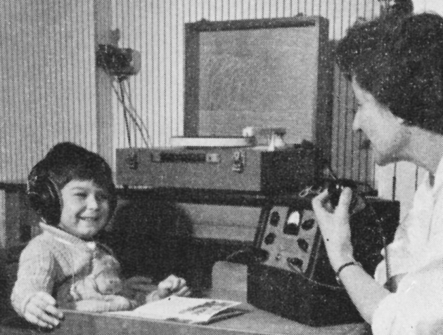
Who we are
Notes:
In 1944, a group of parents of deaf children met in London because they were concerned over the impact of the Education Act 1944 on their children’s education. From these origins, we’ve become the leading UK charity dedicated to creating a world without barriers for every deaf child.

Slide 3
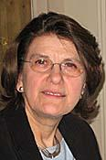
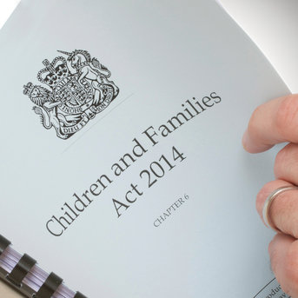

Children and Families Act 2014
Notes:
We were one of the leading charities working to influence the Children and Families Act 2014 when it was being debated. One of our key concerns was to strengthen accountability of SEN services. We supported peers such as Baroness Wilkins and Lord Low who argued that Ofsted should play a role in holding local authorities to account. This eventually led to the DfE announcement that Ofsted would be asked to inspect local area SEND provision.
We’ve continued to engage with this issue and continue to believe that more needs to be done to hold services for deaf children to account. We’d like to thank Ofsted, in particular Joanna Hall, for their willingness to continue to work with us and listen to our feedback.

Slide 4
Key facts
Children learn through hearing. Having a hearing loss can present complex challenges
Low incidence need. Mainstream staff have little training or experience
Over 90% of parents of deaf children have little prior knowledge of deafness
78% of attend mainstream schools (where no specialist provision)
Around a quarter have a statement/EHC plan
Notes:
Deafness is a low incidence need. This means that parents have little prior knowledge of deafness or will have any good understanding of how to develop language and communication in their child in the early years.
It also means that most schools will likely only have one or two deaf children once in a while. Given most deaf children attend mainstream schools, this means there is a risk they will be taught by teachers who will have had relatively few opportunities to build up knowledge and expertise in how to support deaf children.
This is why peripatetic services for deaf children are so vital – who else has the knowledge and expertise to provide families and mainstream teachers with advice and support?
But – one of the other implications of deafness as a low incidence need – is that commissioners may not also have a good understanding of what they need to commission to meet the needs of a relatively small group of children. It’s for these reasons we believe there needs to be more external scrutiny of these vital services for deaf children.
Worth noting that most deaf children won’t have a statement or plan. Real questions over what’s happening to other deaf children?

Slide 5
Technology does not replace normal hearing
Early identification and support (0-2 years is critical to long term outcomes)
Numbers are increasing
Many children with a mild loss don’t get support from health and education services despite the impact on outcomes

Slide 6
Number of deaf children
Notes:
There has been no decline in the total number of deaf children in England – now stands at 41,261.

Slide 7
Impact of mild hearing loss
Outcomes by level of hearing loss (2013)
Severity of loss | Number of pupils in cohort | % achieving 5 or more A* - C GCSEs), including English and Mathematics
Mild | 363 | 46.6%
Moderate | 292 | 44.9%
Severe | 79 | 39.2%
Profound | 101 | 36.6%
All deaf children | 835 | 44.1%
Children with no identified SEN | 452,230 | 70%
Notes:
Data shows that even a mild on moderate hearing loss can have a big impact on educational attainment. (Above data is a little older).

Slide 8
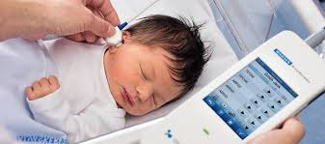
Effectiveness of local area in identifying deaf children

Slide 9
Newborn hearing screening:
PHEs 5 quality standards
Coverage: % of babies screened within 4 weeks of birth. (PT: 97% acceptable.99% achievable.)
2 standards to test performance of the screen
Intervention: % offered audiology appointment within 4 weeks of screen (PT: 97% acceptable. 99% achievable)
Intervention: % attending audiology appointment within 4 weeks of the screen. (PT: 90% acceptable. 95% achievable)

Slide 10
Newborn hearing screening:
More information
The standards: www.gov.uk/government/publications/newborn-hearing-screening-programme-quality-standards
Performance data reports: Obtainable from Public Health England (newborn screen programme). Includes funnel plots which identify outliers
https://www.gov.uk/government/publications/newborn-hearing-screening-programme-nhsp-operational-guidance/7-data-and-reports

Slide 11
Other government standards
“Children’s Services (usually education) are notified within one working day of confirmation of PCHI
Families are offered a visit within two working days of contact (year round)”
http://webarchive.nationalarchives.gov.uk/20150408175925/http:/hearing.screening.nhs.uk/standardsandprotocols

Slide 12
Identification: Audiology
“Audiological services that are responsible for the assessment of NHSP referrals must participate in a peer-review process of ABR and in a quality initiative such as Improving Quality in Physiological services (IQIPS)”.Public Health England https://www.gov.uk/government/publications/newborn-hearing-screening-programme-nhsp-operational-guidance/9-audiology
For information of services accredited through IQIPS see www.ndcs.org.uk/listenup
Notes:
Paediatric audiology services are expected by NHS England to seek and maintain accreditation under the Improving Quality in diagnostics Physiological Services (IQIPS) programme. To date, relatively few have. Inspectors may want to ask if a service is accredited and, if not, if this is a sign of weaknesses in the ability of the local area to identify deafness promptly
Half of deaf children are born deaf and the other half acquire deafness as they get old. Inspectors may wish to look into how the local area identifies late onset deafness. If there is no school entry screening in the area, inspectors may want to look into alternative procedures or protocols for identifying acquired hearing loss
In our experience, many local areas are weak in collating data on overall numbers of deaf children. There is a tendency to collect data only on children who are receiving education support from a Teacher of the Deaf. This raises questions about how the needs of other deaf children are being identified and monitored.

Slide 13
Identification: other considerations
Children with complex needs: University of Manchester research found hearing loss overshadowed by other needs
Children with glue ear: common in young children – can impact on language
Acquired hearing loss: 50% of children with HI acquire hearing loss. for every baby identified. School entry screening and what arrangements are in place if there is not SES.

Slide 14
Identifying and meeting need
Quality Standards for Education Sensory Impairment Services
(DfE / National Sensory Impairment Partnership 2016)
  www.ndcs.org.uk/document.rm?id=12354
Notes:
Teachers of the Deaf, play a key role in supporting families from both and mainstream education professionals.
The National Sensory Impairment Partnership have developed quality standards for services. Good services will have audited themselves against these standards. The standards include, for example, effective use of specialist assessments to establish how well deaf children’s language is progressing and using that data effectively to ensure targeted support is provided.

Slide 15
QS aligned with inspection framework
Identification: Early contact with family, assessment information on implications of diagnosis and support, keeping records
Assessing and meeting needs: Eligibility, effective use of specialist assessments, satisfaction from establishments, parents and children YP
Outcomes: Impact on (i) T&L and inclusion; (ii) attainment and progress (post 16).

Slide 16

Effectiveness of local area in improving outcomes for deaf children
Attainment data
Notes:
If you were comparing deaf children to other types of SEN, you would conclude deaf children doing quite well. However, deafness is not a learning disability. Providing deaf children get the right support, no reason why they shouldn’t be achieving as well as other non-disabled children. Extremely important that Ofsted inspectors look closely at how well deaf children are doing compared to their hearing peers, and not any other groups.
Also important to split out and segment any attainment data on SEN to make sure that any underachievement by deaf children is not masked by relatively good achievement by other SEN groups.

Slide 17
Early years
Proportion achieving a good level of development
in the early years foundation stage
 | Deaf children | Children with no identified SEN
2016 | 33% | 75%
2015 | 28% | 71%
2014 | 26% | 66%
2013 | 20% | 56%
Notes:
Wide attainment gap in the early years

Slide 18
GCSEs
Proportion of children achieving 5 GCSEs (including English and Maths) at grades A* to C
Year | Deaf children | Children with no identified SEN
2016 | 41.3 % | 63.9%
2015 | 41.1% | 64.2%
2014 new methodology | 36.3% | 65.3%
2014 old methodology | 40% | 69.3%
2013 | 42.7% | 70.4%
2012 | 37.4% | 69.3%
2011 | 39.7% | 69.5%
2010 | 36% | 66.5%
2009 | 29.4% | 61.3%
2008 | 28.3% | 57.8%
2007 | 27.2% | 54.3%
Notes:
And continues throughout to GCSE…
Progress 8 data indicates that deaf children aren’t catching up – in 2016, Progress 8 score was -0.05

Slide 19
Improving outcomes
National Sensory Impairment Partnership’s: Annual Outcomes benchmarking programme funded by DfE
104 LAs participating
Inspectors can ask to see data and how it is used or why the LA is not participating
Notes:
Many education services participate in an outcomes benchmarking exercise, which is facilitated by the National Sensory Impairment Partnership (NatSIP). Information on which services participate in this exercise and on what outcomes they achieve is not published. However, local authorities may be able to make this available to inspectors on request.
Cohorts will be small. However, no reason why you can’t aggregate date over 3 or 5 years to help you identify trends.
Eligibility framework is used by many services to make decisions on effective use of resources to meet needs. Takes into account range of factors such as language development and other needs. Framework doesn’t decide what resources should be allocated, but how. Not intended to replace professional judgement and services are encouraged to focus on outcomes.

Slide 20

Effectiveness of local area in improving outcomes for deaf children
Children’s Hearing Services Working Group (CSHWGs)
Parent groups
Notes:
Key source for information on whether local area is improving outcomes are CHSWGs and parent groups
The CHSWG is a multi-agency forum that brings together education, health and social care services for deaf children in each area. There is a parent representative in each group. CHSWGs can be an effective way for a local authority to demonstrate co-production with parents of deaf children, as well as joint working and commissioning across education, health and social care.
If key partners consistently fail to attend the CHSWG, this may indicate that the service is ineffective in improving outcomes across the area.
Many parent groups across UK – sometimes known as local groups or Local Deaf Children’s Societies. Many will have active youth groups attached to them.

Slide 21

How NDCS can help
Local area information sheets
Regional Directors
Contact: brian.gale@ndcs.org.uk
Notes:
Once NDCS becomes aware of an inspection, we will forward a local area information sheet about services for deaf children and key contacts. We hope these are helpful.
Our team of Regional Directors are happy to have follow up discussions with inspectors.
We also routinely alert any parent members in our area to the inspection and a webinar. Some parents may wish to contact Ofsted inspectors directly.

