Slide 1

Changes in Education Funding in the Early Years
NatSIP Working Day
February 2017
Brian Gale
Director Policy and Campaigns

Slide 2

Funding Allocation to LAs

Slide 3
Funding to LAs
National Average hourly rate from £4.56 to £4.94 for 3 and 4 year olds (for disadvantaged two year olds from £5.09 to £5.39)
Historic allocation replaced by the National Funding Formula

Slide 4


Current EY funding allocation per hour
Darlington £3.92 | Sunderland £5.39

Slide 5
The NNF
Universal base rate accounts for 89.5% the total allocation
Additional needs: FSM 8%, DLA 1%, EAL 1.5%
Area cost adjustment
Minimum hourly rate £4.30

Slide 6
Make up of hourly rate for 3-4 year olds
EYNFF average hourly rate £4.72
EY pupil premium £0.05
Nursery schools allocation £0.09
Quality and expertise £0.01
Disability access fund £0.2
= national average £4.88 per hour
(+£30m to give a £4.30 minimum takes it to £4.94)

Slide 7
Funding floors
80% of LAs will see an increase in hourly rates
No LA will experience a reduction of more than 5% in a year and no more than 10% in total by 2019-20
All LAs will be fully funded by the NFF by 2019-20

Slide 8

Funding from LAs to providers

Slide 9
Distribution to providers
93% of a LA’s EY grant must be delegated in 2017/18 rising to 95% in 2018/19
By 2019/20 90% must be distributed using a universal base rate (same rate for all types of provider)

Slide 10
10% used to fund supplements for deprivation (which is the one mandatory supplement) and discretionary supplements for rurality, flexibility of provision, quality and EAL
£55m pa to protect funding in nursery schools/classes

Slide 11


Additional needs

Slide 12
Additional needs
EY pupil premium £0.53 per hour
Disability Access Fund (DAF) - £615 pa per child. For 3-4 year olds in receipt of DLA
Every LA required to establish an inclusion fund

Slide 13
The DAF
DfE acknowledge problems with DLA but nothing better
£12.5m allocated – a small fraction of the additional billion being invested
The £615pa paid straight to the provider

Slide 14
The DAF
4 year olds in reception year not eligible
2 year olds entitled to a place are not eligible
Children don’t have to take up the full 570 hours to b eligible

Slide 15
The DAF
The DAF funding each LA receives is based on Feb 2015 data from DWP
Should not be offset against funding which is ordinarily provided
Paid as a lump sum once a year

Slide 16
SEND Inclusion Fund
Statutory requirement to cover 3-4 year olds (LAs encouraged to cover 2 year olds)
DfE advises it should focus on children with lower level or emerging SEN (more complex needs funded from HNB)

Slide 17
SEND Inclusion Fund
Eligibility determined in consultation with EY providers, parents and specialist
LAs determine level of funding which can be funded from the HNB or EYB and how the money is allocation. (Top up payments count towards delegation levels.)

Slide 18
Factors to consider
The LA makes these decisions following discussion with providers on:
The level of SEN support which will be offered, bearing in mind the number of SEN children with SEN and their level of need

Slide 19
The capacity of their EY market to support these children without a call on additional resource
The appropriate balance of funding between the SEN inclusion fund and the universal base rate

Slide 20
Inclusion fund and LO
LAs required to publish in the Local Offer:
Eligibility criteria
Planned value of the fund at start of year
Process for allocating funding

Slide 21
High Needs National Funding
Formula and other reforms
DfE Consultation
NatSIP Working Day
February 2017
Brian Gale
Director Policy and Campaigns

Slide 22
Stage 2 consultation
Confirms formula factors in the national formula includes historic spend (50%)
Up to 3% gains per year for over 70 LAs in 2018-19 and 2019-20

Slide 23
Stage 2 consultation
A funding floor no LA loses funding
Limited flexibility to address the risks of a ring-fence around mainstream schools funding
Changes to the funding of special units

Slide 24
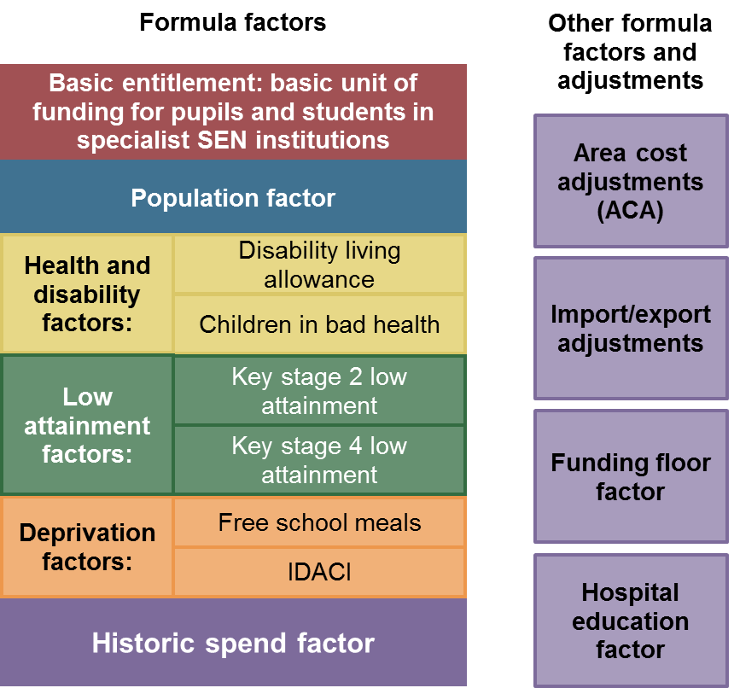
High needs national funding formula factors…..

Slide 25
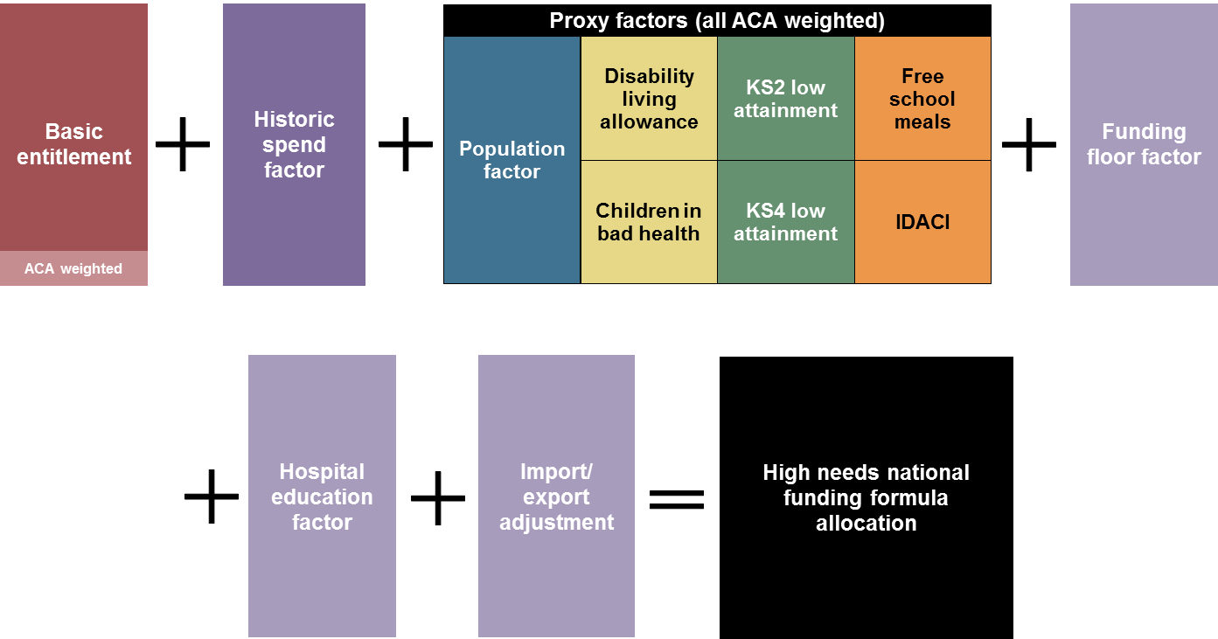
….and how the factors link to calculate allocations for each local authority
The published consultation documents include a step-by-step calculation of each local authority’s illustrative allocation, and a technical note to explain the calculation in more detail

Slide 26
Units - Existing
£10k per place with the place number deducted from the pupil number used to calculate the mainstream school budget to prevent double funding
Top up funding from LA

Slide 27
Units – proposed 2018/19
Pupils attending unit won’t be deducted from the mainstream funding allocation
But level of place funding for places occupied by pupils will be reduced to £6k
Places not filled at the time of the school census will be funded at £10k

Slide 28
Current example
20 places – 15 on roll at census time, 3 pupils join later, 2 empty places:
20 places at £10k = £200k
Plus any top up

Slide 29
Proposed example
20 places – 15 on roll at census time, 3 pupils join later, 2 empty places:
4k basic mainstream entitlement = 15x£4k = £60k
£6k per high needs place occupied = 15x£6k = £90k
£10k per unoccupied place = 5x£10k = £50k
Plus any top up

Slide 30
Ring fencing of the schools block?
12% increase in under 5 in special schools (6051 in 2015)
5-10 years: in mainstream increased by 8% but 21% increase in special (27,905 to 33,684
11-15 years: in mainstream decreased by 3% but an increase in 1% in special to 50,923

Slide 31
Ring fencing of schools block
No ring fencing in 2017/18
But restrictions in 2018/19
Transfer can only take place with the agreement of school forum and the majority of mainstream schools

Slide 32


Slide 33
£23m for strategic reviews
“We envisage three key outcomes emerging from these reviews:
A strategic plan for high needs provision that makes sure there is an attractive offer for parents and young people which will meet the needs of future cohorts, at a cost that is sustainable…..

Slide 34
……This might include, for example:
i. measures to support mainstream schools in meeting the SEN of a wider range of pupils, for example through workforce training or clear routes to access specialist expertise; (para 4.26)

Slide 35
“The C&F Act 2014 is clear that, when considering any reorganisation of provision, decision makers must be clear how they are satisfied that the proposed alternative arrangements will lead to improvements in the standard, quality and/or range of educational provision for children with SEN” paragraph 4.20

Slide 36
Support services
“We acknowledge that teachers and practitioners do not always feel equipped to meet the wide range of SEN. It is particularly important that mainstream schools are able to draw on specialist support and advice so they are confident in offering high-quality education to all.…..

Slide 37
Things to note
Alternative provision still under review
Post-16 funding changes need more work. Consultation likely in 2017
Consultation on the revenue funding of special free schools

Slide 38
Another thing to note
Research – looking at the link between outcomes, costs and benefits; the availability of new data to improve the formula, and the funding of national and regional provision for very complex needs – leading to a review of the formula in 4 years

Slide 39
More things to note
  Allocations of special provision capital fund announced early in 2017
  The role of mainstream schools in making special and alternative provision and how best to use the local budget flexibility

