Slide 1

Products and technology which could help deaf young people in education and work
Chris Bowden
Head of Technology Development

Slide 2

Technologies for education, face-to-face conversations and meetings

Slide 3
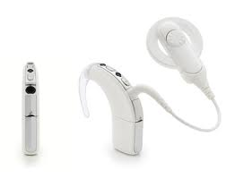
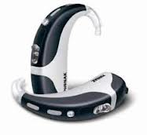
The problem with hearing aids, implants and bone anchored hearing aids
They amplify ALL sound and classrooms are poor listening environments!

Slide 4
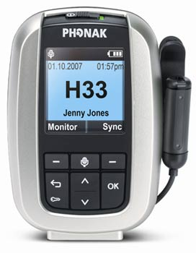
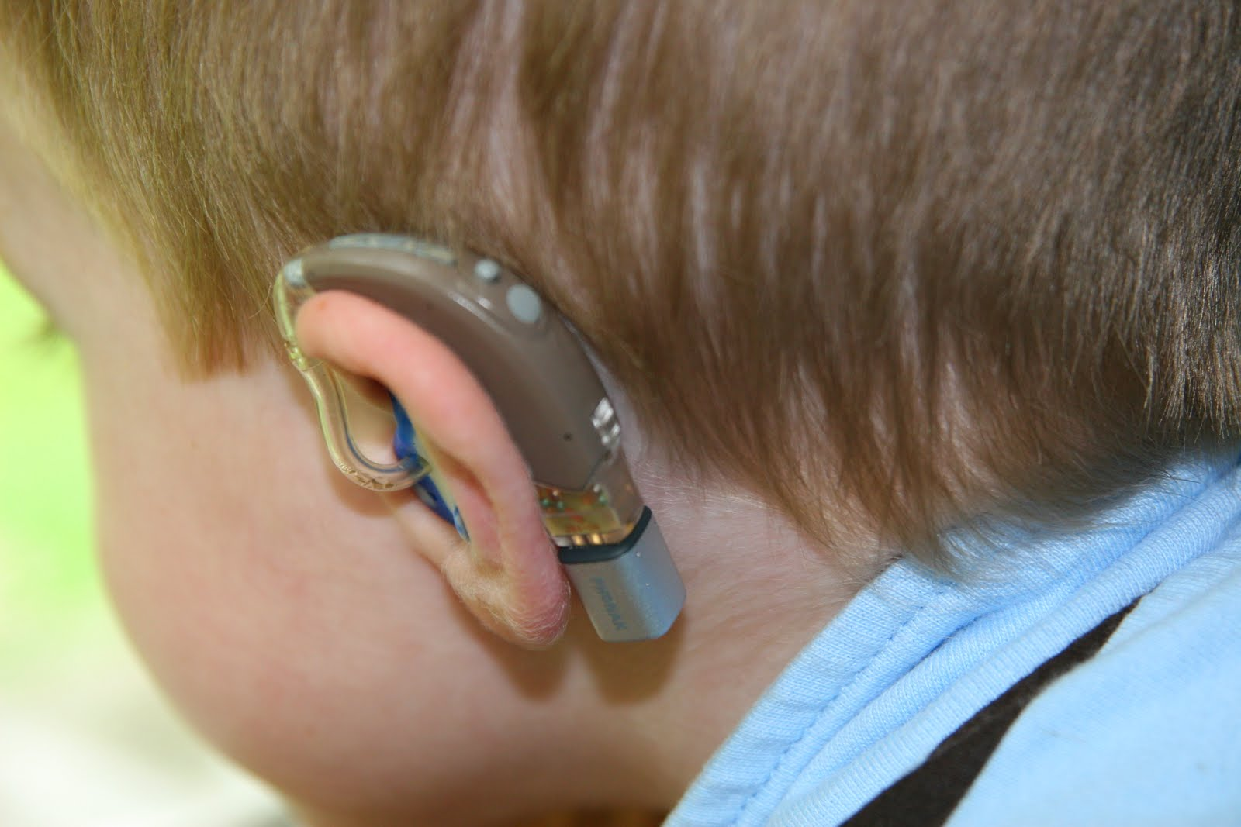
What are radio aids?
Two main components:
    Transmitters Receivers

Slide 5
Benefits
Main benefits
Direct communication from lecturer to student
Easier for young person to hear and concentrate
They can sit wherever they want
Especially helpful when room has poor acoustics
Can be used with or without hearing aids
Cost - Typical wireless radio aid system £1450

Slide 6
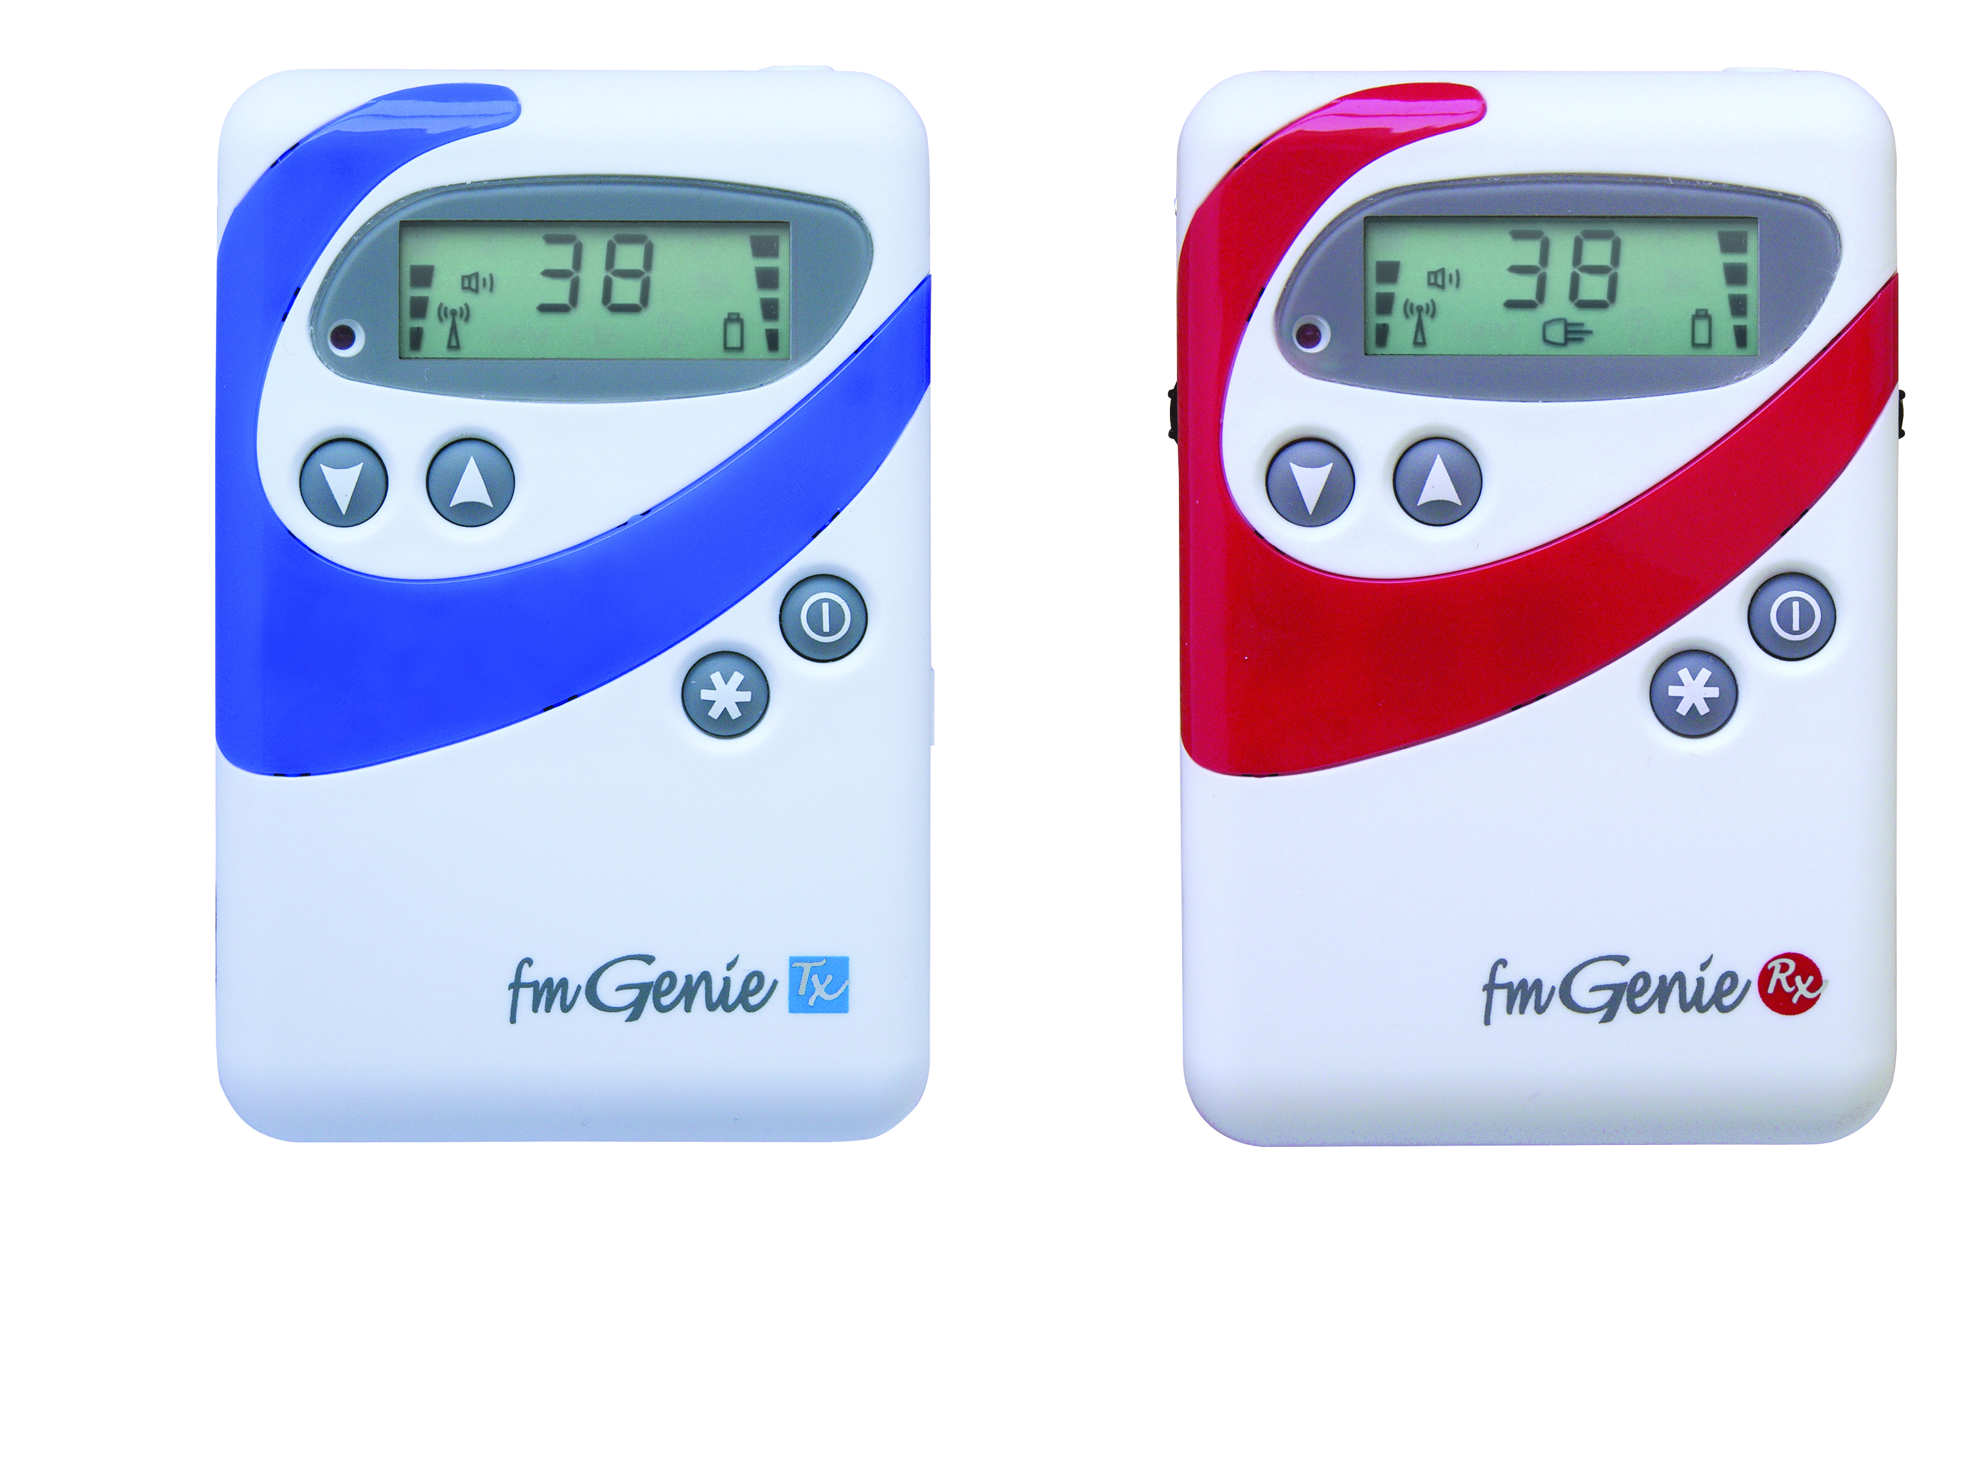
Body-worn receiver
Transmitter
Connevans FM Genie
Receiver

Slide 7
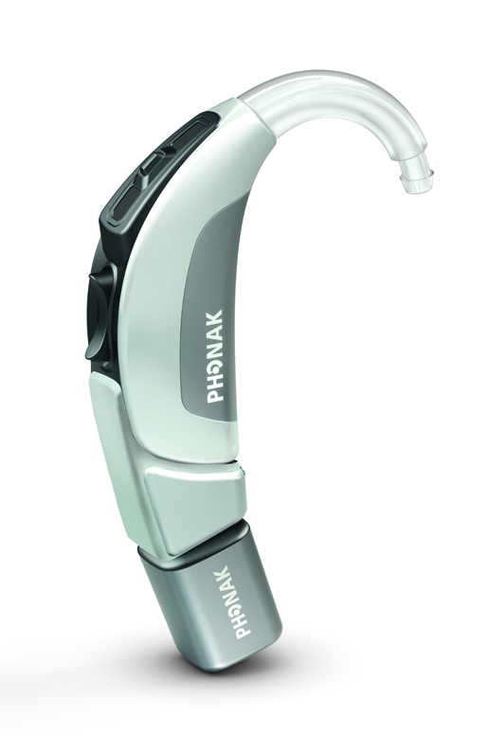
Ear-level receiver
Hearing aid
Direct input shoe
Receiver
Phonak Roger X receiver

Slide 8
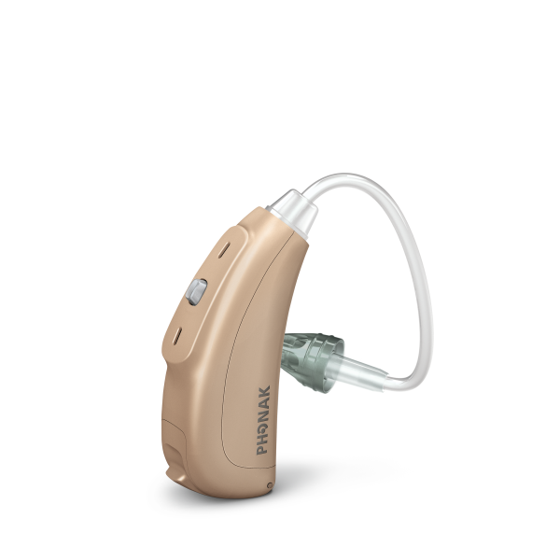
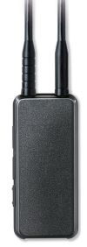
Neckloop and personal radio aid receivers

Slide 9
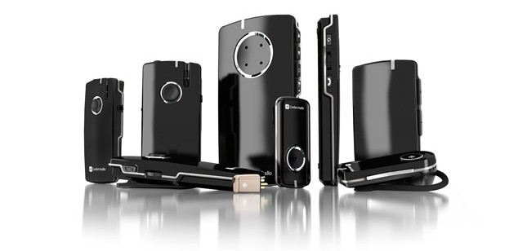
Digital systems
Comfort Audio Digisystem

Slide 10
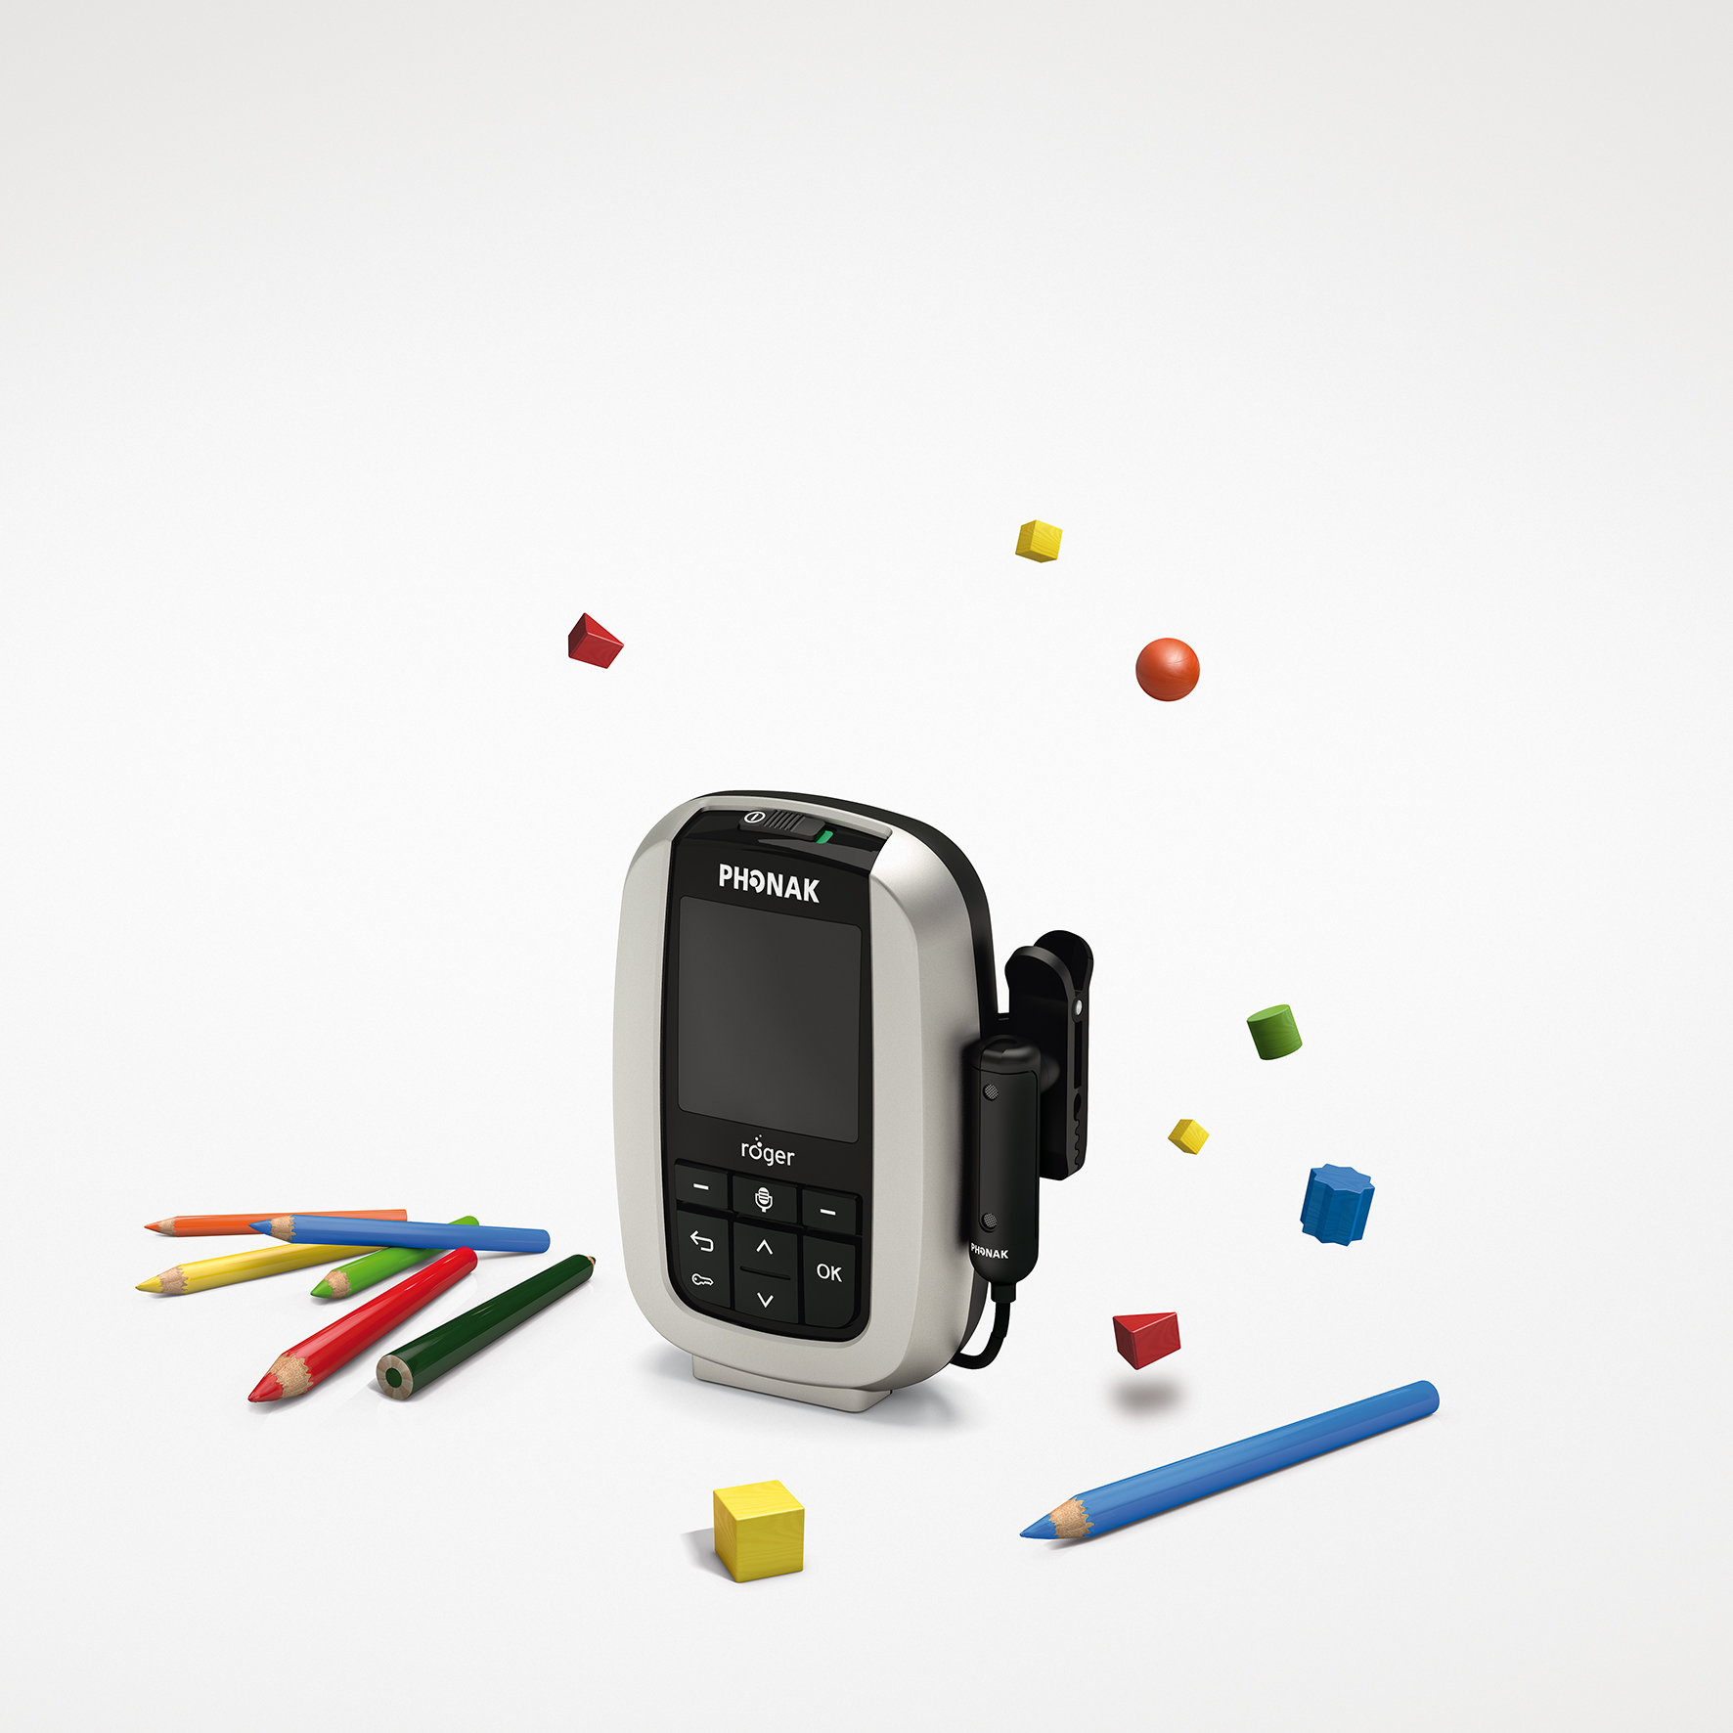
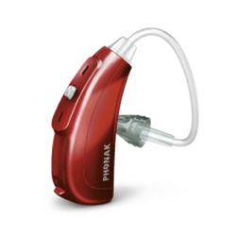
Phonak Roger Inspiro system

Slide 11
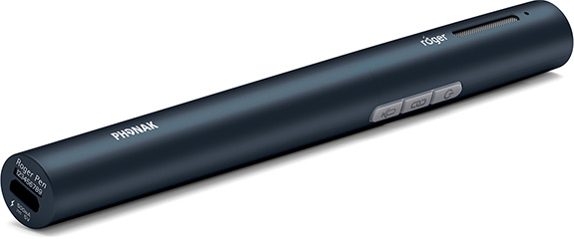
Phonak Roger pen

Slide 12
What they can be used with
A soundfield system
Whiteboard
Tablet device
Television and entertainment
Streamer
Bluetooth enabled products
Computers

Slide 13
Where could a radio aid be used?
At college / University / training
At work
Out of school activities and sports
In public places; Shopping or socialising
At the doctors
In the car
At home – linked to TV or music

Slide 14
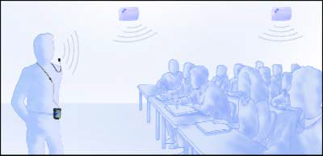
Soundfield systems
  An amplification system which provides an even spread of sound around the room.
  Teacher speaks at normal voice level, avoiding voice strain.
  All students hear at the same level wherever they are seated in the classroom

Slide 15
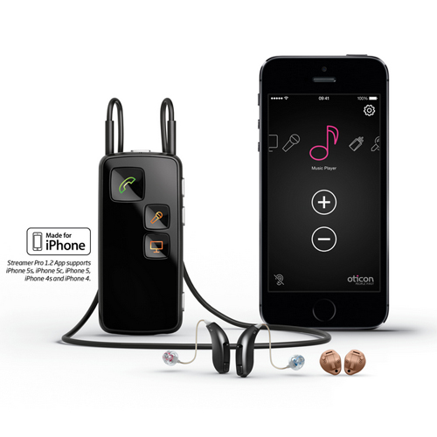
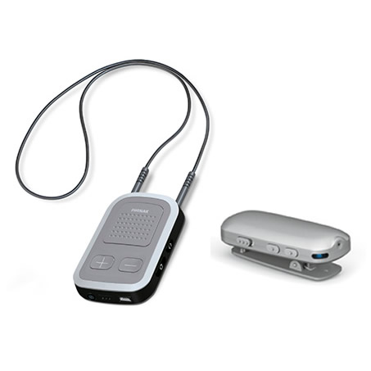
Streamers
Listening to the phone, mobile, TV , music or conversations

Slide 16
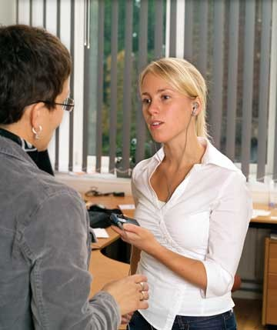
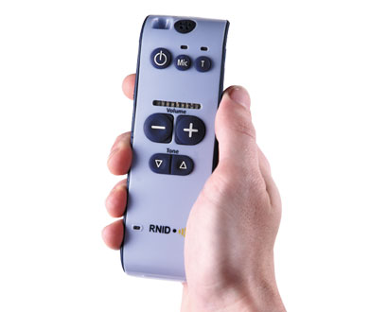
Personal listeners

Slide 17
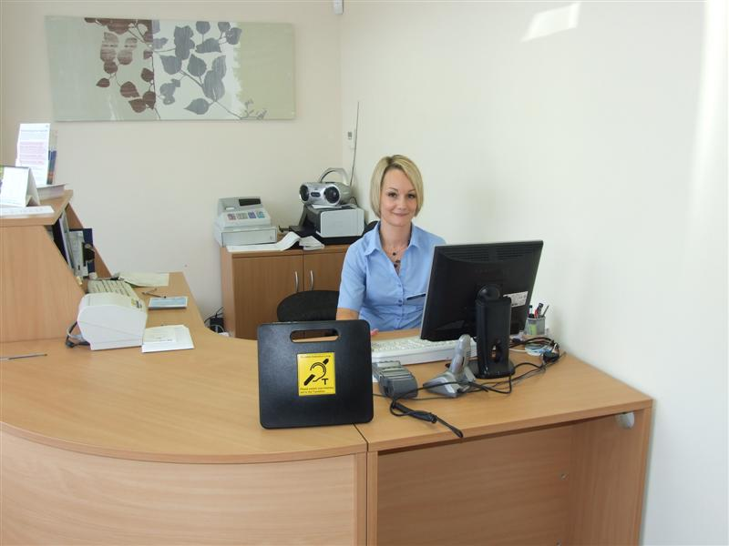
Communicating face to face

Slide 18
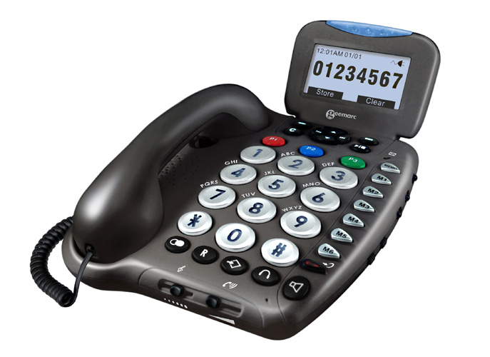
Talking on the phone
Amplified, hearing aid compatible phone

Slide 19
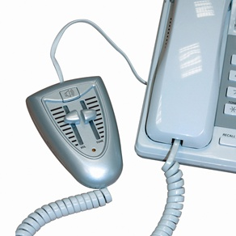
In-line telephone amplifier
PhonePlus PL51

Slide 20
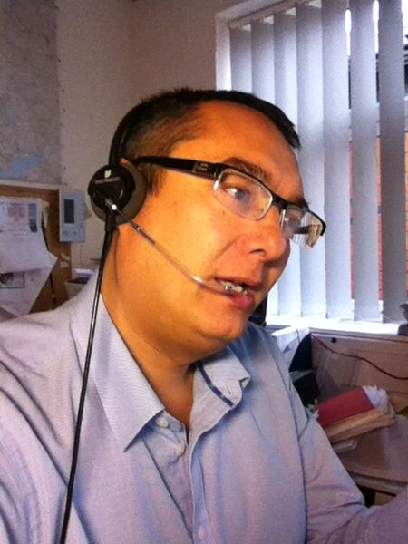
Headsets
Amplified and hearing aid compatible

Slide 21
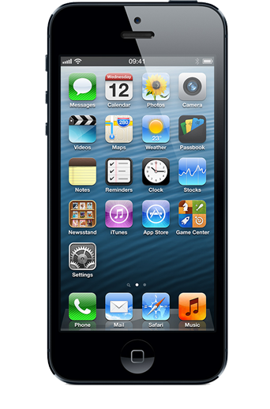
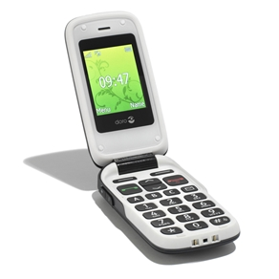
Talking on the phone
Making mobile phone calls
M and T ratings

Slide 22
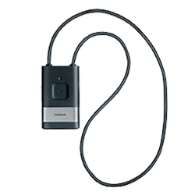
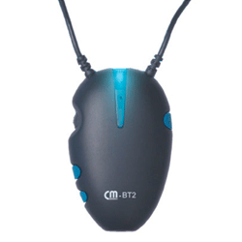
Making mobile calls....
Streamers
Bluetooth neckloops and earhooks
  Need T programme
  Ideal for cochlear implants

Slide 23
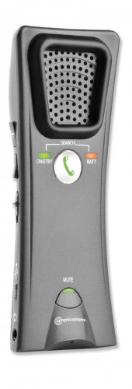
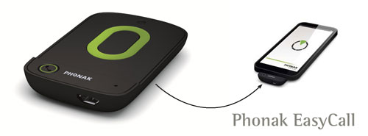
Making mobile calls.... latest accessories
Amplicomms SA40 Phonak EasyCall

Slide 24


Other ways to communicate
Text
SMS, email and social media
Text phones & Next Generation Text service
emergencySMS service
Voice recognition / Speech-to-text software
Remote captioning / palantypist

Slide 25

Other ways to communicate
Video
Skype, FaceTime and live videochat services
Video relay services

Slide 26
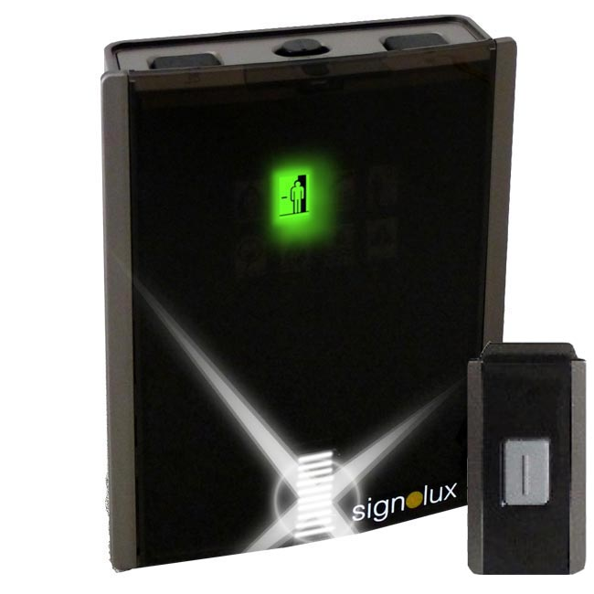
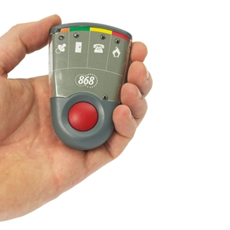
What’s going on?
Personal paging system Doorchime

Slide 27

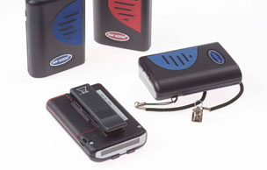
Safety at work

Slide 28


Our information resources

Slide 29
To find out more …
Webpage www.ndcs.org.uk/technology
Apps resource www.ndcs.org.uk/apps
Technology Test Drive loan service
Got a question?
ask the NDCS Freephone Helpline on
0808 800 8880
Email us at : technology@ndcs.org.uk

Slide 30

Any questions ?

