Slide 1


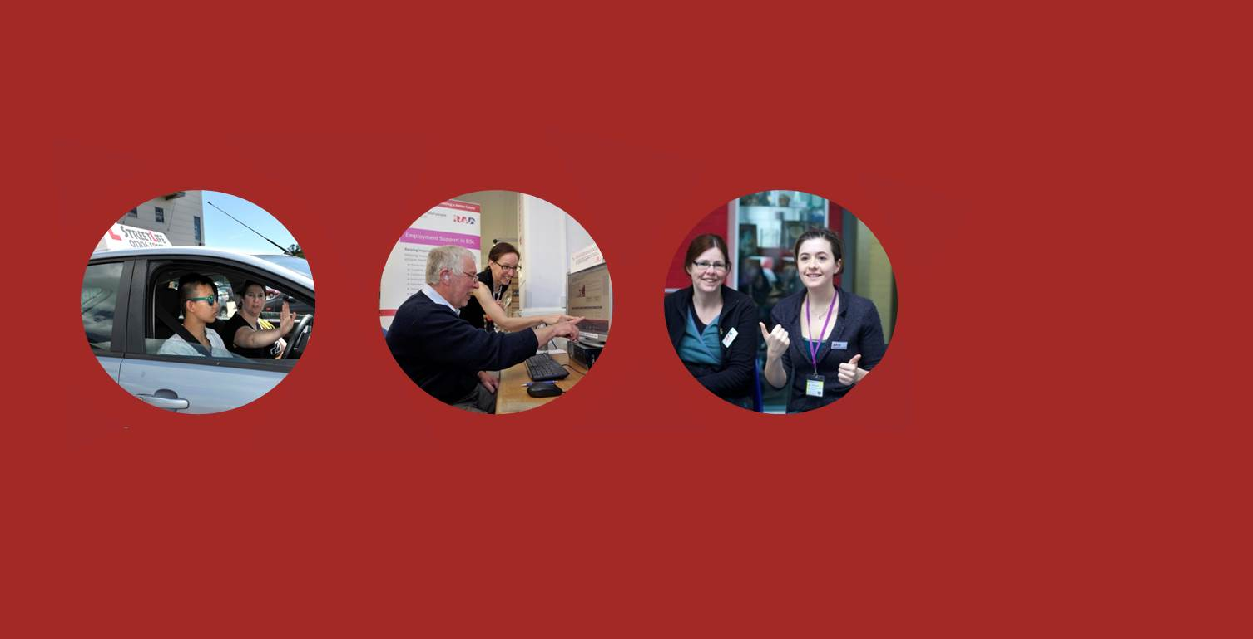
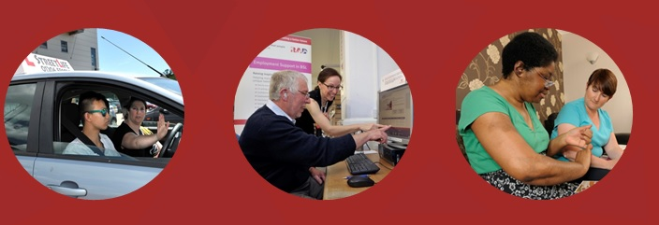
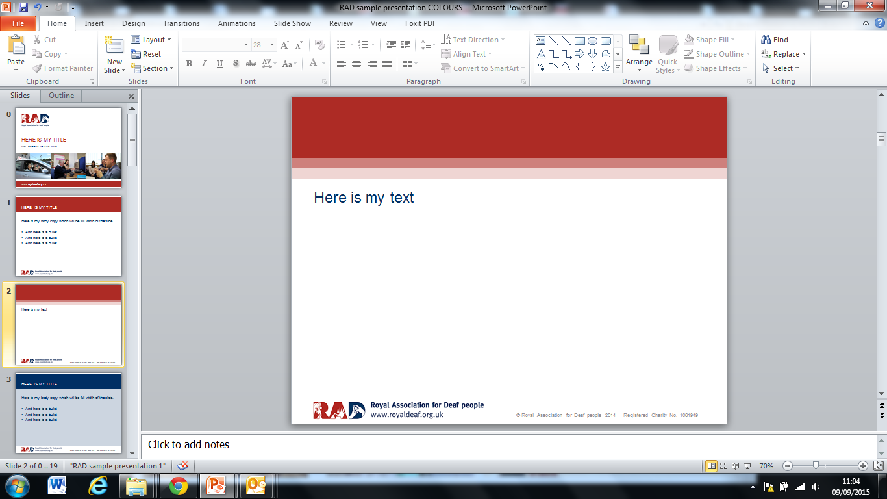
SERVICES
Who are we? What do we do?
NatSIP 11th Jan 2017 – supporting Deaf apprenticeships

Slide 2
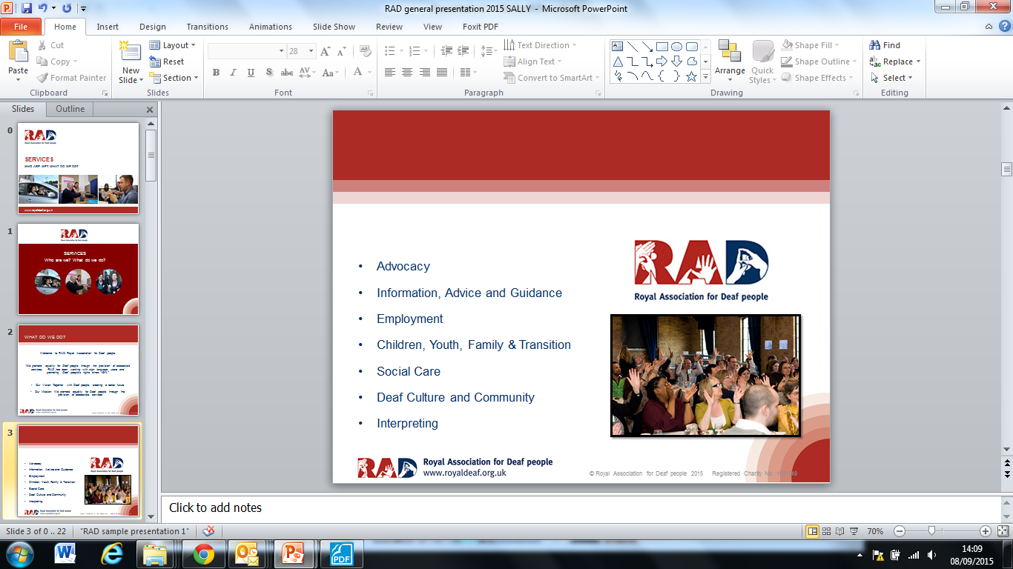


Who are we?
Our Vision: Together with Deaf people; creating a better, more accessible future
Our Mission: We promote equality for Deaf people through the provision of accessible services

Slide 3
Our Values
We:
Take the time to understand and deliver what matters to Deaf people
Respect Deaf language, identity, community, heritage, and diversity
Develop services and partnerships that Deaf people need
Acknowledge the contributions our staff and volunteers make
Always deliver on our promises
Promote continuous improvement in all we do
Communicate clearly
Are honest with ourselves and our stakeholders

Slide 4
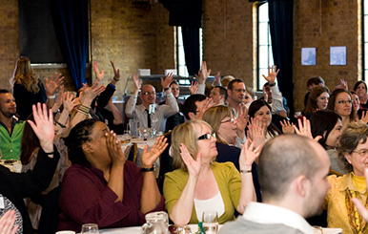
What do we do?
Advocacy
Information, Advice and Guidance
Employment
Children and Family, Youth and Transition
Social Care
Deaf Culture and Community
Interpreting (including VRS and VRI services)
Provide back office services to other charities

Slide 5
Who are we?
We:
Have a long and well established relationship with the Deaf community – ‘in it not for it’
Work mainly in London, East Anglia and the South of England
Have 130 staff and 1 bear
Hold Investors in People – Gold

Slide 6
We have four key ambitions
To deliver the services Deaf people want and need
To support mainstream providers to be accessible to Deaf people
To ensure financial sustainability
To be an exemplary employer

Slide 7
Recruiting a Deaf apprentice
We work with Deaf young people at our youth hub who sometimes struggle to find work
We wanted to provide at least one opportunity (hopefully more) for a Deaf apprentice to join our team and work towards a qualification
We advertised in a wide variety of places (social media, Deaf jobs UK, specialist apprenticeship web sites)

Slide 8
Supporting a Deaf apprentice
All new staff need time to settle into a new role – for someone who hasn’t been in a working environment before it takes a little longer to help them to settle in
Matching a Deaf apprentice with the right manager is important
Making sure they have the right level of support is critical to success

Slide 9
Lucy Michaels
I am profoundly deaf however I wasn’t diagnosed until I was 2 years old
I moved to Colchester when I was 10 years old so I could attend the Philp Morant School which has a deaf unit
After attending Philip Morant School, I went to Colchester Sixth Form College to achieve my A-levels. I have left with 3 A-levels and 1 AS level which I am proud of
Notes:
Lucy to introduce herself - school experience, qualifications hobbies

Slide 10
Lucy Michaels
I currently work at RAD which I enjoy!
My hobbies varies for example I socialise with my deaf friends, going on deaf events for example Deafpool in Blackpool in the summer. I love going on shopping trips! Lastly I love spending time with family.
Notes:
Lucy to introduce herself - school experience, qualifications hobbies

Slide 11
Becoming an apprentice
I wanted to be an apprentice because I wanted to have more experience and also to gain another qualification
My Uncle saw the role advertised, I applied and got the job – I was really happy

Slide 12
Being an apprentice
I have a manager who gives me work to do – mainly admin tasks (e.g. filing and getting things ready for interviews/meetings)
I have a mentor I can go to if I’m worried about anything
I meet with my tutor regularly about my study and my qualification

Slide 13
Being an apprentice
I enjoy shadowing other colleagues in their job roles for examples going to London
I enjoy sorting out things for example filing and sorting out the folders for new staff
I enjoy my work environment because it is very friendly
Applying to Access to Work to pay for my interpreter has been difficult

Slide 14
The future…..
I am hoping to carry on my job at RAD maybe in a different team to get more experience of different areas of work
I am hoping to become a role model for Deaf people to show that we can do anything - Deaf people usually get told that we can’t do it because we are Deaf – this isn’t true

Slide 15
Any questions?
?????

