Slide 1

NatSIP Online Training Event
Tuesday 1 July 2025
Sensory impairment resource base provision
Resource base provision
Practice in the sector
Jen Nicholson

Slide 2
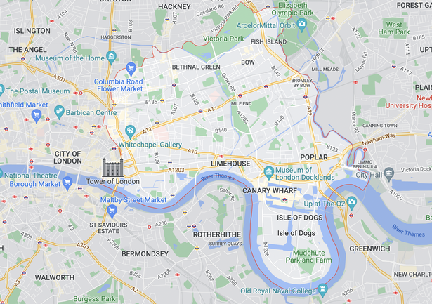
Tower Hamlets
Most densely populated area in England & Wales
2nd fastest growing area in England with population of 325,789 in 2022 and increasing by 4.2% / year
2nd highest proportion of children living in poverty in London and top quartile nationally
1 in 6 households have no one in the household with English as a main language
Notes:
1 in 6 of the total Bangladeshi population in England and Wales live in Tower Hamlets.

Slide 3
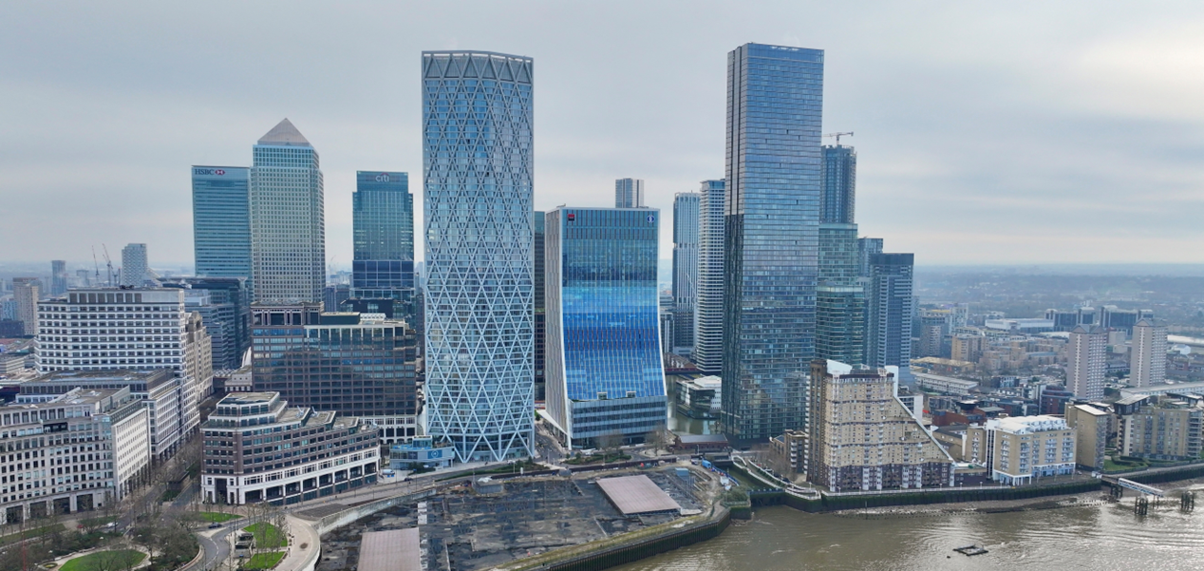
In just 8 miles² – a very diverse mix
Canary Wharf in London Borough of Tower Hamlets

Slide 4
Sensory Data – quick overview
 | VI | DPH
Total known to belong | 290 | 594
- Preschool | 26 | 66
- School age, inc 6th Forms & Post 16 | 264 | 528
# in Special Schools complex needs & ASD | 111 | 79
# in Specialist Schools out of borough | 2 | 13
# in Resource Base type provision in mainstream schools in borough | 15 | 65

Slide 5
Sensory Team’s Reach
68 Primary Schools
16 Secondary Schools
4
Nursery Schools
1
Additionally Resourced Centre 2-year-olds
(deaf children)
2
Centres of Expertise
(VI C&YP)
3
Deaf Resource Bases
Devolved funded
?
Pre-school / home visiting
4
Schools for 14-19
5
Special Schools

Slide 6
Additionally Resourced Centre ARC
An intensive early intervention offer for high needs and potentially vulnerable 2-year-old deaf children
Nursery School places funded from 2-year-old funding (parents helped with application for funding)
Daily access to QToD (4 days nursery, 1 day Stay and Play)
2 days input from bilingual Sensory Support Assistant
Fortnightly input from BSL Instructor in nursery
Weekly specialist Speech and Language Therapy (NHS)
Operates as an Assessment Centre
SEND Section do help with transport

Slide 7
Centres of Expertise (VI) CoE
Specialist input - QTVI / Sensory Support Assistants (Braille & Bilingual Braille Instructors) and Senior Habilitation Specialist from the peri service
All other additional staffing employed by the school via devolved SEN budget or EHCP funding.
One CoE in secondary long established, but reducing input now as cohort changes / YP transition on to Post 16 / 18
One CoE in primary with an amalgamated nursery school near by. Relatively new, born out of parental requests. Expanding.

Slide 8
Horizon scan, early alert & needs
In 2018, monitoring of SSI new referrals (babies) identified a cluster of SSI all without additional or complex needs. High needs yes, but mainstream in the future.
Started planning with senior SEND officers to develop an offer to consolidate support needs and provide a suitable peer group.
A primary place review was going on – so spare capacity with local schools. We had a HT in a school near the service base on board and she had lined up her governors who were excited. We were planning an INSET package etc.
The stars appeared to be in alignment… , but it wasn’t to be

Slide 9
Parent Power + best use public funds
Fast forward to school entry and this cohort was scattered across the borough in different nursery and primary schools.
The peri service was very stretched to empower so many different schools to meet needs.
The children reported their isolation. We ran after school clubs to try and enable them to realise they were not alone. There were other children like them out there, but it was hard.
Some parents started looking at alternatives, including out of borough specialist school offers but they all said they wanted their children to stay local.
Finally, we were given the green light to try again via
organic growth from within

Slide 10
Deaf Resource Bases (DRB)
That area of overlap between the peri service and the borough’s direct commissioning of places in the DRB hosting schools who have their own QToDs and other staffing.
We provide Aux Aids across the whole borough - economies of scale and efficient deployment and retrieval of equipment. Our BSL Instructor works in the DRB settings free of charge.
We expect DRB staff to monitor those deaf children in mainstream without EHCPs.
Challenges – staffing levels / recruitment and retention and how to flex their staffing models for changing placement demands.

