Slide 1


Quality Assuring Resource Base Provision

Slide 2
Quality standards: Resource provisions for children and young people in mainstream schools
Leadership and Management
The Curriculum
Teaching and Learning
Educational Progress, Attainment and Expectations
Involvement of pupils and their Social and Emotional Well-Being
Staffing
Use of Technology
Partnership with Parents/Carers
Adapted from the NDCS self-evaluation tool)

Slide 3

Meeting with resource base teaching assistants
Learning walks in the mainstream classrooms
Discussion with Governors
Feedback from parents
Opportunity to meet with mainstream subject teachers
Session with young people
Feedback and priority areas discussed
Creation of a development Plan

Slide 4
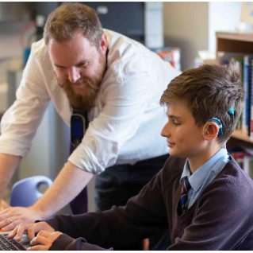
Kennet School Hearing Resource Base
Established 2010
10 spaces
3 specialist TAs
Qualified Teacher of the Deaf
Purpose built building (2013)
  Large classroom
  2 small group rooms
  Social space

Slide 5
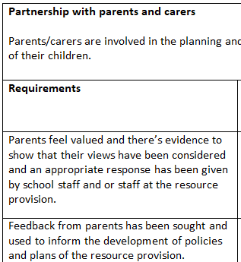
The Audit Document
The Audit document
  WAGOL (What A Good One Looks Like)
  Necessitated self-reflection
  Encouraged co-production

Slide 6
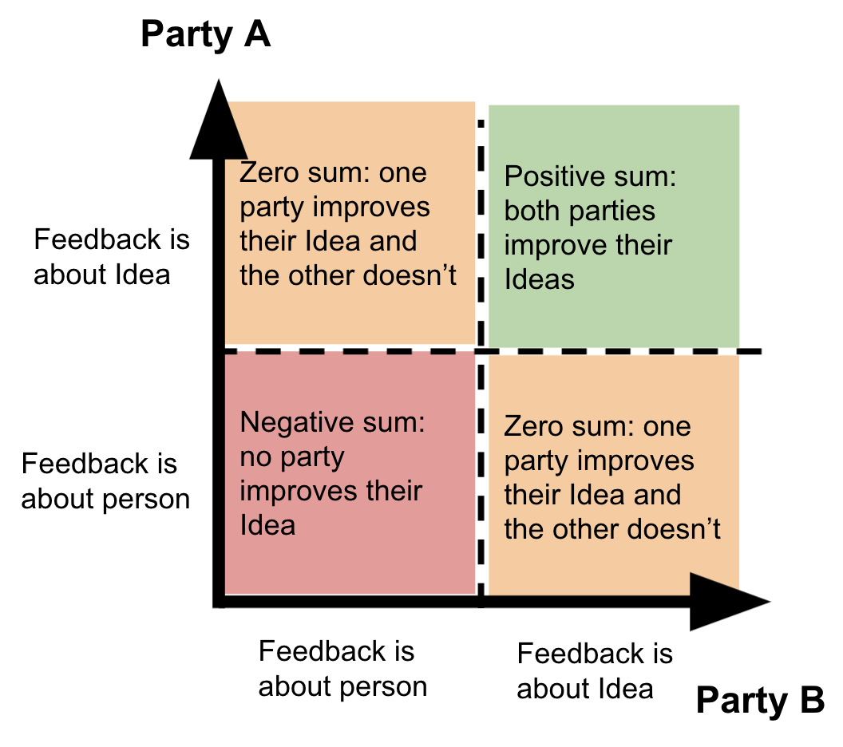
The Audit Meeting
Supportive Dialogue
Focus on student progress
Felt like partnership
https://www.cloudstreaks.com/blog/2021/8/29/ideas-vs-ego-disassociating-your-ideas-from-your-ego-is-key-to-growth

Slide 7

The Audit Impact
Co-production
(Resource-based) Teaching and Learning

