Slide 1
Resource base and unit provision for learners with SI
Brian Lamb
NatSIP Policy Lead

Slide 2
Rational for Resource Provision
Low incidence means resource provision more effective way to provide support for children with additional needs without recourse to special school
Service can be used as a base in some areas for peripatetic teachers
Supports mainstream practice and skills

Slide 3
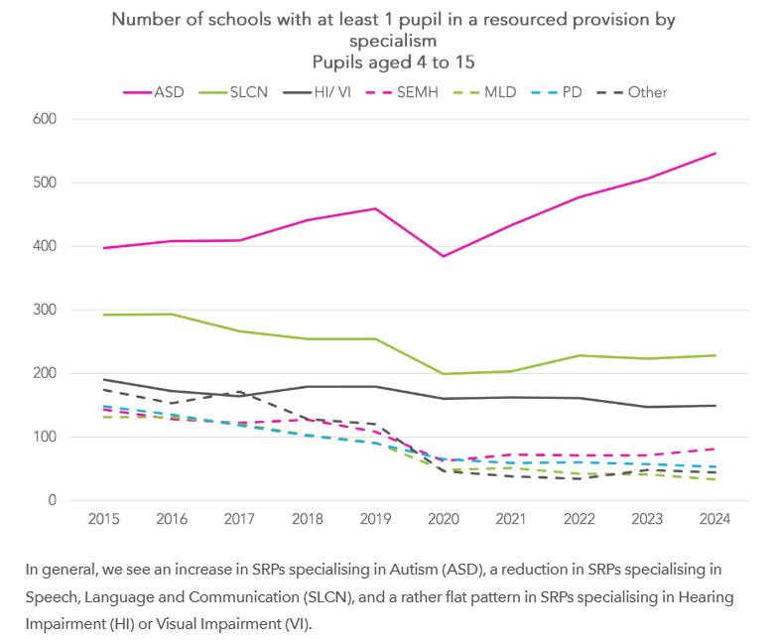
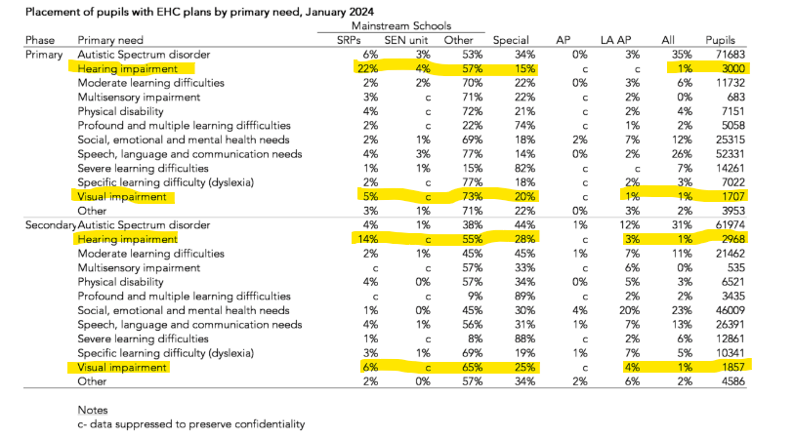

How many resource provisions?
From FFT Education Datalab

Slide 4
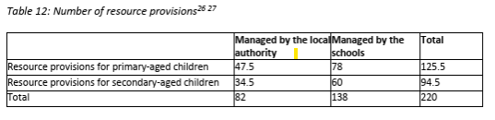
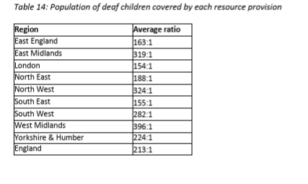
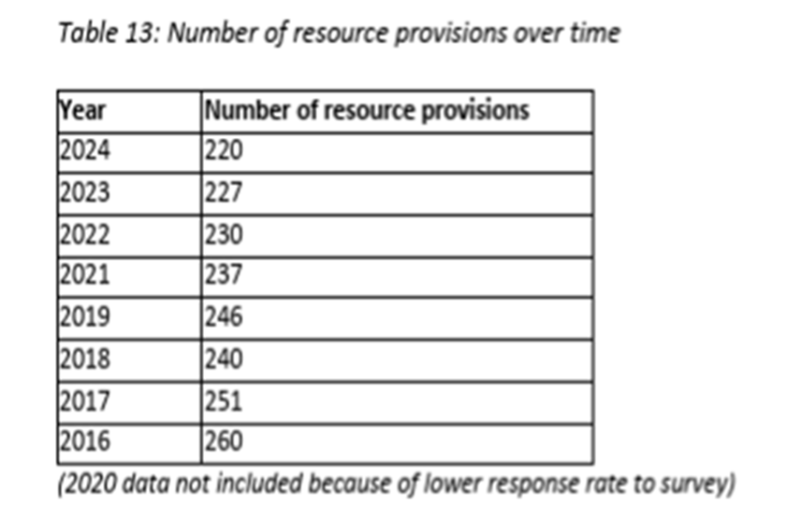
CRIDE Number and ratio of pupils covered

Slide 5
CRIDE-Deaf Children
The number of TODs in employment in resource provisions has increased by 2% from 303.22 to 310.27 fte since 2023. Of these, the proportion with the mandatory qualification has decreased from 82% to 76% whilst the number in training has increased from 14% to 20% (Cride 2024).
In 2023 CRIDE estimated that there were 1,951 children with hearing impairment in resource provision in mainstream schools and 217 in resourced provision schools out of local authority area.
The number of qualified TODs in employment working in a peripatetic role or, in a resource provision and/or in a special school or college not specifically for deaf children has decreased by 5% since 2023 and decreased by 24% since the survey started in 2011.
While the number of resourced provisions has gone down by 40 from 2016 the number of deaf children has gone up from 41,261 to 46,933 deaf children.

Slide 6
Children with VI.
LAs maintain or support resource bases or additional forms of support in schools.
NatSIP has identified 16 provisions across primary and secondary (we know there are more than that) and some joint VI/HI provisions. These are also known by a number of different names including Vision Impairment Additionally Resourced Provisions.
Funding seems to be mainly provided centrally by the LA with a number of different models or provision.
Most of these provisions are managed by a the mandatory QTVI.
Some feedback also suggested there are whole authorities with no resourced provision and it was thought that there was no resourced provisions in Wales.
Feedback to date seems to align with DfE figures that there are less resourced provisions for VI.

Slide 7
The Future?
164. “We will encourage schools (and LAs) to set up resourced provisions and SEN Units to increase capacity in mainstream schools. We will work with the sector to extend best practice across the system, including how SEN Units and resourced provision can promote greater inclusion.” DfE response to the select committee inquiry on SEND.” https://committees.parliament.uk/writtenevidence/137777/html/#_Toc189742889
DfE capital grant expenditure intended in part to support resource bases. Analysis showed that “over 70% of new SEND unit and resource base places funded through this grant are being funnelled towards ASD and social, emotional and mental health needs, with virtually nothing for less common types of SEN and Disability.” https://www.specialneedsjungle.com/vanishing-resource-bases-sen-units/

Slide 8
Questions for discussion.
1. If the Government is looking to support more specialist provision through resource-based provision is there currently capacity in the sector given the growth in number of children with HI and VI and the reductions in the workforce? How can this be addressed?
How should funding of resourced provision be secured in the future
Options:
      Retain requirement for EHCP or whatever the system changes to?
      Ensure separate funding stream through LAs-how would placement be decided and funding accessed?
      Other models of funding through schools-how would funding streams be protected?
3. What impact will LA reorganization have on Sensory support services and how might this also impact on resourced provision funding and organisation?

