Slide 1
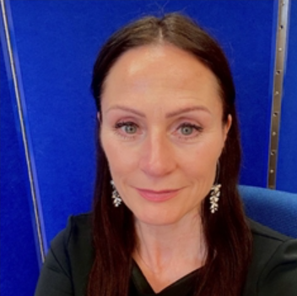

Sensory Teaching, Advisory and Resources Service
ruth_crosby-stewart@middlesbrough.gov.uk

Slide 2
Accessibility – local Case Study

Slide 3
Context
Local area inspection immanent
Exponential rise in EHCA, suspensions and exclusions
Rapid radical changes in the SEND Teams, processes

Slide 4
Panels
EHCA panel
Inclusion panel, pre-school, primary and secondary
Doesn’t like noise/noisy environments.
Doesn’t like bright lights.
Can’t/won’t follow instructions…..

Slide 5
Strand 1: Improving the Physical Environment
Objective
All new build work and alterations to existing buildings will consider the needs of people with a disability and/or sensory impairment.
Action
Audit needs as part of any arising site works.
Clean the Reception carpet.
Outcome
School fully complies with Fire Regulations and Health & Safety Regulations.

Slide 6
Local Area Accessibility Strategy
What does Accessibility mean to schools?

Slide 7
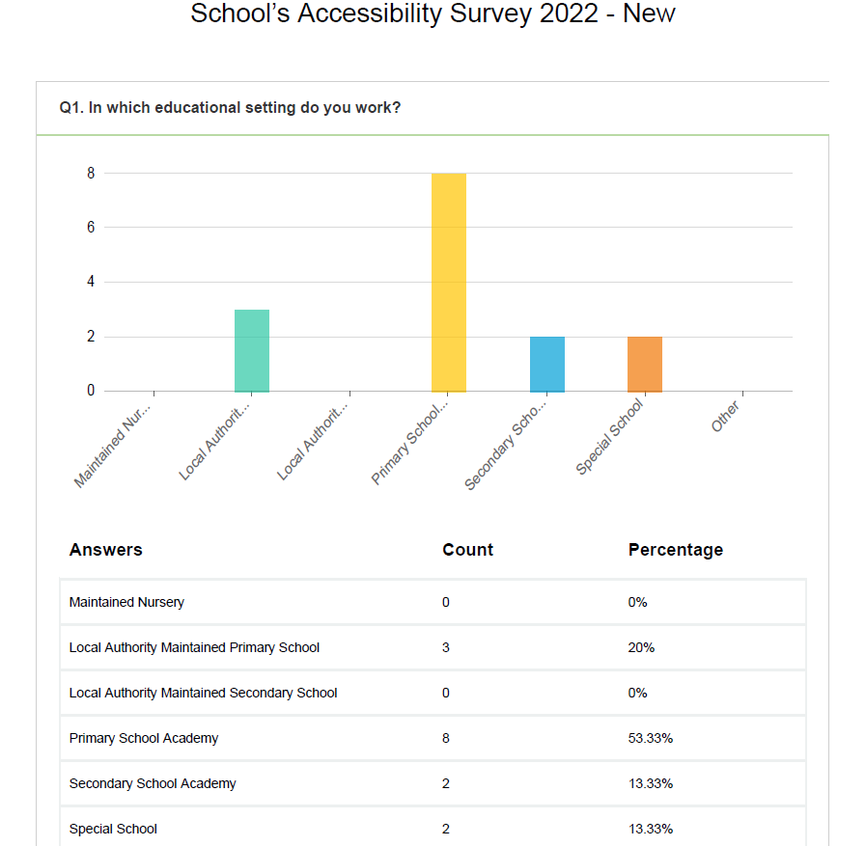

Slide 8
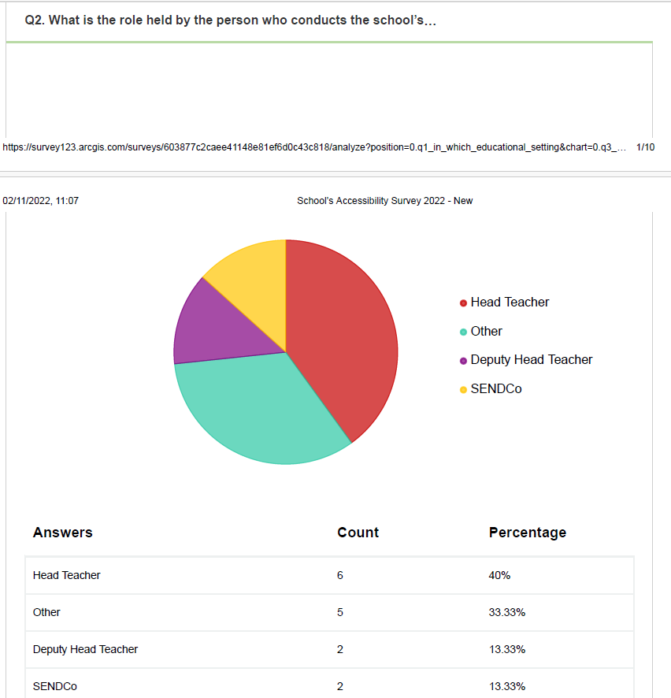

Slide 9
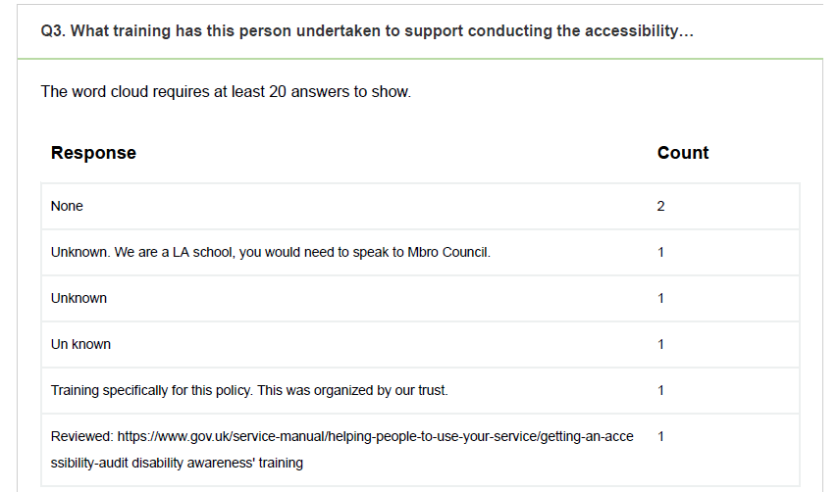

Slide 10
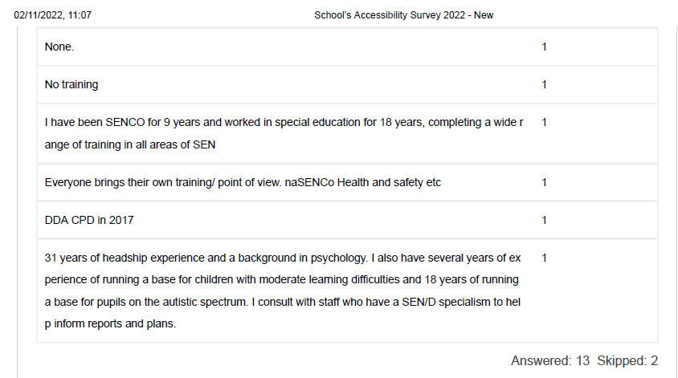

Slide 11
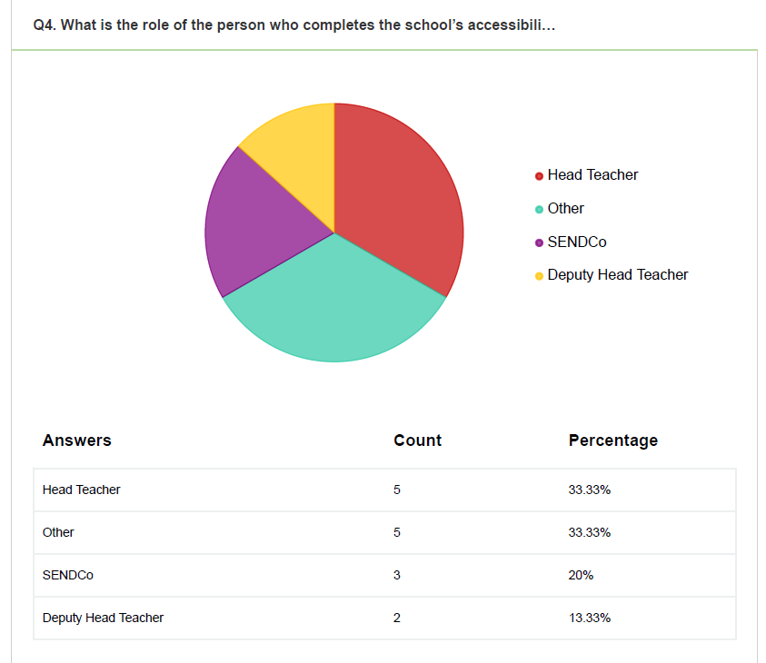

Slide 12
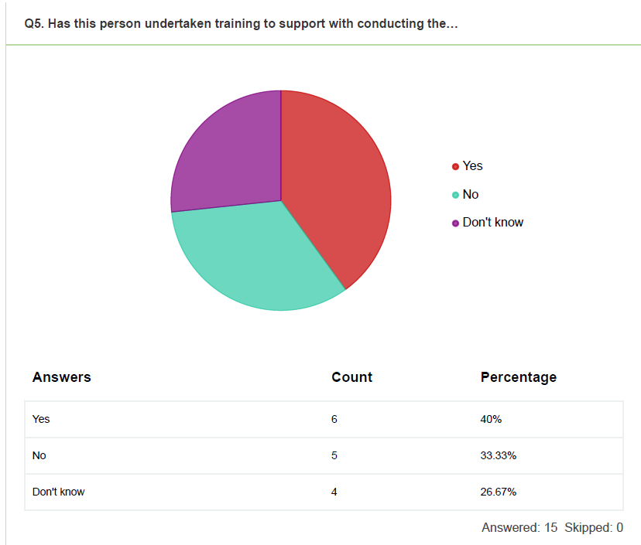

Slide 13
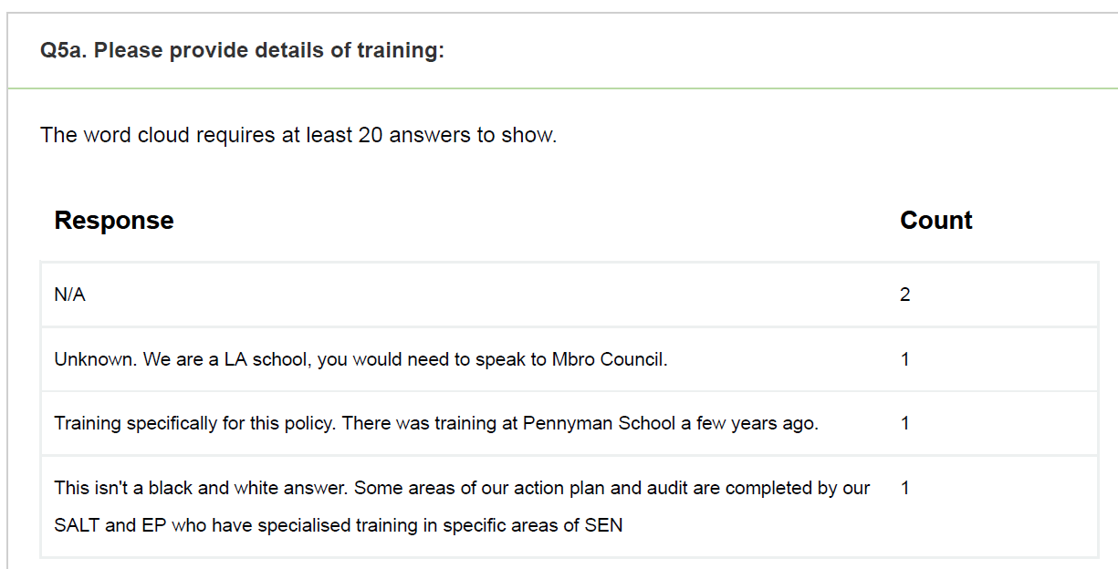

Slide 14
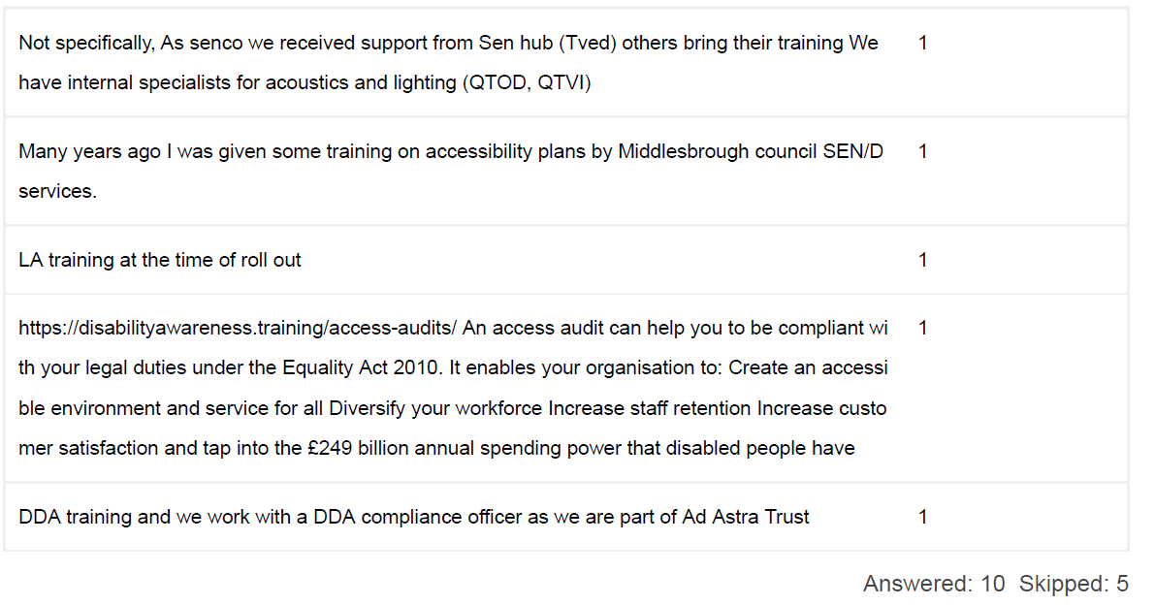

Slide 15
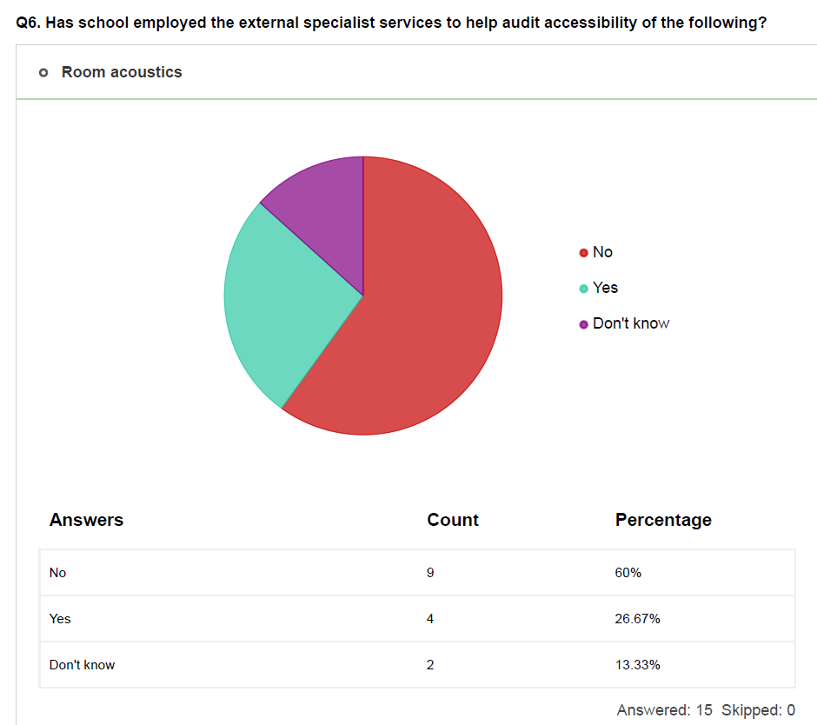

Slide 16
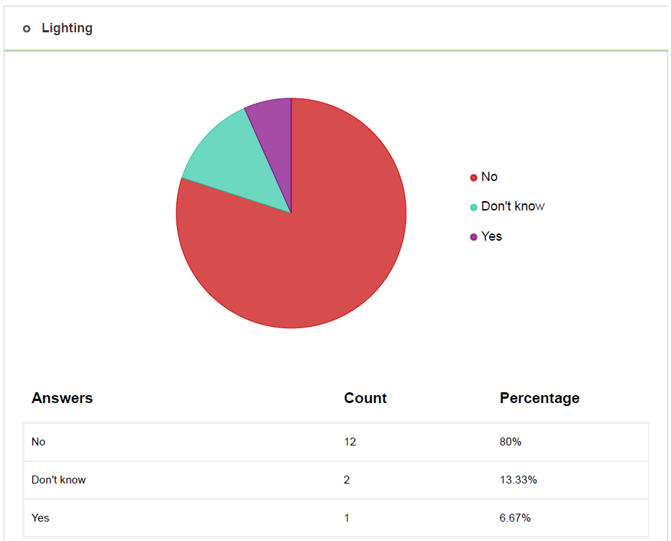

Slide 17
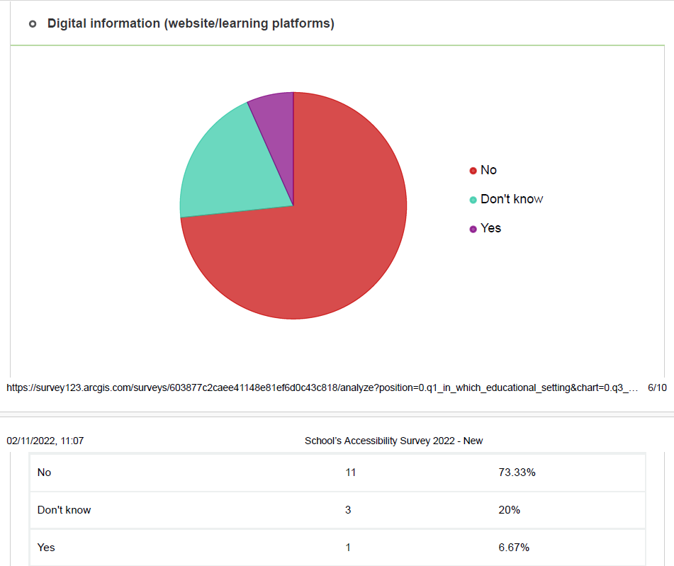

Slide 18
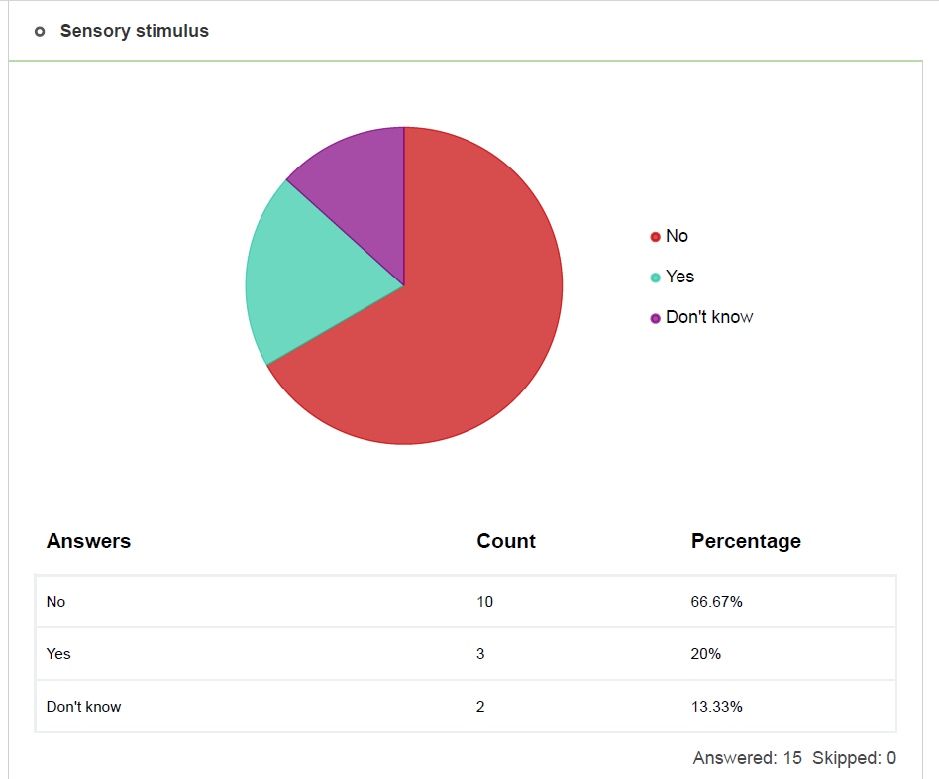

Slide 19
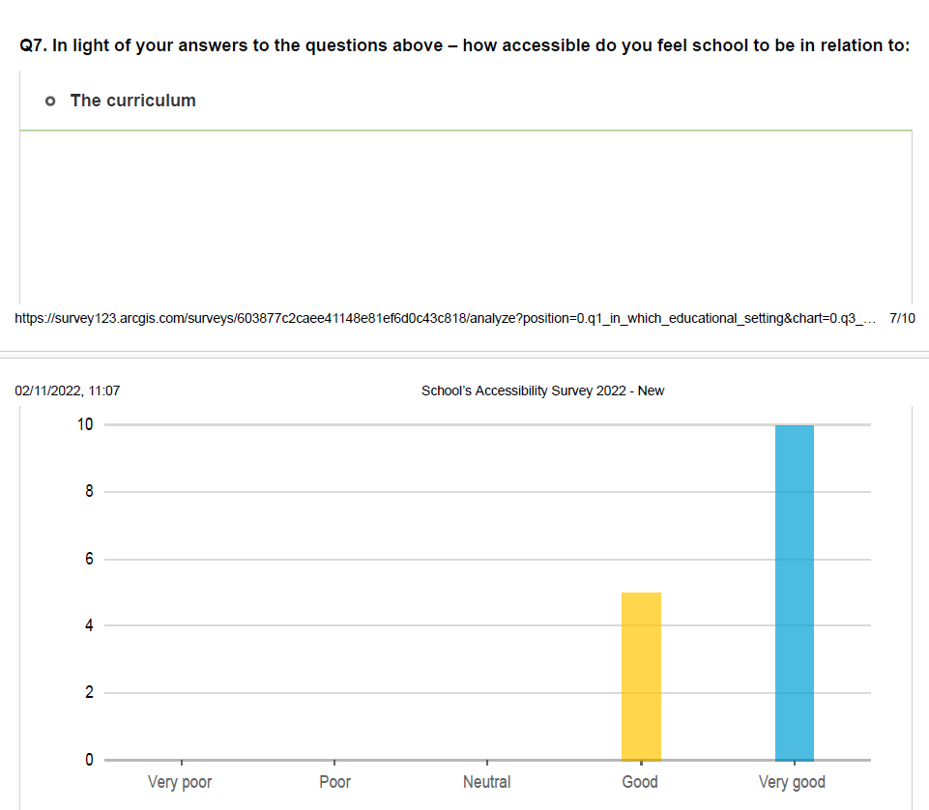

Slide 20
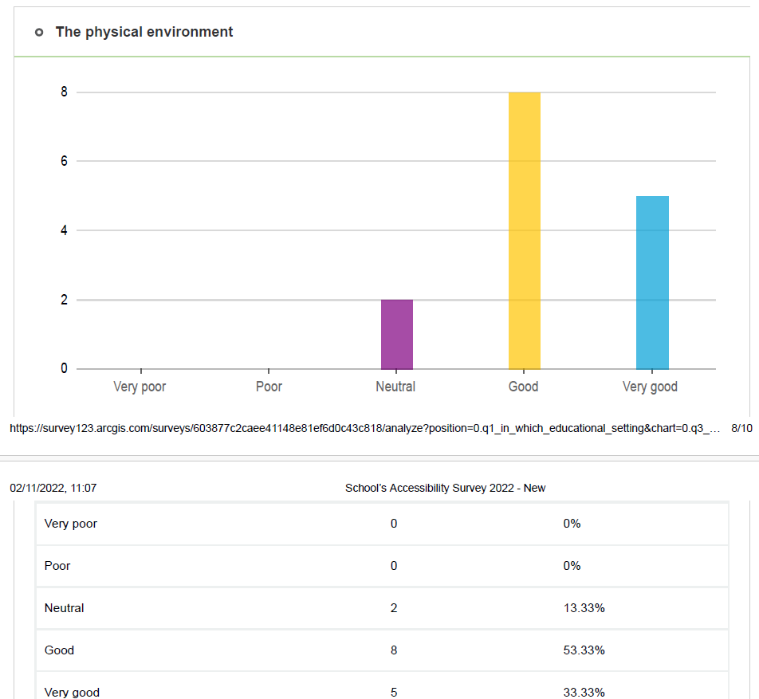

Slide 21
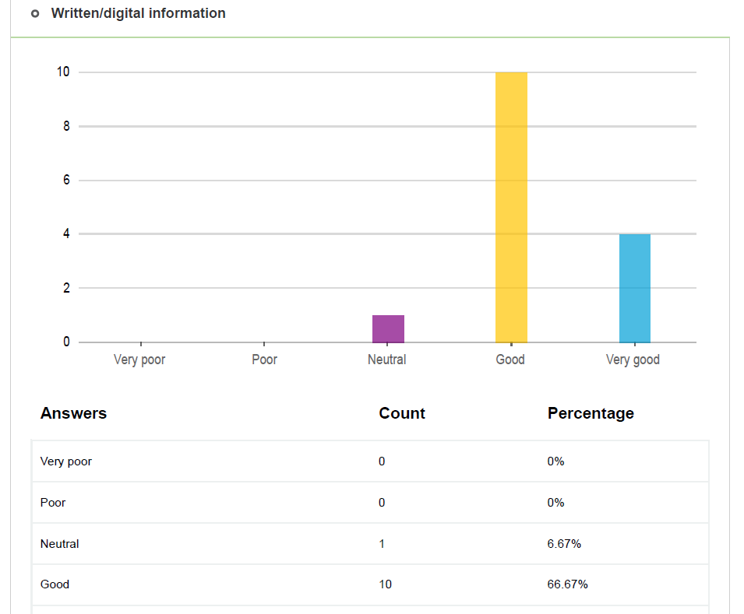

Slide 22
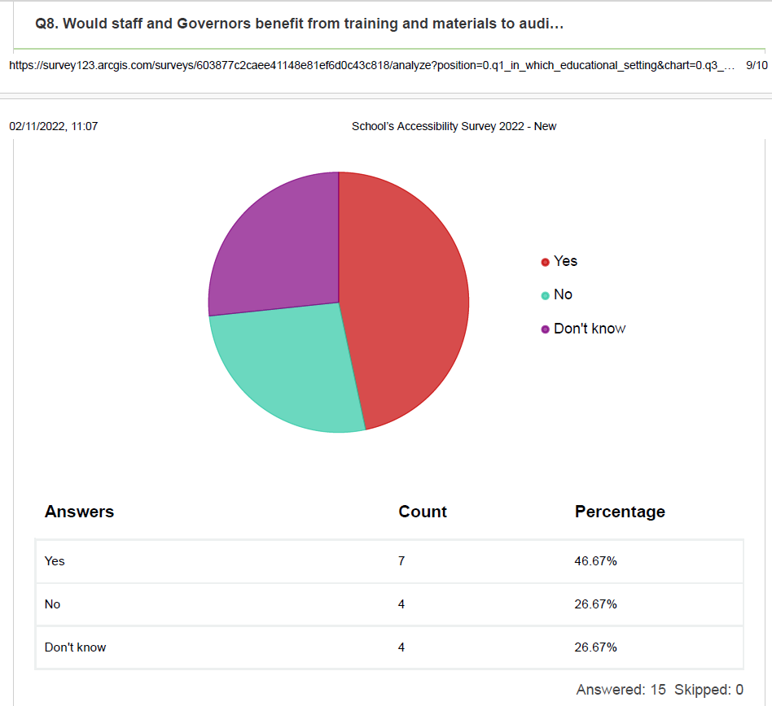

Slide 23
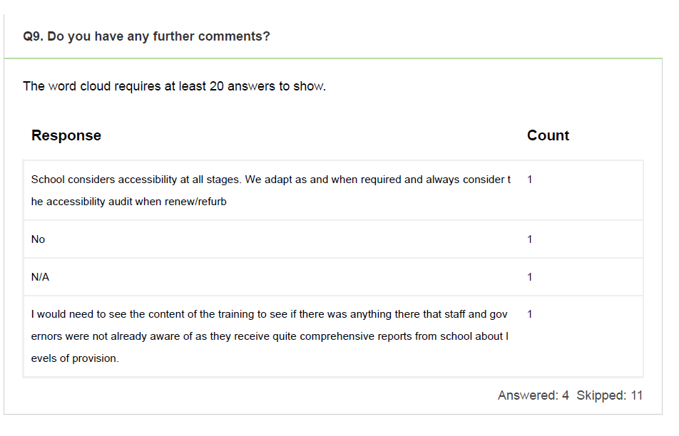

Slide 24

Conclusion – there was work to be done.

Slide 25
The approach was to raise awareness of acoustics and lighting across all areas of SEND – temporary and permanent conditions.
‘The effects poor room acoustics and lighting have on learners with SEND.’

Slide 26
What followed…
LA conferences
LA inset for SEND Teams
SEND and Inclusion Clinics

Slide 27

Psychoacoustics
The scientific study of the psychological and physiological responses to sound.

Slide 28
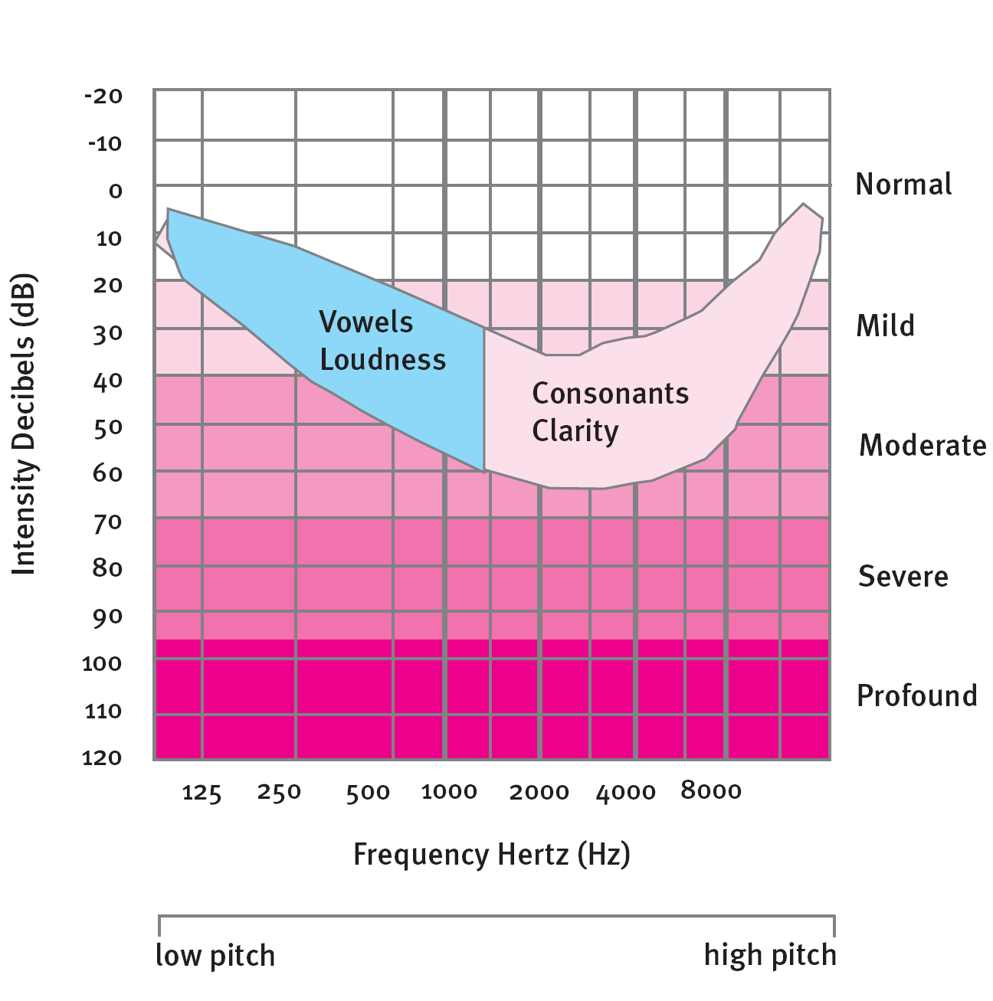
Making sense of speech…
Low frequency
vowels give loudness and power
80%volume, 20% information
High frequency
consonants give clarity and meaning
20% volume, 80% information

Slide 29
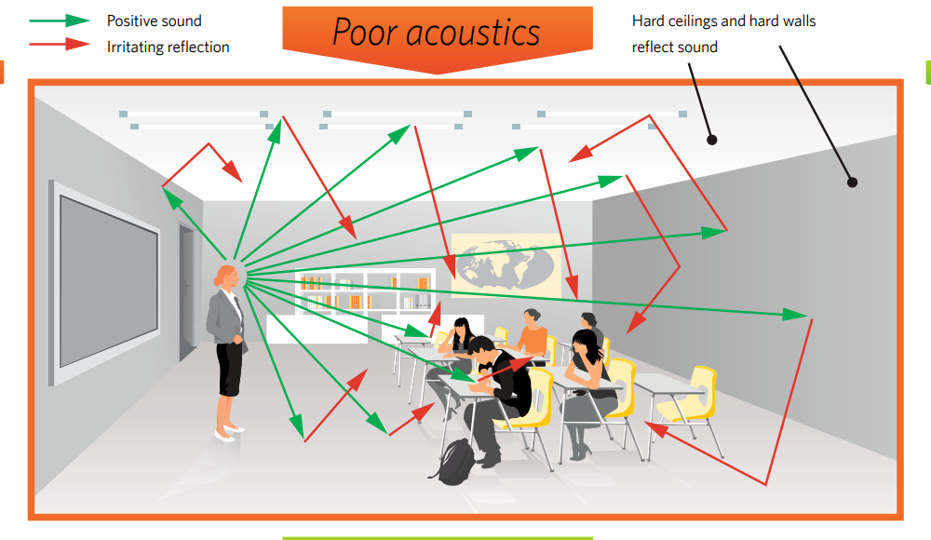

Slide 30
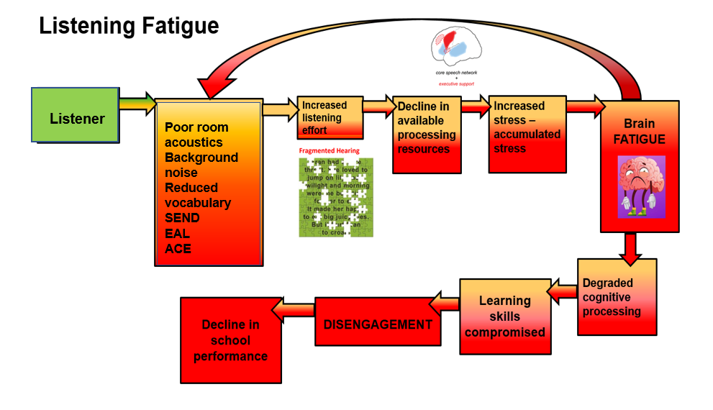
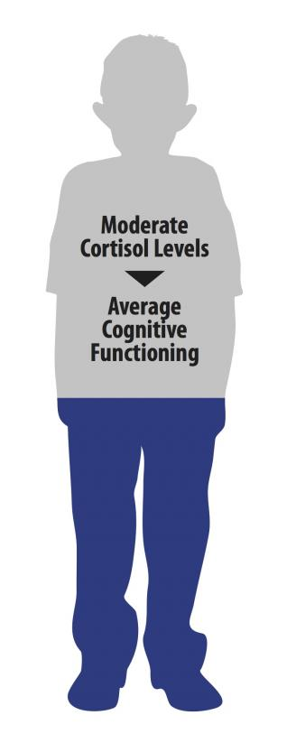
Poor room acoustics
Background noise

Slide 31
What are the effects on children with SEN?
Microsoft Word - Shield_Dockrell.doc

Slide 32
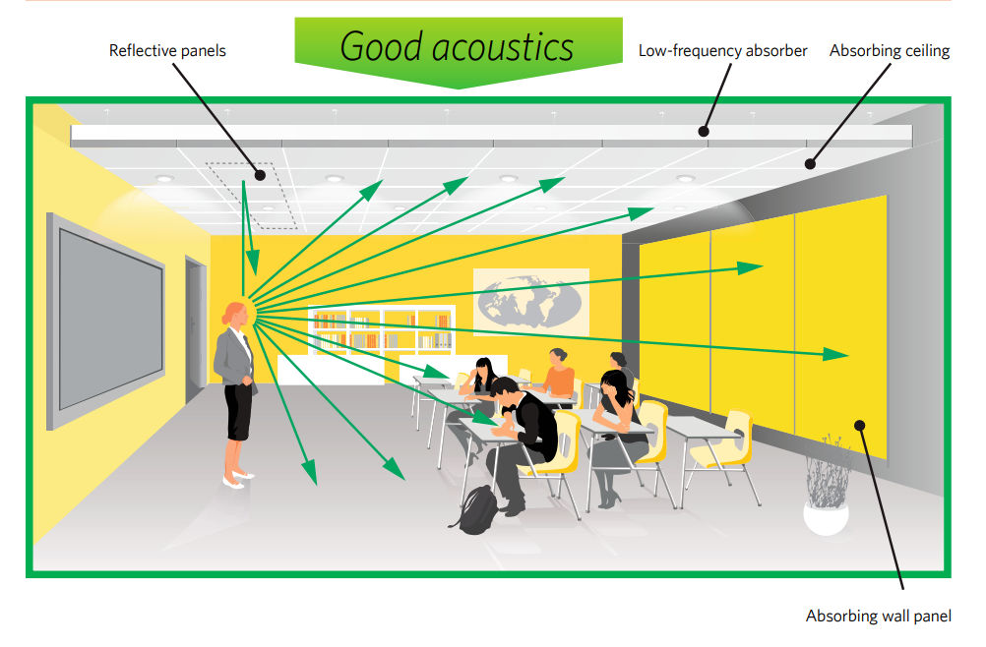

Slide 33
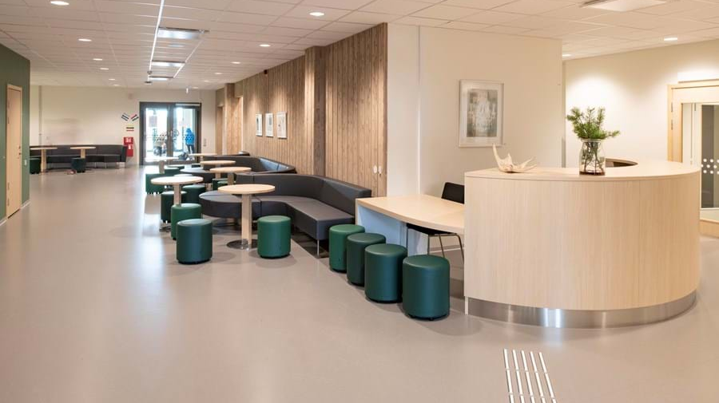

Slide 34
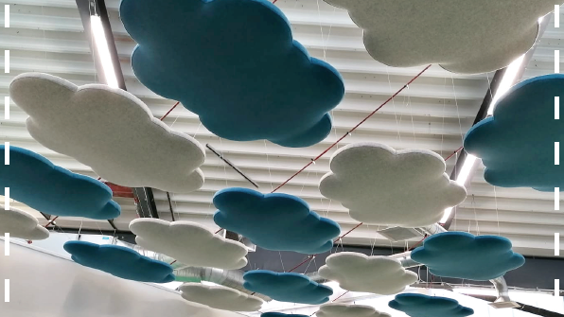

Slide 35
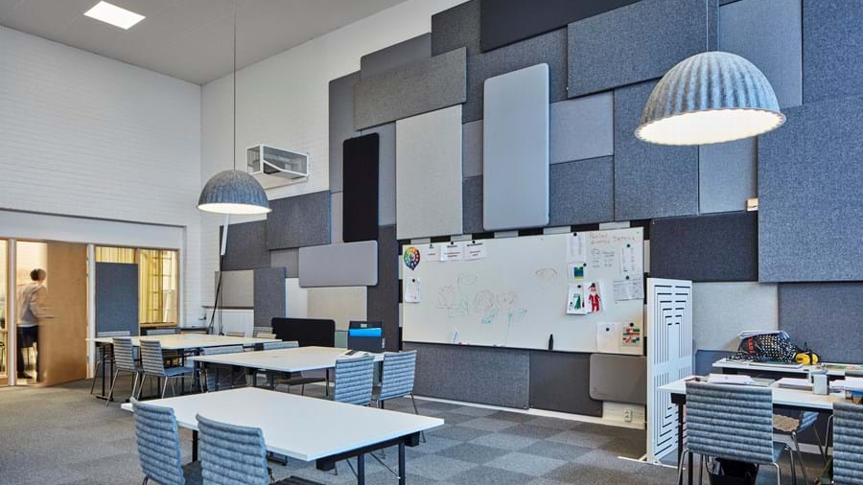

Slide 36
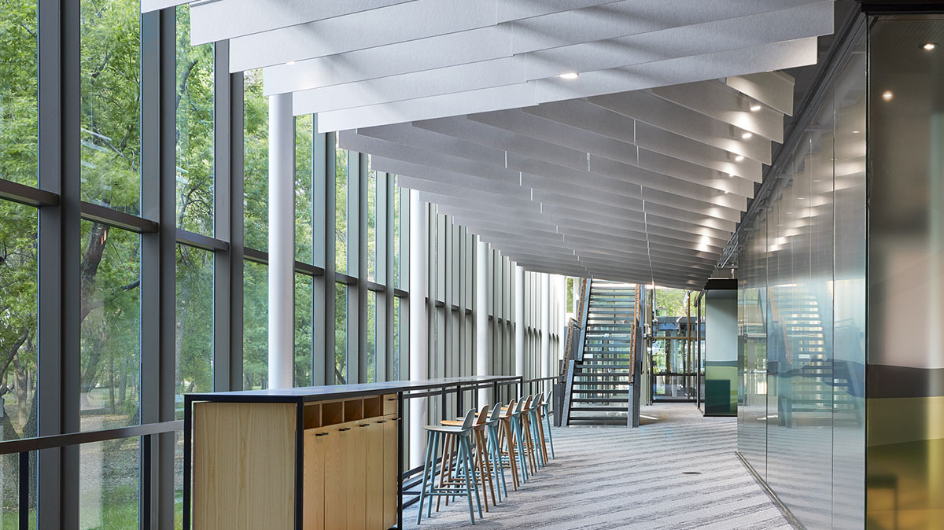

Slide 37
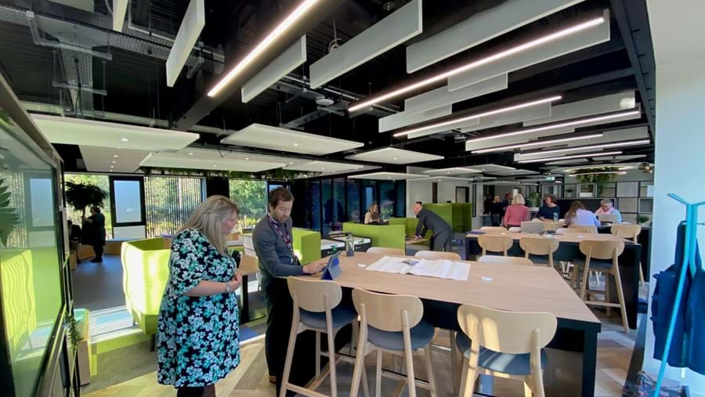

Slide 38
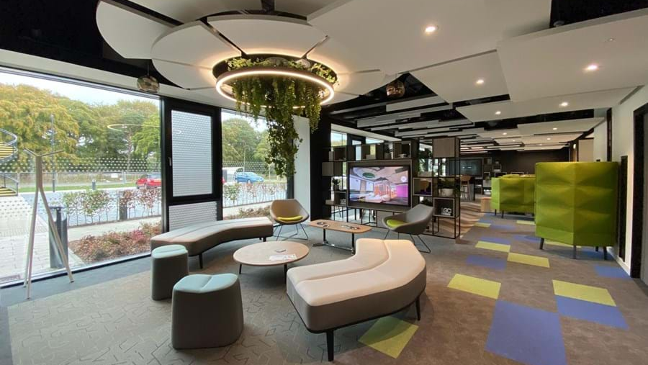

Slide 39
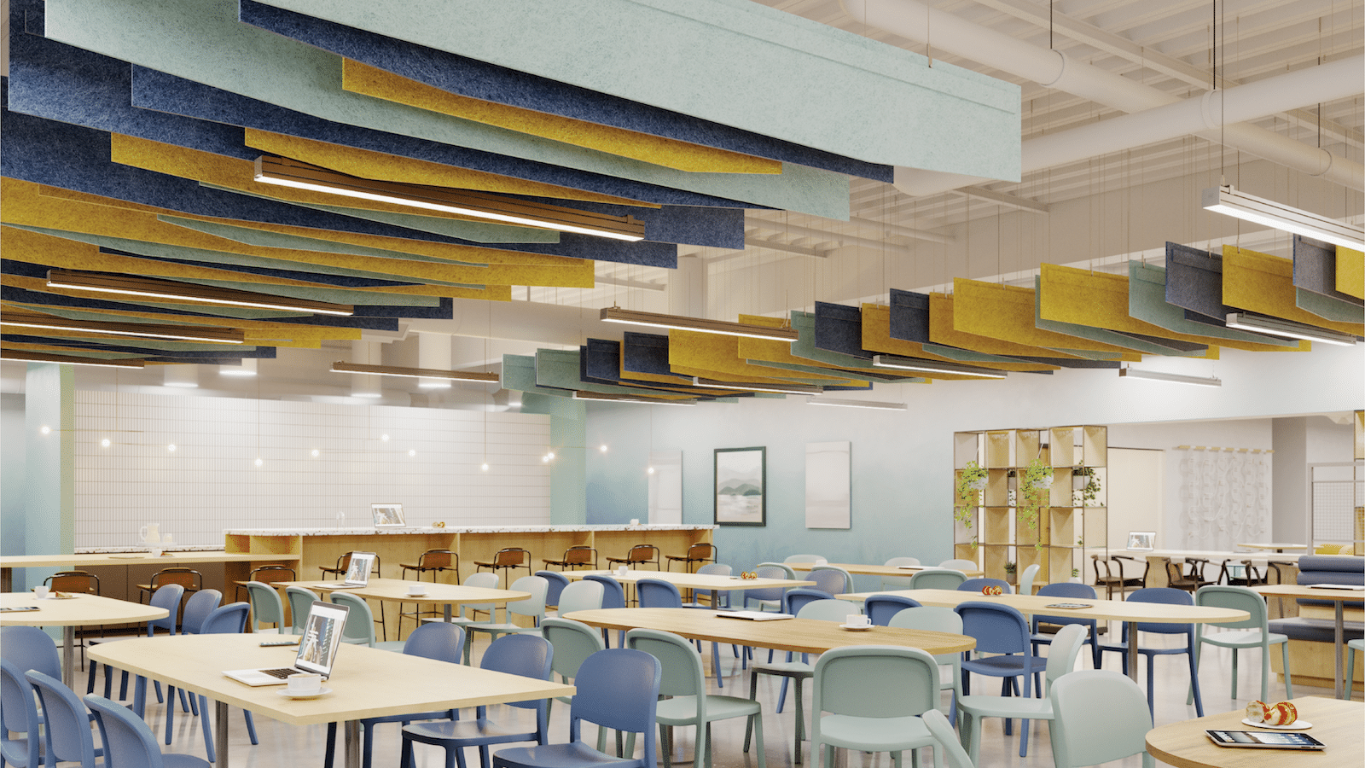

Slide 40
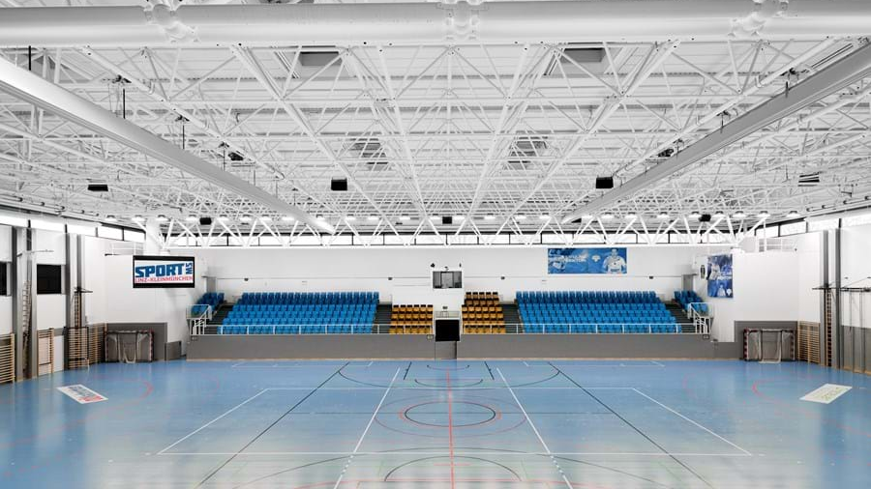

Slide 41
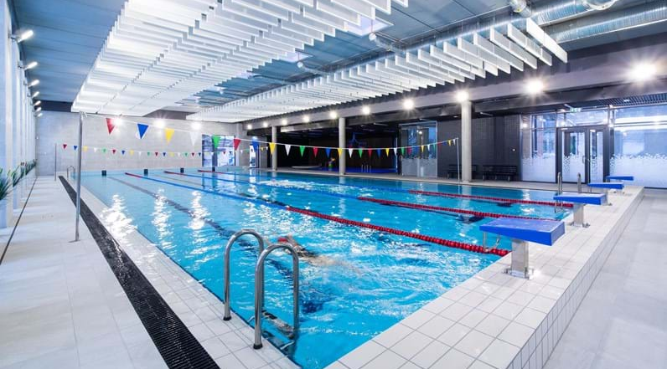

Slide 42
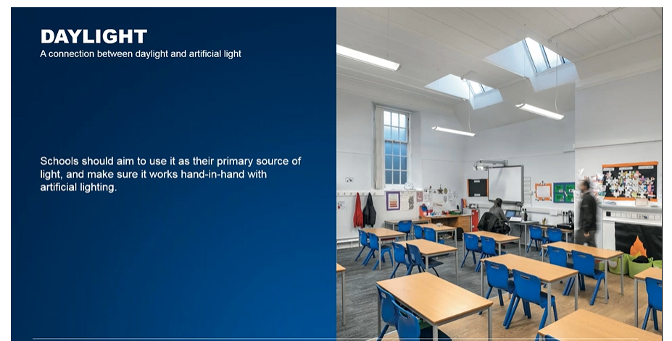
Lighting

Slide 43


Slide 44
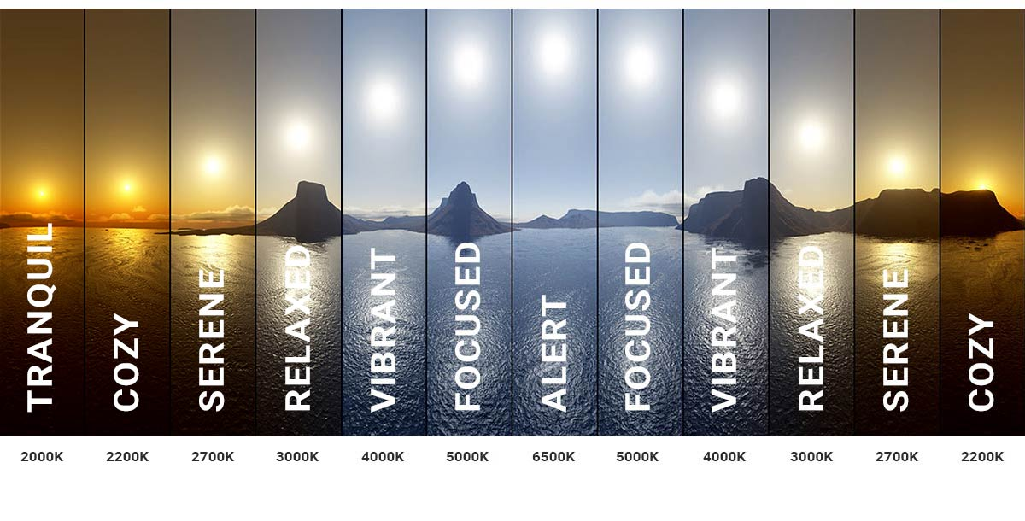

Slide 45


Slide 46
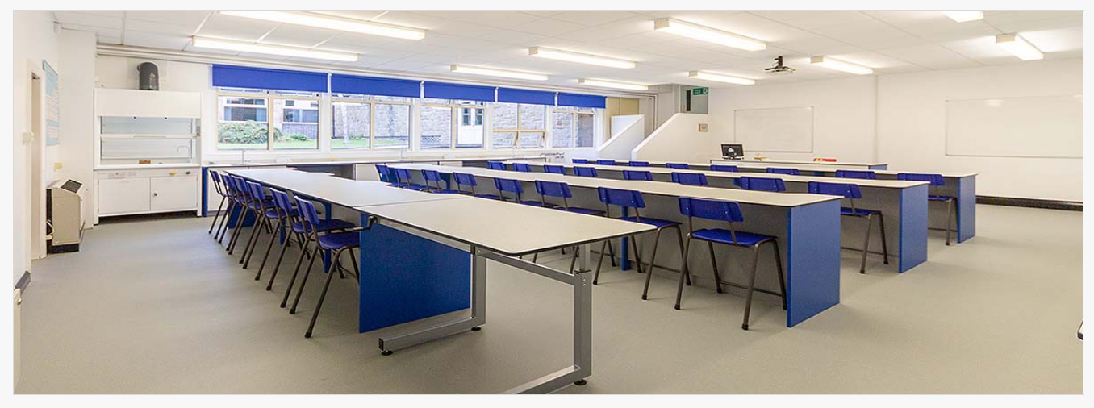
Lighting
A carefully balanced lighting system will take into account a number of factors, including illuminance, uniformity, glare, flicker and colour, in order to provide optimal learning conditions.

Slide 47
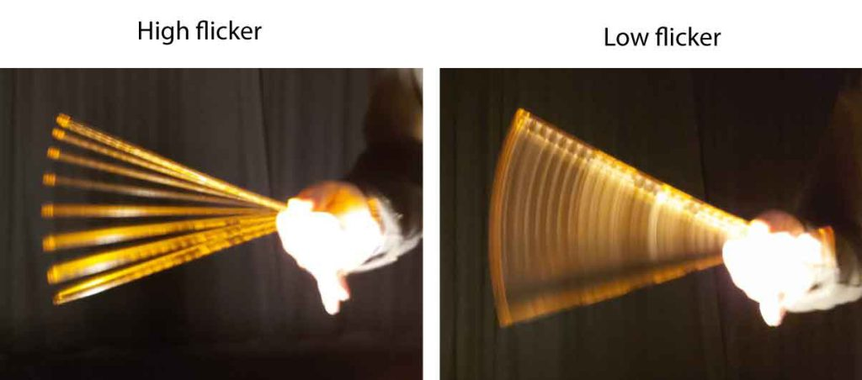
Flicker
Flicker is produced by certain lighting equipment and can result in discomfort or irritation. At a more serious level, it can lead to visual disturbance – for example, making moving objects or machinery appear stationary.
Flicker can also trigger epilepsy and exacerbate various other conditions.

Slide 48
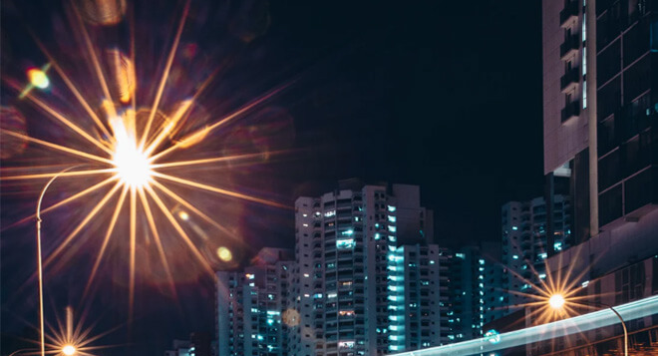
Glare
Glare refers to light’s excessive brightness or contrast, which can cause discomfort, eye strain, and reduced visibility. Glare can come from both direct and reflected light sources, such as windows, computer screens, or overhead lighting. Glare can be controlled by using shades or diffusers to soften and reduce light intensity.

Slide 49
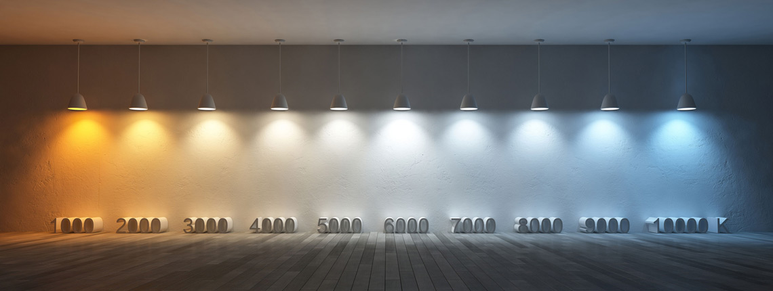
Colour
Colour also plays a vital role in the learning environment and good colour rendering performance is essential for effective learning, allowing pupils to make accurate colour judgements.

Slide 50
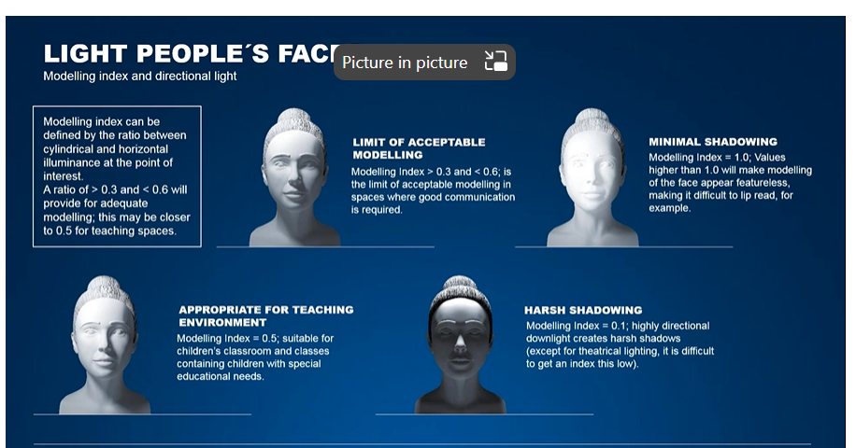

Slide 51
EVERY SEND child is entitled to learn in good room acoustics and lighting.
EVERY child benefits from learning in good room acoustics and lighting.

Slide 52
Next steps
Specialist reports incorporate recommendations re acoustics and lighting – challenge at Annual Reviews
LA wide non-negotiable accessible teaching materials – universal accessibility
Acoustics and lighting into The Ranges
Accessibility Plans (following the new guidance) to be central to future SEND Clinics
Consult with specialist services re acoustics and lighting to negotiate favourable discounts

