Slide 1
NatSIP Ofsted event 8th February 2024
SEND Local Area Inspections
Pupil Deep Dives
Blackburn with Darwen Local Authority
Nicola Savage – Lead Advisory Teacher for Hearing and Vision Impairment –
Special Educational Needs and Disability Support Service

Slide 2
Background
In November and December 2021, Blackburn with Darwen Local Authority participated in a trial of the Joint Local Area SEND inspections.
This involved a number of ‘deep dives’ of Children and Young People with SEND throughout the borough.
In the trial, 12 pupils were identified – 6 with Education, Health and Care Plans and 6 at SEND support at a range of schools throughout the authority.

Slide 3
Children and Young People with SEND
Children with identified SEND with come under either:
SEND Support
Education, Health and Care Plan (EHCP)
SEND Support
A child or young person has an identified special educational need/disability and is receiving additional support, but this can be delivered through the school or college’s mainstream provision.
EHCP
An Education, Health and Care (EHC) plan is for children and young people aged up to 25 who need more support than is available through special educational needs support. An EHCP is put together by professionals in education, health, and social care to make sure children with SEND have the right support to help them through their education and on to adulthood. Input from all services involved with the child or young person is key to the plan being successful. Plans are reviewed on an annual basis to ensure that they continue to be relevant and up to date.

Slide 4
Area SEND Inspection – What is it?
An Area SEND inspection evaluates how well members of a local area partnership work together to improve the experiences and outcomes of children and young people with SEND
‘Local area partnership’ refers to those in education, health and care who are responsible for the strategic planning, commissioning, management, delivery and evaluation of arrangements for children and young people with SEND who live in a local area.
These inspections are carried out jointly by Ofsted and the CQC. Inspectors who specialise in education, health and social care will work together as a single inspection team
Inspections evaluate arrangements for all children and young people with SEND aged 0 to 25 covered by the SEND code of practice, including those who have an Education, Health and Care (EHC) plan and those who receive special educational needs (SEND) support.

Slide 5
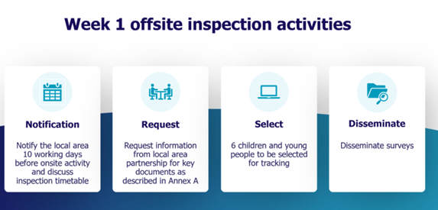
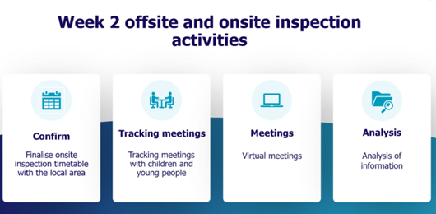
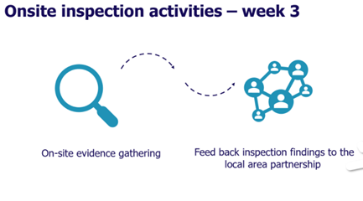
What happens during the Area SEND Inspection?

Slide 6
Pupil Tracking
When the pupils were identified – each team were asked to gather a range of data to produce a ‘pen portrait’ of each child and their support.
Parents were also contacted to ask whether they would participate in the discussions.
Data was gathered and collated.
Pupils met with the Inspectors via Teams – these meetings were usually facilitated by the settings and included either parents or adults, and the two inspectors.

Slide 7
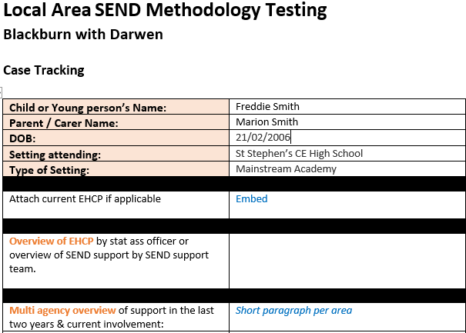
Local Area SEND Methodology Testing – pupil portraits

Slide 8
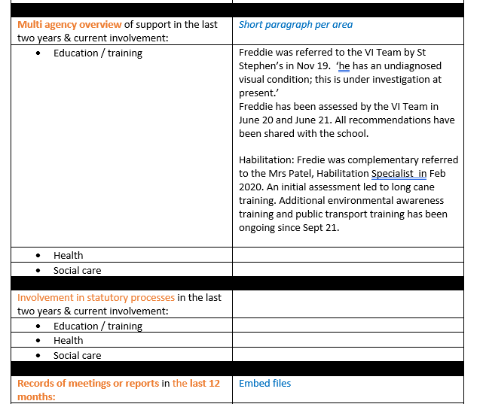

Slide 9
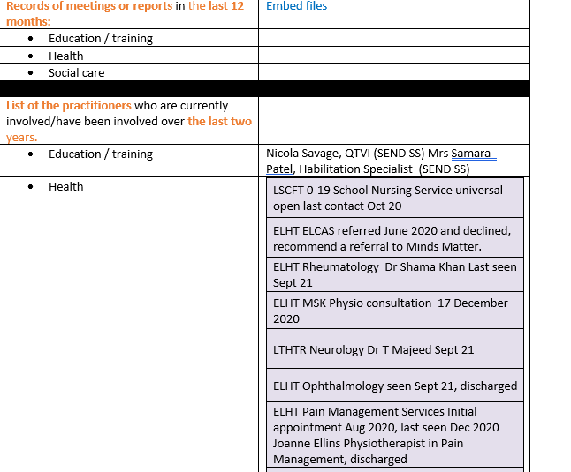

Slide 10
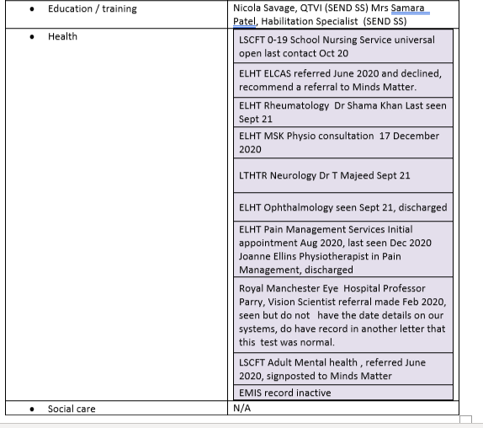

Slide 11
In the methodology testing, those who worked most frequently with the parents were asked to contact them and discuss the meetings, briefly what they would entail and what dates and times they would be available.
The parental meetings were arranged via TEAMS, by the Inspections Team with all relevant and available parties invited.
The discussions were scheduled for 90 minutes.
Each discussion had all those who were involved with the child – SEND Support, SENDCO, Social care, Habilitation Specialists, school nurse, social workers etc.
Interviews were held with a HMI, Ofsted inspector and CQC representative.

Slide 12
Forms
There was a standard consent form – which parents and pupils (over 15) had to sign.
Now - All the data that LAs must collect and are detailed in: Supplementary guidance for Area SEND Annex A person-level data lists 1 and 2 are all in the new handbook which was released on 30th Jan 24!
Area SEND inspections: framework and handbook - GOV.UK (www.gov.uk)

Slide 13
Evidence
All teams were required to provide evidence of their work and support with the CYP.
We had to provide EHC Plans, IEPs, medical records, any recent reports that we had written.
Each multi-agency team completed a summary paragraph of their support and involvement.
This then gave us an idea of what evidence we would need to collect going forward.

Slide 14
Findings.. In the SEND Support Service we:
**All UPS3 teachers have personal targets which allude to the collection and collation of information.
Individual teams produce case studies (pupil/family/setting) - this has now been adapted to show IMPACT! ‘You said, we did.’
We have developed a SEND Co-production co-ordinator and Charter across the borough.
Highlight collaborative working between SEND Teams and other professionals e.g. EPs and Advisory Teachers work together on EHCP submission documents.
More involved links with social care – improved pathway for CVI collation and information sharing across the borough.
Integrated commissioning boards across the LA and NHS.
Host and take part in other Local Authority Peer reviews.
All parties attend a SEND Strategic Partnership Board which encompasses every dept at the highest level

Slide 15
Data includes:
Parent and child voice
SENDCO and setting feedback.
EHCP reports/submissions quality assurance reviews
Audit Records of involvement / Synergy data
Impact reviews on CPD training received and presented.
Audit of any written reports and recommendations
Overall collated feedback

Slide 16
What happened next?
As part of our improvement journey, the SEND Partnership is embarking on an ambitious programme of auditing pupils with SEND lived experience, detailed in our SEND Quality Assurance Framework, which aims to achieve greater consistency, improve quality and celebrate good practice.
Rationale and Guidance
The aim of undertaking quality assurance audits is to bring everybody together to provide assurance around the delivery of the best outcomes for children, young people and their families.
The Quality Assurance Framework includes an audit system to evaluate how effectively multi-agency (Health, Social Care and Education) processes and procedures are being implemented.

Slide 17
These audits explore the quality of practice and:
The quality of the EHC plan – for those case studies where it is applicable
Identify and celebrate good practice
Ensure outcomes and measures are SMART
Ensure compliance with the SEND Code of Practice and SEND Strategy in relation to identification and referral pathways: assessment; planning; implementation and reviews
Identify and ensure the voice of children young people, parents and carers is central to the process, at all stages of the referral and assessment process
Identify any unmet needs to determine future support/provision

Slide 18
Ongoing Process…
EHCP and SEND Support Case Studies were randomly selected and information gathered from all agencies involved with the child or young person. These ‘pen portraits’ plus any accompanying advice, guidance or reports produced formed the historical chronology for the case study and shared with all partners.
Alongside this, a reflective discussion took place within each case study meeting focusing on:
  What is working well?
  What difference has been made?
  What are we worried about?
  What are the next steps?

Slide 19
Summary of findings from the pilot case studies
Three EHCP and three SEN support case studies were undertaken during the Autumn 2023. Below is a summary of the findings from these pilot case studies. As a result, the Quality Assurance framework has been reviewed and amended and a thematic approach to the selection of case studies agreed and planned for next year. These findings will also help to inform future training, guidance and support needs within the partnerships.

Slide 20
What’s Working Well and what difference have we made:
Most children and young people access support at the right time.
Interventions happening academically and social emotional needs.
Family involved in planning for the child or young person
Evidence that children and young people have relationships with key figures which have had a positive impact.
The child or young person’s voice is mostly evident in their plans and one-page profiles give a clear overview of their strengths and areas for support.
Collaborative practice is evident including the joining up health education, social care particularly for children with an EHCP.
Most parents / carers feel that they are well supported.
Feedback from the child or young person is that they are accessing educational learning which is at the right level to meet need.
Graded care profiles have evidenced positive impact for children/young people and their families.

Slide 21
Areas that need support / improvement:
Has there been a focus on emotional/behaviour needs rather than academic learning needs?
Lack of communication with parents / carers for children at SEND support around the specific support they are receiving in school both academically and socially.

Slide 22
Next Steps: Organisational Learning:
Focus on sustainability of progress when consideration is giving to ‘stepping down’ on the continuum of need.
A need to focus on next steps and preparation for adulthood against the four PFA outcomes.
Health information needed for the audit process to ensure a holistic picture is gathered about the child or young person’s lived experience and needs.
Consideration of the long-term impact of health issues on child or young person’s needs.
Ensure consistent communication with parents /carers for children at SEND Support around the specific support they are receiving in school both academically and socially.
Equal consideration being given, by all professionals, to the child’s lived experience and whether needs are responses to trauma or a possible underlying special educational need.
Regular opportunities for multi-agency professionals to reflect on decision making and the impact of this.
Tracking back through previous case history to ensure that no opportunities are missed, particularly where children have had numerous changes of professional involvement and school placements.
Ensuring that chronologies are used and are reflective of historical information.
Review of the EHCP invite process to ensure that all involved professionals are invited to the EHCP reviews and have the opportunity to feed into the child’s plan.

Slide 23
How Local Areas are Judged
Inspectors will evaluate the impact of the local area partnership’s SEND arrangements on the experiences and outcomes of children and young people with SEND, including the extent to which:
children and young people’s needs are identified accurately and assessed in a timely and effective way (identification)
children, young people and their families participate in decision-making about their individual plans and support (co-production)
children and young people receive the right help at the right time (appropriateness)
children and young people are well prepared for their next steps, and achieve strong outcomes (transitions)
children and young people are valued, visible and included in their communities (inclusion)

Slide 24
How Local Areas are Judged
Inspectors will judge the impact of the local area partnership’s SEND arrangements through the experiences and outcomes of children and young people.
Inspectors will assess whether outcomes are sufficiently ambitious and reflect high expectations. This includes whether children and young people with SEND:
have developed the knowledge, skills and behaviours to gain employment or meaningful occupation, move on to further or higher education, and live as healthily and as independently as possible (with a big focus on transition from Children’s to Adult’s Social Care)
have developed their self-esteem and resilience
have made friends, and feel safe, valued and visible in their local communities

Slide 25
How Local Areas are Judged
When evaluating experiences, inspectors will assess whether children and young people’s experiences of education, health and care in their local area are positive, and why. They will evaluate whether children and young people with SEND:
have gained from stable, supportive relationships and environments
have had the opportunity to participate in community activities to widen their understanding of the opportunities available to them now and in their future
have participated in decision-making about their own plans and support
have had support provided when they have needed it and feel supported and believe that adults understand and advocate for them.

Slide 26
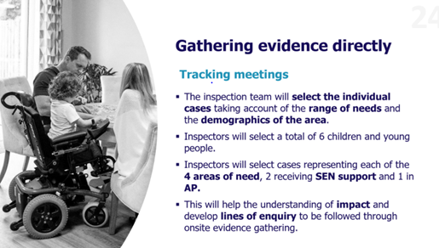
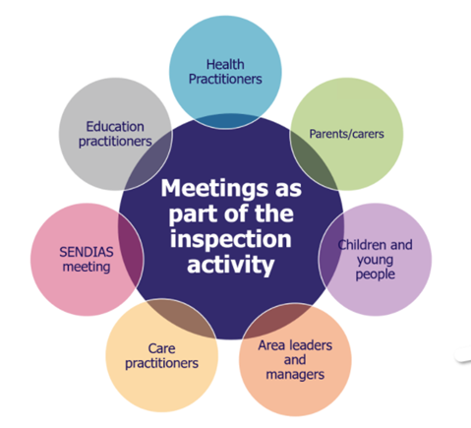
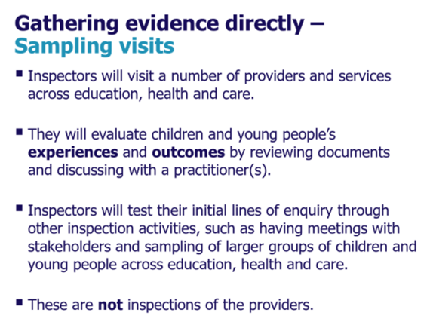
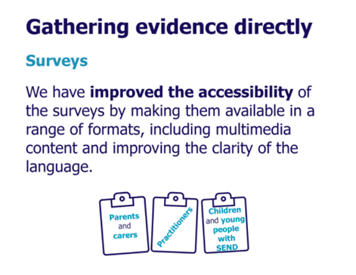
Examples of Evidence Gathering through a multi-agency lens

Slide 27
What happens after the inspection?
Following a full Area SEND inspection, inspectors will report on the effectiveness of the local area partnership’s arrangements for children and young people with SEND. The report will include:
the inspection outcome
what it is like to be a child or young person with SEND in the local area
what the local area partnership is doing well and what needs to be improved
recommendations for improvements that the local area partnership should act on

Slide 28
Roles & responsibilities?
The Area SEND inspection, is a multi-agency responsibility.
Inspectors will look at:
How practitioners work together and share appropriate information in a timely manner, including strong systems for identifying and responding to risks to children and young people with SEND
If practitioners are clear on their individual roles and how they can best work together to improve outcomes for children and young people
Whether practitioners working with children and young people with SEND have the right knowledge and skills to reduce the risk of harm, and understand that children and young people with SEND may be more vulnerable to abuse, neglect and exploitation.
How practitioners work together to focus on the child or young person, identifying alternative solutions when existing options do not meet needs and aspirations effectively

Slide 29
Roles & responsibilities – what can you do?
Any child or young person on a school’s SEND register could be chosen to be one of the 6 ‘tracked cases’ as part of the Area SEND Inspection. Therefore, all practitioners working with these pupils needs to know:
What is the pupil’s SEND status (SEND Support or EHCP), what category of need(s) the pupil’s needs come under and how the pupil was identified as having SEND?
Who has been/is currently working with the pupil to ensure their needs are being met from an education, health and social care point of view. What support are they receiving and what services are they accessing?
What is the ‘lived experience’ of the child or young person and their family? What would they say about the support they are receiving?
How are (and how have) the pupil and their family’s views taken into account to ensure that the support they’re receiving is right for them?

