Slide 1

Sensory Teaching, Advisory and Resources Service
ruth_crosby-stewart@middlesbrough.gov.uk
admin_STARS@middlesbrough.gov.uk

Slide 2


Slide 3
STARS have two experiences of LA Inspections
● Hartlepool - ‘light touch’
● Middlesbrough – ‘in depth’

Slide 4
Hartlepool
STARS were sent an email requesting the presence of a QToD at an interview with inspectors to discuss ‘child X.’

Slide 5
Middlesbrough
Supporting evidence folder
Each department were directed to collate a paper folder of supporting evidence which was taken into the interview session.
Very useful:
● supporting evidence
● served as a prompt to ensure questions were answered as comprehensively as possible

Slide 6
Pre-inspection
● LA SEF – constantly reviewed
● Workstreams – Inclusion and Outreach, Inclusion and SEND Sufficiency, Workforce Development, Participation and Engagement, PfA
●Creation of the Outreach Inclusion service, Early Years and Secondary and Post
16 provisions
● Weekly virtual whole service briefings – ‘good practice’ and ‘impact’
● Half-termly ‘Service-days’ – ‘the local SEND landscape development and challenges
● Appointment of the Middlesbrough DSCO, Exclusions Manager and QA Officer
● Half-termly case studies and moderation (of them)
● Weekly Triage panels for outreach support
● Weekly resources panels for funding, alternating Early Years & Primary and Secondary and Post 16
● QA process, auditing quality of EHCPs led to QA of all ‘practice’
● LA had undertaken the Delivering Better Values (DBV) government initiative
● Mock interview panels for practitioners working face to face with service users.

Slide 7
The Interview

Slide 8



Slide 9
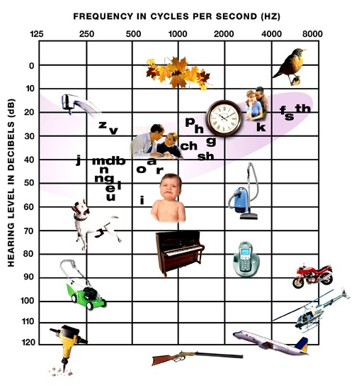


Slide 10
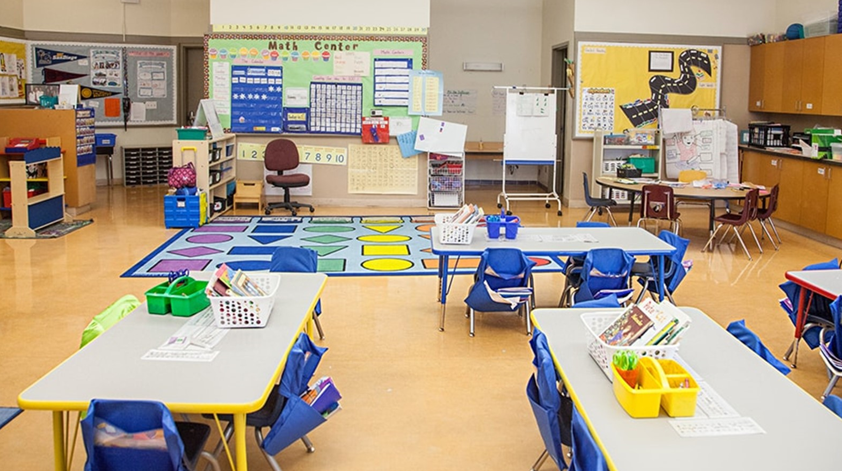


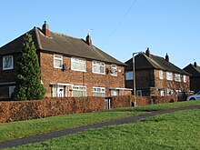

Slide 11










Slide 12
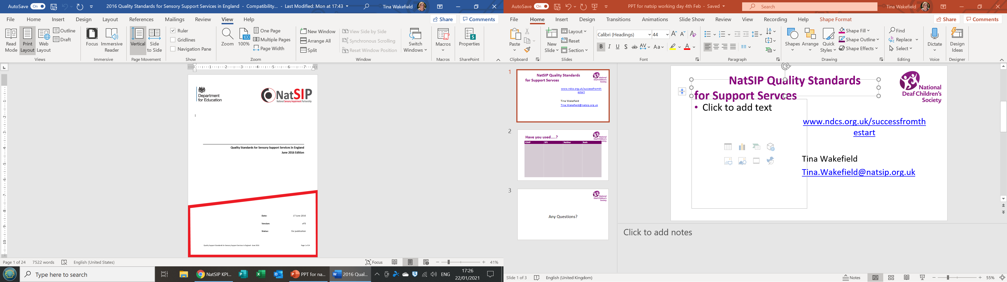


Slide 13
Staff
1.0 FTE HoS (QTOD(CYP) and Ed Aud
8.1 FTE Qualified Teacher of DeafCYP
Including a Team Lead
1.0 FTE Audiology Assistant
3.9 FTE Qualified Teacher of Visually ImpairedCYP
Including a Team Lead
1.0 FTE Habilitation Officer
1.0 FTE Rehabilitation Tutor
1.0 Assistive Devices Tutor

Slide 14
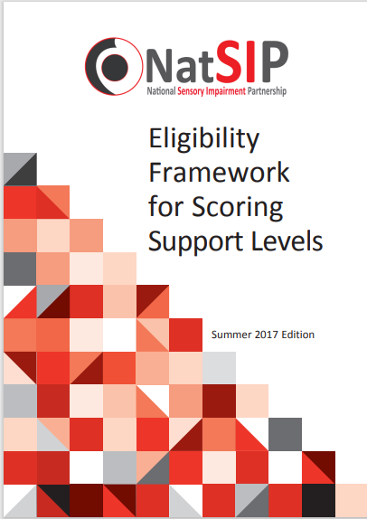

Slide 15
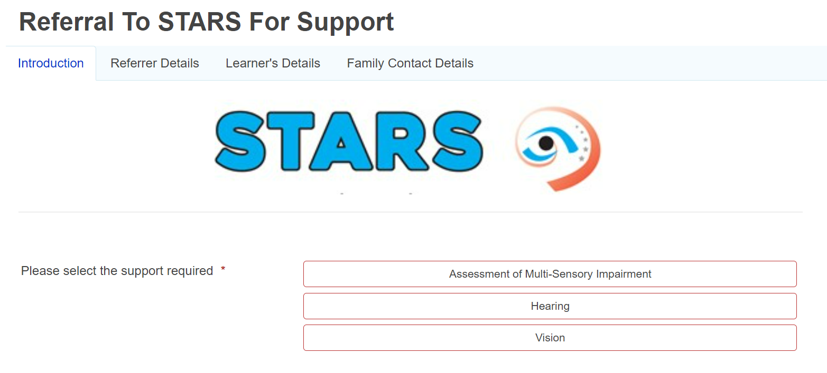

Slide 16
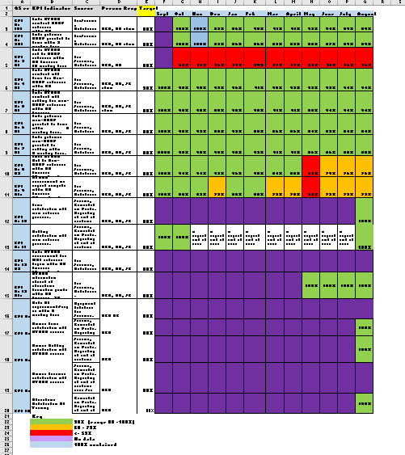

Slide 17
Curriculum Framework for Children and Young People with Deafness
Deaf identity
-Deaf history and culture
- Meeting other DCYP and adults
- Different perspectives
Communication, Language & Literacy
- At home
- In education
- With others
- Technology for communication
Understand access to sound
-Hearing aids and
implanted technology
-Technology for access to sound
-Audiology
-Aetiology (causes) of deafness
Knowledge of acoustics and the impact on sound
Social, Emotional, Physical & Mental Health
(inc. Technology & staying safe)
Manage Change
-Moves and changes in education settings
- Understanding their own access needs
- Moving to adult NHS services
Preparation for Adulthood
-Developing independence
-Careers and seeking employment
-Money management
-Independent travel
-Preparing for the world of work
-Staying safe
-Technology to support independent living, learning and work
Specialist Assessment & Monitoring
-DCYP & their families
-QToDs

Slide 18
Curriculum Framework for Children and Young People with Vision Impairment
Facilitating an Inclusive World Recognising the role of educators
(including specialist practitioners) and parents/carers as facilitators and advocates for children and young people with vision impairment in education and society.
Sensory Development
Working with the children and young people to maximise use and development of the senses.
Communication
Working with children and young people to develop their social communication skills.
Literacy
Working with children and young people to develop literacy skills.
Habilitation: Orientation and Mobility
Supporting children and young people to be able to move safely through their world as independently as possible.
Habilitation: Independent Living Skills
Supporting children and young people to develop the day-to-day skills they need in order to live as independent a life as possible.
Accessing Information
Teaching of methods children and young people can use to access, produce and manage information independently.
Technology Providing training and opportunity for children
and young people to use technology with as much
independence as possible.
Health: Social, Emotional, Mental & Physical Wellbeing
Providing targeted teaching and support to facilitate the development of the mental, emotional, social and physical wellbeing of children and young people.
Social, Sports and Leisure
Supporting children and young people to have opportunities
to participate in social, sports and leisure.
Preparing for Adulthood
Supporting children and young people to prepare for their
lives after compulsory education and make decisions for
their future

Slide 19
Supporting evidence
Each department were directed to collate a paper folder of supporting evidence which was taken into the interview session.
Very useful:
● supporting evidence
● served as a prompt to ensure questions were answered as comprehensively as possible

Slide 20
STARS Introduction
● STARS Position Statement and Action Plan
● Staffing levels
● Caseload data – including number of EHCP and
SEN Support Plans
● Numbers of CYP in specialist SI provision

Slide 21
Early Intervention and Assessment
● NATSip Quality Standards
● New referral KPIs

Slide 22
Quality Assurance
● NATSiP Standards, Audit and Action Plan
● Eligibility Criteria
● Evidence of QA – Supervision, moderation and QA process of Live Journal records (and plans to extend the process)

Slide 23
Multi-disciplinary working
● In addition to SEND panels (referenced earlier)
● Half-termly MDT, audiology, CI, SALT, STARS
● Joint visits, HV, Occ Th, SALT

Slide 24
Participation and Engagement
● Results of previous electronic surveys and incidental feedback (recorded in an excel document)
● Introduction of parental engagement app (up to over 250 users)
● Social media, Facebook Page is most popular, Tik Tok, X,
What’s App for AllSTARS
● STARS Extra-curricular offer, all age groups, TinySTARS, Mini-STARS, SuperSTARS, AllSTARS, annual residential, newsletters and feedback
● STARS Youth Voice
● Whole Family Events x 3 per year, videos, newsletters

Slide 25
Planning for Adulthood
● SI specialist curriculum/skills and development
programmes (HI/VI/MSI)
● Transition booklets N- R, KS2-3, KS4-5
● Evidence of QA – records detailing PfA outcomes
● Assistive devices (for the home) leaflet

Slide 26
Workforce Development
● STARS Training offer
● STARS IAG
● Evidence of STARS supporting other specialist areas, re room acoustics and lighting
● Training and networking undertaken by the entire team
● Accessibility Strategy, Middlesbrough Audit tool and Action Plan Template
● Presentation (x2) to NHS, trainee paediatricians
● Attendance at SENDCo Forums

Slide 27
Case Studies
● K mainstream sign user to specialist SI provision
● T mainstream sign user opting not to attend SI specialist provision
● MDT – successful MDT approach to the acceptance of a safer referral

Slide 28
Trends/areas of development
▪ increased new referrals – increased awareness
▪ STARS Early Years provision
▪ SEND and Alternative Provision Improvement Plan
▪ increased levels of SEMH
▪ increased Autism and SI
▪ increased Social Care involvement with families
▪ Eastern Europeans and International cohorts with genetic SI
▪ BSL offer locally
▪ Post 16 + Provision – cost efficient support models
▪ inefficient communication and data sharing
▪ NHS wait times for ENT and Ophthalmology
▪ cross-border agreements

Slide 29


