Slide 1
Amanda Card
Low Incidence Needs Team amandacard@gateshead.gov.uk

Slide 2
Gateshead Low Incidence Needs Team
Gateshead maintains a central team of
Specialist Teachers (VI, HI, MSI),
Teaching Assistants and Intervenors,
Specialist Learning Mentor,
SaLT (HI) - commissioned via Health
Habilitation Specialist
We provide the statutory hours of support as identified in pupils EHCPs along with any specialist equipment.

Slide 3
Support to Independent Schools
Numbers of Independent settings (excluding early years and colleges)
3 Primary schools
2 Secondary
1 Special
These schools are supported by a representative body which – “promotes and defends schools’ interests, in addition to providing training and support to help them excel and thrive.
80 schools across each of the four main UK communities: Gateshead, North London, North West, London and Manchester.
Funded by parental fees and are charitable organisations.

Slide 4
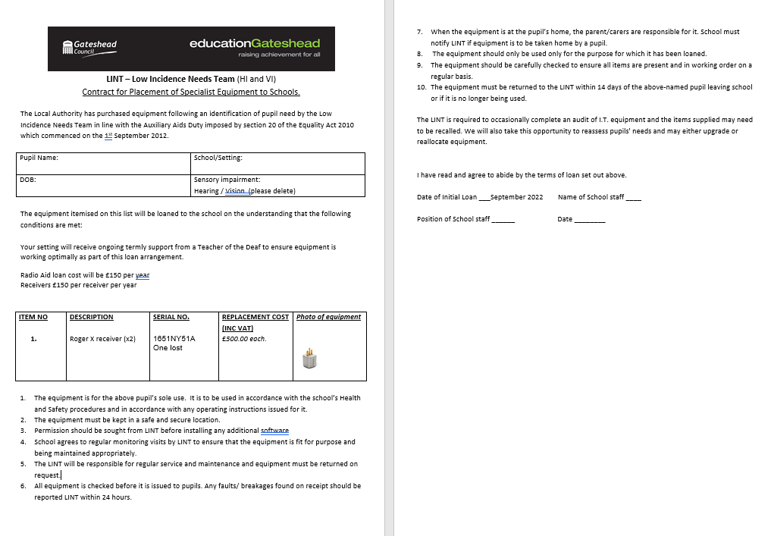
LINT Offer - SEN Support (Independent)
Regular teacher visits in line with Eligibility Criteria - no cost
Pupils requiring equipment e.g. Low Vision Aids, Radio Aids and receivers – minimal charge (£50 per item per half term).
Loan charge also includes training, regular equipment checks and covers costs of repair, loss and maintenance.
A couple of parents are loaning equipment from NDCS as an alternative to taking on the loan costs (however the expectation is that LINT will manage these!)

Slide 5
The challenges:
1. To the Local Authority in relation to wider statutory duties relating to SEN funding for independent mainstream schools (14 day response)
2. Direct to the Low Incidence Needs Team in relation to provision of equipment. (7 days response)
Required 2 separate replies – they were seen as 2 separate matters.

Slide 6
The letter to LINT
Initial letter received from the school SENDCo:-
Acknowledged no EHCP is maintained
Attached the report and recommendations from the LINT HI teachers with regards equipment
Stated:
“They believe the loan charge is unlawful and that Section 63(4) CAF Act 2014 states that LAs must pay fees payable in respect of SEN provision made at the school which is required to meet the SEN of the CYP”
LINT were given 7 days to respond before they would instruct solicitors

Slide 7
Challenge 1 – to the LA SEND Manager
Data was presented which was thought to evidence that there was a disproportionate low number of pupils with EHCP and at SEN Support – due to lack of funding
Local authorities have a number of general duties under the CFA 2014 to children within their areas, including to children that attend independent schools. Section 22 states:
“A local authority in England must exercise its functions with a view to securing that it identifies—
all the children and young people in its area who have or may have special educational needs, and
all the children and young people in its area who have a disability.
Section 24 of the CFA 2014. Local authorities have specific duties for those children for whom they are “responsible”.
Section 27 of the CFA 2014 to keep various matters relating to education under review, including the educational provision, training provision and social care provision made in its area for children and young people who have special educational needs or a disability
Additional challenges around sections 37-40 of CFA with regards to EHCPs
Sections 63(1) and (2) of the CFA, where a local authority maintains an EHC plan for a child or young person, special educational provision in respect of the child is made at a school, and the school is named in the EHC plan, the local authority must pay any fees payable in respect of the education provided for the child or young person at that school in accordance with the EHC plan.
Additionally, there are intimated suggestions of discrimination (Equality Act 2010) due to the schools being Faith Schools.

Slide 8
Challenge 2 (to the LINT Manager)
Charges in regard to the loan of specialist equipment.
“Section 63 (4) of the Children and Families Act states that the local authority must pay any fees payable in respect of the special educational provision made at the school which is required to meet the special educational need of the child/young person”.

Slide 9
Initial discussions and next steps
Clarification of ‘independent’ school with help from the DfE SEN Advisor (as opposed to non-maintained)
Discussed what would be ‘reasonable adjustments’
LA acknowledged that as an independent school they will not be receiving the SEN notional budget of £6k per pupil and that these are the funds that maintained schools use to provide some support/equipment when required.
Does the term ‘fees’ within the Act include loan charges for equipment?
Approached regional colleagues regarding local arrangements
Posted on HOSS to gain national picture
Approached NatSIP colleagues for advice (thank you).
Lots of discussions around section 63 of CFA in particular. Legal – looked in detail at parliamentary questions, court rulings etc.
On going query as to whether the school fees should be paid for too (parental choice v LA maintained school)
Application of CAF Act 2014 and SEND COP in independent settings
Lots of online research – e.g. IPSEA

Slide 10
The response
Need to maintain positive relationships.
Gateshead prepared a joint response (to hold until further legal advice was sought).
Reminded them of what is currently in place e.g.
  Funding given from High Needs block for additional support
  The offers from HINT and LINT at no cost
  Support offered through attendance at SENDCo Network meetings.
  Invitation to be involved in development of strategic LA development
  Capital funding – given to support building work in settings
  Regarding section 63 – we asked them to explain the basis on which they think equipment for use in pupils in an independent school should be funded by the LA (in the meantime we are taking external legal advice)

Slide 11
IPSEA
Referred them to the IPSEA (Independent Provider of Special Education Advice) website
“Under Part 3 of the Children and Families Act 2014, nurseries, schools and colleges have legal duties to identify and support children and young people with special educational needs.
However, the Children and Families Act 2014 and the SEND Code of Practice do not apply to wholly independent schools, and so these duties do not apply. If a child attends an independent school and you (parents) pay the fees, the school is not legally required to identify SEN or provide support in the same way.
The Equality Act 2010 does apply to all schools and education settings. Independent schools must not discriminate against disabled pupils and must make reasonable adjustments where necessary to avoid disability discrimination.”
https://www.ipsea.org.uk/faqs/my-child-attends-and-independent-school-and-we-pay-the-fees-are-children-at-independent-settings-entitled-to-support

Slide 12
Thank you for listening

