Slide 1
Disability Discrimination in Schools:
The role of the Tribunal
District Tribunal Judge Clive Dow
Lead Judge
Disability Discrimination in Schools
First-tier Tribunal (Health, Education & Social Care)

Slide 2
The Equality Act 2010: Disability
Disability is a ‘protected characteristic’ under the Equality Act 2010 alongside: age, gender reassignment; marriage and civil partnership; pregnancy and maternity; race; religion or belief; sex; sexual orientation (Section 4).
A person is disabled if they have a mental or physical impairment which has a substantial and long-term adverse effect on their ability to carry out normal day-to-day activities. (Section 6)
A person who is registered blind, severely sight impaired, sight impaired or partially sighted as certified by a consultant opthalmologist is automatically treated as disabled (2010 Disability Regulation 3).

Slide 3
Chapter 1 of Part 6 of the Equality Act 2010:
What schools are required to do
Schools must not discriminate against a pupil or prospective pupil because of their disability (ss 85(1)-(3))
Schools must not harass or victimise a pupil or prospective pupil because of their disability (ss 85(4)-(5))
Schools must remove barriers for disabled pupils so they can access and participate in education in the same way, as far as reasonably possible, as non-disabled pupils (s.85(6))
Duties under Section 85 fall on the ‘Responsible Body’: normally the Governing Body of a maintained school or the Proprietor of an Academy, Free School or Independent School

Slide 4

What is a school? Section 4 of the EA 1996
(1) In this Act (subject to subsections (1A) to (1C)) “school” means an educational institution which is …an institution for providing—
(a) primary education,
(b) secondary education, or
(c) both primary and secondary education, whether or not the institution also provides part-time education suitable to the requirements of junior pupils or further education.
(1C) An alternative provision Academy is a school.

Slide 5
What is not a school?
(1A) An institution which—
  (a) provides only early years provision (as defined by section 96(2) of the Childcare Act 2006), and
  (b) is not a maintained nursery school,
is not a school.
(1B) A 16 to 19 Academy is not a school.
a sixth form college is not a school
a further education college is not a school
a place of higher education is not a school
Ceci n’est pas une ecole

Slide 6
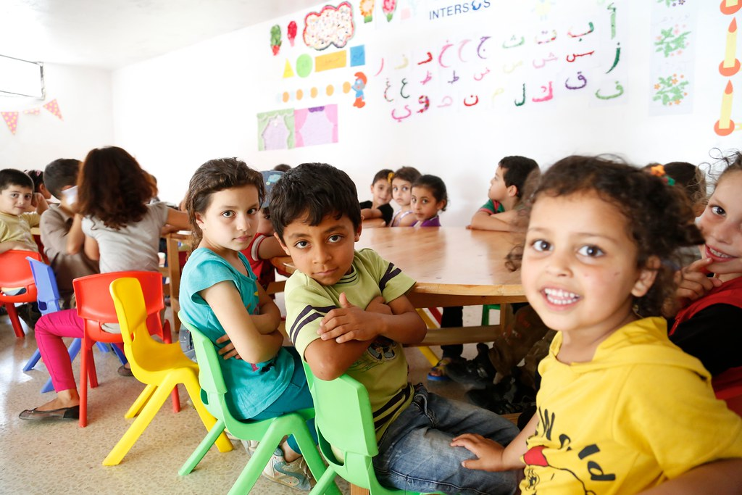
Who is a pupil? Section 3(1) of the EA 1996
A person for whom education was / is / or will be provided at a school
BUT NOT
Those who have turned 19
Those over compulsory school age receiving part-time education

Slide 7
Who can bring a claim and when?
The parents of a child below compulsory school age.
A young person (above compulsory school age) on their own behalf.
Compulsory school age is normally the last working day of June in the academic year a child turns 16 (so the end of Year 11).
Claims cannot be brought more than 6 months after the conduct complained of occurred, except with the leave of the Tribunal.
There is no general requirement for a claimant to have gone through any other complaints process before making a claim although:
  Where a claimant has sought review of a permanent exclusion through an independent review panel, that process must have concluded; and
  An appeal against a refusal to admit a disabled pupil must be brought through the Local Authority’s appeal arrangements where those apply.

Slide 8

Some building blocks
Does the child meet the definition of a disabled person in Section 6?
Is the conduct complained of, conduct that engages the RB’s duties under Section 85?
Is the conduct unlawful discrimination, harassment or victimisation?
If so, what is the appropriate remedy?

Slide 9
Is the conduct prohibited?
Section 85(1) provides
(1) The responsible body of a school to which this section applies must not discriminate against a person—
(a) in the arrangements it makes for deciding who is offered admission as a pupil;
(b) as to the terms on which it offers to admit the person as a pupil;
(c) by not admitting the person as a pupil.
Over the next few slides we will try to identify whether there is prohibited conduct
We will start with School Admissions.
In practice the Tribunal only deals with independent schools’ admissions because complaints about admissions decisions for maintained schools, grammar schools, academies and free schools must be made through the Local Authority’s appeals process.

Slide 10
What about selective schools?
Part 3 of Schedule 11 (Schools: Exceptions) permits some forms of selection by ability and/or aptitude; AND
Schedule 13 paragraph 2, restricts the duty to make reasonable adjustments to deciding who is offered admission as a pupil.
So… a mainstream independent school which selects pupils by interview must make reasonable adjustments to the interview process for a prospective pupil who is hearing-impaired. However, the school might still be justified in refusing admission to that pupil (i.e. treating them unfavourably because of their disability) if, for example, the school did not have the resources to provide the 1:1 BSL interpreters that the pupil requires in order to access classroom learning.

Slide 11
Where a child has an EHC Plan
Where a child has an EHC Plan, the Local Authority is responsible for naming an ‘appropriate’ placement in Section I;
Appeal lies to the Tribunal under Section 51(2) of the Children and Families Act 2014 if a parent or young person disagrees with the school named.
However, since neither the Local Authority nor Tribunal can name a ‘fully’ independent school in Section I against its wishes, some parents may bring both a claim (against the school for its non-admission decision) and an appeal (against the LA’s decision to name a different school in section I) which the Tribunal will hear together.

Slide 12
Is the conduct prohibited?
We move on to scenarios relating to treatment in school…
Section 85 (1) and (2) provides:
The responsible body of such a school must not discriminate against a pupil—
in the way it provides education for the pupil;
in the way it affords the pupil access to a benefit, facility or service;
(c) by not providing education for the pupil;
(d) by not affording the pupil access to a benefit, facility or service;
(e) By excluding the pupil;
(f) by subjecting the pupil to any other detriment.

Slide 13
Discrimination arising from disability
Where a person (e.g.: a teacher, assistant, governor or administrator) treats a disabled pupil unfavourably ‘because of something arising in consequence of the pupil’s disability’ and the Responsible Body cannot show that the treatment is a proportionate means of achieving a legitimate aim.
Tim is 11. He attends an independent prep school. He is told he cannot join the school football team. He is not given any reason. Tim is sight impaired but enjoys playing football.
Ella is 15 and attends a mainstream secondary academy. She has a severe hearing impairment. She is suspended for ‘verbally abusing a teacher’. The teacher was chastising Ella for being late to the lesson. Ella says she did not hear the school bell but the teacher would not accept her explanation which made her angry.

Slide 14
Harassment
A teacher regularly tells Suzie that if she keeps using the “Time Out” card to leave lessons, then she will never learn what she needs to know for her GCSEs.
Is the conduct prohibited?
Section 85(3) provides:
(3) The responsible body of such a school must not harass—
(a) a pupil;
(b) a person who has applied for admission as a pupil.
[NB Harassment is defined in s.26]
A school secretary makes a point of reminding students of the uniform policy where she sees they are not dressed properly. Sam has sensory issues and is wearing trainers when he is told off.

Slide 15
Is the conduct prohibited?
The provisions relating to victimisation are in sections 85(4) and 85(5)
27 Victimisation
(1) A person (A) victimises another person (B) if A subjects B to a detriment
because—
(a) B does a protected act, or
(b) A believes that B has done, or may do, a protected act.

Slide 16
Victimisation
Jaswinder is starting primary school in September. His mother wanted him to go to the nearest primary school but the LA has given him a place at a school which is at least ½ hour away on foot and there are no direct buses. Jaswinder’s mother has mobility issues and will be unable to take him to and from school like non-disabled mothers. She says Jaswinder did not get a place in the nearest school because she had complained that it did not have a disabled toilet she could use when Jaswinder’s stepsister used to attend.
Parents have made accusations on social media about how staff at an independent school have mistreated their 15-year-old sight-impaired son. School staff have told their son that if he continues to tell lies to his parents, they will have no option but to terminate his place, even though that will mess up his GCSE year.

Slide 17

A duty to make reasonable adjustments
Section 85(6):
To mitigate or overcome the substantial disadvantage suffered by disabled pupils compared with non-disabled pupils when a provision, criterion or practice is applied to pupils generally (e.g. a school uniform policy).
The duty to make reasonable adjustments includes the duty to provide auxiliary aids (which may include equipment or personal assistance).
But excludes a requirement to make physical alterations to school buildings.
The duty to make reasonable adjustments does not extend to exclusions (although the school must take reasonable steps to ensure a disabled pupil is able to comply with its behaviour policy).

Slide 18
What adjustments are reasonable?
Considerations might include (per EHRC Technical Guidance for Schools):
  The extent to which special educational provision will be provided to the pupil under Part 3 of the Children and Families Act 2014;
  The resources of the school and the availability of financial and other assistance;
  The financial and other costs of making the adjustment;
  The extent to which any particular step would be effective in overcoming the substantial disadvantage suffered by a disabled pupil;
  The practicability of the adjustment;
  The effect of the disability on the pupil;
  Health and safety requirements;
  The need to maintain academic, musical, sporting or other standards;
  The interests of other pupils and prospective pupils.

Slide 19
Remedies
The Tribunal has a broad discretion to direct remedies.
Primarily to mitigate the impact of discrimination for the disabled pupil named in the claim (e.g.: to make the adjustments sought, reinstatement following exclusion, provide catch-up tuition or provision of school trips missed).
May include training for staff or governors, requirement to review policies and arrangements.
Must be directed at the Responsible Body corporately (not an individual employee).
Cannot include financial compensation.

Slide 20
Questions…

