Slide 1

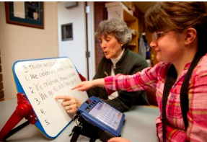

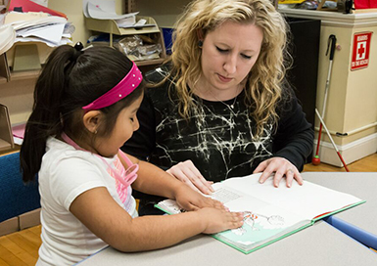
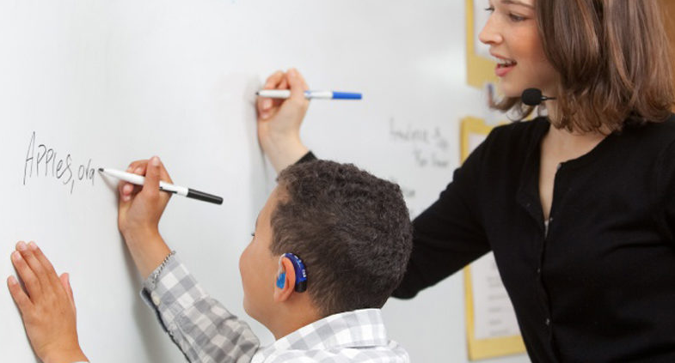
Sensory Trailblazer Update April 2023
Rory McDonnell, Team Leader, Royal Greenwich Sensory Service
Tina Wakefield, Education Consultant, NDCS

Slide 2
What is a trailblazer?
Trailblazer groups are responsible for developing an approved apprenticeship.
They promote their apprenticeship to potential users
They also remain active once their apprenticeship is approved for delivery, to respond to any changed requests.

Slide 3
Who is involved in the Sensory Teachers’ Trailblazer?
There is broad representation from across the sector. This includes representatives from: NATSIP, RNIB, VIEW, BATOD, NDCS, Birmingham University, Manchester University, Mary Hare/Hertfordshire, and employer representatives from Wandsworth, Kent, Greenwich, Milton Keynes, Gateshead, Newcastle, and others.
And we are very grateful to all involved!

Slide 4
Recap of where we are up to…
Formed a Trailblazer Group (autumn 2019)
Developed an occupational proposal (submitted November 2020, approved January 2021)
Developed an Occupational Standard which was completed Summer 2021, submitted to the Institute for Apprenticeships and Technical Education (IfATE) in March 23
Developed an End Point Assessment Plan (submitted to IfATE March 23).
Made a detailed funding band request (submitted to IfATE Feb 23)

Slide 5
What happens next?
We hope to soon have approval of all the key documents
Then the apprenticeship documents will be sent to the Secretary of State for final approval.
Following this, the course providers will need to go through their own new programme processes, and then make application to IfATE to offer the apprenticeship.
The apprenticeships will be offered to new students
This may all take some time!

Slide 6
What are the entry requirements for the apprenticeship?
They are the same as the current requirements for entry to the PG Dip courses for QTOD/QTVI/QTMSI i.e.:
QTS
English and Maths at grade C/level 4 or equivalent
An enhanced DBS check
Preferably one year’s teaching experience
Plus one extra: the apprenticeship student must be supported by their employer who will work with them throughout the programme.

Slide 7
Is the apprenticeship different from the MQ PG Diploma for QTOD/QTVI/QTMSI?
There is a different funding stream, and the apprentice must be employed working with children and young people with SI, but the course is the same as the current MQ courses except for one additional assessment.
Students follow the exact same course and must complete the MQ requirements. When we designed the knowledge, skills and behaviors for the apprenticeship we were allowed to use the new MQ curriculum which starts from this autumn… so that it works in synchrony with the MQ standards.
There is one additional assessment to complete at the end of the course called the End Point Assessment (EPA) .

Slide 8
Typical example:
An employer will employ a teacher to work with children or young people with SI.
The teacher applies to one of the course providers with the support of their employer.
Typically, the teacher will undertake the course over 22 to 24 months.
The apprentice teacher will normally work for 80% of their time and study for 20% of their time.
At the end: after completing the End Point Assessment the apprentice is awarded the MQ. At this point they are no longer an apprentice, they will be QTOD/QTVI or QTMSI.

Slide 9
Funding
Employers will be able to use apprenticeship levy funding to fund their apprentices. This should cover 90 to 100% of the cost of the course.
What's not included? Travel costs, teaching cover for teaching practice, costs of textbooks and resources.

Slide 10
What about charity funders and self funders?
Teachers who wish to either self fund their course costs, have their course funded by a charity, eg BATOD/Con Powell, or use another funding stream, will not be taking the apprenticeship route.
They will study the same course and they still need to meet the same entry requirements, but they do not need to take the end point assessment or necessarily need to be currently working with SI children and young people.

Slide 11
DfE and Charity support
The DfE and leading charities in our sector have all been very supportive of this project.
The DfE announced in March support for the apprenticeship as part of a range of new SEN training measures within the SEND Review.
The long term aim is that the apprenticeship will provide significantly improved support to employers who need to train teachers to become QTOD/QTVI/QTMSI.
The option for teachers who wish to train without undertaking the apprenticeship will also continue.

