Slide 1

Updating the Mandatory Qualifications for QTSI
Dr Jackie Salter
President-Elect BATOD,
MQToD Working Group Lead

Slide 2
Aims
  Context of the update
  Key objectives
  Format of the new MQ documentation
  Maintaining the specialist teacher workforce

Slide 3
Optimising outcomes for children with SI
Support the development of highly specialised teaching workforce with knowledge, understanding and skills required to ensure children and young people with SI have
  equality of access to education
  opportunities to develop their independence and personal agency
  be prepared for adult life
provides QTSIs with the tools to maintain the knowledge, understanding and skills
  within our dynamic educational context
  in response to a growing research informed evidence base

Slide 4
Context of the update
NatSIP engaged in work for DfE on the Future of the SI workforce 2018/2019
DfE engaged NatSIP in the revision of MQ Standards 2109/2020
Working group/s
  QTVI - Professor Graeme Douglas
  QTMSI - Dr Liz Hodges
  QToD - Dr Jackie Salter
Collaboration across the groups
Individual work on specific areas
Wide consultation that included a number of different stages

Slide 5

DfE requirements
  Reflect the changing landscape in education
  Flexible in order to continue to meet the needs of SI children
  Align DfE priorities to co design and deliver training in an increasingly school led system
  Raise aspirations for children and young people with SI

Slide 6
NatSIP working group objectives
Qualified specialist teachers developed the necessary knowledge, understanding and skills to optimise outcomes for children and young people with SI
Acknowledge the common areas of knowledge, understanding and skills in the SI sector
Ensure the specific knowledge, understanding and skills for the different specialisms are clearly articulated
Reflect the different contexts in which QTSIs now work
Reflect the full age profile of the population
Align specifications with current discourses in education
Provide a set of competencies that supports continual professional development /learning

Slide 7
Format of the new MQSIs
Standard 1 The current legislative and educational framework
Standard 2 Personal professional development
Standard 3 Working in Partnership with families
QTVI
specific standards 4-9
QTOD
specific standards 4-9
QTMSI
specific standards 4-9

Slide 8
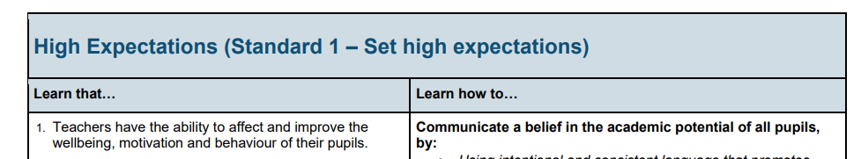
Early Career Framework

Slide 9
Narrative for each standard
Standard 1: The current legislative and educational framework
Specialist teachers must have detailed knowledge and understanding of current educational legislation and practice and recognise that this will change over time (both in terms of legal frameworks and guidance/codes of practice at national and local levels). QTSIs, as determined by their specialism, must be able to apply this knowledge and understanding when working with learners with sensory impairment 0-25 years, in a range of educational contexts, and working with other professionals and families.

Slide 10
Format of the individual components
Knowledge and Understanding | Skills
3K2 Understand the importance of early intervention. | 3S2a To work in partnership with families to understand and implement strategies to support the development of their child. 3S2b To work in partnership with families to adjust to family life with their child. 3S2c To work in partnership with families to understand and navigate the systems and transitions they engage with to support their child.

Slide 11
Example Standard 3
3K3a Understand the range of education, training and employment opportunities available to SI learners, as well as the support available to them as they leave school.
3K3b Have up to date knowledge of services and supporting organisations available for families at both a local and national level. Including local charities, national professional bodies.
3S3 To work with families in making an informed choice on appropriate provision for their child or young person.
Knowledge and Understanding | Skills
3K3a Understand the range of education, training and employment opportunities available to SI learners, as well as the support available to them as they leave school. 3K3b Have up to date knowledge of services and supporting organisations available for families at both a local and national level, including local charities and national professional bodies. | 3S3 To work with families in making an informed choice on appropriate provision for their child or young person.

Slide 12
What has happened since 2020?
Covid
DfE process to accredit programmes
Development of new programme materials
New programmes available from September 2023
Image by MiroslavaChrienova

Slide 13
Maintaining the specialist workforce
Reduced number of applications to the QTSI programmes in recent years
Children with SI need a full specialist teaching workforce to optimise outcomes
Need experienced colleagues to mentor trainees
September 2023 new programmes reflecting current practice, new curricula
Need to support these programmes - or lose them

Slide 14
Thank you

