Slide 1

Making Inclusion
NatSIP Working Day - The SEND and Alternative Provision Improvement Plan and national priorities
Moving Forward - The SEND and AP Improvement Plan
Wednesday 19 April 2023
André Imich, SEN and Disability Professional Adviser, DfE

Slide 2
Session to cover
Improvement Plan (March 2023)
A more inclusive system
Data/ National Benchmarking
Reasonable adjustments
Co-production – Building parental trust
Q&A

Slide 3

Creating a more inclusive society through a new national SEND and alternative provision system
“Our vision is to create a more inclusive society that celebrates and enables success in all forms, with the cultures, attitudes and environments to offer every child and young person the support that they need to participate fully, thrive and fulfil their potential”. (March 2023)

Slide 4
Key Facts
Over 15% of all pupils – 1.4 million – are identified with SEN
12.6% of pupils were identified as requiring SEN Support
A further 4.0% of all pupils had an EHCP
Of all CYP with an EHCP, 77% are in schools or AP
82.7% of pupils in AP were identified with SEN
High needs budget has risen by 41% over last 3 years
Increasing numbers of appeals to Tribunal

Slide 5
State of the nation 2022: Children and young people’s wellbeing
Pupils with SEN were more likely than pupils without SEN to report:
Low happiness with school
Having difficulty concentrating in class
Not being motivated to learn
Having been a victim of bullying in the past 12 months (in both primary and secondary school).
(State of the nation 2022: children and young people’s wellbeing - GOV.UK (www.gov.uk)

Slide 6



The SEND and AP Green Paper (March 2022) sought to solve the following problems
Outcomes for children and young people with SEND are consistently worse than their peers – across almost every measure
Experiences of navigating the SEND system to secure support are poor
There is too much inconsistency across the country – with decisions made based on where a child lives, not on their needs

Slide 7
A challenge: “There is too much inconsistency across the SEND system in how and where
needs are assessed and met”
(GP, 2022)

Slide 8

Identifying pupils with SEND (March 21)
The primary school a child attends makes more difference to their chances of being identified with SEND than anything about them as an individual, their experiences or what LA they live in.
Over half of all variation in SEND identification is explained by which school child attends.
True for EHCP as well as School Support.

Slide 9
% of pupils with identified SEN – Range across individual LAs (2022 census)
 | England Average | Range across LAs
EHC plans | 4.0% | 1.7% - 5.9%
SEN Support | 12.6% | 8.2% - 17.6%

Slide 10
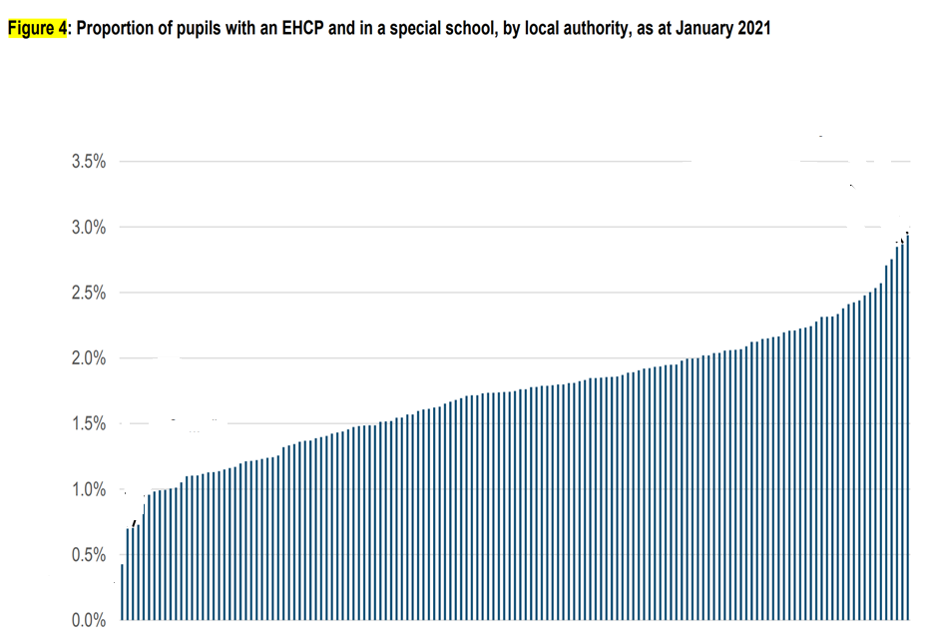
Specialist placements by LAs

Slide 11

The SEND and AP Green Paper (March 2022) sought to solve the following problems
Outcomes for children and young people with SEND are consistently worse than their peers – across almost every measure
Experiences of navigating the SEND system to secure support are poor
Despite unprecedented investment, the SEND system is not delivering value for money for children, young people and families
There is too much inconsistency across the country – with decisions made based on where a child lives, not on their needs

Slide 12
A new national SEND and alternative provision system with a mission to:
Fulfil children’s potential
Build parents’ trust:
A fairer, easily navigable system that restores parent and carer confidence that their children will get the right support, in the right place, at the right time
Provide financial sustainability
LAs make the best use of the high needs budget to meet CYP’s needs and improve outcomes, while placing them on a stable financial footing.
CYP with SEND enjoy their childhood, achieve good outcomes and are well prepared for adulthood and employment.

Slide 13
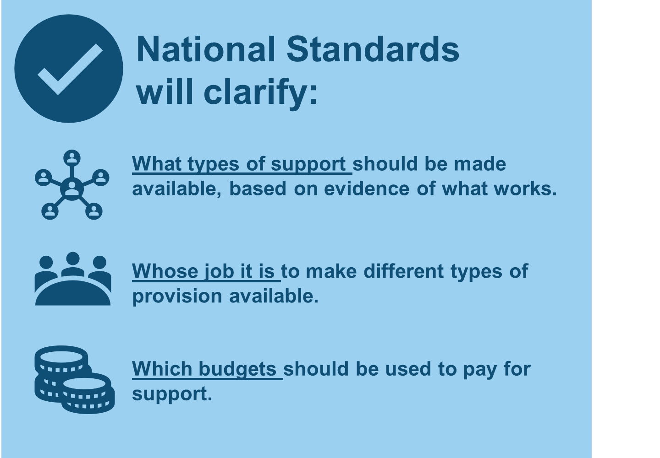
A national system underpinned by National Standards
Will build on what good local areas are already doing with their local offer and ordinarily available provision and set this as the standard everywhere.
We propose setting standards in legislation, via a framework, to clarify who is responsible for securing what provision – emphasising what should be ‘universally’ available in early years, schools and colleges.
Intend standards to apply across education, social and healthcare
Alongside the National Standards, we will develop ‘practice guides’, to offer frontline professionals a single source of evidence on ‘what works’ to support CYP with SEND.

Slide 14
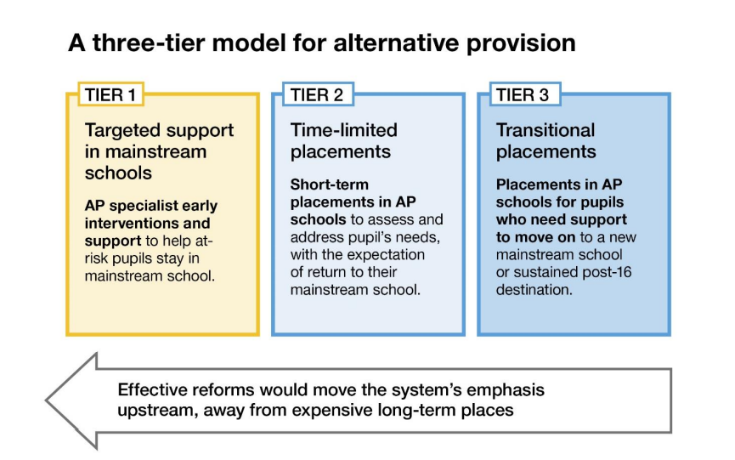
An integrated SEND and alternative provision system

Slide 15
Leadership - Local SEND and AP partnerships and local inclusion plans
Partnerships to be responsible for undertaking a joint needs assessment and producing a strategic local inclusion plan (LIP) for local delivery.
Partnerships to include reps from across education, health (inc mental health) and care, and parents and young people.
Testing and learning about Partnerships a key part of the Change Programme.

Slide 16
Further developments
Capital investment - £2.6 billion over next 3 years to deliver new places and improve existing specialist and AP provision – can include mainstream units/ RPs.
Standardisation of templates - Develop a national EHCP template, supported by guidance.
Encourage all SEND services to move to EHCP digital systems.
We will introduce a national framework of banding and price tariffs
We have asked the Law Commission to review existing social care legislation re disabled children.

Slide 17
Preparation for employment
Supported Internships: Funding to enable LAs to double the number of supported internships by 2025, with over 700 job coaches being trained by 2025.
Apprenticeships: conduct a pilot to consider the evidence required to access flexibilities to standard English and maths requirements for apprenticeships.
Supporting effective transitions - focus initially on transitions into and out of post-16 settings, inc. transitions into employment, adult services and for YP leaving AP at end of KS4
Adjustment Passport – we will trial the Passport with supported interns and apprentices

Slide 18
Ensuring SEND leadership across schools
To support excellent school SEND leadership, ensuring high quality SEND provision is included in:
A new MAT CEO development offer
The descriptors for academy trust strength, which will include measures for a high-quality, inclusive education.
The NPQ for Headship - to develop the knowledge that enables all pupils to succeed.
A new NPQ for Early Years Leadership
Inspection: To be judged good or outstanding, schools must show that CYP with SEND achieve good outcomes - inspectors expect to see an inclusive culture in all education settings

Slide 19
Improving mainstream provision through high-quality teaching and SEND training
We intend to replace the NASENCo with a mandatory high-quality leadership level SENCo NPQ for SENCos that do not hold the current qualification, inc. those that became a SENCo prior to Sept 2009.
Explore opportunities to build teacher expertise through a review of the ITT Core Content Framework and ECF.
We will set out clear guidance on the effective use and deployment of Teacher Assistants
Universal Services programme provides free SEND-specific professional development, online training, live webinars and peer mentoring opportunities to school and college staff.

Slide 20
Providing specialist support at the point of need
Expanding Mental Health Support Teams (MHSTs) in schools and colleges to around 500 operational teams by 2024
An offer to all state schools and colleges grants to train a senior mental health lead by 2025
We are investing a further £21 million to train two more cohorts of Educational Psychologists in 2024 and 2025
Alternative Provision to provide early outreach support for mainstream schools
We are ensuring a secure supply of teachers of CYP with visual, hearing and multi-sensory impairments.

Slide 21
Bands and tariffs
Most LAs already make use of banded funding arrangements, based on local levels of available provision and costs - We will introduce a national framework of banding and price tariffs.
Most responses to NFF consultation indicated support for the direct NFF to include the identification of an indicative SEND budget determined by DfE - publish the outcome of this consultation in spring 2023.

Slide 22
Wider measures
A National SEND and AP Implementation Board to oversee the implementation of this Improvement Plan, chaired by ministers.
Introduce inclusion dashboards as a way of improving understanding of the local area and as a tool to strengthen accountability.
Updated Ofsted/CQC local area SEND inspections, from Jan 2023.
We will support schools to comply with their disability duties under the Equality Act 2010.

Slide 23

Equality Act 2010 and disability
Where something a school does places a disabled pupil at a disadvantage compared to other pupils, then the school must take reasonable steps to try and avoid that disadvantage.
A school must not discriminate against a disabled pupil because of something that is a consequence of their disability – for example by not allowing a disabled pupil on crutches outside at break time because it would take too long for her to get out and back.
What examples are there of reasonable adjustments that don’t ‘cost’ anything?

Slide 24
Examples of reasonable adjustments
Wearing a hoodie and putting up hood if he has sensory overload
Time out cards
Walk around when needing a break
Going to sensory room when needed
Going to toilet at any time
Arriving late without interrogation
No homework
Can wear shorts instead of trousers
Round neck version of school tee shirt instead of polo shirt
Use of laptop
100% Attendance Club allows for absence due to disability
Sitting next to best friend
Can walk out of assembly if need to
Choice of where to eat dinner
Changing for PE is optional
Being able to sit on a chair instead of carpet

Slide 25
Key implications for school workforce
A more skilled workforce
the SENCO NPQ;
a review of the ITT and ECF;
a commitment to SEND across several leadership NPQs;
research into the best practices of teaching assistants.
National Standards
access to more good evidence-informed strategies and practices;
support to make good decisions about provision quickly;
focus on the implementation of provision.
Reduced reliance on EHCPs
better and earlier identification;
a more robust plan of intervention/ support through ‘ordinarily available provision’ at SEN Support Level;
reduced time requesting EHCNAs and undertaking Annual Reviews.

Slide 26
Specialist support really working
LA1 - Across all settings, including in the early years, parents and setting leaders commend the work of the specialist sensory teachers for visual impairment and hearing impairment.
LA2 - Advisory teaching services, such as the autism service and sensory service, are highly regarded. Many parents and school leaders describe these services as ‘second to none’.
LA3 - Parents and carers of CYP with sensory needs, such as visual and hearing impairment, were overwhelmingly positive about the support given to their children, for example in teaching braille
      From Ofsted/ CQC local area SEND Inspections, 2022

Slide 27
Priorities:
Business as usual – getting it right now.
High quality teaching and support for pupils with SEND - Evidence-based practices and interventions.
Encouraging attendance; minimising exclusions; preventing bullying; applying reasonable adjustments.
Co-production with parents and young people.
Effective use of SENCo knowledge and skills.
An inclusive school culture – thinking SEND across the board.

Slide 28


