Slide 1

Making Inclusion
Where we are in the national SEND system now and how engagement and partnership really work
Linden Lodge
Friday 10 March 2023
André Imich, SEN and Disability Professional Adviser, DfE

Slide 2
Objectives
To highlight good practice in parent, child and young person engagement.
To outline the key opportunities within the Improvement Plan (March 2023) for improving outcomes and inclusivity.

Slide 3
Parent engagement and partnership really working:
LA1 - Leaders take co-production seriously. Members of the PCF sit on a number of steering groups to advise and evaluate aspects of SEND provision. They organise annual conferences, coffee mornings and virtual support to help parents and carers.
LA2 - The PCF was involved with the recommissioning of the SEND transport service to ensure transport staff are trained to administer emergency medication to CYP.
LA3 - Leaders and parent reps jointly make important decisions for SEND provision across the area, e.g. professionals and parents worked together to improve the online local offer and develop the new neurodevelopmental pathway.
      From Ofsted/ CQC local area SEND Inspections

Slide 4
Assessments - The voice of the child and young person being really heard:
LA1 - Children and young people are routinely included in discussions about their SEN support or EHC plans.
LA2 - Young people told inspectors that they had recently been involved in the development of their EHC plan and that, overall, the plans accurately represent them as a person and what they want for the future. This was evident in the plans sampled by inspectors.
LA3 – EHC Plans capture the children’s voices and the views of parents and carers well. The outcomes are sharply focused and reflect the hopes and aspirations of CYP.
      From Ofsted/ CQC local area SEND Inspections

Slide 5
Young person engagement and partnership really working:
LA1 - The ‘changemakers’, a large group of volunteer CYP with SEND, work closely with area leaders. They help to shape future projects such as the area’s leisure offer, and challenge leaders about existing services.
LA2 - The SEND youth forum was established in 2019. It is an influential group and integrated fully into the LA’s youth council.
LA3 - LA Young Health Champions have been trained to increase consultation, participation and engagement with young people with SEND. Leaflets have been produced in easy-read formats to ensure information is accessible.
      From Ofsted/ CQC local area SEND Inspections

Slide 6
Specialist support really working
LA1 - Across all settings, including in the early years, parents and setting leaders commend the work of the specialist sensory teachers for visual impairment and hearing impairment.
LA2 - Advisory teaching services, such as the autism service and sensory service, are highly regarded. Many parents and school leaders describe these services as ‘second to none’.
LA3 - Parents and carers of CYP with sensory needs, such as visual and hearing impairment, were overwhelmingly positive about the support given to their children, for example in teaching braille
      From Ofsted/ CQC local area SEND Inspections

Slide 7
Key SEND Facts
Over 15% of all pupils – 1.4 million – are identified with SEN
12.6% of pupils were identified as requiring SEN Support
A further 4.0% of all pupils had an EHCP
Of all CYP with an EHCP, 77% are in schools or AP
82.7% of pupils in AP were identified with SEN
High needs budget has risen by 41% over last 3 years
Increasing numbers of appeals to Tribunal

Slide 8




The SEND and AP green paper sought to solve the following problems
Outcomes for children and young people with SEND are consistently worse than their peers – across almost every measure
Experiences of navigating the SEND system to secure support are poor
Despite unprecedented investment, the SEND system is not delivering value for money for children, young people and families
There is too much inconsistency across the country – with decisions made based on where a child lives, not on their needs

Slide 9
Consultation feedback
During a 16-week consultation period we:
Attended 175 events and heard from over 4,500 people, including children, young people and their families.
Received around 6,000 responses to the consultation questions set out in the green paper.
Most people agreed with:
Our problem analysis
The proposal to introduce a new single national SEND and alternative provision system
That we should get on with some proposals now, and test others
Some people:
Were concerned that some proposals would make it difficult for families to access support
Wanted to hear more about how proposals would work in practice

Slide 10

Creating a more inclusive society through a new national SEND and alternative provision system
“Our vision is to create a more inclusive society that celebrates and enables success in all forms, with the cultures, attitudes and environments to offer every child and young person the support that they need to participate fully, thrive and fulfil their potential”.

Slide 11
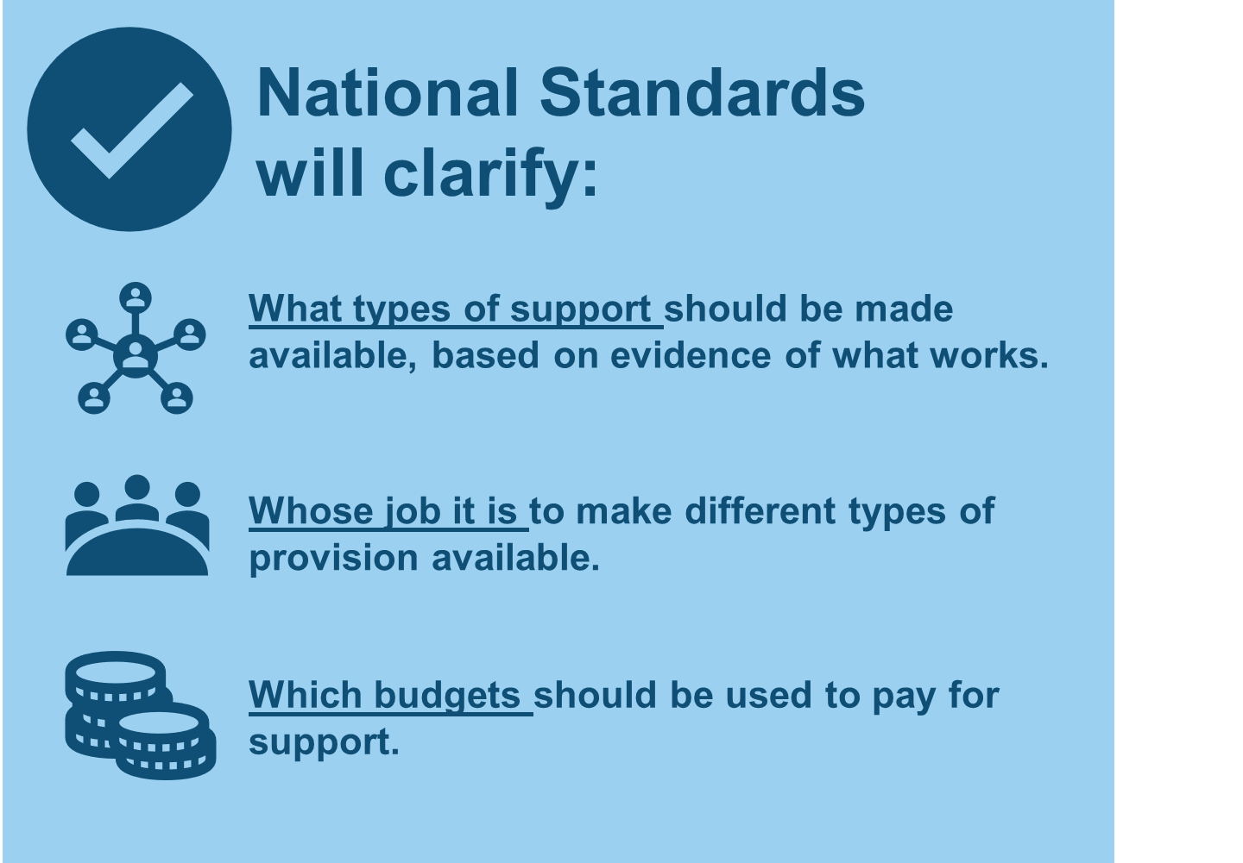
National Standards
Aim of national standards is to set clear expectations for what good looks like, in identifying and meeting need, and clarify who must secure support and from which budgets.
This will set out what every child and their family must receive and what providers must deliver.
We will improve the evidence base for identifying and meeting needs

Slide 12
System Leadership - Opportunities
National SEND Delivery Board – to bring together relevant government departments with national delivery partners including parents, to hold partners to account for the timely development and improvement of the system.
Local SEND partnerships – leading at local level, bringing together education, health and care partners with LAs to produce a local inclusion plan

Slide 13
Delivery - Opportunities
Local multi-agency EHC needs assessment panels
Standardising and digitising EHCPs
Aiming to resolve disputes earlier, e.g. strengthen mediation.
Support parents to express an informed preference; providing a list of settings from the local inclusion plan.
Alternative Provision – more focus on mainstream support.

Slide 14
Workforce opportunities
Introduce a new SENCo National Professional Qualification (NPQ) for school SENCos
Increase the number of staff with an accredited Level 3 SENCo qualification in early years settings
Commission analysis to better understand the support that CYP with SEND need from the health workforce

Slide 15
Teachers of pupils with sensory impairments
To support the supply of specialist teachers who need the Mandatory Qualification for Sensory Impairment (MQSI), we have developed a new approval process to determine providers from the start of 2023/24.
Institute for Apprenticeships and Technical Education (IfATE) is developing an occupational standard for teachers of Sensory Impairment to open up a paid, work-based route by enabling people to undertake high-quality apprenticeships –from 2025.
DfE also exploring further options to maximise take up of MQSIs to improve supply of teachers of Sensory Impairment.

Slide 16
Opportunities for increased accountability
Deliver clarity in roles and responsibilities for every partner, with the levers to fulfil their responsibilities
DfE new Regions Groups to take responsibility for holding LAs and MATs to account for delivering for SEND
Provide statutory guidance to Integrated Care Boards (ICBs) about how to discharge their SEND legal duties
Ofsted/CQC to deliver an updated Local Area SEND Inspection Framework
Inclusion dashboards for 0-25 provision, with a timely, local and national, picture of how the system is performing

Slide 17
Priorities:
Business as usual – getting it right now.
High quality teaching and support for pupils with SEND - Evidence-based practices and interventions.
Encouraging attendance; minimising exclusions; preventing bullying; applying reasonable adjustments.
Co-production with parents and young people.
An inclusive school culture
Moving forward on the Implementation Plan developments

Slide 18


