Slide 1


Positive Relationships
Principles in practice
Head of Service / TOD
Berkshire Sensory Consortium Service
Jane.peters@achievingforchildren.org.uk

Slide 2

Words we use ……..
Difficult
Challenging
Hard to engage
Tricky
Persistent
Constantly moaning
Needy
They don’t know what they want
Unrealistic
Why won’t they ….
Client
They just won’t listen

Slide 3

Beliefs
Parents are capable of communicating with their child
Parents have the right and responsibility to make choices
Children and parents will learn even when professionals are not there to support them
We see every parent as an individual

Slide 4

Two key themes
Understanding diversity and uniqueness of families
Expert v partnership

Slide 5
Diverse and Unique
Recognition that all families are diverse
Understanding how families can differ from each other.
Culture and how this impacts on family systems
Question -what does this look like in our interactions with parents?

Slide 6


Slide 7

Emotion-focused or
problem focused?
When emotions are
high then cognition is
low

Slide 8
Theoretical Model
Expert Model
Partnership model
Davis, H. & Day, C. (2010) Working in Partnership with Parents. 2nd Edition. Pearson: London

Slide 9

Family Partnership model
7.2
Partnership / co –production
Sharing power
Complementary expertise
Agreed aims
Mutual respect
Open communication
Flexibility
Skilled communication
Negotiation.

Slide 10

Important questions to ask parents about their child
What would you like your child to be able to do?
Why would you like them to be able to do that?
What support does your child need to achieve these outcomes (i.e. to be able to do this)?
Does your child need to develop new skills to make this happen?
Who can help or support your child to achieve this?

Slide 11

Key Point
Challenge to understand what the situation looks like and feels like to the parent.

Slide 12

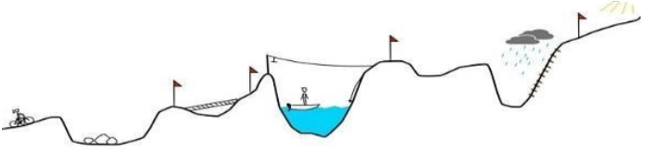
Our plans…….
Parents journey ….

Slide 13

“It’s hard to think straight when being
chased by a polar bear”

