Slide 1


11 May 2022
André Imich, SEN and Disability Professional Adviser, DfE

Slide 2
Objectives
To highlight key SEND facts and challenges
To provide information on the aims of the Green Paper
To highlight connections with the Schools White Paper (Opportunity for all: strong schools with great teachers for your child)
To focus on some of the Green Paper proposals
To encourage your response(s) to the consultation questions

Slide 3
Key Facts
Over 15% of all pupils – 1.4 million – are identified with SEN
12.2% of pupils were identified as requiring SEN Support
A further 3.7% of all pupils had an EHCP
Of all CYP with an EHCP, 77% are in schools or AP
82.7% of pupils in AP were identified with SEN
High needs budget has risen by 41% over last 3 years
Increasing numbers of appeals to Tribunal

Slide 4
Three challenges
1. Outcomes for children and young people with SEND or in alternative provision on average are poor
2. Navigating the SEND system and alternative provision is not a positive experience for too many children, young people and their families
3. Despite unprecedented investment, the system is not delivering value for money for children, young people and families
LEADING TO
A vicious cycle of late intervention, low confidence and inefficient resource allocation is driving these challenges

Slide 5
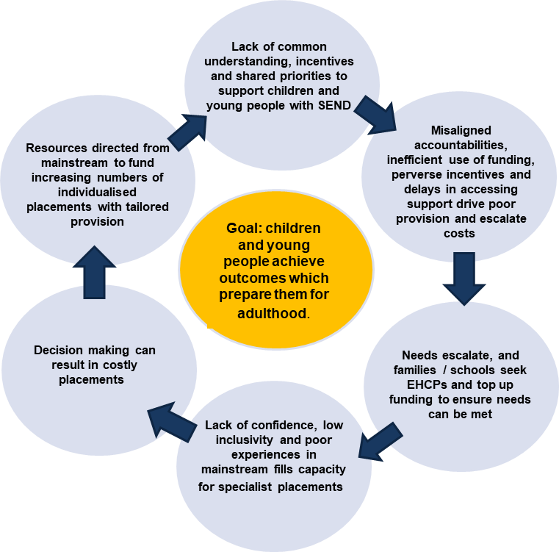

Slide 6
Our overall aim is to:
Create a more inclusive education system with excellent local mainstream provision which will improve the experience and outcomes for children and young people with special educational needs and those who need alternative provision.

Slide 7

We propose to do this by creating:

Slide 8
An inclusive education system - The Schools White Paper
A vision of the school system in which every CYP can fulfil their potential, supported by an excellent teacher, high standards of curriculum, behaviour and attendance, backed by high-quality targeted support for those that need it.
“We believe that, with excellent teaching and improved identification of need in inclusive educational settings, fewer children and young people will need additional interventions as they will be getting the support they need as part of high-quality teaching within the classroom.”

Slide 9

The Parent Pledge (Schools White Paper)

Slide 10
Role of LA (Schools White Paper)
LAs remain at heart of the education system, championing all children in their area – especially most vulnerable
Coordinate local services to improve outcomes for children.
Meet communities’ needs for good school places (planning/securing provision) - DfE to make decisions re expansion existing schools/trusts, creation new ones
Secure best outcome for individual children, especially most vulnerable – admission, safeguarding, attendance
New legal powers – object to PAN, power to direct trusts to admit children
We will “work openly with LAs and the wider school system to co-design the detail over coming months”

Slide 11
Key proposals (I) – SEN and AP Green Paper
Consistent national standards will facilitate a more inclusive system, with more CYP able to have their needs met in high-quality mainstream provision with high aspirations, a confident and expert workforce and access to high-quality targeted support as needed.
How needs should be identified and assessed
Appropriate provision to be made available for different types of need
Standardised processes for accessing and reviewing support
Standards for co-producing and communicating with children, young people, parents and carers
Standards for transition
What key factors should be considered when developing national standards to ensure they deliver improved outcomes and experiences for children and young people with SEND and their families? This includes how the standards apply across education, health and care in a 0-25 system

Slide 12
Key proposals (II) – SEN and AP Green Paper
Establish new local SEND partnerships, bringing together education, health and care partners with local government to produce a local inclusion plan setting out how each local area will meet the national standards for provision, processes and systems
How should we develop the proposal for new local SEND partnerships to oversee the effective development of local inclusion plans whilst avoiding placing unnecessary burdens or duplicating current partnerships

Slide 13

Key proposals (III)
Mandating the use of local multi-agency panels in the EHC needs assessment process
Standardising EHCPs to ensure consistent access to specialist provision
Digitising EHCPs to reduce bureaucracy
What components of the EHCP should we consider reviewing or amending as we move to a standardised and digitised version?

Slide 14
Key proposals (IV)
Support parents to express an informed preference for a suitable placement by providing a list of settings drawn from the local inclusion plan
Streamline the redress process, aiming to resolve disputes earlier, including through mandatory mediation.
How can parents and LAs most effectively work together to produce a tailored list of placements that is appropriate for their child, and gives parents confidence in the EHCP process?

Slide 15
Excellent provision from early years to adulthood
Increase the total investment in schools budgets by £7b by 2024-25, with an additional £1b in 2022-23 for high needs
Consult on introducing a new SENCo National Professional Qualification (NPQ) for school SENCos
Increase the number of staff with an accredited Level 3 SENCo qualification in early years settings
Commission analysis to better understand the support that CYP with SEND need from the health workforce
To what extent do you agree or disagree that we should introduce a new mandatory SENCo NPQ to replace the NASENCo?
Strongly Agree, Agree, Neither Agree or Disagree, Disagree, Strongly Disagree − If you selected Disagree or Strongly Disagree, please tell us why.

Slide 16
Improve mainstream provision through excellent teacher training and development
Initial Teacher Training (ITT) - framework sets out a minimum mandatory entitlement for all trainee teachers with mentoring in supporting pupils with additional needs
The Early Career Framework includes training on identifying pupils who need new content further broken down
A reformed suite of National Professional Qualifications (NPQs) for teachers and leaders, designed to help the teaching profession ensure they support all pupils to succeed in both mainstream and specialist settings
Establish an Institute of Teaching which will become England’s flagship teacher development

Slide 17
Excellent provision from early years to adulthood
Fund up to than 10,000 additional respite placements through an investment of £30m
£82m to create a network of Family Hubs
Invest £2.6 billon to deliver new places and improve existing provison for CYP with SEND or who need AP
Invest £18m over the next 3 years to build capacity in the Supported Internships Programme
Improve transitions at FE by introducing Common Transfer Files alongside piloting the roll out of adjustment passports

Slide 18

A reformed and integrated role for alternative provision (AP)
Local SEND partnerships to deliver an AP service
Focus on early intervention
LAs to create an alternative-provision-specific budget
A bespoke performance framework for AP, focused on progress and re-integration into mainstream
A clear, tiered package of support from AP
Targeted support for children in mainstream;
Time-limited placements in AP with a return to original school;
Transitional placements for children to transition to a different school or to a suitable post-16 destination.
A call for evidence on the use of unregistered provision
More children and young people will remain in mainstream schools, improving their experience, wellbeing, and outcomes

Slide 19
Accountability, system roles, funding reform (I)
Deliver clarity in roles and responsibilities with every partner having a clear role to play, and having the levers to fulfil their responsibilities
DfE’s new Regions Group to take responsibility for holding LAs and MATs to account for delivering for SEND
Provide statutory guidance to Integrated Care Boards (ICBs) to set out clearly how to discharge their SEND statutory responsibilities
Ofsted/CQC to deliver an updated Local Area SEND Inspection Framework

Slide 20
Accountability, system roles, funding reform (II)
New inclusion dashboards for 0-25 provision, providing a timely, local and national, picture of how the system is performing
New national framework of banding and price tariffs, matched to levels of need and types of education provision set out in the national standards
What are the key metrics we should capture and use
to measure local and national performance?
Please explain why you have selected these.
How can we best develop a national framework for
funding bands and tariffs to achieve our objectives and mitigate unintended consequences and risks?

Slide 21
Delivering change for children and families
Stabilise local SEND systems by investing an additional £300m in the Safety Valve Programme and £85m in the DBV programmes, over 3 years, to support LAs with the biggest deficits
DfE to work with system leaders from education, health and care and DHSC to develop the national SEND standards
Support delivery through a £70m SEND and AP Reform change programme to test and refine key proposals and support local SEND systems

Slide 22
Delivering change for children and families
Publish a national SEND and AP delivery plan – setting out our response to this Green Paper and how reforms will be implemented
Establish a new National SEND Delivery Board to bring together national delivery partners across education, health and care and hold them to account
What will make the biggest difference to successful implementation of these proposals?
What do you see as the barriers to and enablers of success?

Slide 23
Summary - An inclusive education system: The Green Paper
The Review has heard that we need a more inclusive system in order to ensure that CYP with SEND are set up to thrive and are prepared for adulthood.
We will set out a well-designed delivery programme with a clear roadmap for improvement that stabilises the system in the immediate term and delivers the necessary culture change to build an inclusive system in the longer term.
Our proposals respond to the need to restore families’ trust and confidence in an inclusive education system with excellent mainstream provision that puts children and young people first.
We aim to ensure that children and young people receive the Right Support, in the Right Place, at the Right Time.

Slide 24

22 Consultation questions Here
All resources are available on GOV.UK and include:
a full British Sign Language (BSL) version
an easy-read version to support those with learning disabilities
a guide for children and young people with SEND or those in AP
Closes at
11:45pm on Friday 22 July 2022
Please respond!

Slide 25


