Slide 1
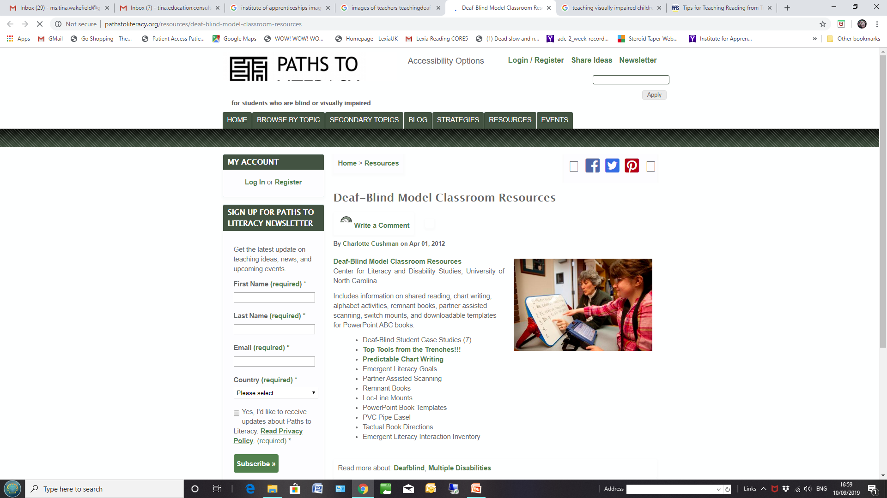

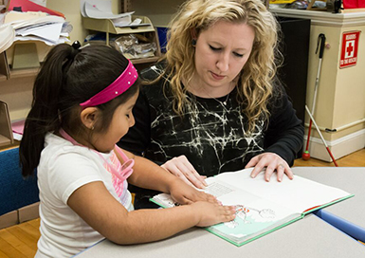
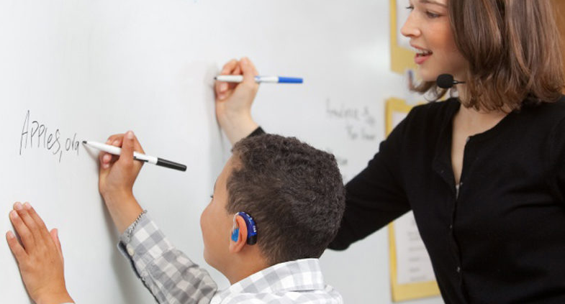
A new apprenticeship for Teachers of the Sensory Impaired: update November 2021

Slide 2
Why apprenticeship? Brief Recap
The aim of the apprenticeship Trailblazer Group, brought together through NatSIP, is to help create an apprenticeship pathway that supports the MQ’s for QTMSI, QTVI and QTOD in England and Wales. This will be a level 7 apprenticeship.
This has evolved from discussions between DfE and NatSIP about creating an additional pathway for the SI MQs.
It has involved a great deal of discussion, planning and the creation of necessary documentation.
The group includes representation from a variety of employers such as special schools, LA Sensory Services, Charities, professional groups and University Course providers as well as a representative from the Institute of Apprenticeships.

Slide 3
Who is in the Trailblazer group?
Chaired by the Head of Service from Royal Greenwich, the group is made up of employers and professionals from Wandsworth (Linden Lodge), Kent, Gateshead, Newcastle, Mary Hare, Milton Keynes, NatSIP, NDCS, RNIB, BATOD, University of Hertfordshire, University of Birmingham, University of Manchester, and the Institute for Apprenticeships.

Slide 4
Brief Recap….
When the work is complete employers will be able to train teachers to become QTMSI, QTVI or QTOD using funding from the apprenticeship levy.
Will other routes to train still exist? Absolutely yes; students who self fund or who are funded by charities will still be able to undertake training without being an apprentice.

Slide 5
Brief recap…
Are there prerequisites to the apprenticeship? Yes, the requirements are:
Qualified teacher status
Enhanced DBS Check in place
Employed working with CYP with a sensory impairment!
The apprenticeships route is in alignment with the SI MQs.

Slide 6
To summarise
Existing Routes
Or
Self funding
Charity scholarships
Apprenticeship Route
Apprenticeship levy funded
Employer funded

Slide 7
What does the apprenticeship mean for the students?
Employer arranges funding (already paying into the Apprenticeship Levy).
Student undertakes MQ at university
Student reaches the Apprenticeship Gateway

Slide 8
How far on are we in the process to develop the apprenticeship?
Formed a Trailblazer Group (autumn 2019)
Developed an occupational proposal (submitted November 2020, approved January 2021)
Developed an Occupational Standard (complete Summer 2021)
Now developing an End Point Assessment (work is current and near completion); Create Sample Course funding documents; nominate an End Point Assessor in principle and then submit all documentation to the IfA for approval
There is more to do before we reach the end…….

Slide 9
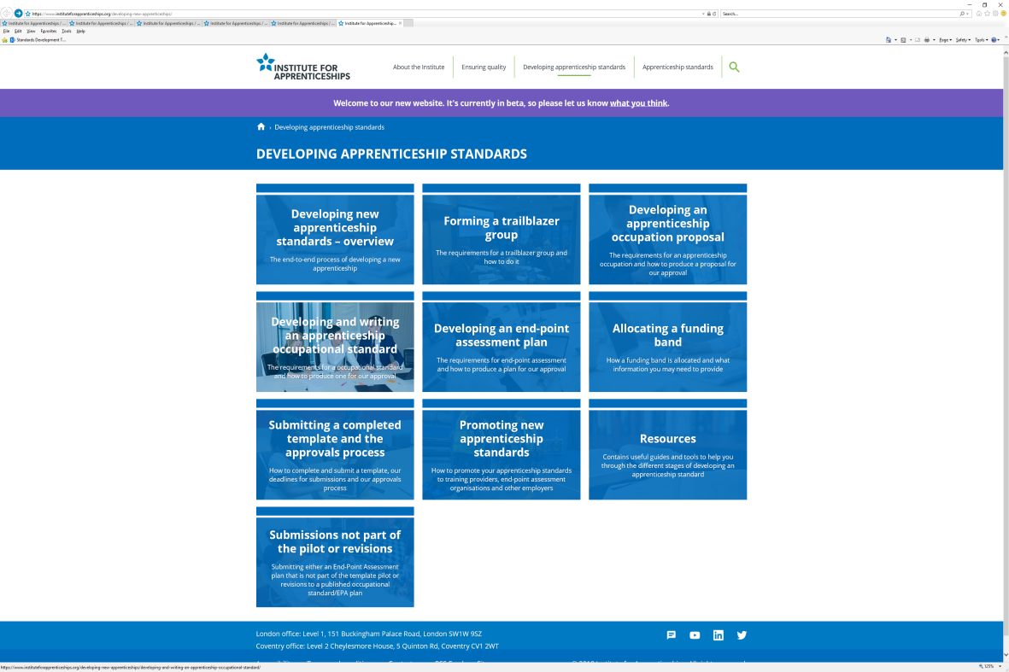
The process of developing the apprenticeship

Slide 10
Update on progress
Proposal
Included a job profile and duties:
Standard
End Point Assessment plan (EPA)
Submit as one package
Funding
EPAO in principle
(organisation)

Slide 11
Timeline….
Our introduction of the Apprenticeship for Teachers of the Sensory Impaired is dependent upon progress through the stages of the development for the Institute for Apprenticeships. The earliest possible introduction is September 2023 and this is aspirational at this stage.

Slide 12
Thank you
There has been an enormous amount of time and effort devoted to this project already
We are grateful to everyone involved and all are determined to see it come to fruition.
Thank you to NatSIP and NDCS for coordination and support to the process and to all NatSIP members for your interest and your patience!

