Slide 1
Low Incidence Needs Team
Manager – Amanda Card
amandacard@gateshead.gov.uk

Slide 2
Building Back
Current context:
Supporting pupils, families and schools again face to face
Gateshead are taking a cautious approach and still have a number of control measures in place still
Regular liaison with health and safety regarding use of PPE, regularly updated risk assessments for schools, home and office.

Slide 3

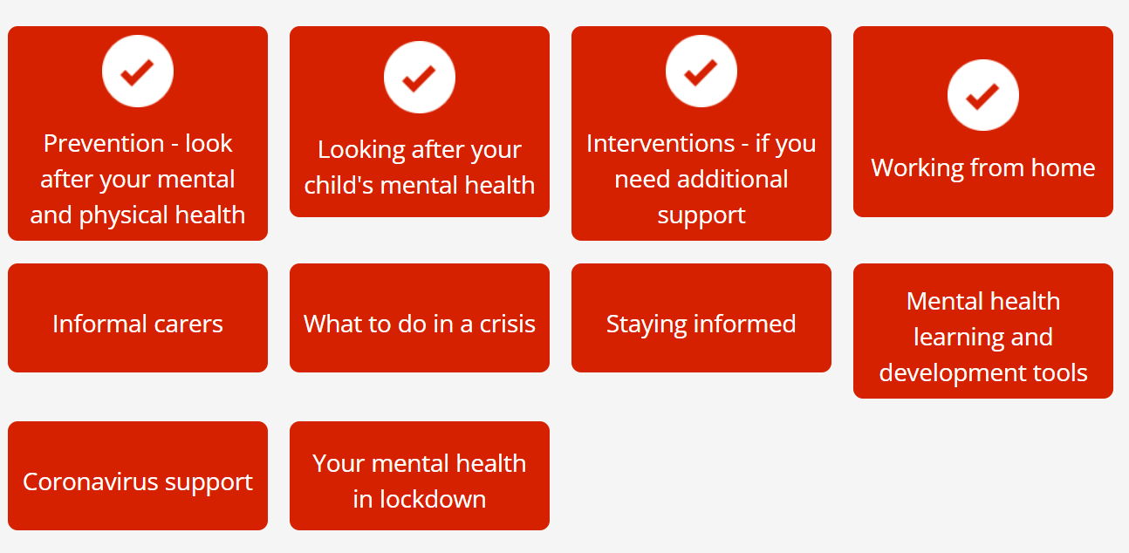
Staff:
Wellbeing and mental help – wobble rooms (group support), courses, counselling, increased mentoring, wellbeing activities. Sessions are designed to help, support and prepare employees for issues that may affect their health and wellbeing either at work or in every-day life.
Currently two types of sessions offered- themed group support sessions ( themes - working from home, Teams fatigue, coming out of lockdown) and wobble/support rooms. Led by counsellor.
Fortnightly ‘check in’ with staff by Lead Teacher/Manager – resources from MIND

Slide 4
Pupils
Supporting them to re-establish relationships,
Reassessment where appropriate,
Lots of transition work,
Using knowledge of pupil’s development/behaviour during lockdown to determine needs i.e. lots of progress in quieter environments.
Reminding them how to use equipment – training

Slide 5
Schools
Focus on transition – new staff/new schools
Upskilling school staff – school staff have been facilitating the LINT remote sessions and we have been able to further develop this interest and enthusiasm to learn about what SI pupils need
Regular liaison – school staff have seen the benefits of a collaborative approach, teachers regularly attending meetings to share progress/developments/access arrangements.
Re-establishing use of equipment and refreshing school staff on technology use (training)
Cleaning protocols for equipment (COVID specific) and provision of appropriate cleaning materials.
Supporting pupil wellbeing – referrals to Learning Mentors/Deaf CAHMS/Early Help. Liaison with school staff to ensure appropriate support is in place.
Training for school staff making online leaning accessible

Slide 6
Families
Pre-schoolers and parents are engaging – realised impact of COVID is ongoing. Children more engaged on screen, resilient and have adapted to alternative approach
Links - increased and improved communications. Upskilling parents/carers remotely – better quality of intervention at home following training/modelling, pupils are accessing learning materials more successfully and progressing.
Parents expectations increased. They have been able to see differentiated LINT approach working. Some are pushing their children a little harder after seeing what can be achieved.
Themed weekly newsletters for HI families with pre schoolers (available online via website)

Slide 7
Technology
Remote meetings – annual review, CAF/TAF and care team meetings. Team calls with colleagues across education, health and social care – improved communication/liaison. Allows more flexibility/ time efficient.
Joint teaching sessions with Cochlear Implant Team (wouldn’t normally get to do this regularly)
For help with accessing Google Classrooms and other platforms – LINT are often the first point of call for a lot of families, if they are struggling. Relationships have become stronger. LINT has a named person (key worker) approach to keeping in contact with the family.
Use of Microsoft 365, shared drives for planning, record keeping and communications. Peer to peer support and regular troubleshooting sessions for staff (now an item on the staff agenda)
New communication platforms in schools (e.g. Tapestry, Bloomz) – LINT have been able to share videos (demonstrations) with parents/carers. Some parents/carers are finding this less intrusive and feel confident about communicating this way as they are used to communicating on social media.

Slide 8
Moving forward
Parents/carers continue to access TEAMS if appropriate i.e. for monitoring of programmes where this may be more appropriate. Online pre school groups.
Adapted ways of working are still being implemented due to positive feedback i.e. ‘pick up and go’ visual training programmes, concept/language bags.
Coordination of home learning between schools and LINT is continuing. LINT are now coordinating better with schools and quality of home learning/home-work has improved/is more appropriate.
Dealing with faults with pupil’s specialist technology/equipment – parents continuing to pick up the phone and report faults/ask for help/assistance – they feel more confident to get in touch as relationships have strengthened.
Use of Microsoft 365 staff continuing to develop skills
Staff meetings and Pupil liaison meetings continuing online
Online training e.g. sign videos shared with school staff to upskill signing skills
Hybrid model of working - continuing with the things that have worked well (and reduce cost!) although this does lead to other considerations e.g. safety in lone working.

