Slide 1
#togetherwecanachieve

Slide 2
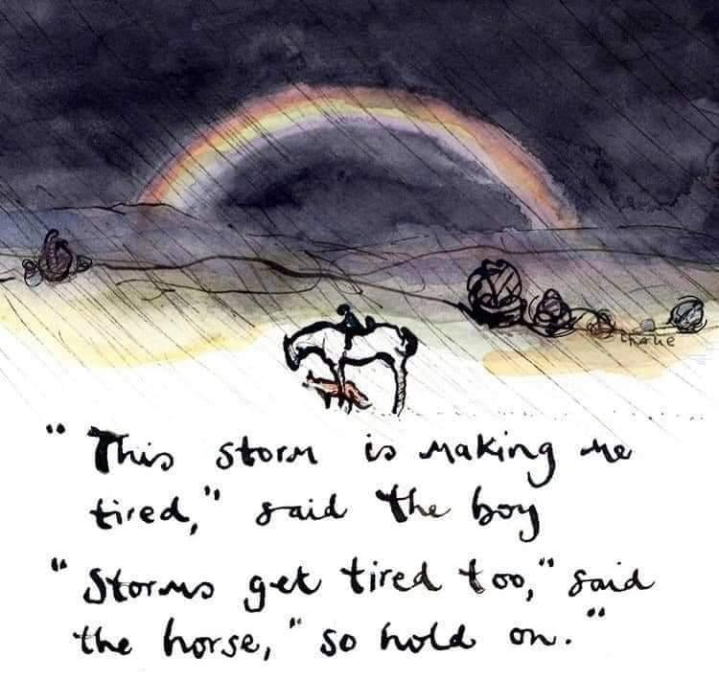
Charlie Mackesy’s book The Boy, the Mole, the Fox and the Horse

Slide 3
BATOD #togetherwecanachieve
This last year, as with previous years, BATOD has maintained the activity related to the core constitutional aim ie “to promote the education of all deaf babies, children, young persons and adults and to promote the interests and status of all Teachers of the Deaf and members of allied professions”. This year the difference has been we have been able to do more, through established and/or new relationships, in formats that have met need, reflecting and changing as required and when possible.

Slide 4
BATOD #togetherwecanachieve
Liaisons with partners:
*The voice of the membership was heard by Unions across the UK and NAHT
*The creation of co-badged resources specific to the pandemic achieved with NDCS, NatSIP, ALTWG and NAHT
*The sustainability of the professional workforce with the MQ revision and Apprenticeship route
*Transformation of the closed charity, adept, to a new Post-16 SIG

Slide 5
BATOD #togetherwecanachieve
Communication is key:
*Capturing members’ views through two key surveys and personalised correspondence
*Cascading partners' surveys
*Responding to consultations eg Ofqual regarding fair Access Arrangements
*Piloting with members specialist CPD material for language modification course
*Sharing good practice via Newsletters, Magazine editions, BATOD website, QToD & HoSS forums, Social Media
*Annual submission to School Teachers’ Review Body (STRB)

Slide 6
BATOD #togetherwecanachieve
Engagement:
*Consultant support to members
*Tailored CPD activities and peer-to peer support through central BATOD and localised through the eight region and national groups
*Embracing different ways of working
*Learning from each other
*Enhancing the global work of deaf education at local levels across the world

Slide 7
BATOD #togetherwecanachieve
We are 45 this year and still surviving; watch this space for new developments

